Slide 1
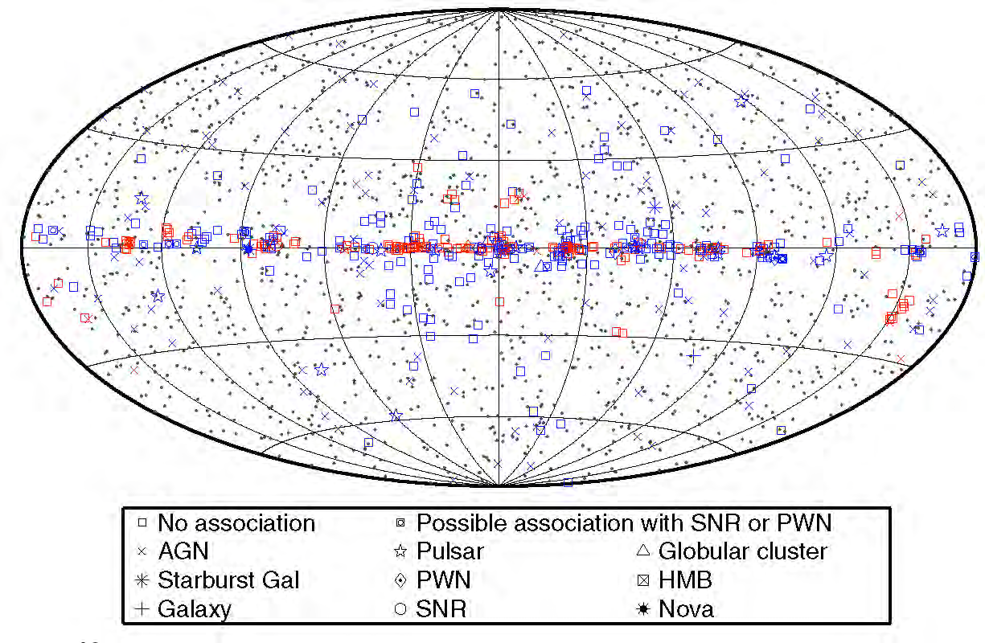
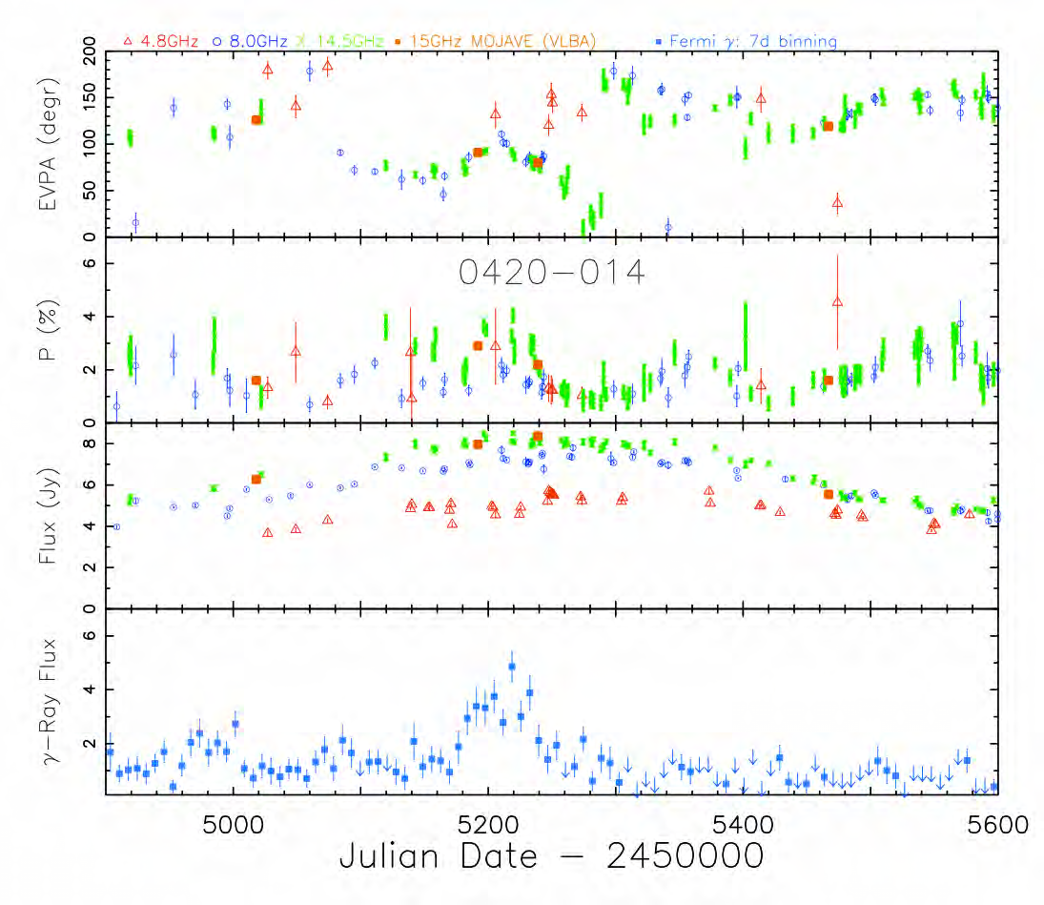
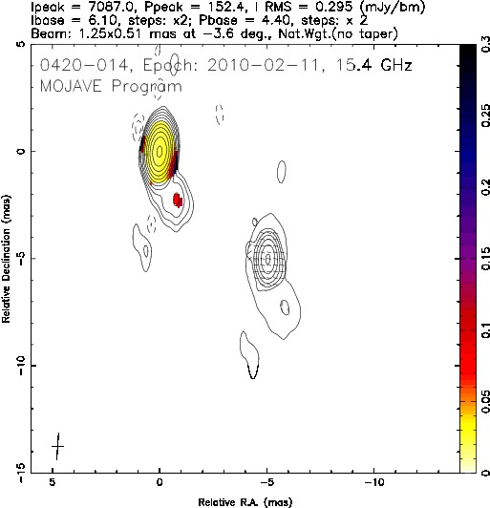
Constraints on Blazar Jet Conditions During Gamma-Ray Flaring from Radiative Transfer Modeling
M.F. Aller, P.A. Hughes, H.D. Aller, & T. Hovatta
The γ-ray sky seen by FERMI
Motivation: 1) prevalence of γ-ray blazars;
2) increasing evidence that γ-ray
emission arises in the parsec-scale jet
swing
LP
increase
Nolan et al. 2012
MOJAVE image
01/03/10
Feb 2010
Correlated flaring
Core-dominated source

Slide 2
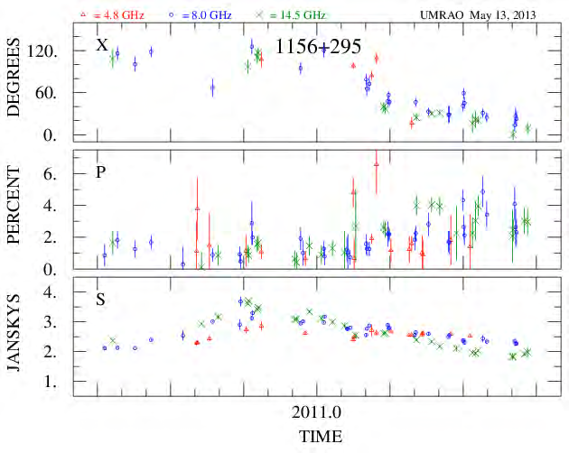
UMRAO Light Curves As Model Constraints
Questions:
1. Is there evidence in the UMRAO data for the presence of shocks during (at least some) γ-ray flares?
2. Can we use the data in combination with shock models to constrain jet conditions during these γ-ray flares?
THE DATA
Example of UMRAO data
UMRAO: multi-frequency LP & S (primary
model constraints)
Time window: 2009.5 - 2012.5
The Sample: initially ≈ 30 sources (reduced to
increase the cadence)
VLBA data: all sources in MOJAVE; several in
BU program

Slide 3
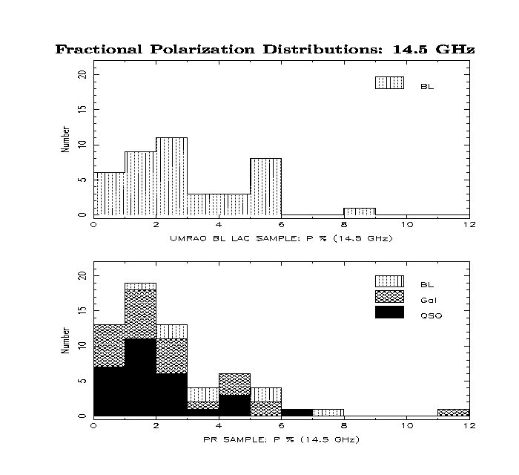
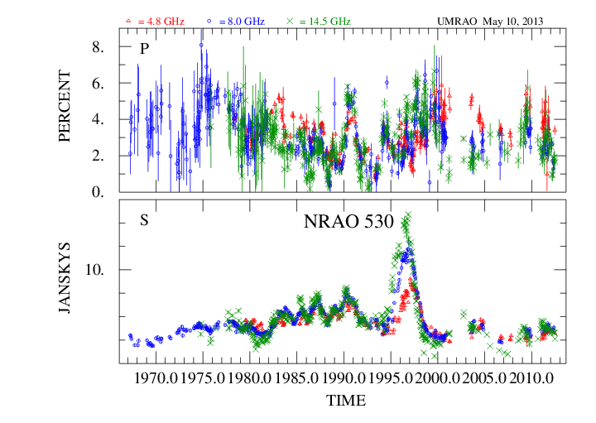
The Model (Framework): The B Field is Initially Turbulent
Histograms of time-averaged LP
Fractional LP: values are only a few %
Individual sources: baseline level during `quiescent’ phase: <2%
Aller, Aller & Hughes 2003
Statistical: time-averaged Q & U in flux-limited samples

Slide 4
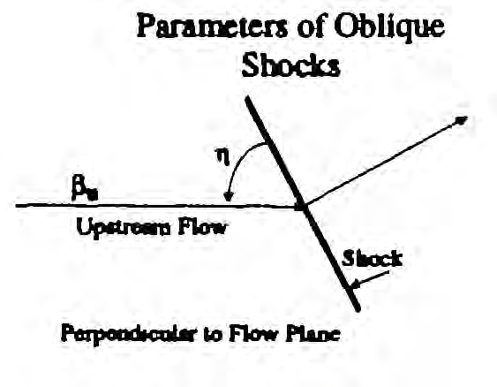
The Oblique Shock-in-Jet Model framework and assumptions
Magnetic Field Structure: random before shock compression (but a fraction of the magnetic energy is in an ordered component to give a well-defined EVPA in the quiescent state)
Shock Orientation: at arbitrary angle to the flow direction & spans the cross section of the flow. The orientation is specified by the obliquity (η) and the azimuthal direction of the shock normal (ψ).
Shock Propagation: the shock propagates at a constant speed (no acceleration or deceleration).
Shocked Flow: specified by a length, width, and compression factor
Definition of η

Slide 5
THE MODEL: values for `free’ parameters
Flow + shock
Parameter | UMRAO Constraint
Cutoff Lorentz Factor (energy spectrum) | UMRAO spectral behavior
Bulk Lorentz factor (flow) | UMRAO P%
Shock Sense (F or R) | UMRAO light curves
Shock Length (l) | UMRAO flare shape
Observer’s Azimuthal Angle (ψ) | Primarily from UMRAO P%
Shock Compression (κ) | ΔS and P% from UMRAO data
Shock Obliquity (η) | ΔEVPA
Additional parameter
Observer’s Orientation (θ):
VLBI gives consistency check

Slide 6
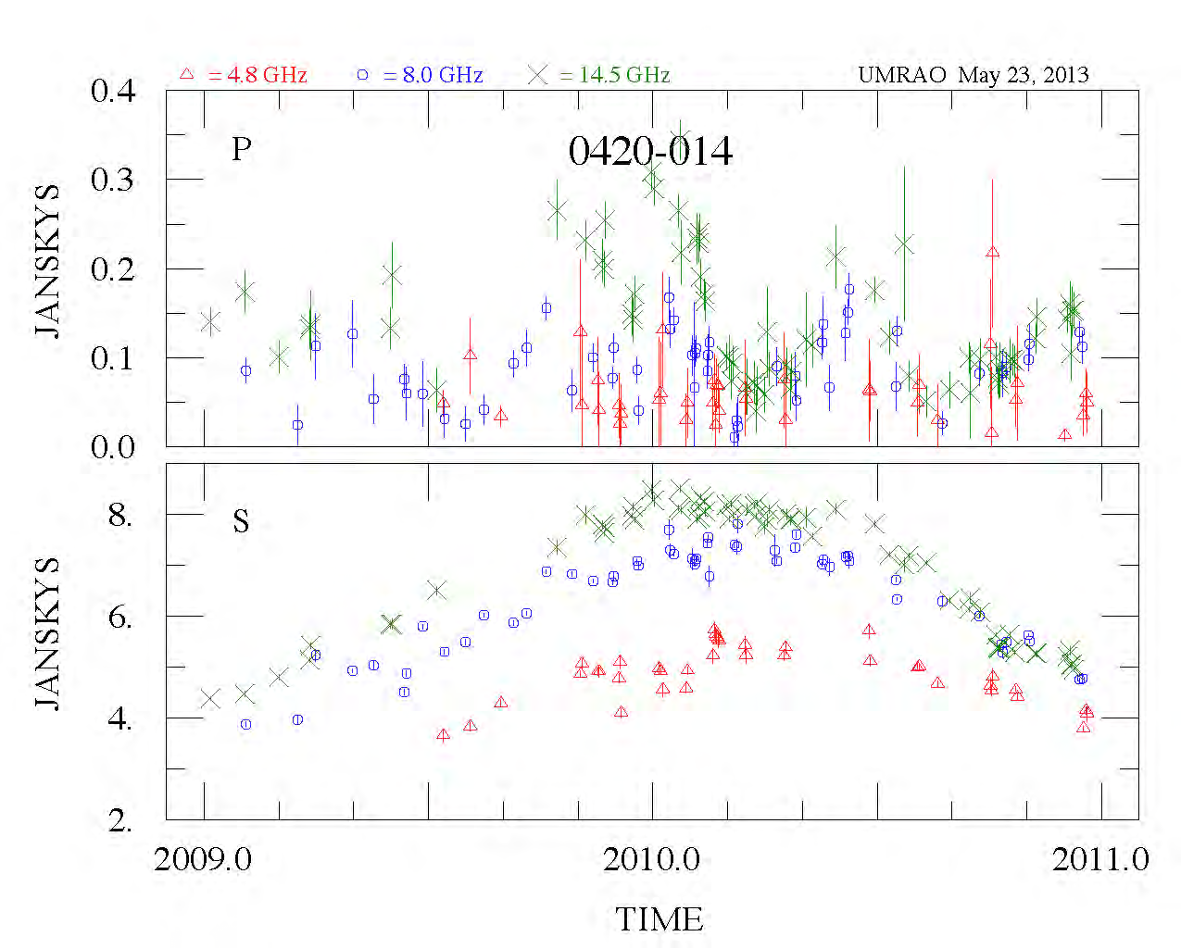
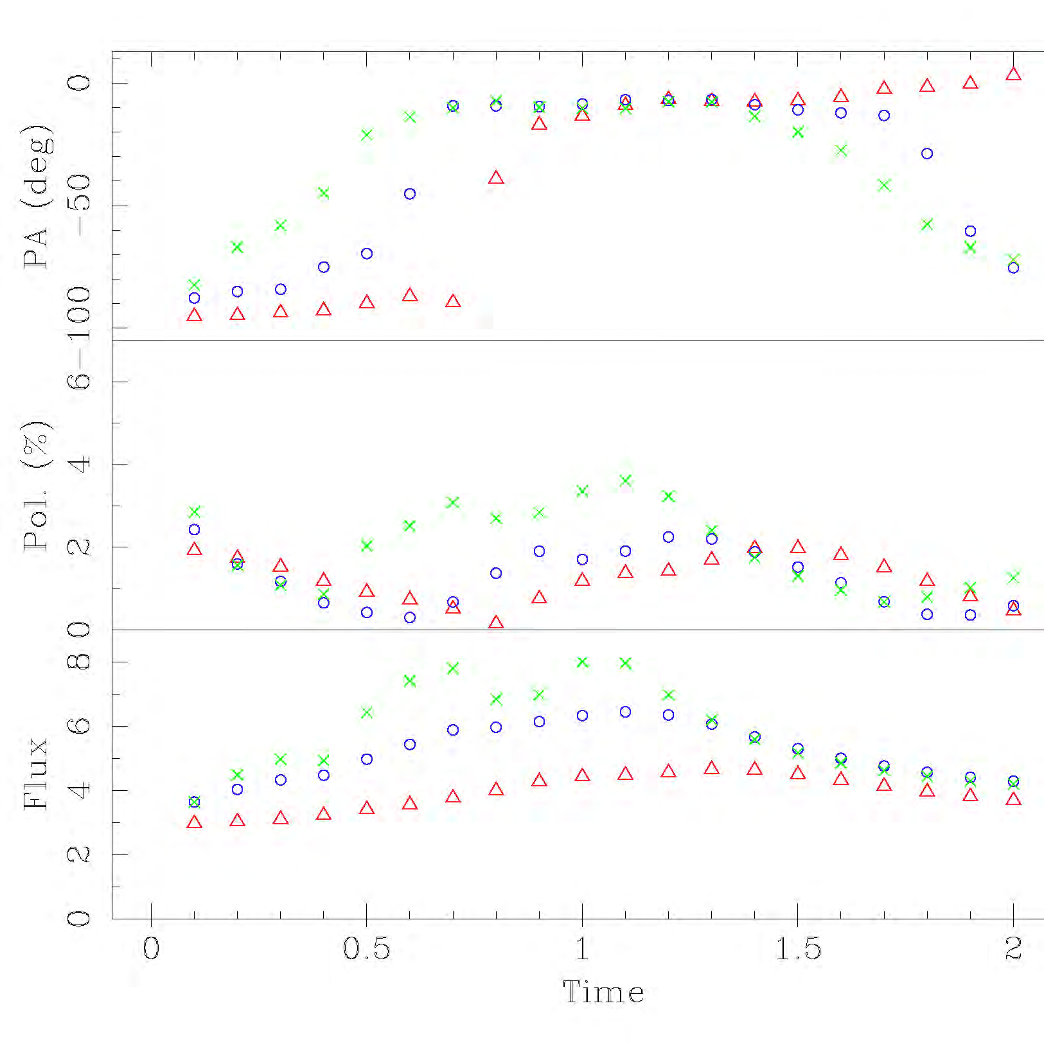
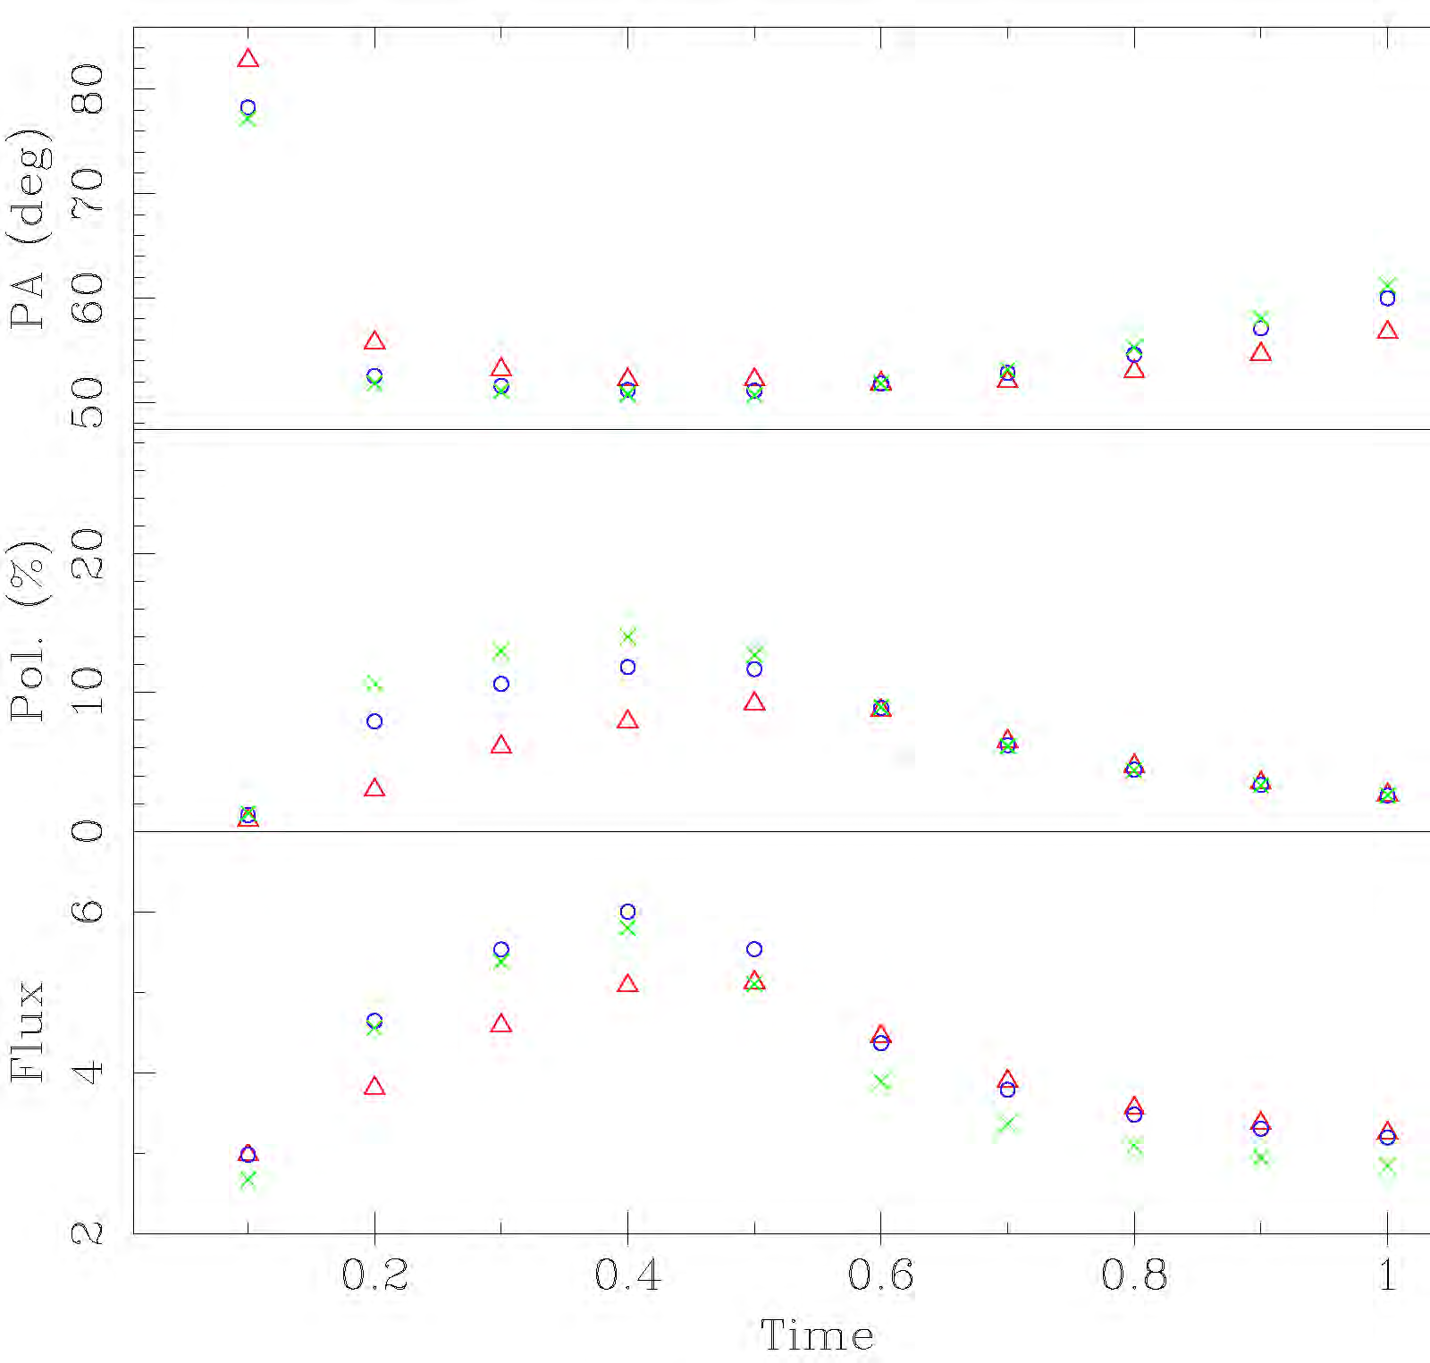
Separation of Blended Events
2
3
1
Structure in the S and P profiles
+
3 shocks required for the best `fit’
Simulated burst profile shape: single shock

Slide 7
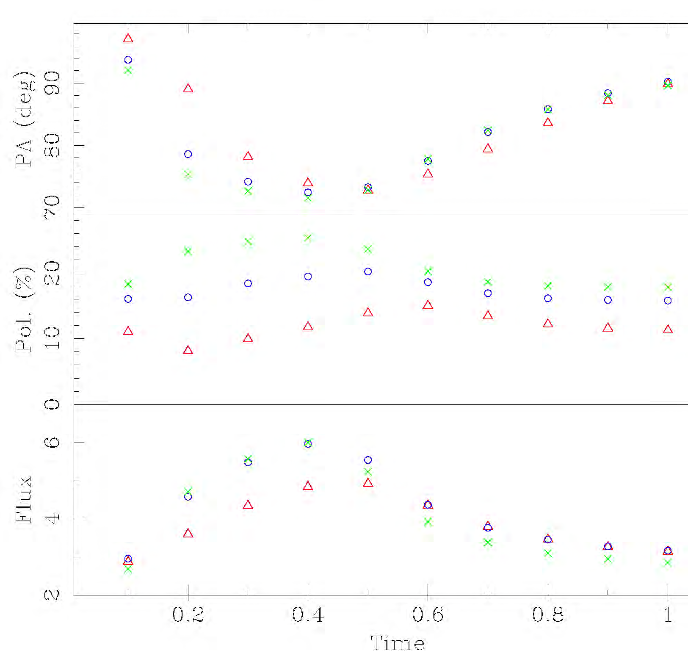
Random or a Helical B field? simulation for a single shock
evolution during outburst rise inconsistent with data
P=25%
HIGH!
Hughes, Aller & Aller 2011)
Random B field dominates
Helical B field dominates

Slide 8
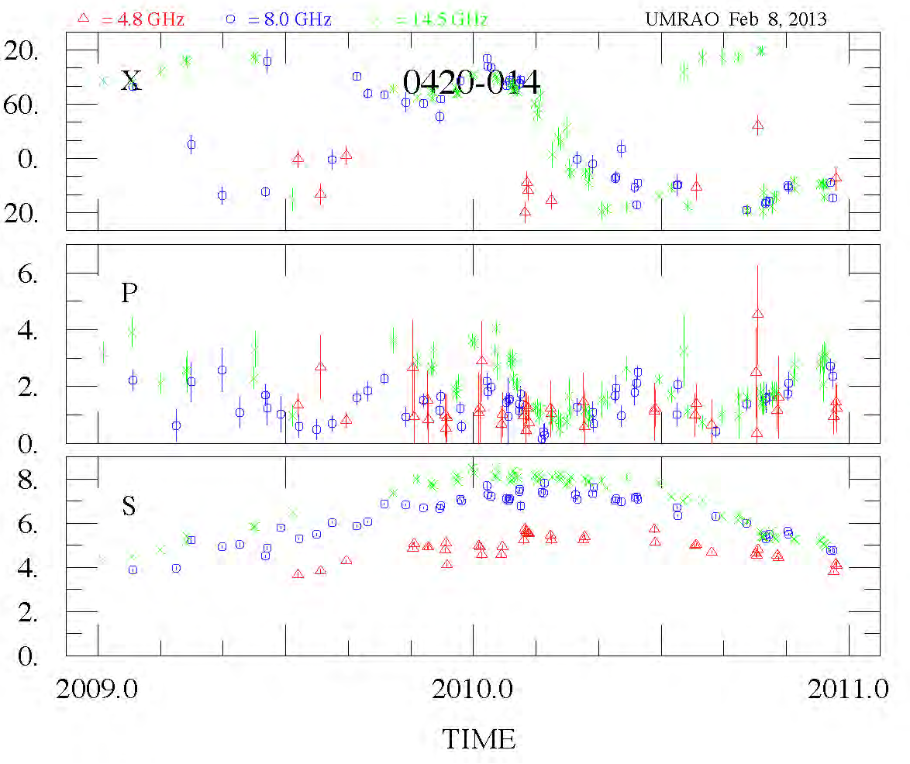
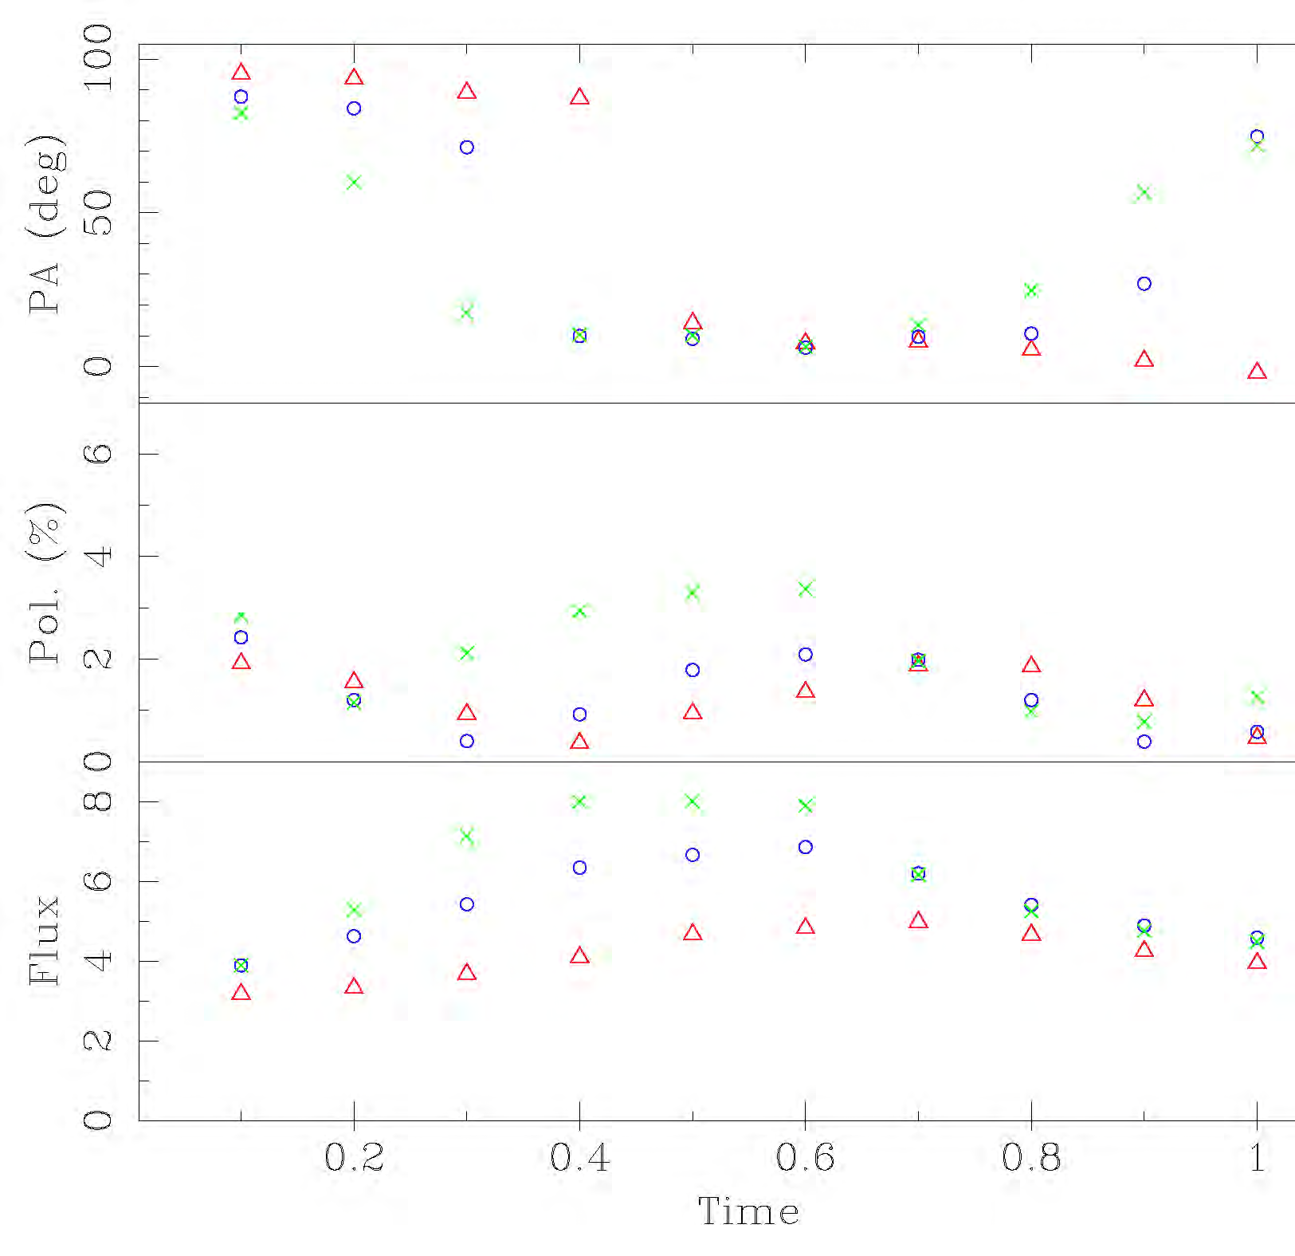
Patterns in 0420-014: data & simulation
%
property | observed | simulatd
ΔS(14.5) | 4-8 | 4-8
α(S) ev | Flat,inv.,flat | Flat,inv.,flat
ΔP% | 1-3 | 1-3
EVPA | complex | complex
03/09
02/11

Slide 9
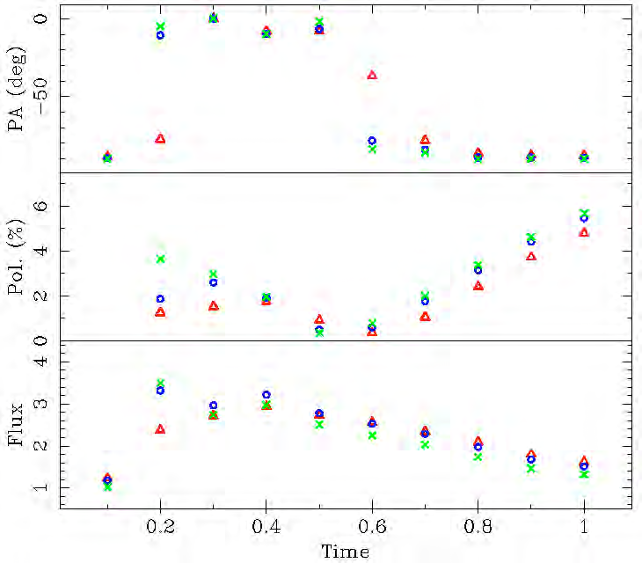
Patterns in 1156+295 event: data & simulation
90
90
peak
Crossover:
14,5 GHz lowest
2010.25
2011.75
EVPA: simulation reproduces `swing’ thru 90° & spectral behavior
P% : simulation reproduces amplitude (6%), bump near peak S, & monotonic rise
S: simulation reproduces peak value, spectral rise, and duration of fall

Slide 10
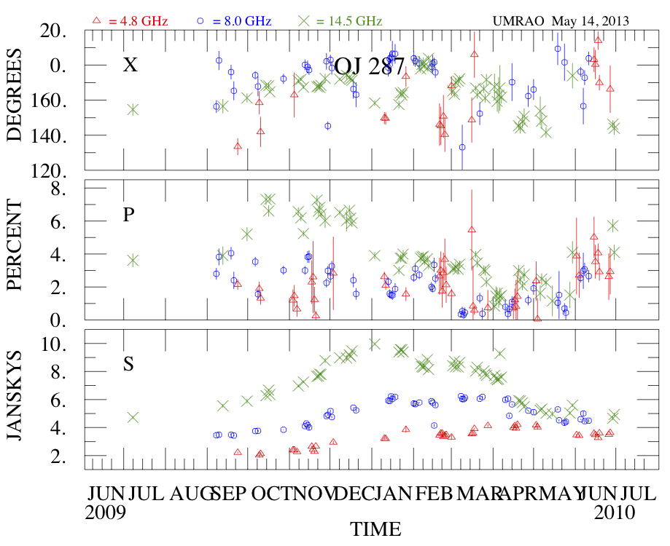
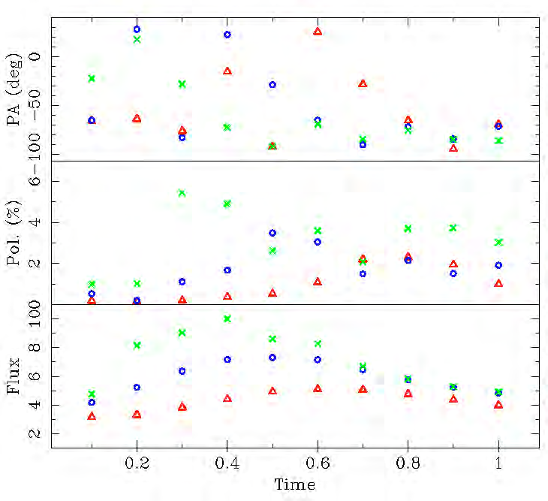
Patterns in OJ 287: data & simulation
Self-absorbed
Self-absorbed
EVPA: ΔEVPA reproduced but detailed spectral behavior complex
P%: range of variation and peak value reproduced by model
S: self-absorbed spectrum during rise with approximate time delay of peak reproduced;
change in spectral behavior during the burst decline is reproduced.

Slide 11
Summary of source properties from modeling UMRAO data:
Parameter | 0420-014 | OJ 287** | 1156+295
Cutoff LF (energy) | 50 | 10 | 50
Bulk Lorentz factor | 5.0 | 5.0 | 10
Shock Sense | F | F | F
Number of shocks | 3 | 3 | 4
Shock Obliquity | 90° (transverse) | 30° (oblique) | 90° (transverse)
Viewing angle | 4° | 2.5° | 2.0°
Axial magnetic field* | 16% | 50% | 50%
Consistency checks based on VLBI data:
viewing angle agrees with the value from VLBI analysis
the deduced apparent motion given the viewing angle and the derived shock speed agrees with the speed from VLBI-scale component motions
Table notes: * axial B field is in terms of energy density which is a small quantity
** the first shock in OJ 287 is strong but narrow

Slide 12
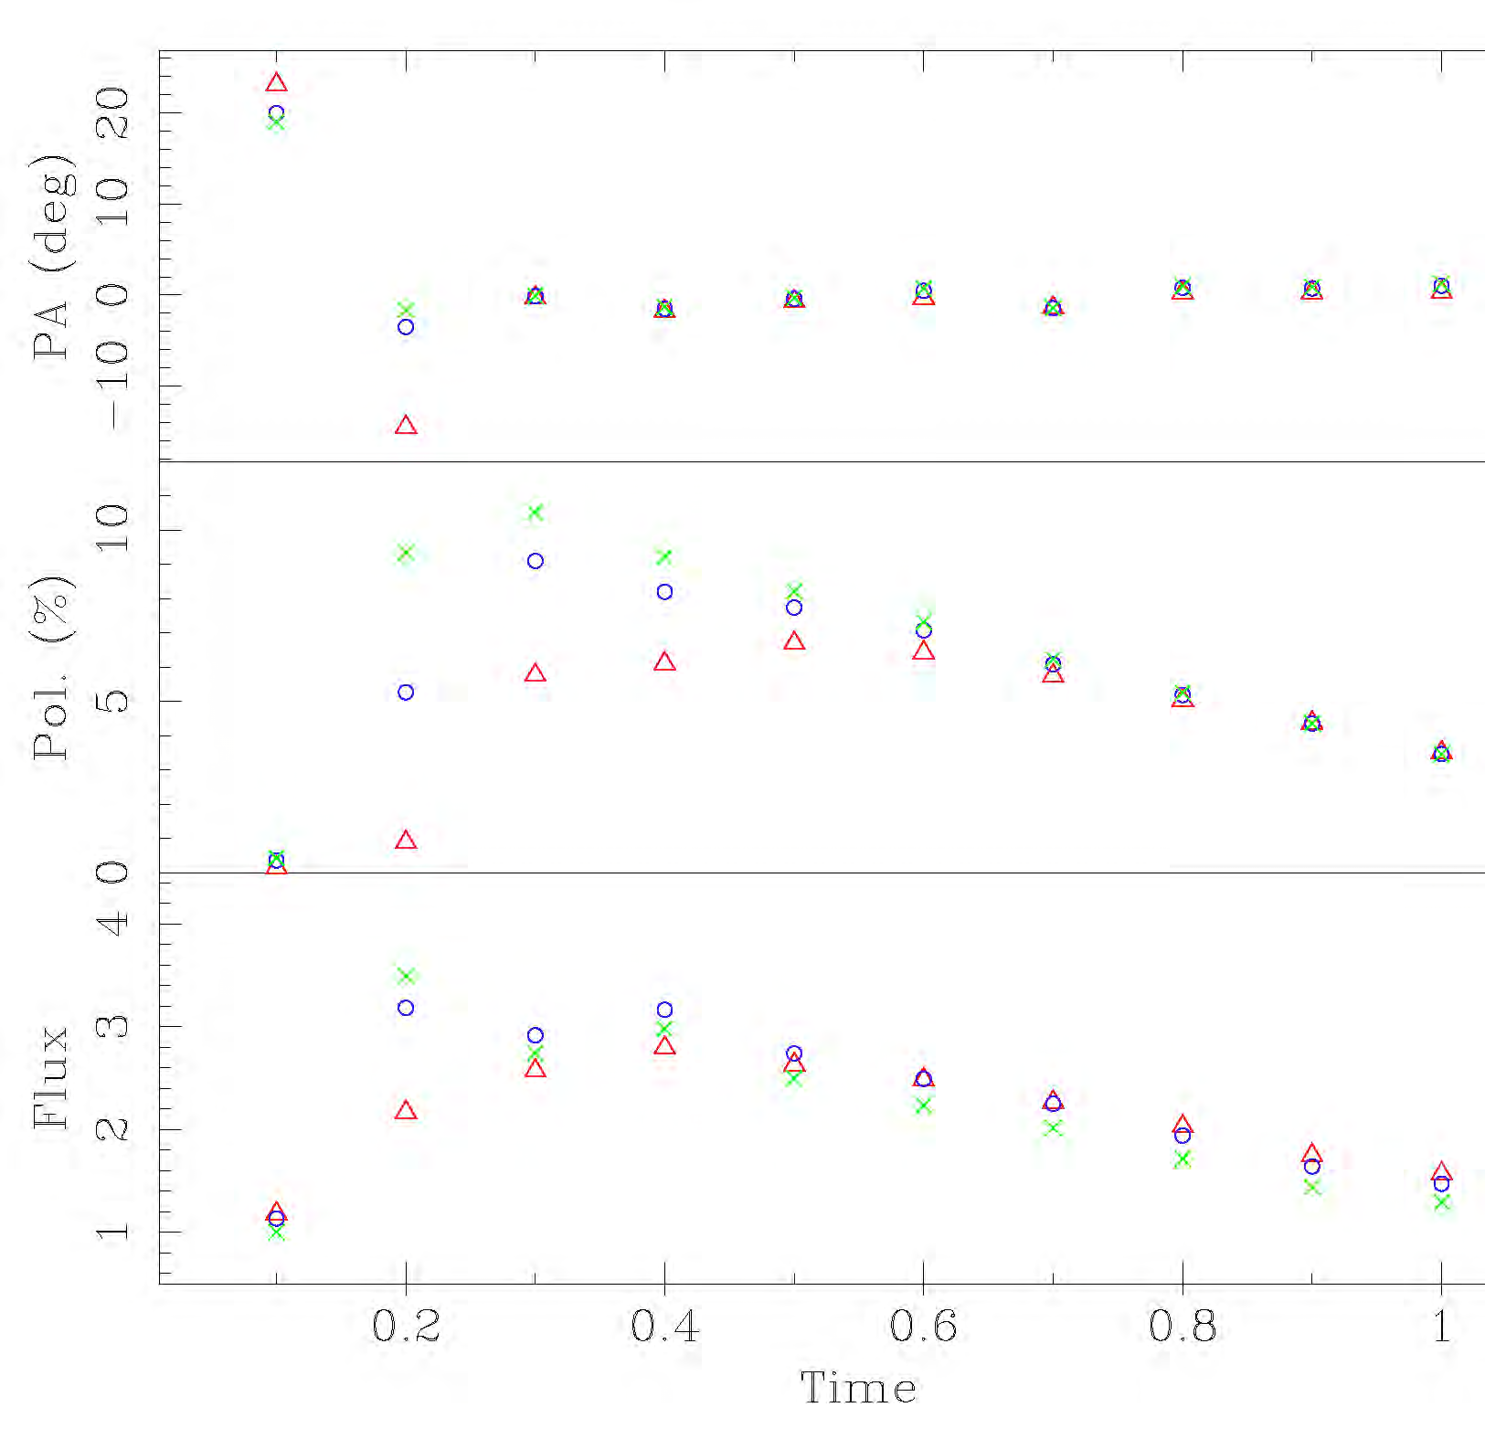
Evidence for an Axial Magnetic Field simulation for 1156+295 assuming no axial B field
EVPA flat
P% too high

Slide 13

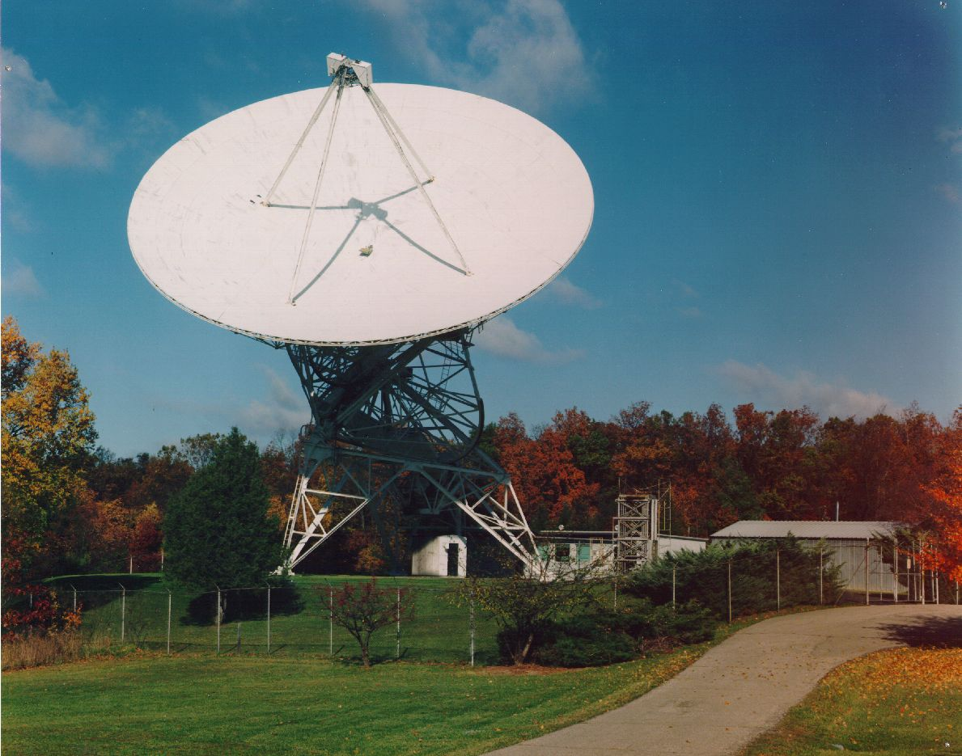
Conclusions
Several centimeter-band events associated with GEV γ-ray flaring show changes in LP and in S expected from a propagating shock scenario.
Comparison of models with UMRAO monitoring data can be used to derive jet flow conditions during these flares, and to constrain the particle energy distribution responsible for the radio-band synchrotron emission.
The simulated P% is very sensitive to viewing angle; derived values are nearly line of sight and in agreement with independently-determined values from VLBI studies.
The magnetic field is predominantly turbulent in the quiescent jet, but a substantial ordered axial component is required to fit the LP data (50% of the the energy density in magnetic energy). Models dominated by a helical field are not required.

