Slide 1
Macroscopic & Microscopic Instabilities in Relativistic Jets
Philip Hardee (U. Alabama, Tuscaloosa)
The Innermost Regions of Jets & Their Magnetic Fields
Granada, Spain , June 2013

Slide 2
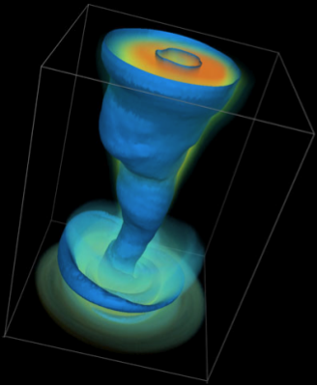
Introduction
Macroscopic Instabilities
KHI (velocity shear driven)
CDI (current driven)
Macroscopic Observables
Pinch/Twisted structures
Flow & Pattern speeds
B-field structure via polarization
Microscopic Instabilities
Filamentation (2-stream)
KKHI (velocity shear)
Reconnection
Microscopic Observables
Spectrum (Synchrotron/Jitter/IC)
Energy distribution
M87 – Implications
McKinney & Blandford (2009)
Jet: γ ~ 10
Kink
Wind
500 R_{s}
Kinked jet basically stable structure

Slide 3
KHI Spine Sheath Mixing
(Walg et al. 2013)
Uniform Jet
Uniform Jet & Tenuous Cocoon
flow
Shocked Ambient Material
TenuousShocked Jet Material
Spine Sheath Jet
Fast Spine & Denser Slower Sheath
Fast Spine
Slower Sheath
Spine Sheath Mixing

Slide 4
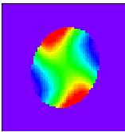
The KH Normal Modes
Intensity Image & Magnetic Pressure Cross Sections (Hardee et al. 1997)
Helical (S) Mode Twist Offset
flow
30
36
42
Elliptical (S) Mode Twisted Filaments
Pinch (F)undamental & (B)ody Modes
Helical, Elliptical, ... (S)urface & (B)ody Modes
Fastest Growing: λ* α γ M R
Growth length: l* α γ M R
Pressure structure of Elliptical (S) mode
Pressure structure of Elliptical (B) mode

Slide 5
Shear Layer Stabilization
3D: No Shear Layer
(Birkinshaw 1991)
3D: Shear Layer
Growth length/Radius
p
Growth length/Radius
p
Surface Modes
Surface Modes
Minor effect: H & E (S) modes
Major effect: shear resonances
Body Modes
h
h
Resonant Modes
e
e
Wavelength/Radius
Wavelength/Radius
(Perucho et al. 2005, 2007 )
No stabilizing hot shear layer
stabilizing hot shear layer

Slide 6
Short λ Saturation/Stabilization
(Pinch Mode - Perucho et al. 2004 ; Helical Mode – Xu et al. 2000)
Pinch Mode:
Long λ Disruption ; Short λ Saturation
Helical Mode: Long λ Disruption
Density
Temperature: box of shocklates
Helical Mode: Short λ Saturation
Density
Wave Advection along expanding jet
λ > λ* ~ γMR
λ < λ* ~ γ MR

Slide 7
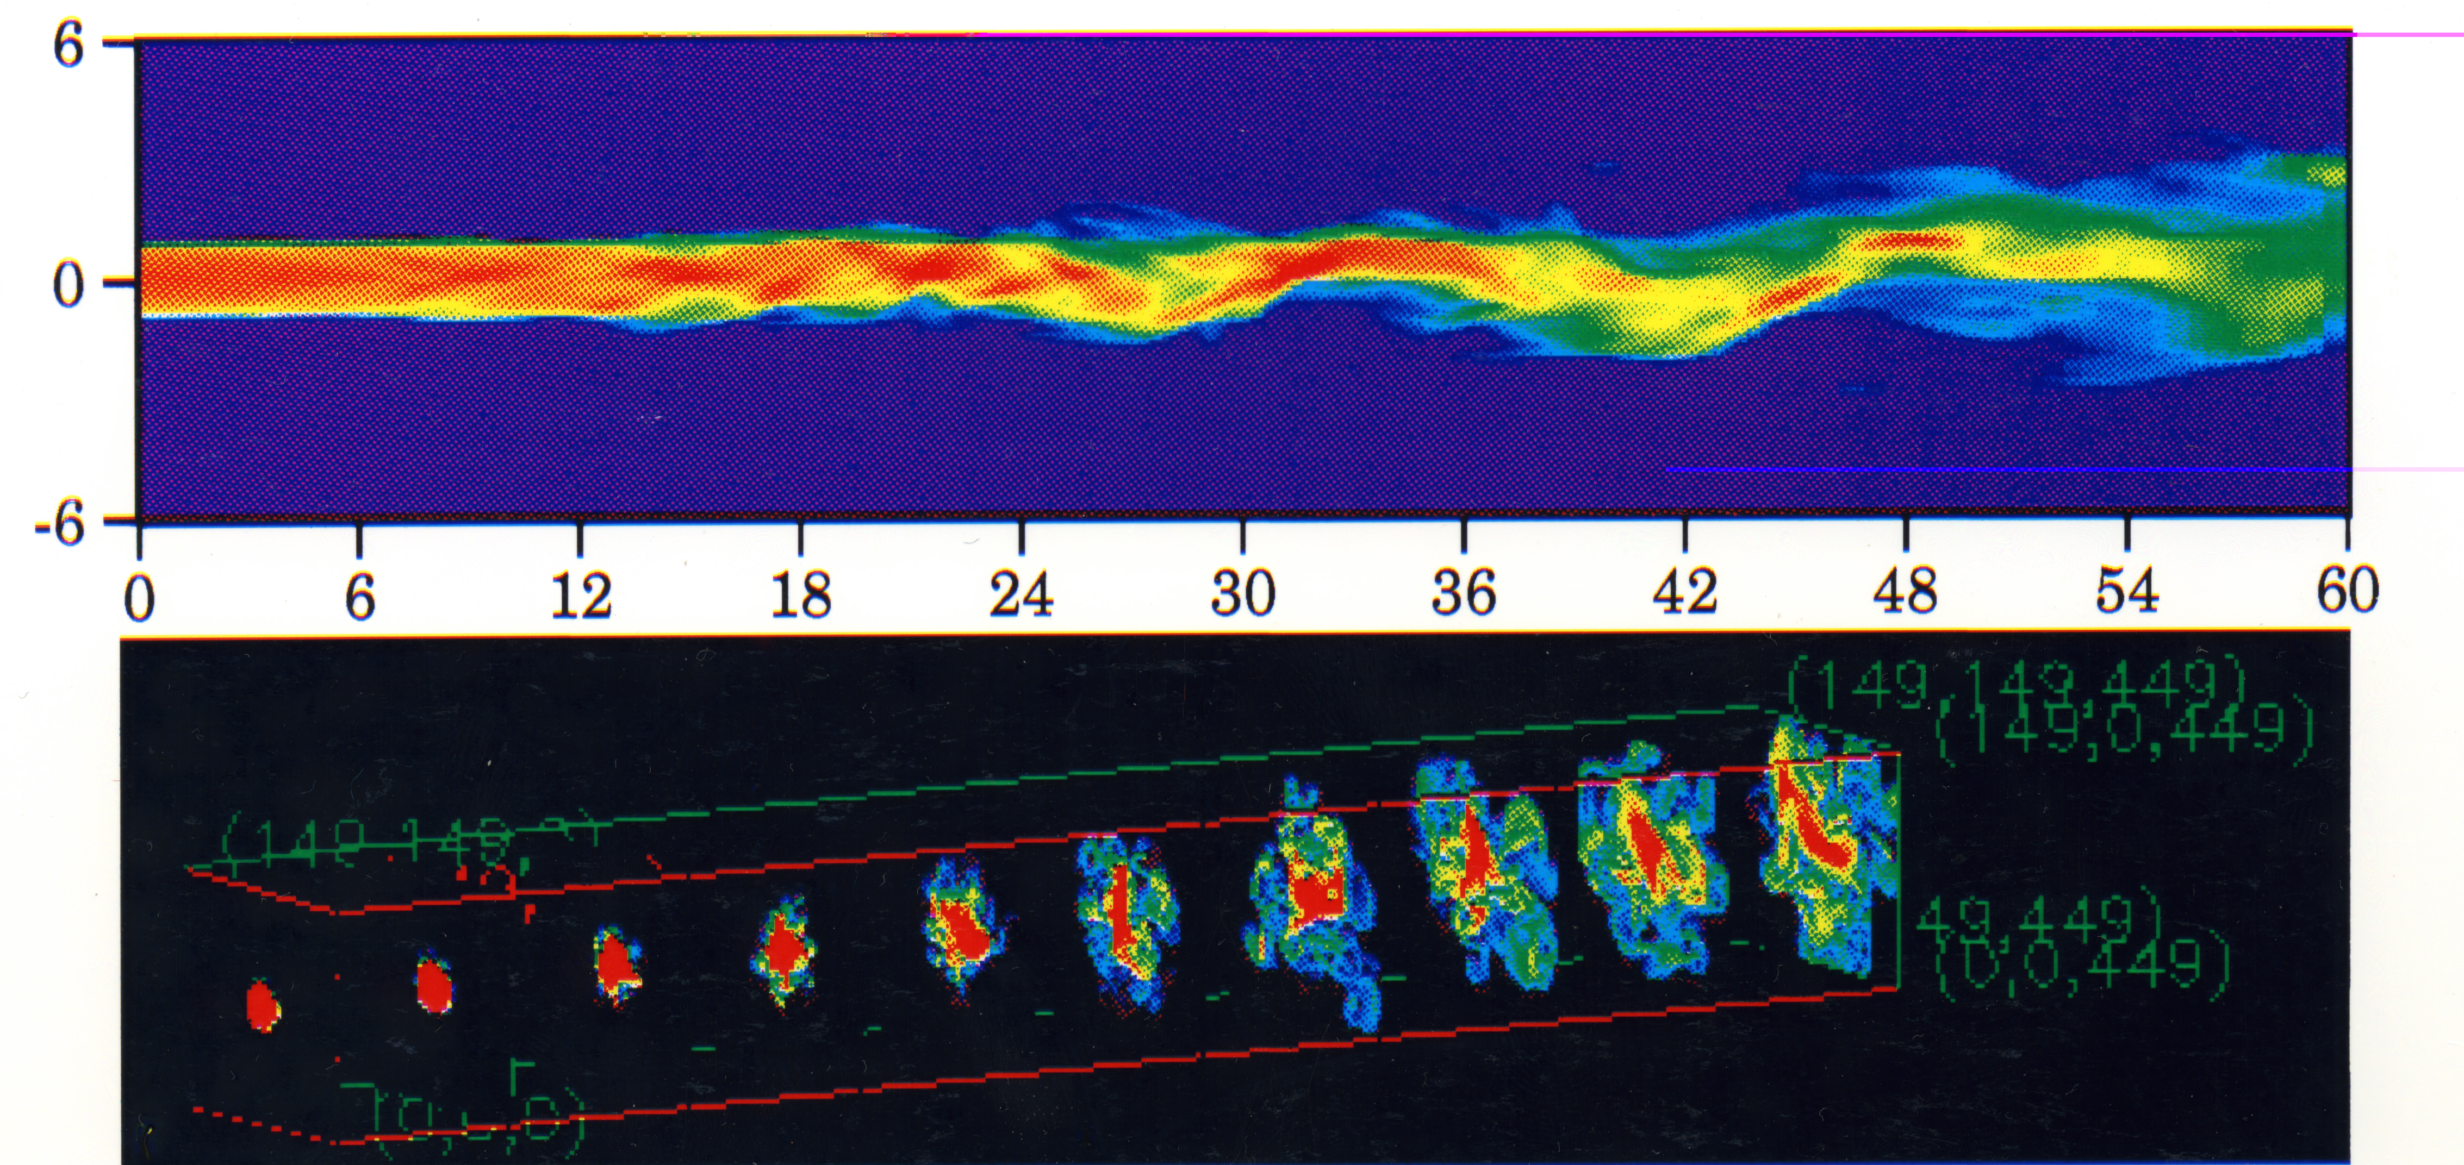
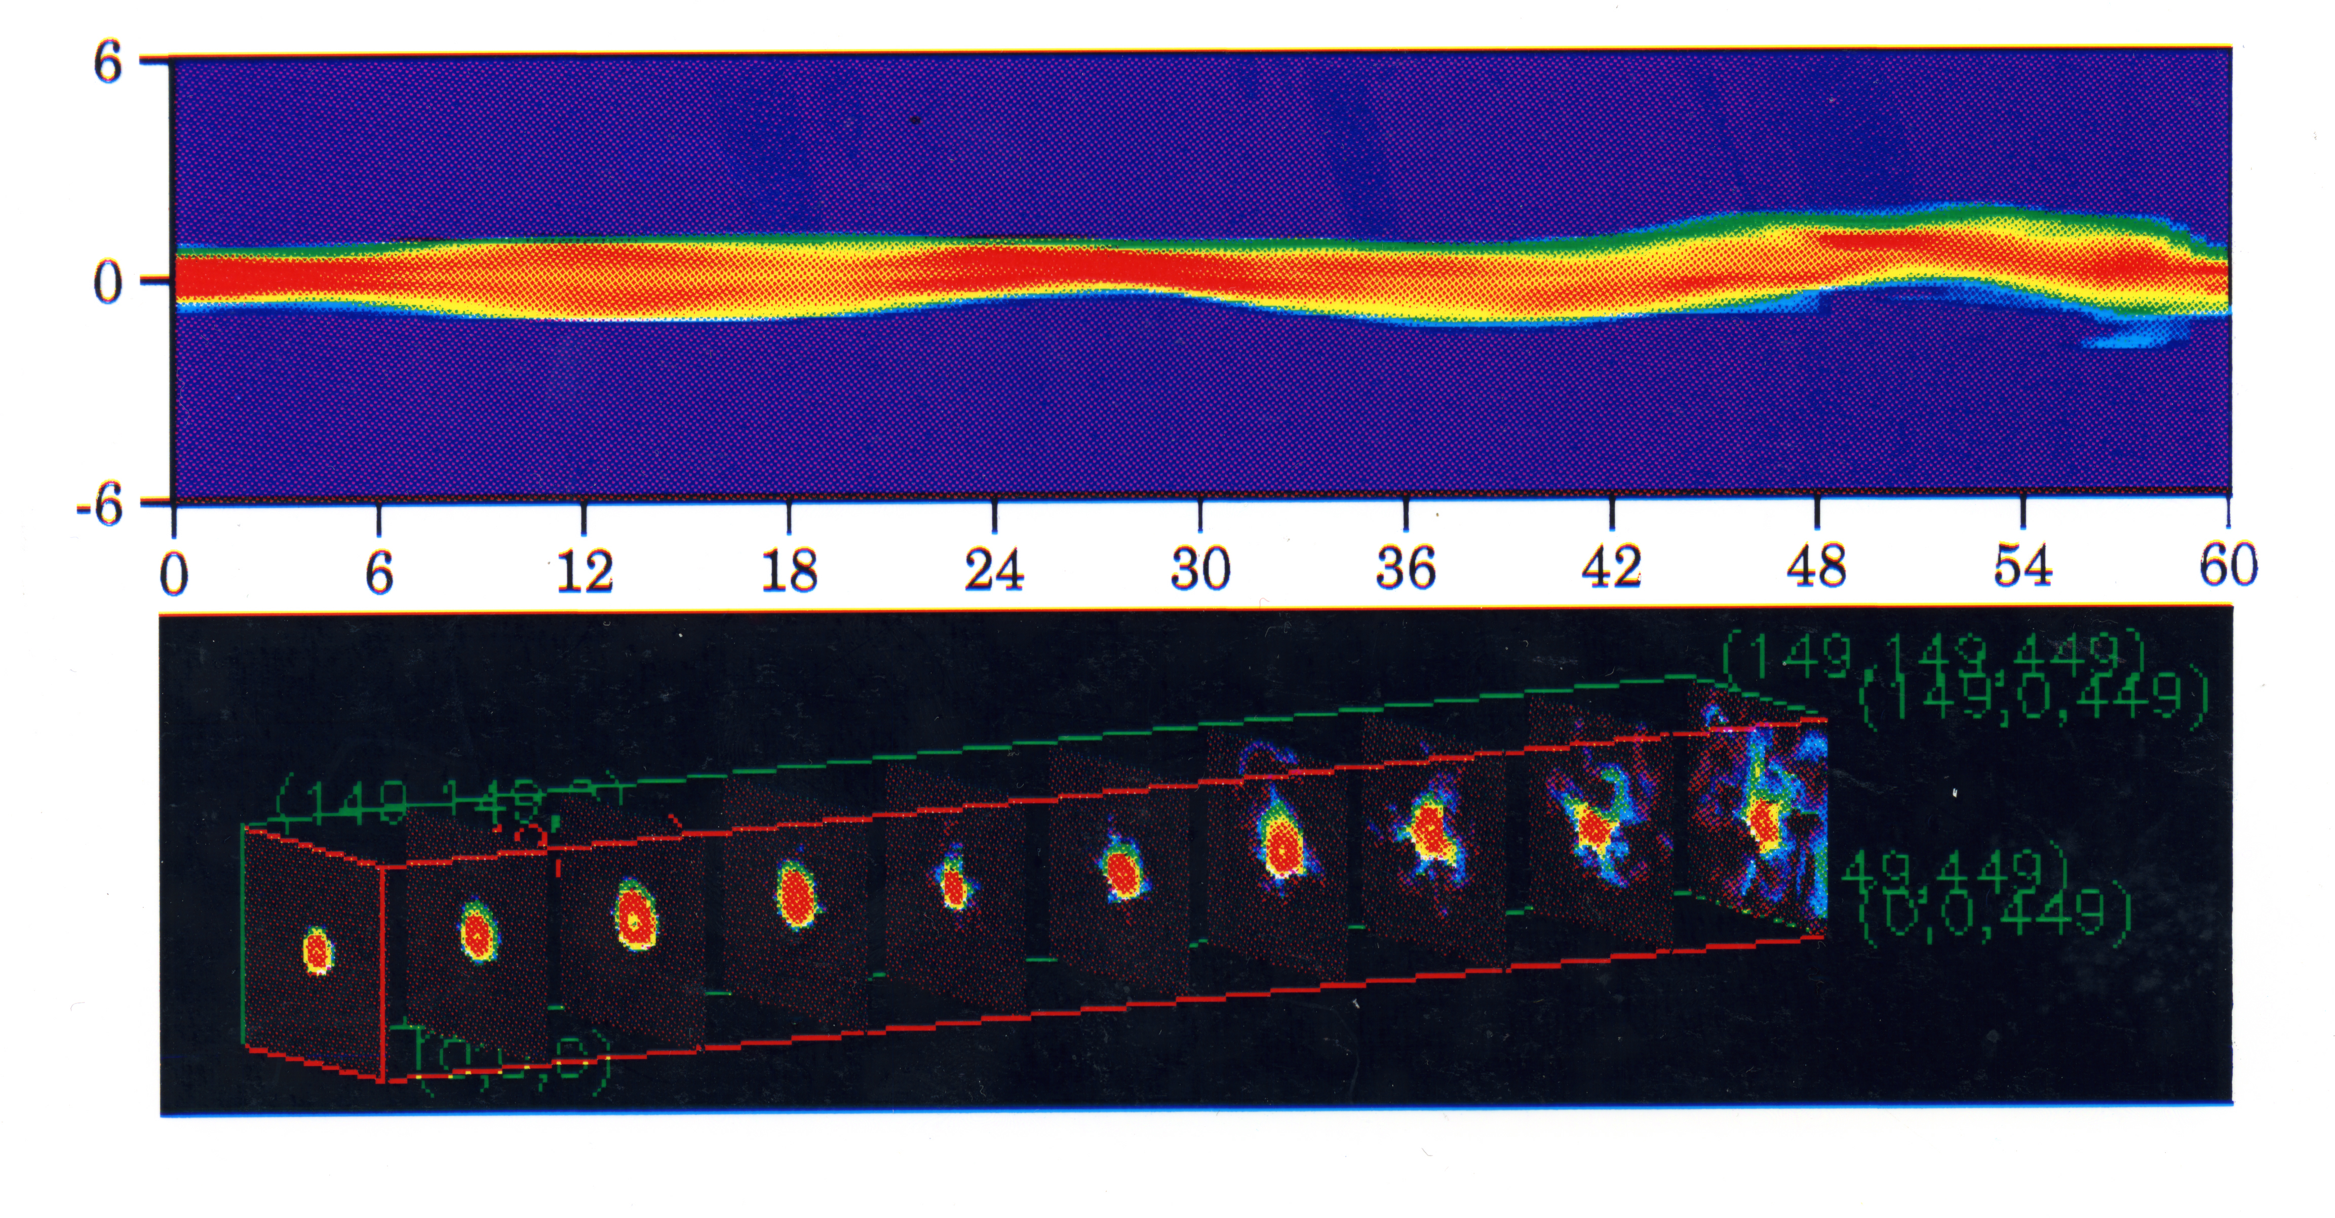
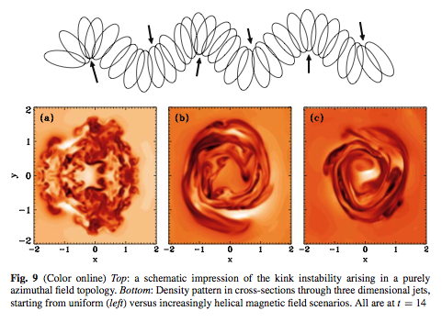
Magnetic Fields & KHI
Poloidal B
(Rosen et al. 1999)
Helical B
Magnetic tension suppresses KHI higher order modes
Poloidal B
Increasing Helicity ➔
Magnetic field suppresses KHI induced vortices (Baty & Keppens 2002)
Helical Field Helps Maintain Spine Sheath Configuration

Slide 8
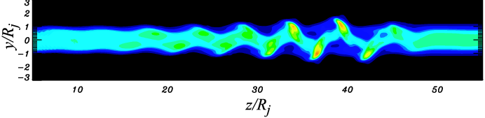
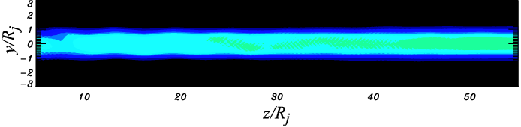
Sub-Alfvénic KH Stabilization
Hardee & Rosen (1999, 2002)
Mizuno et al. (2007)
Poloidal: B_{φ}/B_{p} ~ 0
Super-Alfvénic velocity shear
B_{φ}/B_{p} ~ 0.05
B_{φ}/B_{p} ~ 0.4
Sub-Alfvénic velocity shear
Alfvén point transition
KH Stable when sub-Alfvénic

Slide 9
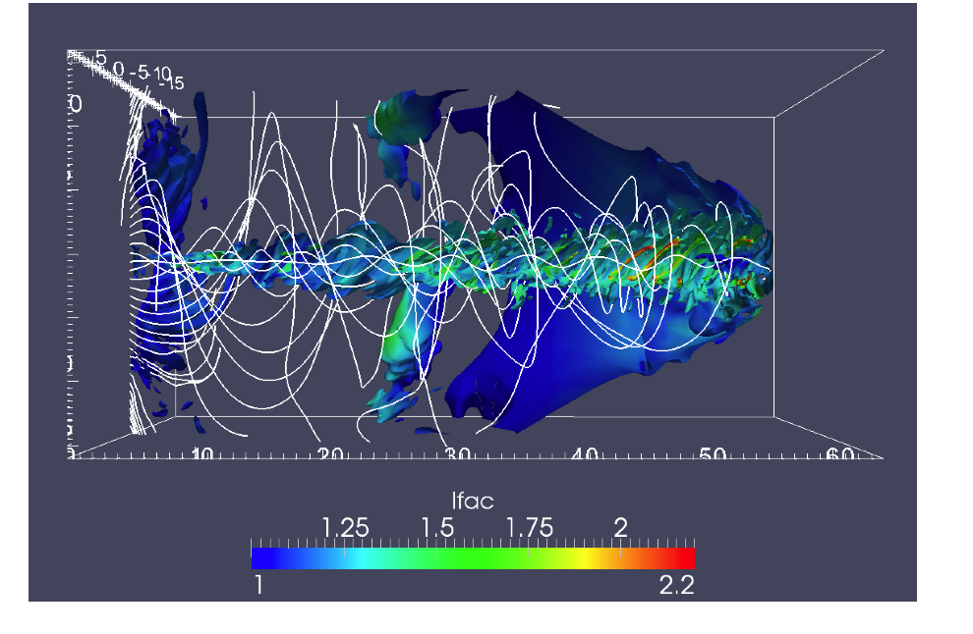
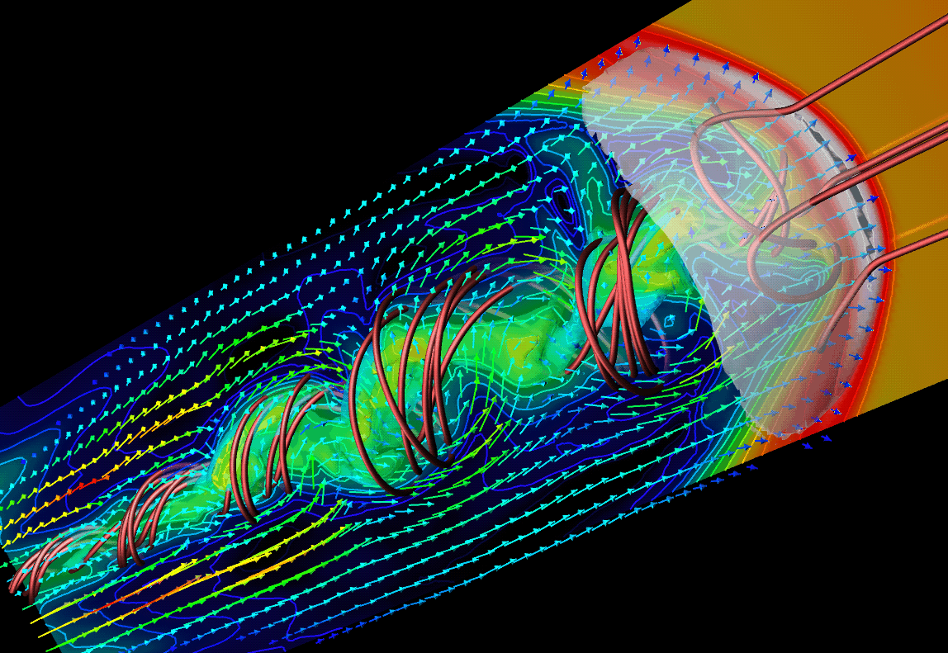
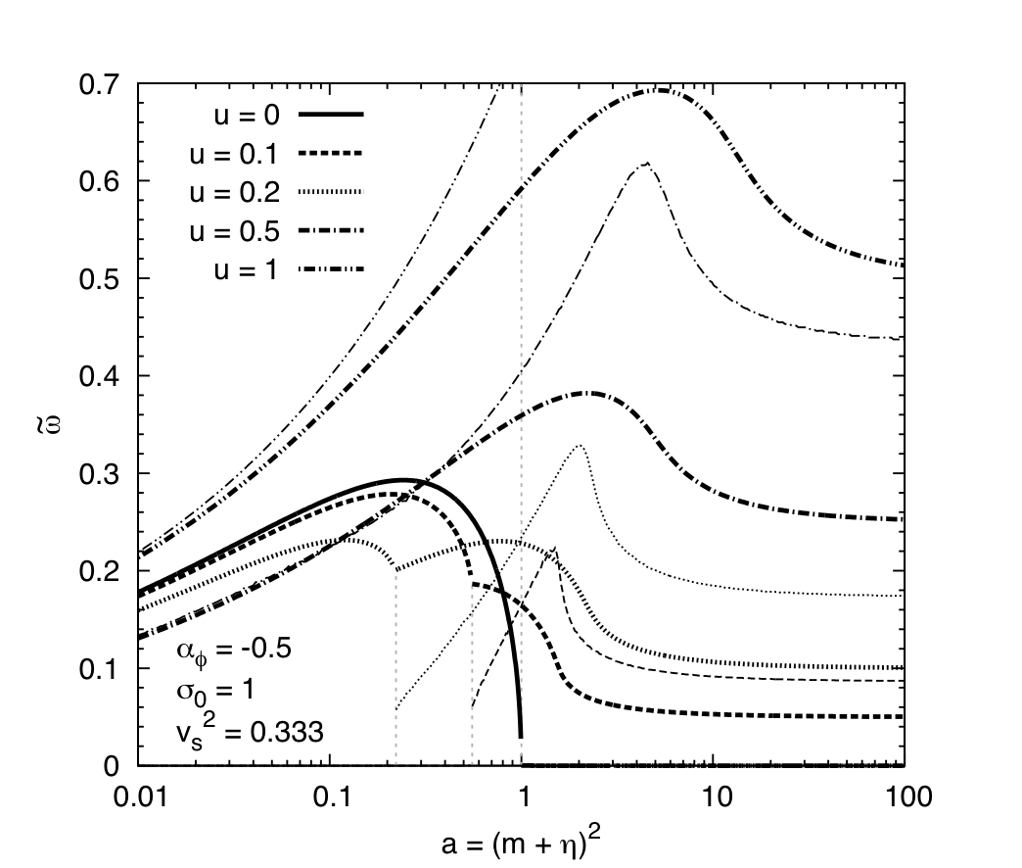
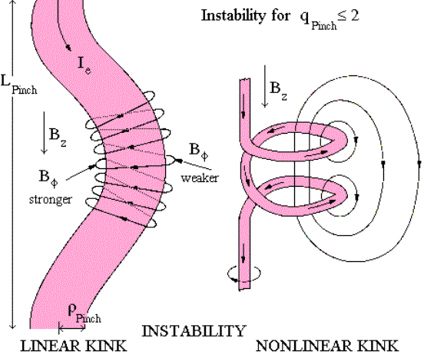
Current Driven Instability
Magnetic pressure (Baty 2005)
Mignone et al. (2010) Toroidal B-field
Porth (2013) B-Field helicity radial decrease More stable
Nakamura & Meier (2004) Helical B-field
Nalewajko & Begelman (2012)
Reconnection: Poynting flux ⇒ Plasma energy flux
CDI Growth: Velocity shear Static no shear
Analytical Analyses: Istomin & Pariev (1994, 1996) Begelman (1998) Lyubarskii (1992, 1999)

Slide 10
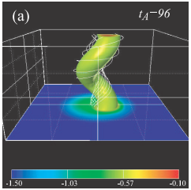
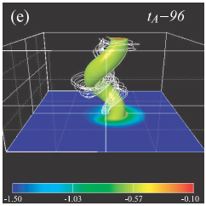
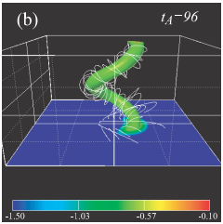
CDI Kink Destabilzation/Stabilization (Mizuno et al. 2009,2012)
2D Density Slices
3D Density Isosurfaces
Increased inner helicity
Multiple Kink Modes
Outer Kink
Inner Kink
a = radius ~ (B_{φ})^{Max}
Helicity Decreasing Constant Increasing with radius
Periodic
16a
16a
16a
32a
32a
32a
Helicity decreasing & Density increasing with radius ➔ Slower growth [Agrees with non-relativistic results of Appl et al. (2000); Lery et al. (2000)]

Slide 11
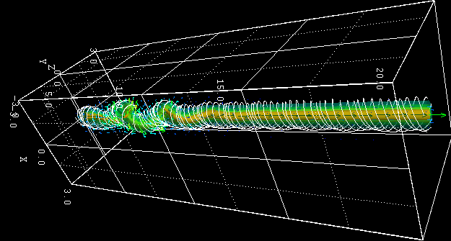
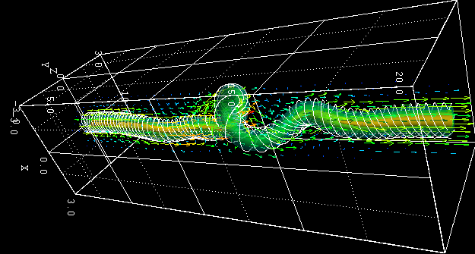
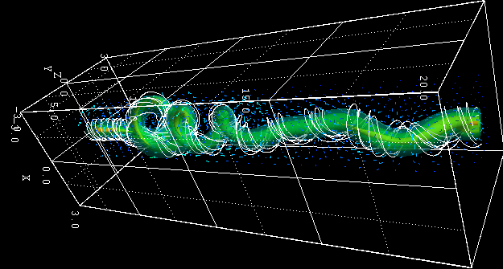
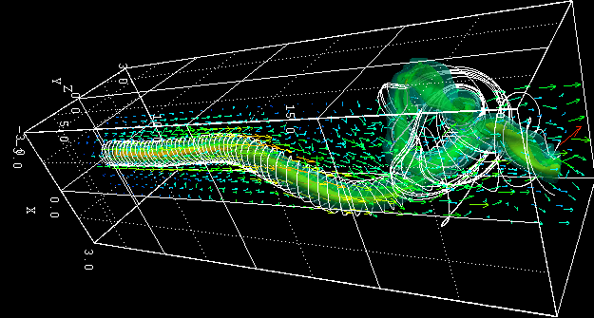
CDI kink: Spatial Growth
(Constant pitch, density decrease: v_{j} = 0.2 c , v_{A} ≤ 0.36 c )
R_{j} = velocity shear radius a ~ radius B_{φ} maximum
R_{j} = a/2 (flow through kink) R_{j} = 4a (kink moves with flow)
flow
flow
B @ 2.4a
t = 55
24a
24a
80a
80a
flow
flow
t = 100
24a
24a
80a
80a
Partial stabilization by kink advection with flow
(Mizuno et al. in progress)

Slide 12
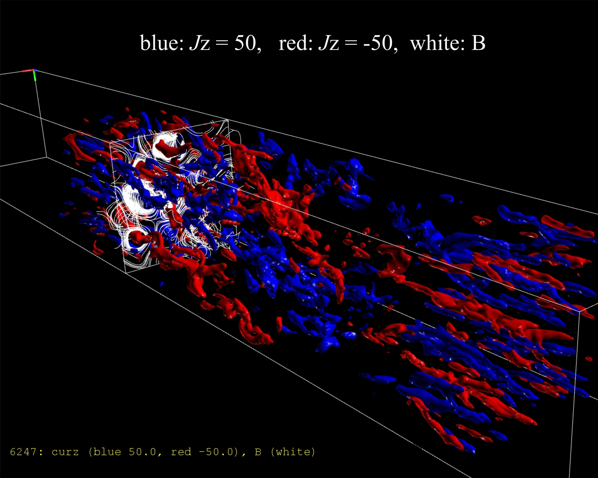
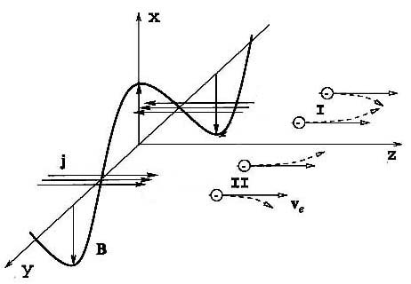
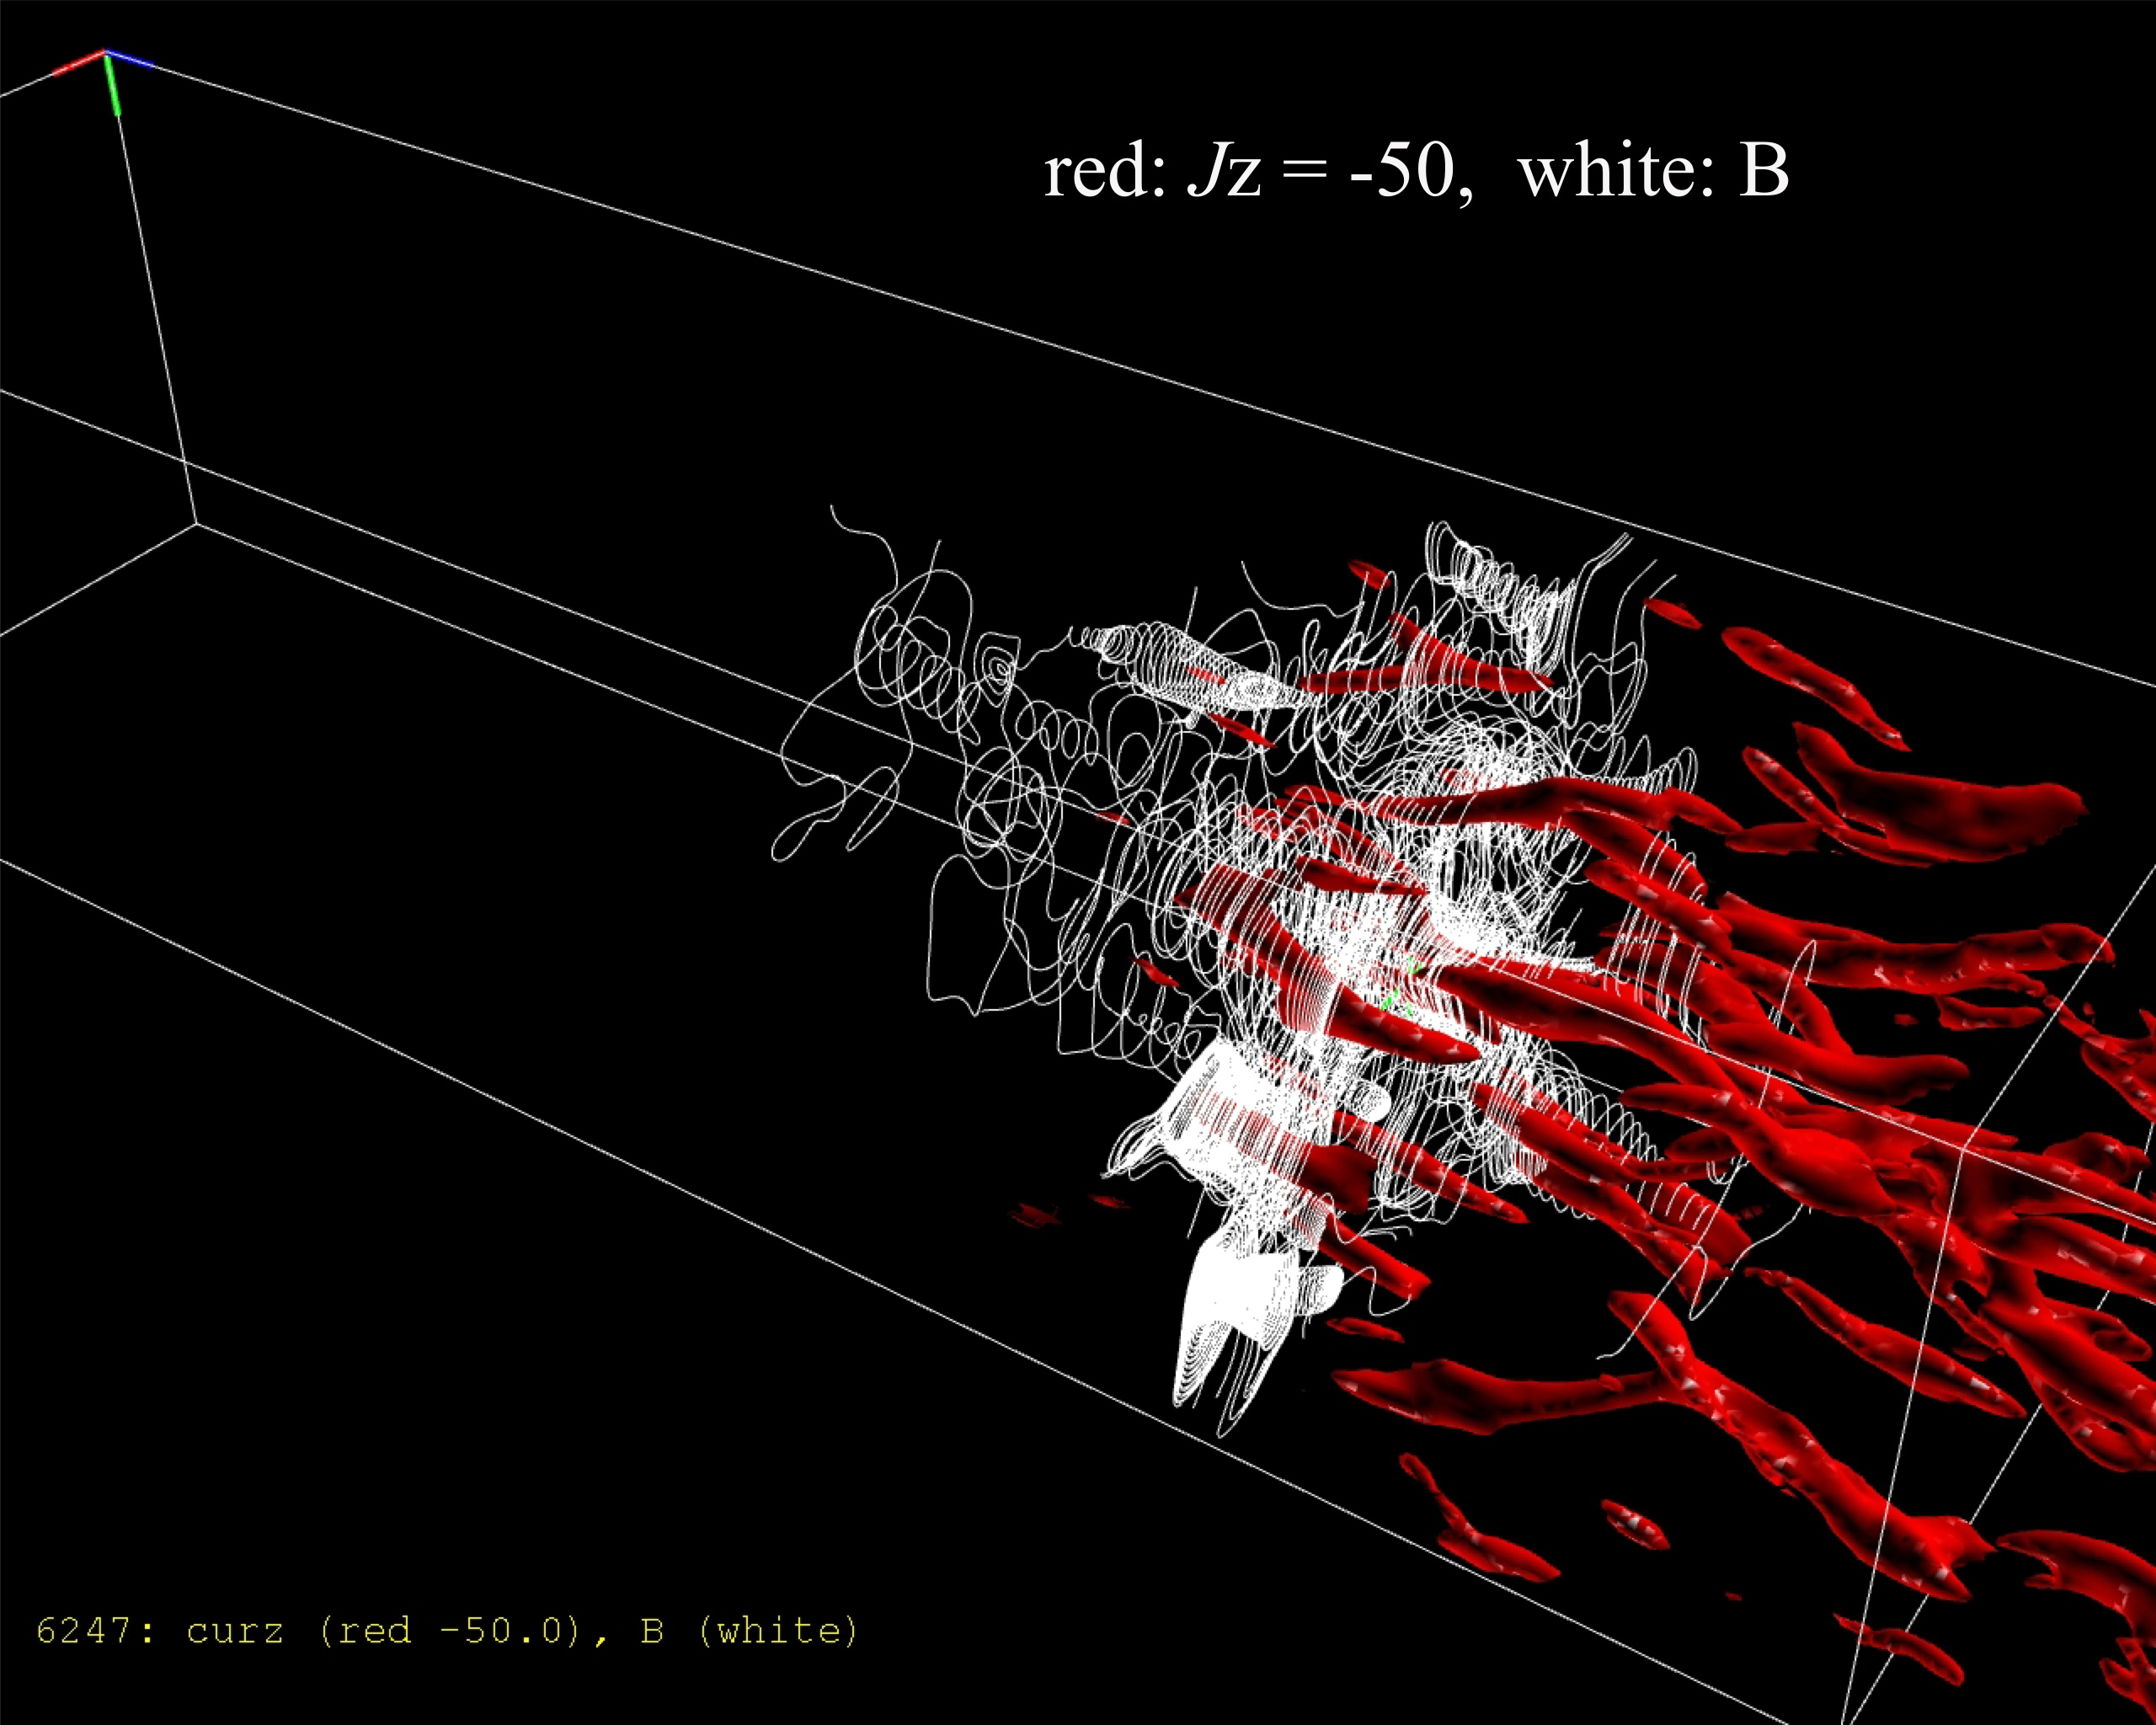
Filamentation Instability - Shocks
Current filaments & induced magnetic fields
Jet
J
J
B_{x}
F = −e (v_{z} × B_{x})
White magnetic field lines
Acceleration timescale ~ few 1000(ω_{p})⁻¹

Slide 13
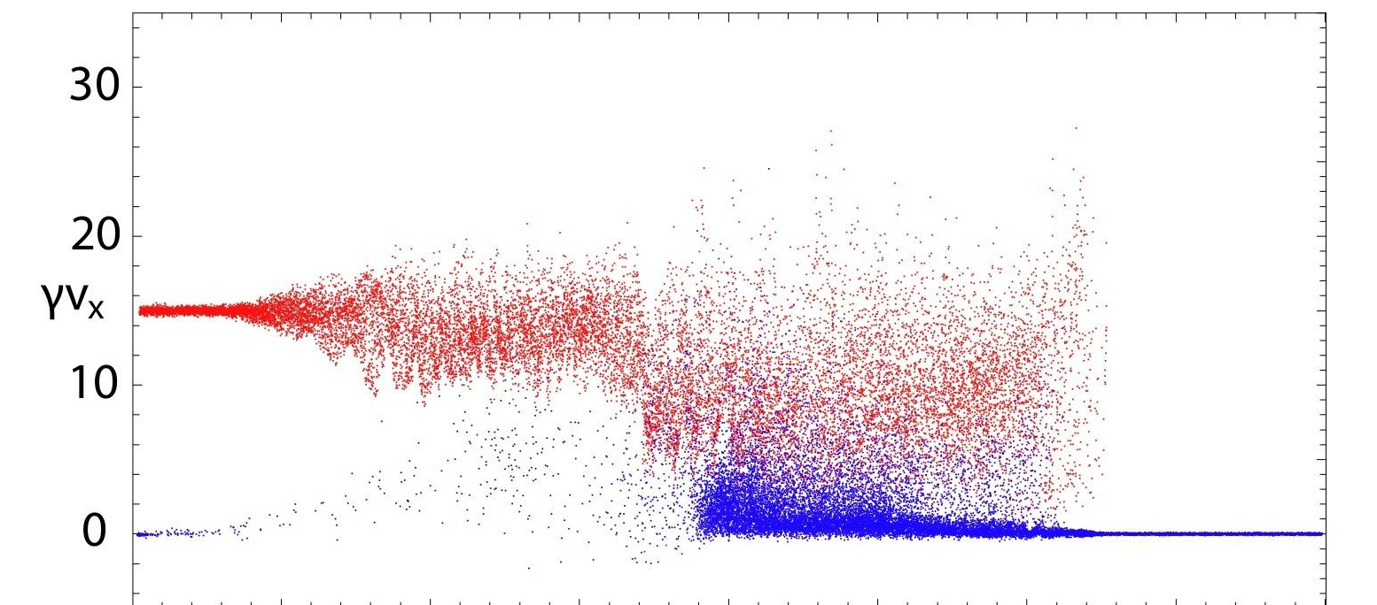
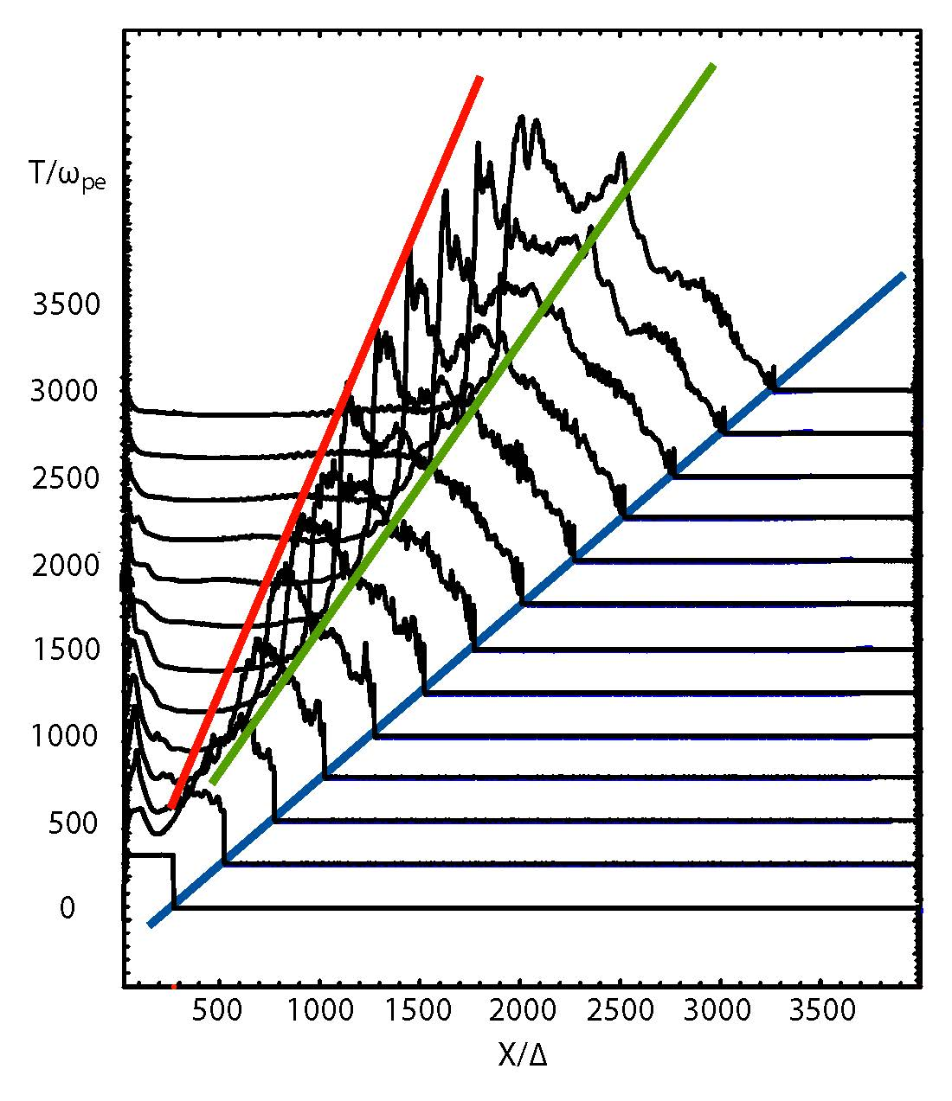
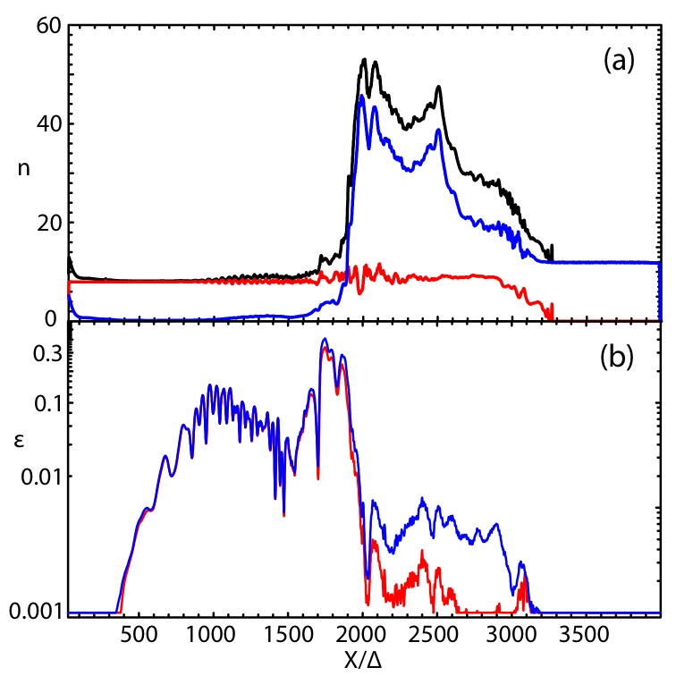
Filamentation Instability & Shock Structure
Jet & Ambient (e±) Particles
Nishikawa et al (2009)
TE
TS CD LS LE
TS (0.56c)
LS (0.76c)
LE (0.996c)
γv_{x}
Jet Ambient Total
n
ε_{BE}
Magnetic Electric
ε_{BE} = ρ_{BE}/ρ_{KE} ~ 0.3

Slide 14
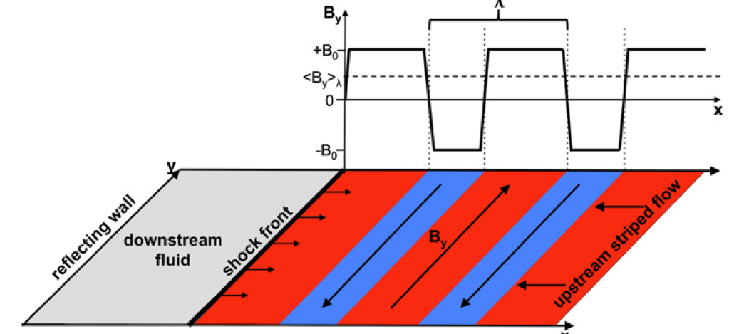
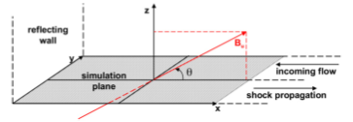
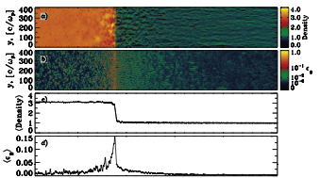
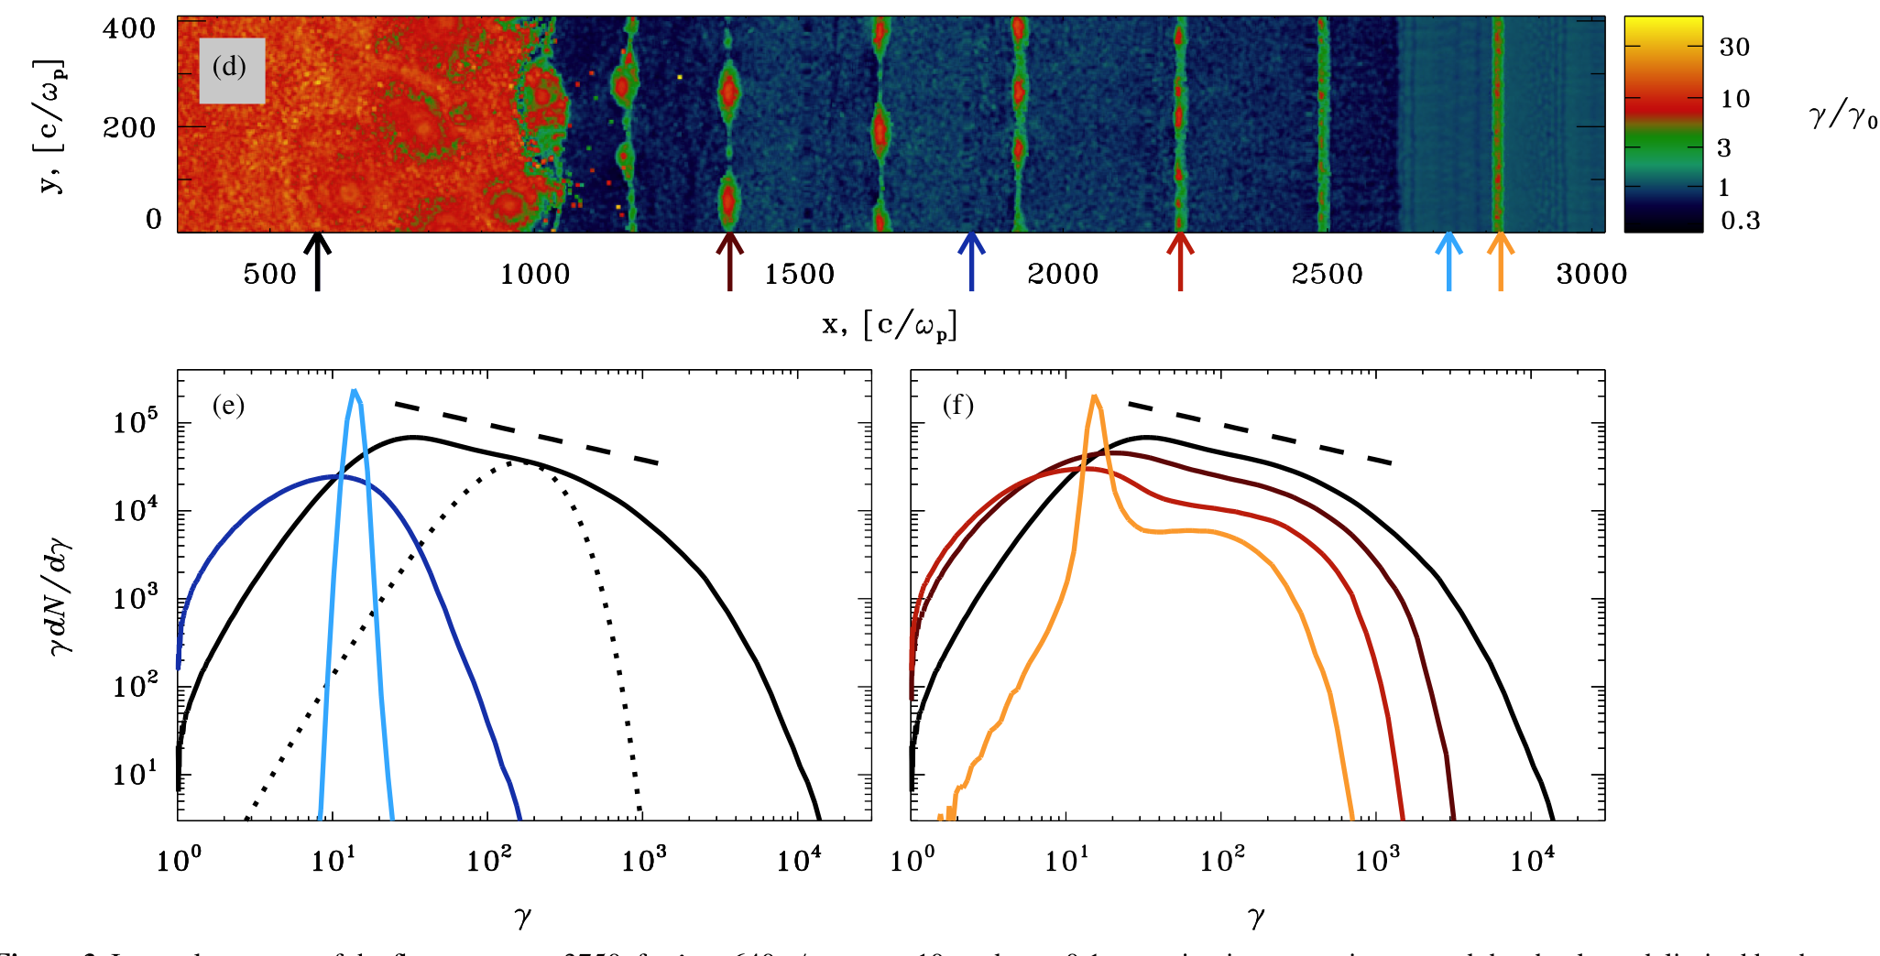
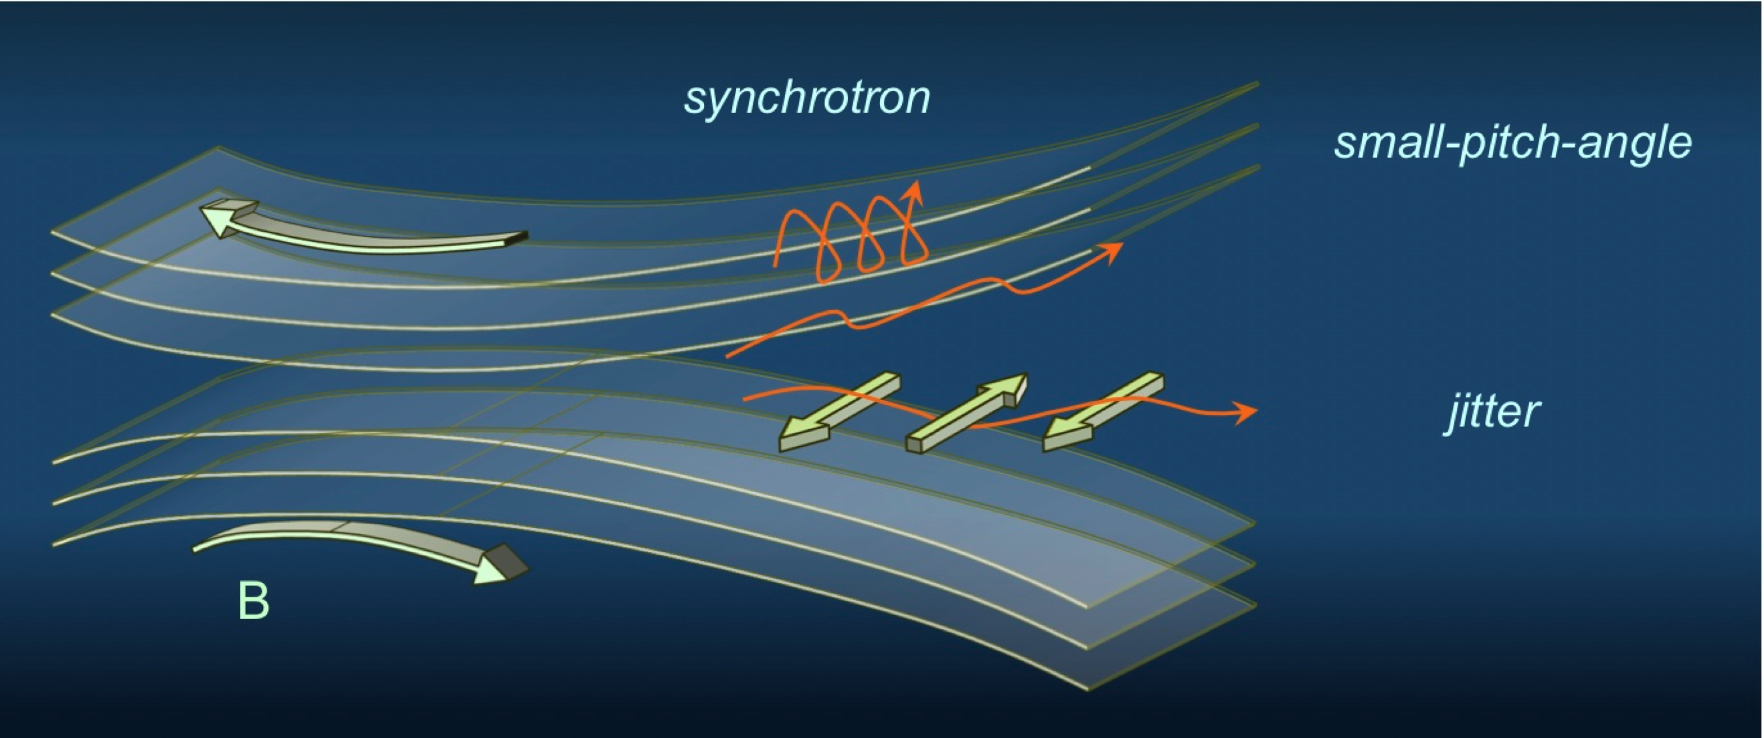
Emission & Reconnection
Sironi & Spitkovsky (2009a,b; 2011)
γ_{flow} = 15
flow
HD Shock
Reconnection
fast MHD Shock
Final particle energy distribution
Initial particle energy distribution
p = -1.4
Shock
Synchrotron spectrum
Emission from Reconnection Region
thermal
non-thermal
Medvedev et al. (2010)

Slide 15
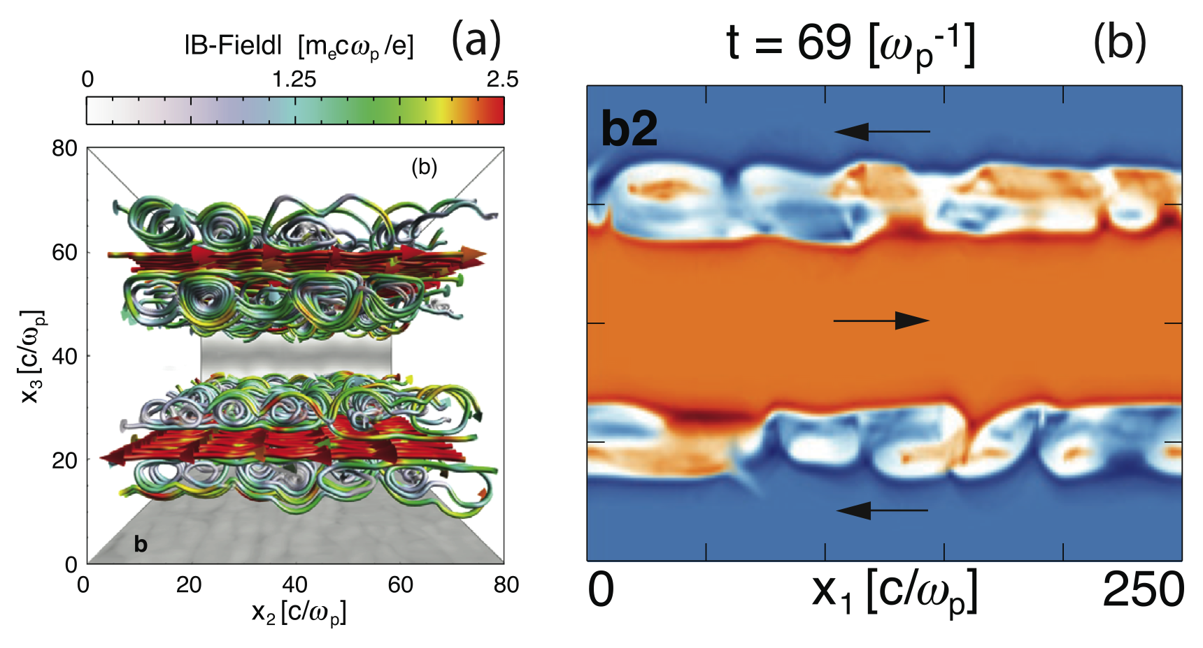
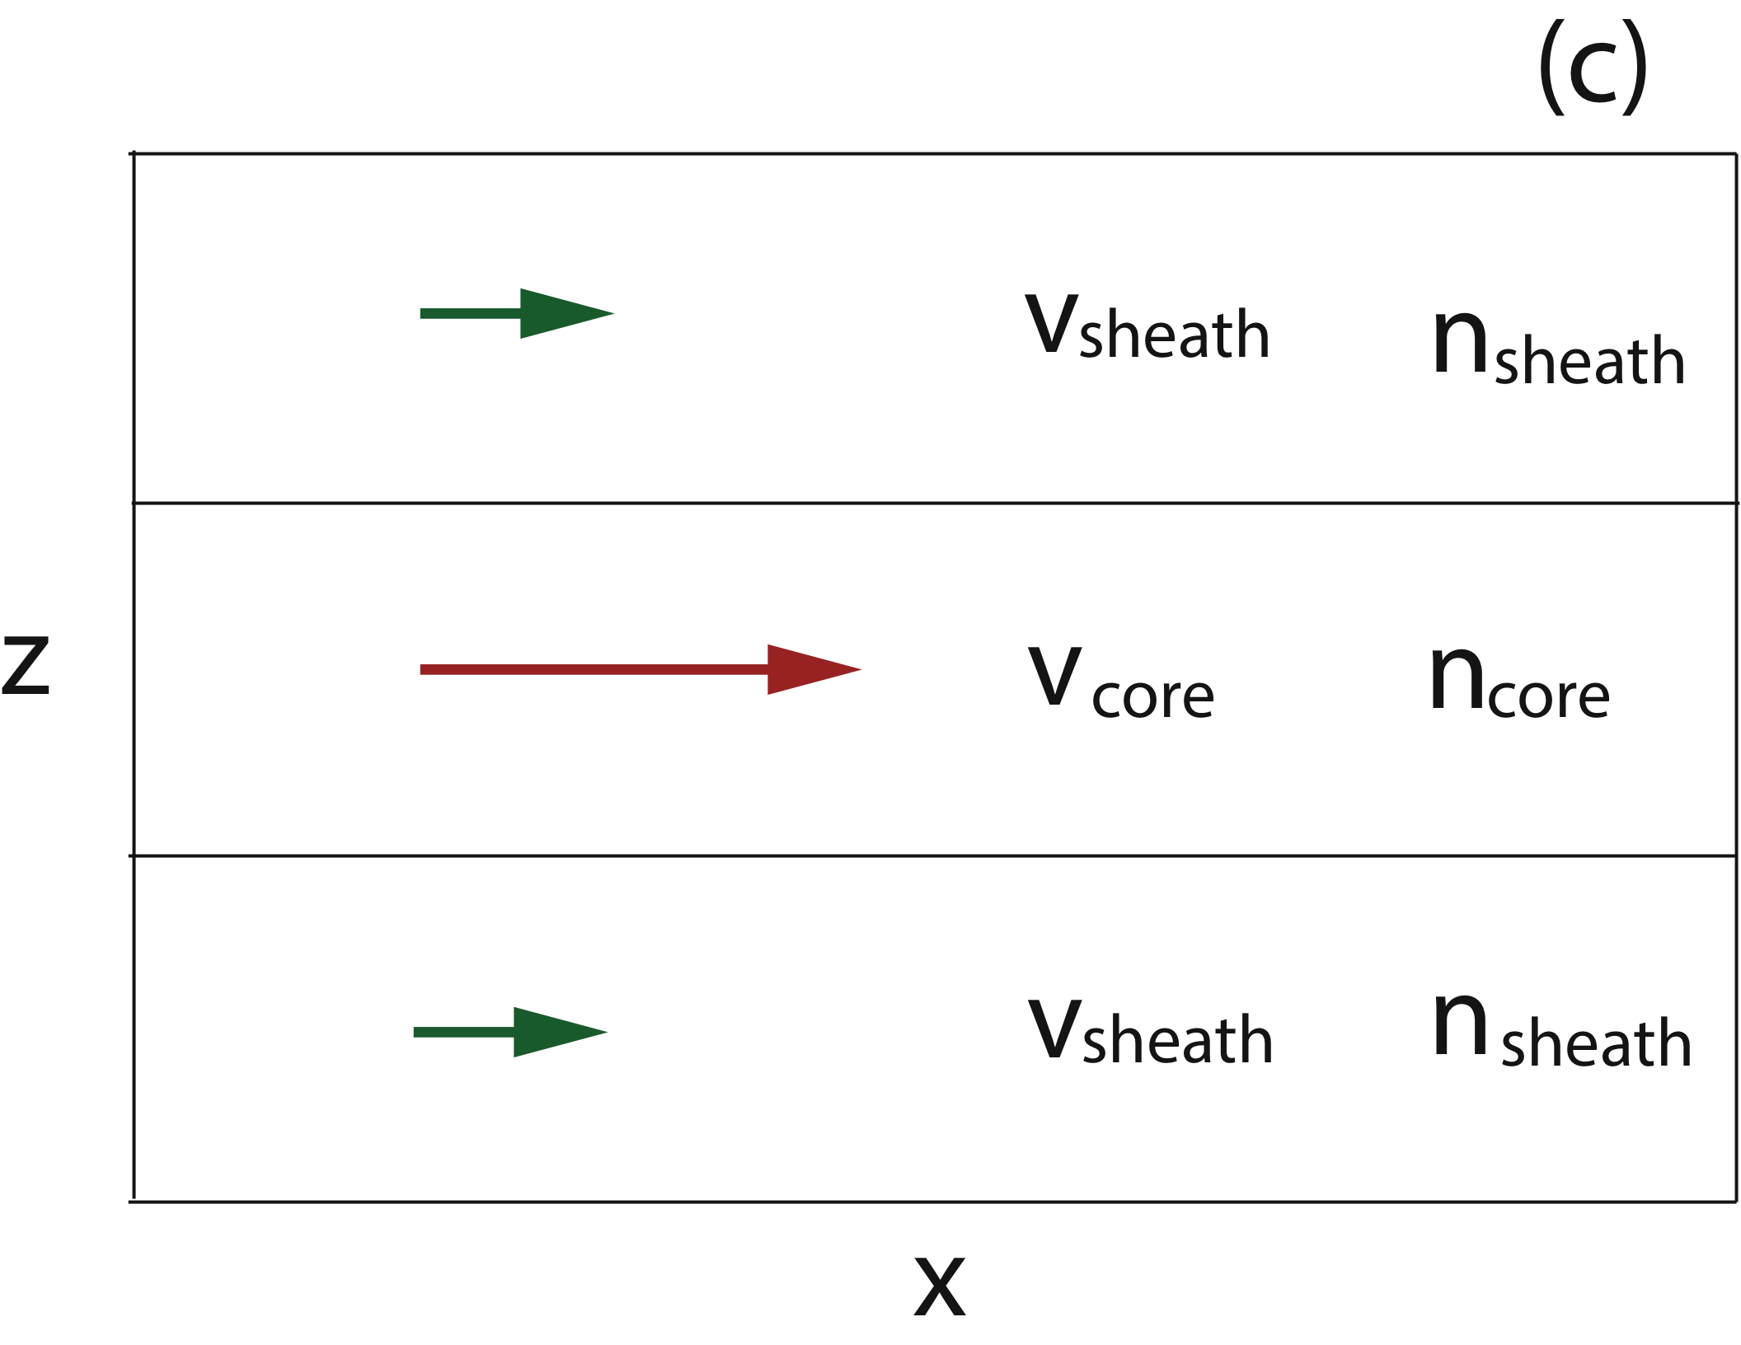
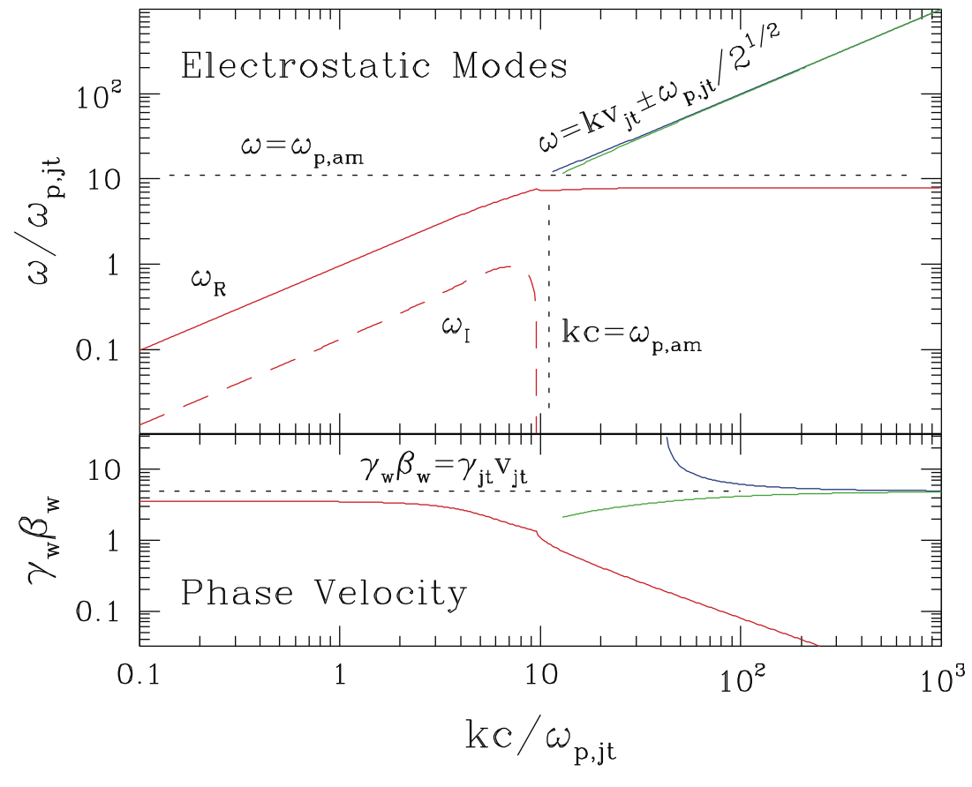
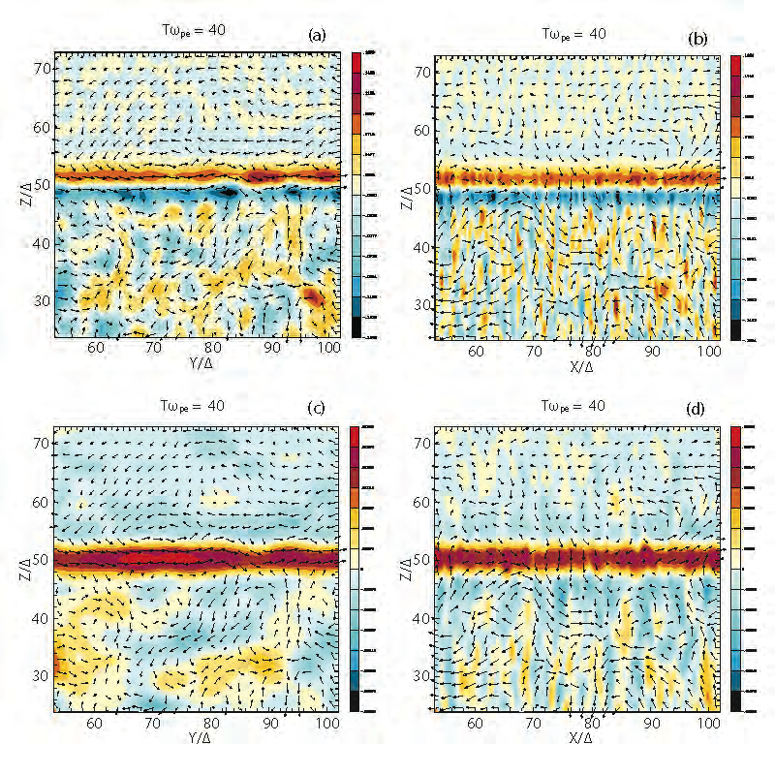
Kinetic Kelvin Helmholtz Instability
Alves et al. 2012: counter-streaming
Nishikawa et al. in prep; core-sheath


✕
✕
◉
◉


✕
✕
Non-Relativistic γ ~ 1
Relativistic γ = 3

Slide 16
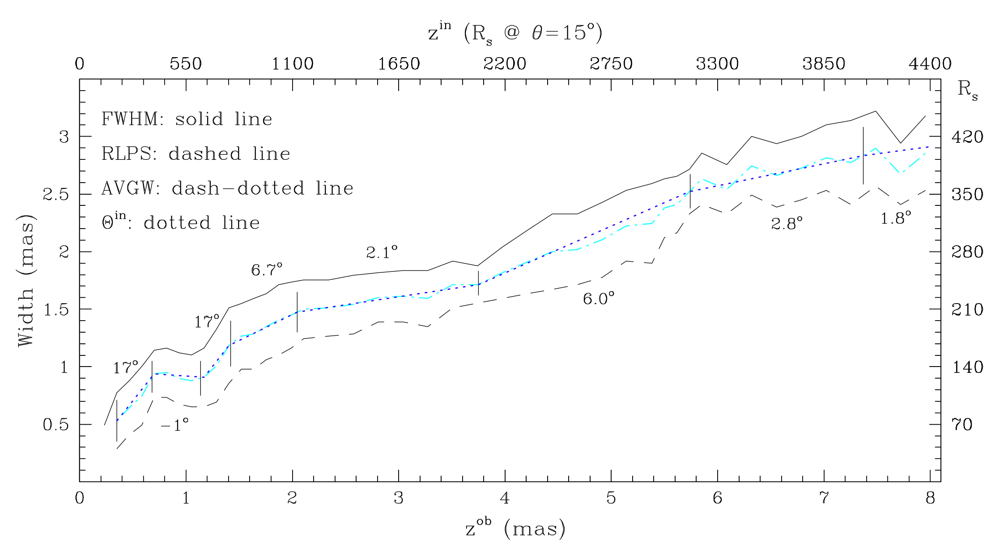
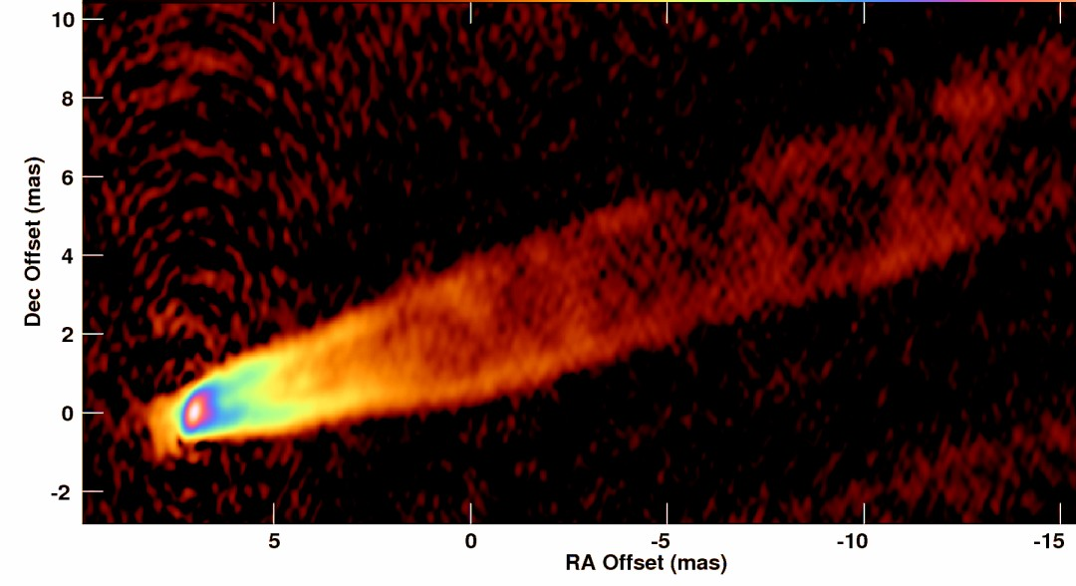
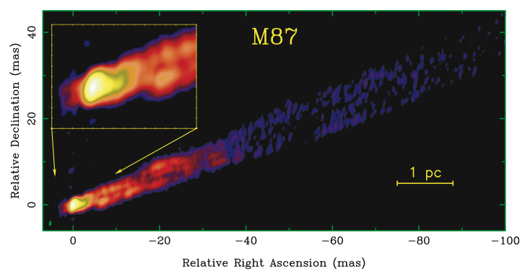
M87: Collimation, Propagation & CDI/KHI
Junor et al. (1999)
Walker et al. (in prep.)
Beam: ~ 0.4 x 0.2 mas 0.3 mas ~ 0.024 pc ~ 42R_{s}
Collimation Region
60º
0.03 pc
@ 15º jet viewing angle
7 mas ~ 2.2 pc ~ 4000 R_{s}
Re-expansion
Edge brightened
Edge brightened (KKHI)
Launching Region
5 mas ≈ 0.4 pc ~700R_{s}
Walker et al. (2008)
Propagation (KHI) Region
(Kovalev et al. (2007)
Wavelet analysis (Mertens & Lobanov)
Sheath Acceleration v_{ob} < c to v_{ob} ~ 2c inner 1 mas
KHI filaments to Knot A
~ 4000 R_{s}
Launching Region (few 100s R_{s}) ; Collimation (CDI/KHI) Region ; Propagation (KHI) Region

Slide 17
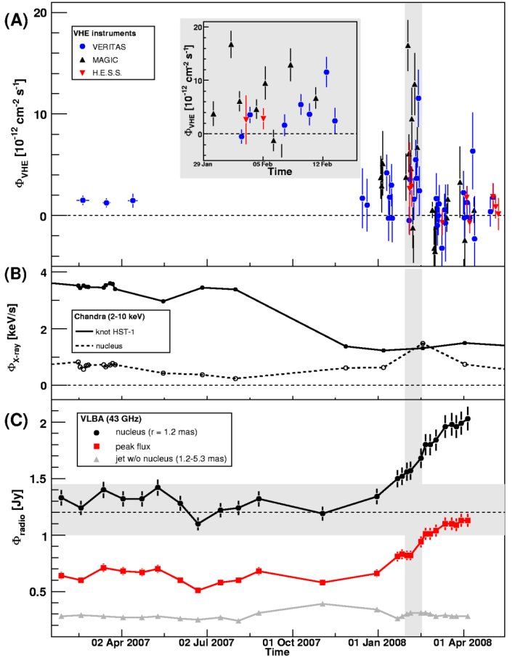
M87: Launching Region & Microphysics
Global Jet Processes too slow for < 1 day Tev variability ⇒
small scale structures for CDI , KKHI , Filamentation, Reconnection & rapid particle acceleration
Tev flaring over 18 days
TeV
TeV from core < 1 day variability ⇒ processes on scales <<< 25 R_{s} ~ δ_{max} Δt_{obs} c
(Poynting domain < few 100 R_{s})
Small scale CDI magnetic reconnection & particle acceleration
“Jet-in-a-jet”
[Giannios et al. (2009)]
(Kinetic domain > few 100 R_{s})
Small scale shock/shear (Filamentation/KKHI & Reconnection) particle acceleration
“Knots-in-a-jet”
[Lenain et al. (2008)]
“Needles”/spine-sheath
[Ghisellini & Tavecchio; Tavecchio & Ghisellini (2008)]
“Knot”/needle deceleration
[Georganopoulos et al. (2005); Levinson (2007)]
HST-1
X-ray
Nucleus
Radio Nucleus

Slide 18
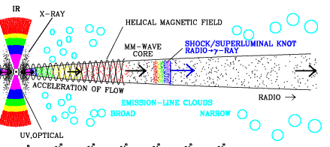
M87: Summary & Conclusion
Jet angle: θ ~ 15°, Global Spine-Sheath: γ_{spine} ~ 7, γ_{sheath} ~ 3, Doppler: δ <<< δ_{max}= 2 γ_{spine}
Launching (sub-pc scales): (γ_{A} v_{Alfvén} > γ_{jt} v_{jt})
Simulation/M87 ⇒ Global CDI stabilized (expansion, acceleration, radial structure)
M87 ⇒ Poynting to plasma energy conversion ( small scale CDI/Reconnection)
Microphysics ⇒ Particle acceleration (Reconnection, KKHI)
Collimation (~ pc scales): (γ_{jt} v_{jt} ~ γ_{A} v_{A})
Simulation/M87 ⇒ CDI/KHI generation global structures
Microphysics ⇒ Shock acceleration/jet knot emission, KKHI acceleration/jet edge brightening
Propagation (> few pc scales): (γ_{jt} v_{jt} > γ_{A} v_{A})
Simulation/M87 ⇒ KHI partial stabilization (expansion, advection, radial structure, magnetic fields)
Microphysics ⇒ shock & shear driven acceleration
Collimation
From Graphic by David Meier
Launching
few 100 R_{s}
Modified Fast MS Point
Alfvén Point
CDI/KHI
KHI
CDI
High speed spine
Slow MS Point
Fast MS Point
Poynting Flux
Kinetic Flux
From Graphic by Alan Marscher
TeV < 200 R_{s}
Hi
hi
mm-core
HST-1 ~ 550,000 R_{s} (~300 pc)
Collimation to 4000 R_{s} (few pc)
White on white

