Slide 1
The core shift measurements for two-sided jets affected by Free-Free absorption using VLBA
Takafumi Haga (SOKENDAI/ISAS)
Collaborators
Akihiro Doi, Yasuhiro Murata (ISAS/JAXA),
Hiroshi Sudo (Gifu Univ.), Seiji Kameno (Kagoshima Univ.),
Kazuhiro Hada (IRA/INAF), Hiroshi Nagai (NAOJ)
Notes:
Thank you.
Today I will talk about core shift measurements for two-sided jet.
’m from SOKENDAI/ISAS in Japan
These members are collaborators.

Slide 2
Outline
Introduction of Our project
Core shift measurements for two-sided jet
Where is the position of the black hole?
Our Targets
NGC 4261, 3C 84, Cen A, Cyg A
Results of NGC 4261
The black hole position
– The interpretation of the counter jet core shift
Notes:
This is outline of my talk.
Firstly, I will introduce our project.
The keyword is core shift measurements for two-side jet
The main purpose is to understand where the position of the black hole is.
These 4 sources are our targerts
Then, I will show you the results of NGC 4261 as example of our target,
There are two topics.
One is the black hole position,
The other is the interpretation of the counter jet core shift.

Slide 3
Opacity effect
Radio core ： Peak intensity at the upstream of a jet
Core position
The base of jet is absorbed ( It’s stronger at lower frequency.)
Core positions seem to be different at each frequency
( = core shift )
Core position ≠ position of the jet base
Radio core at each frequency
Jet in VLBI image
↑Black hole (and accretion disk )?
Jet
Notes:
What is radio core.
We defined the position of radio core as the position of peak intensity at upstream of jet. In this figure, this position is core.
However, the position of core is not so simple.
Because the uperstream of jet is absorbed and this opacity effect is stronger at lower frequency
Therefore, we observe radio cores at different position by frequencies.
This is known as core shift.
For example in this figure
If this jet intrinsically start at this point but we can actually see only inside dashed line at a frequency.
It means that core position is not equal to position of the jet base.

Slide 4
The case of M 87 ( Hada+2011 Nature)
Accurate determination of the position of the jet base in M 87
(14–23) ± 4 Rs away from 43 GHz radio core.
The higher frequency is, the closer core is to the jet base
⇒ core ( @ν→∞ )→ jet base
Jet base = BH position ?
Notes:
M 87 case by Hada et al. 2011 is very important example for determination of jet base.
Kazuhiro Hada talked about this topics at the first day in this meeting.
They determined the jet base in M87 accurately by multi-frequency phase referencing observation.
The jet base of M 87 is located at about 14 times Rs away from 43 GHz radio core
If The frequency is higher and higher the position of the core is closer and closer to the jet base.
Therefore, they expected that the position of core at infinity of frequency should be jet base
However, does jet base represent true black hole position ?

Slide 5
Jet base = BH position ?
One-sided jet cases core (@ ν → ∞ )： lower limit of distance to BH
Two-sided jet cases
can limit range of BH position unambiguously
Core @ 43GHz
BH of
BL Lac case
BH of
M 87 case
Visible Jet
Standing shock model
:10⁵ Rs ( Marscher+2006)
Core shift model
:10 Rs (Hada+2011)
Notes:
It is unclear.
This sketch shows the relation of positions between core and BH. the purple cone is jet and yellow ellipse is core at 43 GHz.
In M 87 case, the position of jet base is 10 times Rs away from 43 GHz.
On the other hand, In BL Lac case, Marscher et al. reported 43 GHz core indicate standing shock point and it is very far by 10 to 5th Rs from BH position.
Therefore, if the jet base is determined by core shift measurements, on one-sided jet it prove only the lower limit of the distance to black hole position,
So, We focused on two-sided jet.
The courter jet core shift gives the upper limit. Both side core can limit range of the position of the black hole unambigously

Slide 6
The goal of our research
Measurements of counter jet core shift
determine true position of BH
BH
Jet Core shift
Counter Jet Core shift
BH
Notes:
The goal of our study is that
We will measure the core shift not only on main jet but also on counter jet side And
We will reveal the true position of black hole by using core shift of both side jet.

Slide 7
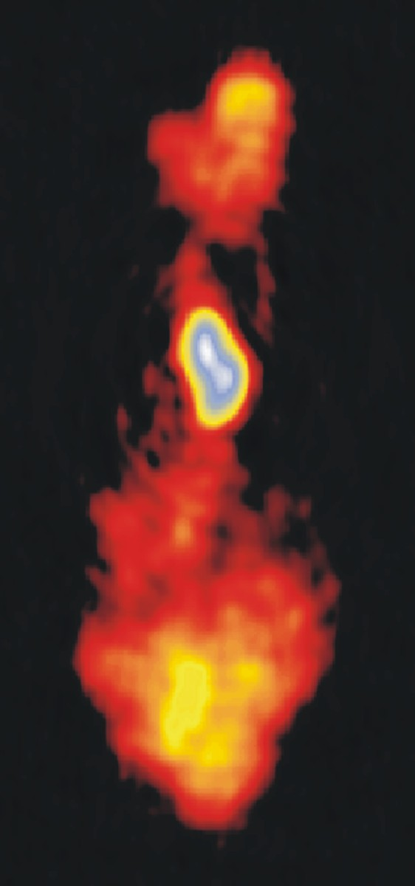
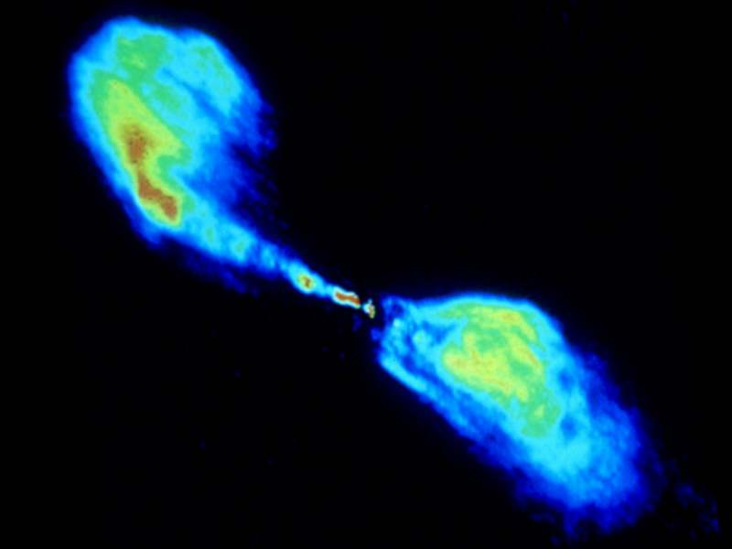
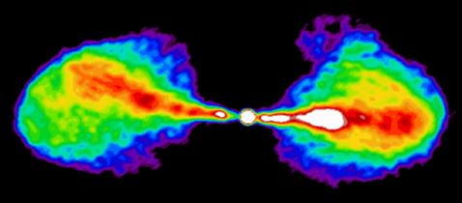
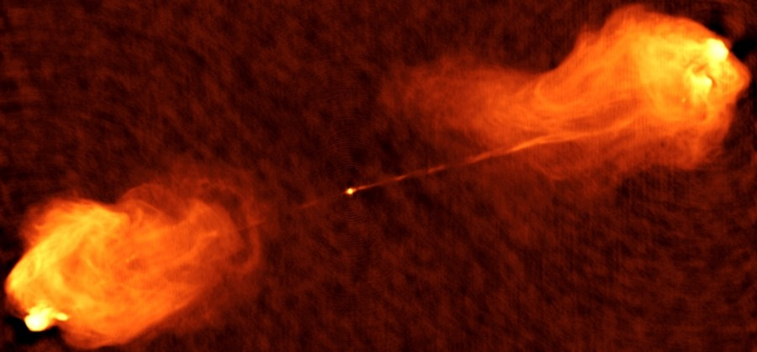
Our targets with two sided jet
Centaurs A
3C 84
NGC 4261
Distance: 3.6 Mpc
Distance：30 Mpc
Cygnus A
Distance:230 Mpc
Distance:70 Mpc
Notes:
The targets are required to be nearby source because we have to measure core shifts accurately.
We selected 4 sources, Centaurs A, NGC 4261, 3C 84, and Cygnus A.
Additionally, all of them have free-free absorption feature around core.
In this talk, I will focus on NGC 4261 case.
About Other sources, we submitted the proposal to VLBA and accepted.
3C 84 and Cen A have already been observed in last winter

Slide 8
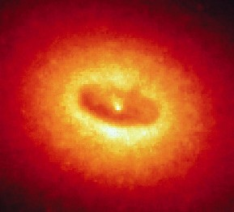
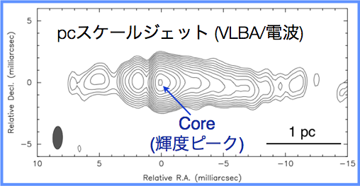
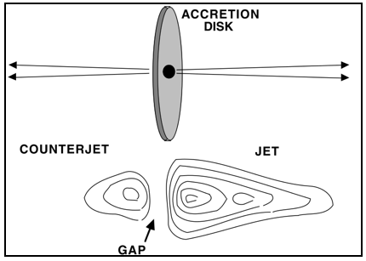
NGC 4261
Kpc scale jet (VLA)
Gas &dust Disk (HST)
FR-I radio galaxy
31.6 Mpc (z=0.0075)
− 1 mas ~ 0.15 pc (Tonry +2001)
BH：4.9×10⁸ M_{sun} (Ferrarese + 1996)
Viewing angle： θ = 63 ± 3° (Pinner +2001)
Intensity gap
The obscuration by disk
Edge-on, geometrically-thin, cold disk (10⁴ K)
30 kpc
100 pc
pc scale Jet (VLBA @ 8GHz )
8 GHz
Counter Jet (CJ)
Approaching Jet (AJ)
Gap
Jones +2000.2001
Notes:
This source is a nearby FR-I type radio galaxy. Top figure shows VLA 5 GHz image.
Its black hole mass is estimated kinematically to be about 500 million times solar mass by HST observation, which discovered a 100 pc scale dusty tours.
middle figure shows pc scales by VLBA observations. It has prominent two-sided jets.
West side is approaching jet. And the other side is counter jet,
Therefore NGC 4261 is one of the best object to study counter jet core shift.
Additionally, viewing angle theta is estimated to be 63 degrees
by using jet speed and flux ratio between Ajet and Cjet.
This source have another important feature.
This is intensity gap. It is located nearby core position.
Jones et al interpreted the gap as the obscuration by an edge-on. geometrically-thin, cold disk with a temperature about 10,000 K like bottom right figure.

Slide 9
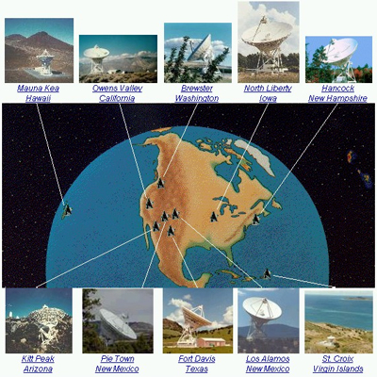
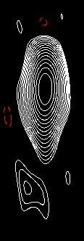
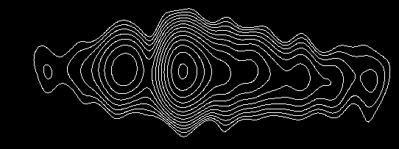
Observational summary
Telescope | VLBA (10 antennas)
Observation mode | Phase-referencing
Frequency [GHz] | 1.4/2.3/5.0/8.4/15/22/43
Date | 28th June, 2003 (15, 22, 43 GHz)
 | 5th July, 2003 ( 1, 2, 5, 8 GHz)
Calibrator | J1222+0413
43 GHz resolution beam size 〜 0.15 [mas] 〜 0.04 pc 〜 1000 Rs
J1222+0413
Decl.
1.7°
R.A.
NGC 4261
Notes:
Next is observational summary
We observed the target by VLBA with 10 antennas at multi-frequency phase-referencing.
We use 7 frequencies from 1.4 GHz to 43 GHz.
The maximum spatial resolution at 43 GHz is 0.15 mas it correspond to about 0.04 pc and 1000 Rs
Calibrator is J1222+0413.
The geometrical relations between the target and the calibrator is like this, the calibrator is within 1.7 degrees from the target.
Each figure is continuum map at 5 GHz. You can see jet’s directions are almost perpendicular so, the target core shift can be measured without being affected by calibrator’s core shift

Slide 10
Continuum maps and core shift measurements
We can measure C-jet’s core shift for the first time
Relative position form 43 G core [mas]
Frequency [GHz]
●:jet core
●:C-jet core
Relative position from 43GHz core [ mas]
Notes:
This is result.
The left figure show the continuum maps at every frequency. These are relative to 43 GHz core position.
The gray ellipse is beam size and the first contour begin from 3 times rms noise at each map.
The red points are plotted on approaching jet core position and the blue is counter jet.
the graph on top of the right shows core shift plot . Horizontal axis is frequency and vertical axis is offset from 43 GHz radio core.
We can measure the counter jet core shift for the first time.

Slide 11
Core shift fitting on approaching jet
 | Value | error
Ω | -8.42 | ± 0.86
k | 1.22 | ± 0.06
c | 0.082 | ± 0.016
Relative position form 43 G core [mas]
Parameter c was determined to be 82 ± 16 μas (~310 ± 60 Rs) from 43 GHz core
Frequency [GHz]
・ Core_AJet@43GHz < c < Core_CJet@43GHz
・ c (core @ ν→∞) = BH position
Notes:
And then, we fit this core shift on A-jet side by function r
The large omega, k, ,c are caling factor, index and asymptotic line respectively, and they are free parmaeters
The table shows determined parameters.
C was determined to be 82 ± 16 maicroarcseconds from 43 GHz radio core, which correspond to 310± 60 Rs
This is the jet base and this is also the lower limit of the distance to BH.
On the other hand, the obtained counter jet core at 43 GHz is upper limit.
It indicates that the jet bases represents BH position because core in both side coincide with same position,

Slide 12
Spectral index map (S_{ν}∝ν^{α})
1-2 GHz
Overlay maps at adjacent frequency
Considered core shift
Using same beam
α > 2.5 (inside heavy line)
1-2, 5-8, 8-15 GHz
5-8 GHz
ν₁
ν₂
Notes:
Next results are spectral index maps. We made spectral index maps between two frequency to overlay continuum images to be careful for core shift.
Beam mach lower frequency’s, which is showed light gray ellipse in this figure.
Top figure is spectral index map between 1and 2 GHz
Bottom figure shows 5 and 8 GHz pair.
Dashed line shows the black hole position to be determined by core shift.
And heavy line indicates that spectral index α exceeds the value of 2.5.

Slide 13
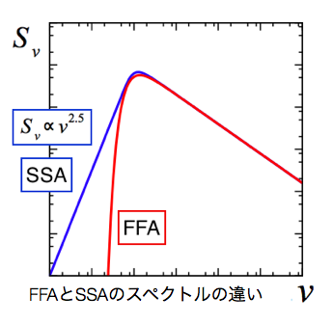
core shift is caused by SSA or/and FFA
Absorption at low frequency
Jet itself ： synchrotron self-absorption (SSA)
Obscuration of accretion matter :free-free absorption (FFA)
α_{SSA} ≦ 2.5
The spectral difference between SSA and FFA
Notes:
There are two possibilities of the process of absorption at low frequency radio band. Both of them can cause core shift.
One is synchrotron self-absorption, SSA. In this case, absorber is jet itself.
The other is Free free absorption, FFA. The absorber is the plasma gas around jet. It may be accretion matter.
The value of the spectral index at low frequency can separate two process. Spectral index below 2.5 theoretically indicates SSA.
Our spectral index map have the region of over 2.5. So it indicates FFA region.

Slide 14
Pure SSA model
The difference of A-Jet / C-Jet
beaming factor
δ (β, θ)
β：0.46, θ: 63°
Ω_{CJ} < Ω_{AJ}
Model
5–8 GHz : lager than pure SSA expectation
Others
：as expectation from pure SSA core shift
Counter Jet
Approaching Jet
SSA
Notes:
I will focus on core shift on counter jet side.
In counter jet, the absorption look like different from approaching jet
Assuming symmetry jet with respect to black hole, index k and black hole position c are common value between jet and counter jet.
However, scaling factor large omega is different.
In SSA case, the difference will reflect beaming factor, which is depended on jet speed beta, and viewing angle theta.
Beaming factor on A-jet is larger than the other.
Also the value can be described by this equation for assuming equipartition. It is important that the difference value between both side is only theta.
Therefore, we can calculate the expected core shift on the counter side using approaching jet parameter. And jet speed, viewing angle.
Light blue line is expected core shift line
Compared to observational position and line, you can see the core positions at 1 and 2 GHz are agreement with the SSA expectation, however, 5 and 8 GHz don’t match.

Slide 15
SSA + FFA model
SSA jet + FFA disk
5, 8 GHz: affected by FFA disk
Other : consistent with pure SSA
Limited regions within 0.4 pc
ν ≦ 2 GHz : outside disk (low density)
ν ≧ 15 GHz : too high temperature : frequency dependence
FFA Disk
τ_{FFA}：FFA opacity, n_{e}: electron density, T : temperature L : path length in absorbers
Jet
observers
Notes:
A possible solution is an additional absorbing component in the limited ration at less than 0.4 pc only on the counter side.
Core shift also suggest the existence of a disk in addition to gap profile and spectral index larger than 2.5
Why are cores at only midrange frequency affected by FFA disk ?
FFA opacity show this equation. It depends electro density and temperature, path length in absorbers and frequency.
At lower than 2 GHz, the core position is outside disk, which indicate the electron density is very low because the distance is too far from BH.
On the other hand, at higher than 15 GHz, temperature is too high and it is also frequency dependence.

Slide 16
Summary
We measured core shift of NGC 4261 not only on main jet side but also counter jet.
The jet base practically represent the BH position.
The BH position of NGC 4261 is determined unambiguously.
It is located within 82 ± 16 μas (310± 60 Rs) from 43 GHz core
C-Jet core shift can’t be interpreted as pure SSA core shift.
Contribution of FFA disk
Notes:
This is summary.

Slide 17
3C 84 phase referencing observation
Going on analysis
8.4 GHz
12 GHz
15 GHz
22 GHz
Decl.
Target
1.28°
Calibrator
R.A.
P.A. –55°
Calibrator: J0313+4120
1.6 GHz
2.3 GHz
5.0 GHz
8.4 GHz
Notes:
We started the analysis of 3C 84.
These show continuum maps
We will try to measure the core shift.
Please wait till the results of other sources,

Slide 18
Thank you for your attention!

Slide 19
Observational summary
Telescope |  | VLBA (10 antennas)
Observation mode |  | Phase-referencing
Date |  | 24th January, 2013
Freq. [GHz] | OST [min] | Pol. | BW [MHz]
1.6 | 15 | LL/RR | 256
2.3 | 15 | RR* | 256
5.0 | 30 | LL/RR | 256
8.4 | 15 | RR* | 256
12 | 40 | LL/RR | 256
15 | 40 | LL/RR | 256
22 | 70 | LL/RR | 256
43 | 120 | LL/RR | 256
3C 84 (NGC 1275)
Distance: 70 Mpc
1mas〜 0.35 pc
New Mark 5C system
Data rate : 2Gbps
8 GHZ
Notes:
In this observation, New Mark 5c system is used.
Data rate achieve 2 Gbps and bandwidth is 512 MHz.

Slide 20
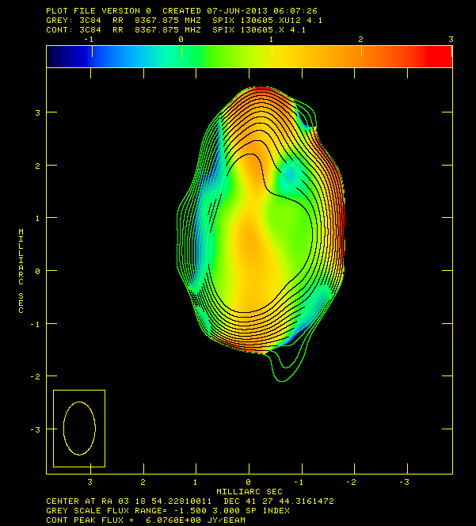
Spectral index maps
8-12 GHz
12-15 GHz

Slide 21
Error budget (μas)
Observation & Analysis
Frequency [GHz] | 1.4 | 2.3 | 5.0 | 8.4 | 15.4 | 22.2 | 43.2
Beam size/ SNR | 52 | 24 | 10 | 6 | 4 | 3 | 2
Ionosphere | 2006 | 779 | 161 | 57 | 17 | 8 | 2
Troposphere | 13 | 13 | 13 | 13 | 13 | 13 | 13
Core identification | 349 | 60 | 17 | 40 | 0.2 | 5 | 3
Earth orientation | 5 | 5 | 5 | 5 | 5 | 5 | 5
Antenna position | 2 | 2 | 2 | 2 | 2 | 2 | 2
Apriori Source coordinates | 1 | 1 | 1 | 1 | 1 | 1 | 1
Total error (RSS) | 2055 | 792 | 170 | 77 | 30 | 23 | 19
Notes:
This table shows the errors we estimated.
There are 7 terms and we calculate root sum square of them.
At low frequency, Ionospheric residual is most important. At high frequency, Troposphere and core identification are major components.

