Slide 1
Probing the magnetic field of 3C 279
by Sebastian Kiehlmann
on behalf of the Quasar Movie Project team
Max Planck Institute for Radio Astronomy,
Auf dem Hügel 69, 53121 Bonn, Germany

Slide 2
Polarization of 3C 279
The 180° ambiguity
Polarization of 3C 279
Conclusions
I

Slide 3
II. Polarization of 3C 279
degree of linear polarization:
mean $\left\langle P\right\rangle =12 \%$
variation $σ\left(P\right)=8 \%$
Fig. 1a: Optical, linear polarization degree of 3C 279
2

Slide 4
II. Polarization of 3C 279
degree of linear polarization
Optical electric vector position
angle (EVPA)
Fig. 1b: Optical, linear polarization degree and EVPA of 3C 279
3
Notes:
OJ287 Kikuchi, A&A 1988
BL Lac Marscher, Nature 2008
3C 279 Larionov, A&A 2008
3C 279 Abdo, Nature 2010

Slide 5
II. Polarization of 3C 279
object | EVPA rotation | time interval | explanation | reference
OJ 287 | 120 ° | 7 d | Helical motion in a helical magnetic field | Kikuchi et al., 1988
BL Lac | 240 ° | 5 d |  | Marscher et al., 2008
PKS 1510-089 | 720 ° | 50 d |  | Marscher et al., 2010
3C 279 |  300 ° | 60 d |  | Larionov et al., 2008
3C 279 |  208 ° | 12 d | Bent jet | Abdo et al., 2010
γ- ray flaring
Fig. 1b: Optical, linear polarization degree and EVPA of 3C 279
3
Notes:
OJ287 Kikuchi, A&A 1988
BL Lac Marscher, Nature 2008
3C 279 Larionov, A&A 2008
3C 279 Abdo, Nature 2010

Slide 6
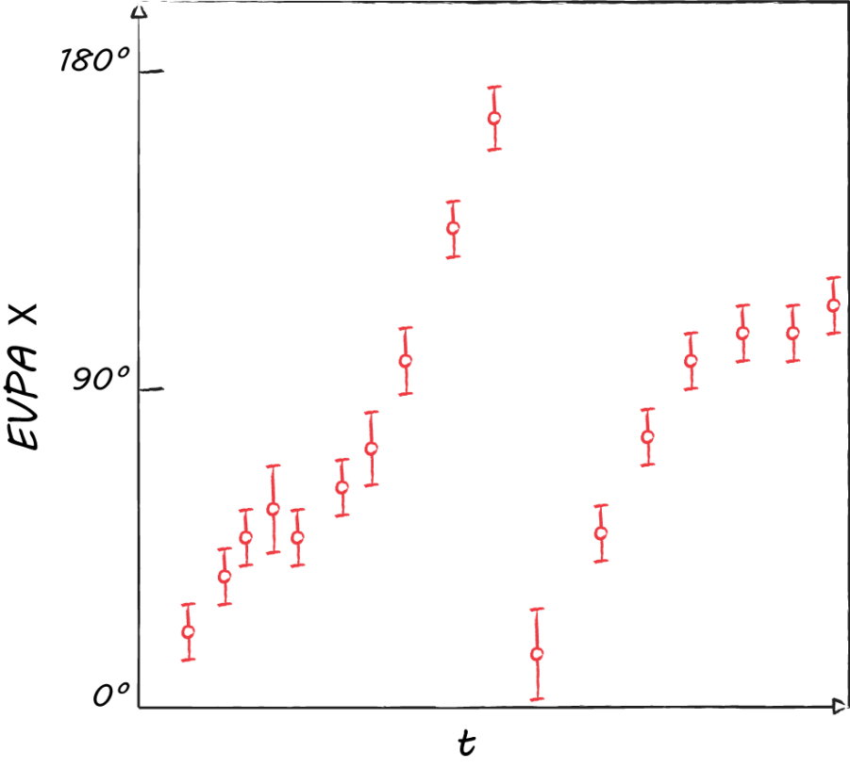
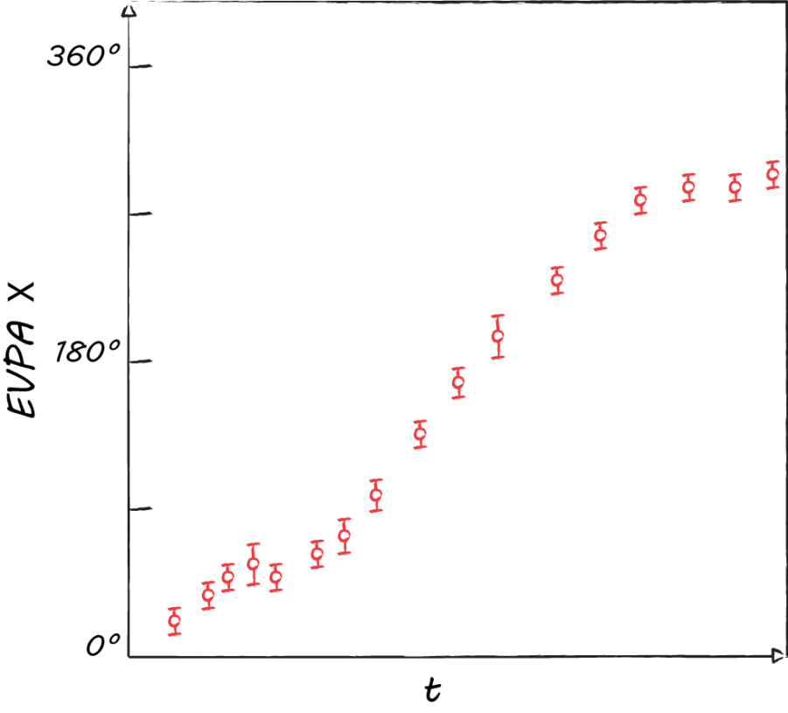
III. The 180° ambiguity
Assumption: smooth variation
Question:
Valid assumption?
Reliability?
Fig. 2a: Sketched EVPA curve
Fig. 2b: Sketched modified EVPA curve
4

Slide 7
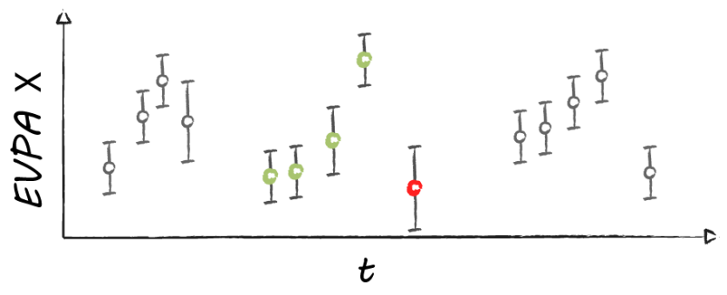
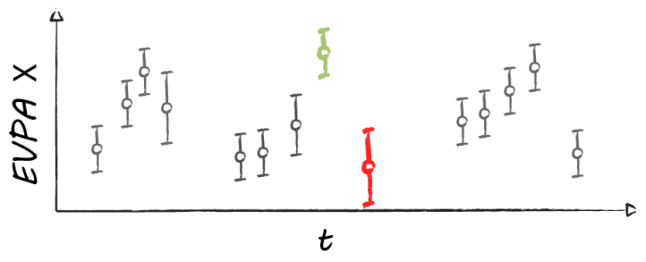
III. The 180° ambiguity
III.a Smoothing methods
Method 1:
Method 2:
$$Χ_{ref, i}=\left\langle \left[Χ_{i−1−N},Χ_{i−1}\right]\right\rangle$$
$$N=4$$
if $\left|Χ_{i}−Χ_{ref,i}\right|>90°$
$${ΔΧ}_{i}=\left|Χ_{i}−Χ_{i−1}\right|−\sqrt{σ^{2}\left(Χ_{i}\right)+σ^{2}\left(Χ_{i−1}\right)}$$
if ${ΔΧ}_{i}>90°$
$$Χ_{mod, i}=Χ_{i}±n∙180°$$
5

Slide 8
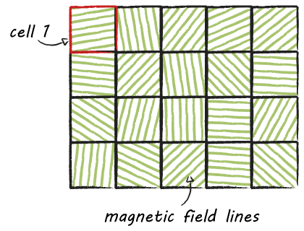
III. The 180° ambiguity
III.c Test 2: assumption of smoothness
Random walk model:
e.g. F. D‘Arcangelo et al., ApJ 2007
Total cells $N=54 ∝{\left\langle P\right\rangle }^{−2}$
Fig. 4a: Sketched cells of the random walk process
6
Notes:
Simulation parameters:
Total time interval: 200 d
Min. time step: 0.7 d
Max. time step: 21 d
Time power-law index: -2
Error levels: 4° (sigma, Gaussian random)

Slide 9
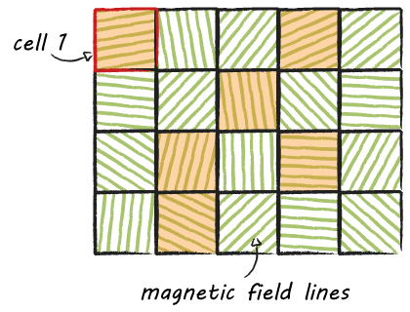
III. The 180° ambiguity
III.c Test 2: assumption of smoothness
Random walk model:
e.g. F. D‘Arcangelo et al., ApJ 2007
Total cells $N=54 ∝{\left\langle P\right\rangle }^{−2}$
Vary Cells $N_{var}=35 ∝\frac{σ\left(P\right)}{\left\langle P\right\rangle }$
Mean time step: $3 \text{d}$
Fig. 4b: Sketched cells of the random walk process
7
Notes:
Simulation parameters:
Total time interval: 200 d
Min. time step: 0.7 d
Max. time step: 21 d
Time power-law index: -2
Error levels: 4° (sigma, Gaussian random)

Slide 10
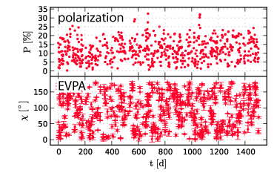
III. The 180° ambiguity
III.c Test 2: assumption of smoothness
Random walk model:
e.g. F. D‘Arcangelo et al., ApJ 2007
Total cells $N=54 ∝{\left\langle P\right\rangle }^{−2}$
Vary Cells $N_{var}=35 ∝\frac{σ\left(P\right)}{\left\langle P\right\rangle }$
Mean time step: $3 \text{d}$
Fig. 5a: Random EVPA variation
8
Notes:
Simulation parameters:
Total time interval: 200 d
Min. time step: 0.7 d
Max. time step: 21 d
Time power-law index: -2
Error levels: 4° (sigma, Gaussian random)

Slide 11
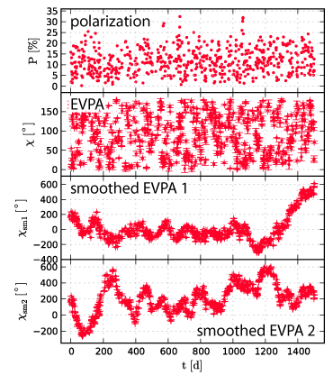
III. The 180° ambiguity
III.c Test 2: assumption of smoothness
1,000,000 simulations
EVPA amplitude $A_{χ}$: | Method 1: | Method 2:
$$A_{Χ}>180°:$$ | > 99.5 % | > 98.5 %
$$A_{Χ}>360°:$$ | 43 % | 43 %
$$A_{Χ}$$
Fig. 5b: Random EVPA variation, smoothed
9

Slide 12
III. The 180° ambiguity
III.c Test 2: assumption of smoothness
1,000,000 simulations
EVPA amplitude $A_{χ}$: | Method 1: | Method 2:
$$A_{Χ}>180°:$$ | > 99.5 % | > 98.5 %
$$A_{Χ}>360°:$$ | 43 % | 43 %
$χ_{sm1}=χ_{sm2}$: | 1 %
$${\left(\frac{ΔΧ}{Δt}\right)}_{i}=\frac{Χ_{i}−Χ_{i−1}}{t_{i}−t_{i−1}}$$
Fig. 5b: Random EVPA variation, smoothed
10

Slide 13
III. The 180° ambiguity
III.c Test 2: assumption of smoothness
1,000,000 simulations
EVPA amplitude $A_{χ}$: | Method 1: | Method 2:
$$A_{Χ}>180°:$$ | > 99.5 % | > 98.5 %
$$A_{Χ}>360°:$$ | 43 % | 43 %
$χ_{sm1}=χ_{sm2}$: | 1 %
$${\left(\frac{ΔΧ}{Δt}\right)}_{i}=\frac{Χ_{i}−Χ_{i−1}}{t_{i}−t_{i−1}}$$
Fig. 5c: Random EVPA variation, smoothed, p-t-p variation
11

Slide 14
III. The 180° ambiguity
III.c Test 2: assumption of smoothness
1,000,000 simulations
EVPA amplitude $A_{χ}$: | Method 1: | Method 2:
$$A_{Χ}>180°:$$ | > 99.5 % | > 98.5 %
$$A_{Χ}>360°:$$ | 43 % | 43 %
$χ_{sm1}=χ_{sm2}$: | 1 %
$$s=\left\langle \left|{\left(\frac{ΔΧ}{Δt}\right)}_{i}−m\right|\right\rangle \text{with} m=\left\langle {\left(\frac{ΔΧ}{Δt}\right)}_{i}\right\rangle$$
Fig. 5c: Random EVPA variation, smoothed, p-t-p variation
12

Slide 15
III. The 180° ambiguity
III.c Test 2: assumption of smoothness
1,000,000 simulations
EVPA amplitude $A_{χ}$: | Method 1: | Method 2:
$$A_{Χ}>180°:$$ | > 99.5 % | > 98.5 %
$$A_{Χ}>360°:$$ | 43 % | 43 %
Variation estimator $s$:
$s<6 °/\text{d}$: | 0 % | 0 %
$s<10 °/\text{d}$: | 0.1 % | 0.3 %
$s<20 °/\text{d}$: | 76 % | 98 %
$$\left\langle s\right\rangle =$$ | 18 °/d | 15 °/d
$χ_{sm1}=χ_{sm2}$: | 1 %
Fig. 5c: Random EVPA variation, smoothed, p-t-p variation
13

Slide 16
↓ 3C 279 observation (optical) ↓
↓ Random walk simulation ↓

Slide 17
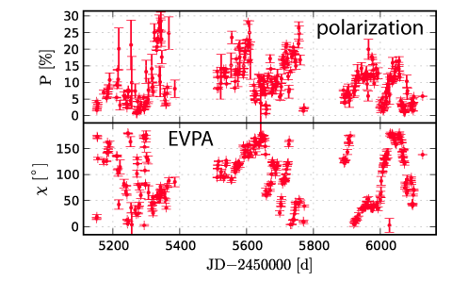
↓ 3C 279 observation (optical) ↓
↓ Random walk simulation ↓

Slide 18
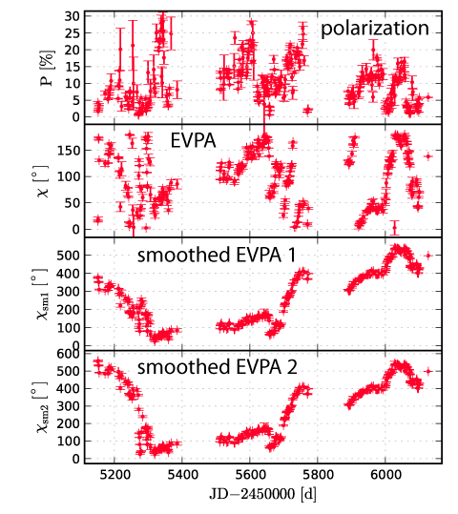
↓ 3C 279 observation (optical) ↓
↓ Random walk simulation ↓

Slide 19
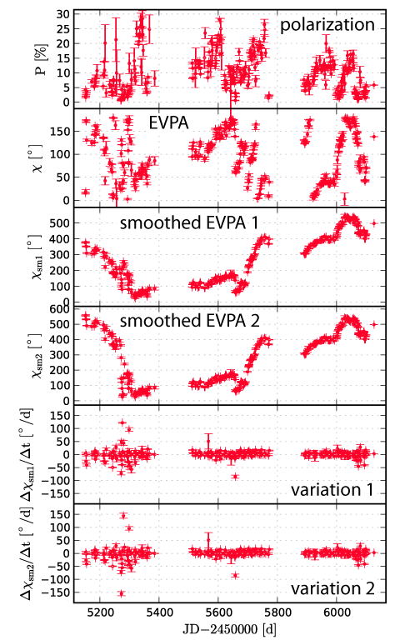
↓ 3C 279 observation (optical) ↓
↓ Random walk simulation ↓

Slide 20
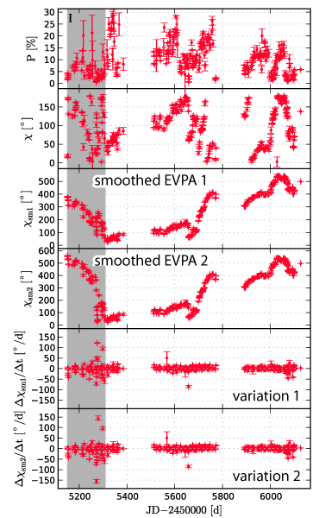
IV. Polarization of 3C 279
IV.a EVPA smoothness
Epoch | EVPA | $s$ [°/d] | $$χ_{sm1}=χ_{sm2}$$
I | ↓ | 32(5) | no
Fig. 6a: 3C 279 optical polarization
15

Slide 21
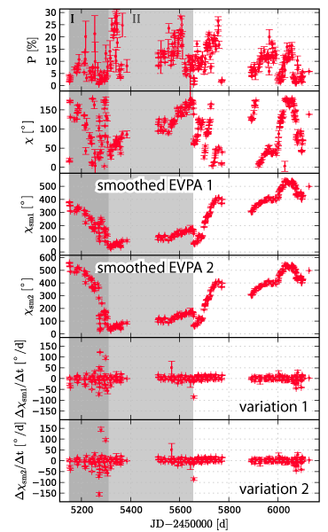
IV. Polarization of 3C 279
IV.a EVPA smoothness
Epoch | EVPA | $s$ [°/d] | $$χ_{sm1}=χ_{sm2}$$
I | ↓ | 32(5) | no
II | ↑
Fig. 6b: 3C 279 optical polarization
15

Slide 22
IV. Polarization of 3C 279
IV.a EVPA smoothness
Epoch | EVPA | $s$ [°/d] | $$χ_{sm1}=χ_{sm2}$$
I | ↓ | 32(5) | no
II | ↑
III | ↓
Fig. 6c: 3C 279 optical polarization
15

Slide 23
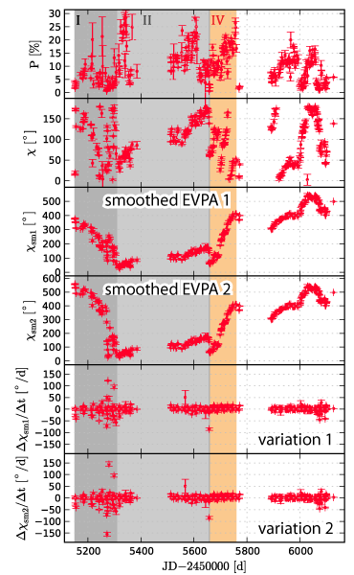
IV. Polarization of 3C 279
IV.a EVPA smoothness
Epoch | EVPA | $s$ [°/d] | $$χ_{sm1}=χ_{sm2}$$
I | ↓ | 32(5) | no
II | ↑
III | ↓
IV | ↑
Fig. 6d: 3C 279 optical polarization
15

Slide 24
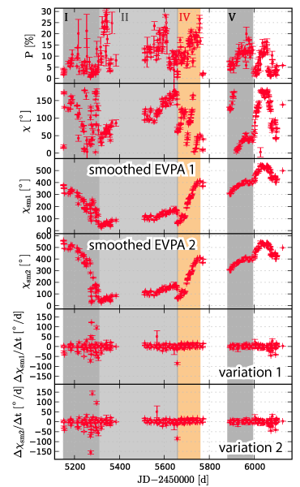
IV. Polarization of 3C 279
IV.a EVPA smoothness
Epoch | EVPA | $s$ [°/d] | $$χ_{sm1}=χ_{sm2}$$
I | ↓ | 32(5) | no
II | ↑
III | ↓
IV | ↑
V | ↑
Fig. 6e: 3C 279 optical polarization
15

Slide 25
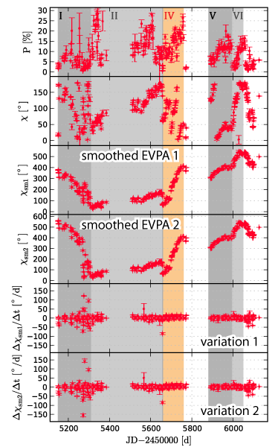
IV. Polarization of 3C 279
IV.a EVPA smoothness
Epoch | EVPA | $s$ [°/d] | $$χ_{sm1}=χ_{sm2}$$
I | ↓ | 32(5) | no
II | ↑ | 2-6 | yes
III | ↓
IV | ↑
V | ↑
VI | ↑
Fig. 6f: 3C 279 optical polarization
15

Slide 26
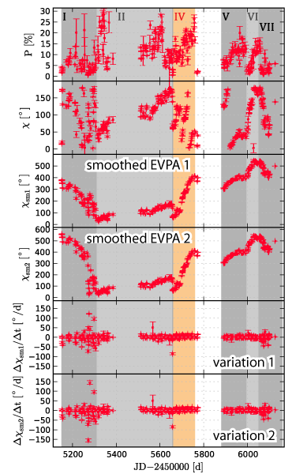
IV. Polarization of 3C 279
IV.a EVPA smoothness
Epoch | EVPA | $s$ [°/d] | $$χ_{sm1}=χ_{sm2}$$
I | ↓ | 32(5) | no
II | ↑ | 2-6 | yes
III | ↓
IV | ↑
V | ↑
VI | ↑
VII | ↓ | 10.5(8) | yes
Fig. 6g: 3C 279 optical polarization
15

Slide 27
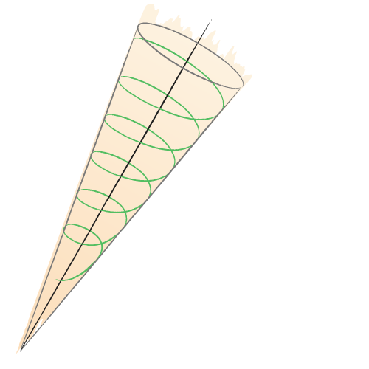
IV. Polarization of 3C 279
IV.b Interpretation
Fig. 7a: Sketched jet model
Fig. 8: 3C 279 LCs (V+R) and opt. pol.
16

Slide 28
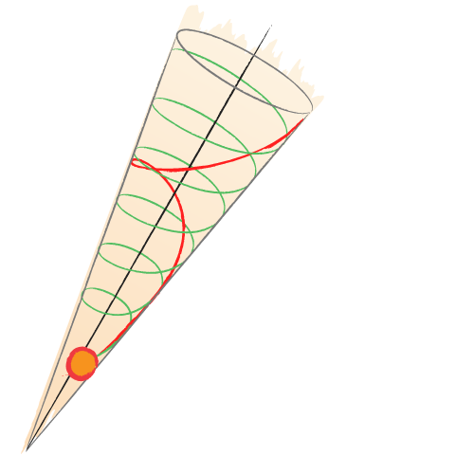
IV. Polarization of 3C 279
IV.b Interpretation
Fig. 7b: Sketched jet model
Fig. 8: 3C 279 LCs (V+R) and opt. pol.
17

Slide 29
IV. Polarization of 3C 279
IV.c Gamma-ray-flaring
Event time:
$$Δt≈110 \text{d}$$
Assuming Lorentz factor:
$$Γ=15$$
Traveling distance:
$$Δr \sim 5∙{10}^{5} r_{S}$$
Fig. 9: 3C 279 γ-ray light curve, optical light curves and polarization
18

Slide 30
IV. Polarization of 3C 279
IV.d mm polarization
Fig. 10: 3C 279 mm and optical EVPA
19

Slide 31
V. Conclusions
Method:
Distinguish stochastic from deterministic EVPA variation.
3C 279 :
Possibly stochastic EVPA variation during low-state
Deterministic EVPA variation during flaring state
EVPA rotation $>360°$
Two-directional
→ no globally bending jet
→ helical motion in a
helical magnetic field
20

Slide 32
Special thanks to the QMP collaborators:
T. Savolainen (PI), S.G. Jorstad, F. Schinzel, K.V. Sokolovsky, I. Agudo, M. Aller, L. Berdnikov, V. Chavushyan, L. Fuhrmann, M. Gurwell, R. Itoh, J. Heidt, Y.Y. Kovalev, T. Krajci, O. Kurtanidze, A. Lähteenmäki, V.M. Larionov , J. León-Tavares, A.P. Marscher, K. Nilson, the AAVSO, the Yale SMARTS project and all the observers.
Acknowledgements:
SK was supported for this research through a stipend from the International Max Planck Research School (IMPRS) for Astronomy and Astrophysics at the Max Planck Institute for Radio Astronomy in cooperation with the Universities of Bonn and Cologne.
Data from the Steward Observatory spectropolarimetric monitoring project were used. This program is supported by Fermi Guest Investigator grants NNX08AW56G, NNX09AU10G, and NNX12AO93G.
We acknowledge with thanks the variable star observations from the AAVSO International Database contributed by observers worldwide and used in this research.

