Slide 1
Search for New Stellar Sources
of Gamma-Rays
Josep Martí
Escuela Politécnica Superior de Jaén
Universidad de Jaén (UJA)
Spain

Slide 2
Search for New Stellar Sources
of Gamma-Rays
Josep Martí
Escuela Politécnica Superior de Jaén
Universidad de Jaén (UJA)
Spain
different aspects of this work in collaboration with:
Pedro L. Luque-Escamilla, A. J. Muñoz-Arjonilla,
Sánchez-Ayaso, E., & Sánchez-Sutil, J. R. (UJA)
Paredes, J. M., & Munar-Adrover, P. (UB)
Combi, J. A., Romero, G. E., Del Valle, M. V. (IAR, UNLP)

Slide 3
Outline of the talk
Introduction.
Search for new gamma-ray binaries using archival data.
Search for new kinds of gamma-ray sources in star forming regions: the ρ-Ophiuchi and Monoceros R2 cases.
Conclusions and future perspectives.

Slide 4
1. Introduction

Slide 5
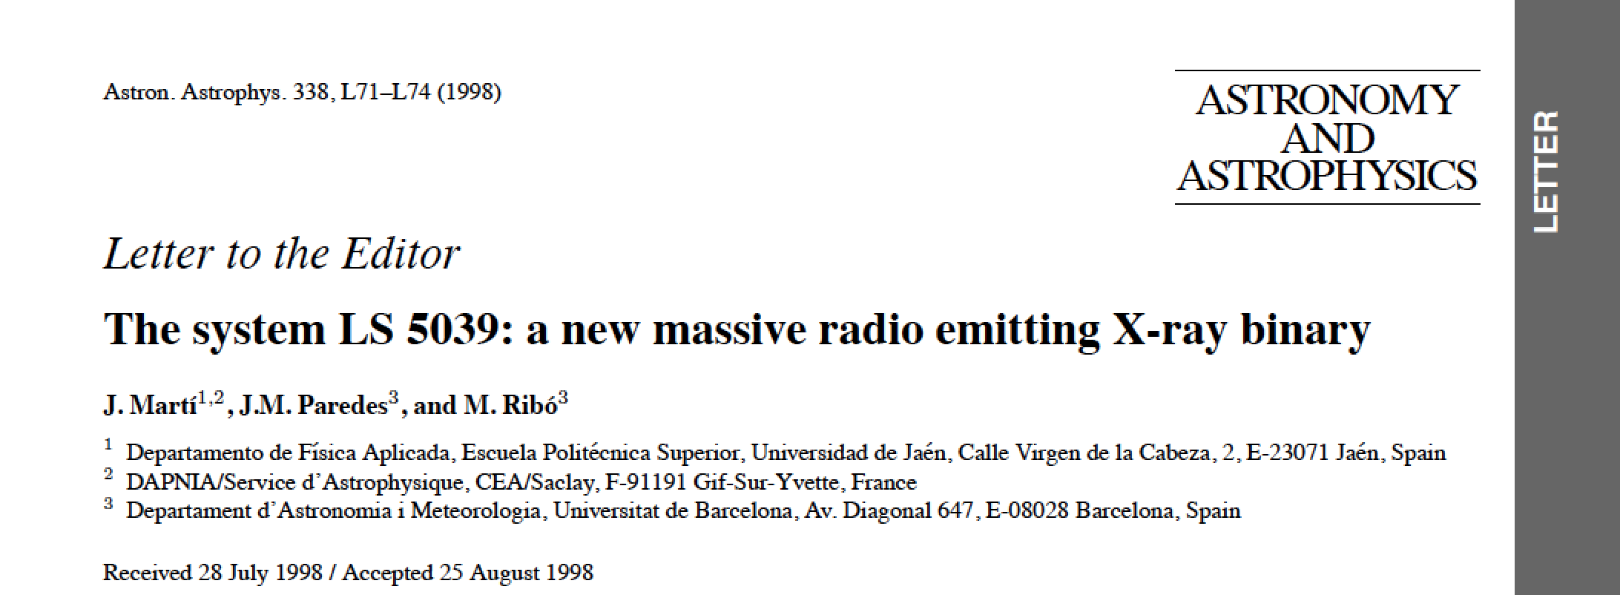
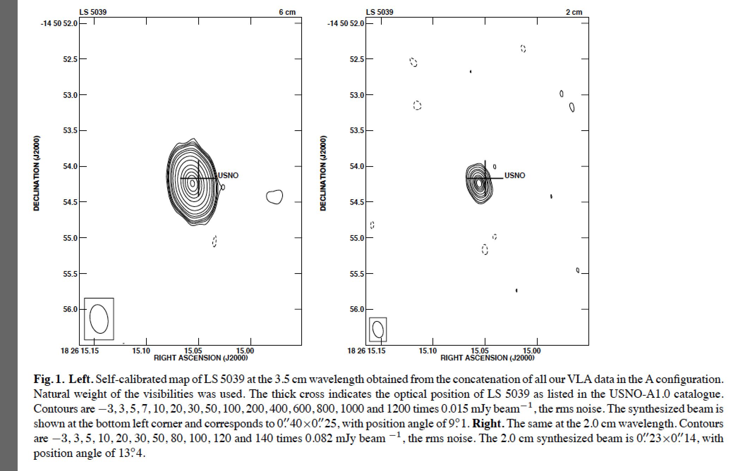
The non-thermal radio counterpart of LS 5039 was first noticed after inspection of archival survey data (NVSS).

Slide 6
Currently known gamma-ray binaries include:
LS I +61303, PSR B1259-63, LS 5039, HESS J0632+057, 1FGL J1018.6-5856, AGL J2241+4454 + …. ?
In addition, microquasar systems detected at gamma-rays include:
Cygnus X-3, Cygnus X-1 + …. ?

Slide 7
Interestingly, some of the currently known gamma-ray binaries and new additions to this class correspond to objects already present in ancient catalogues of peculiar stars. For example:
Catalogue of Luminous Stars in the Northern Milky Way (Hardorp + 1959-1965): LS I+61303, HESS J0632+057 (LS VI+05 11), …
Catalogue of Luminous Stars in the Southern Milky Way (Stephenson & Sanduleak 1971): LS 5039, PSR B1259-63 (LS 2883) …
Catalogue of Early-Type Stars Whose Spectra Have Shown Emission Lines (Wackerling 1970): HESS J0632+057 (MWC 656), AGL J2241+4454 (MWC 656) …
Are there any more similar systems waiting for discovery in the archives?
Systematic searches could still provide interesting results here in parallel to serendipitous discoveries.

Slide 8
Cross-Id techniques have been historically developed in our group (e.g.):

Slide 9
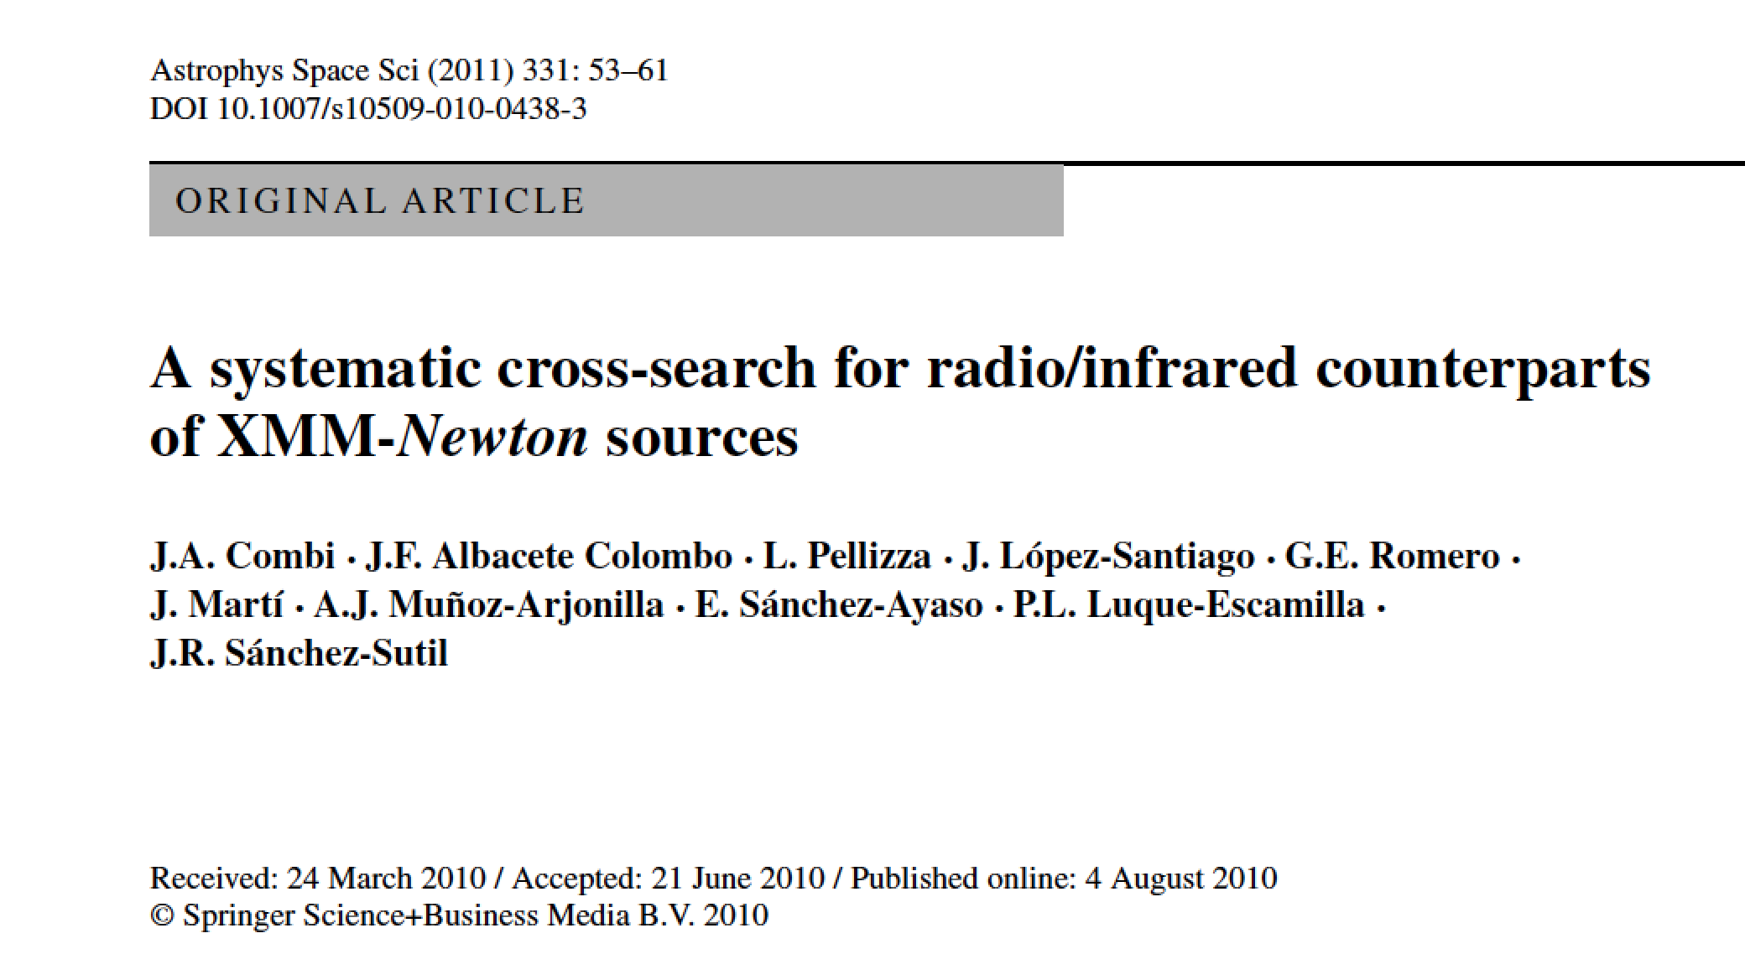
Cross-Id techniques have been historically developed in our group (e.g.):

Slide 10
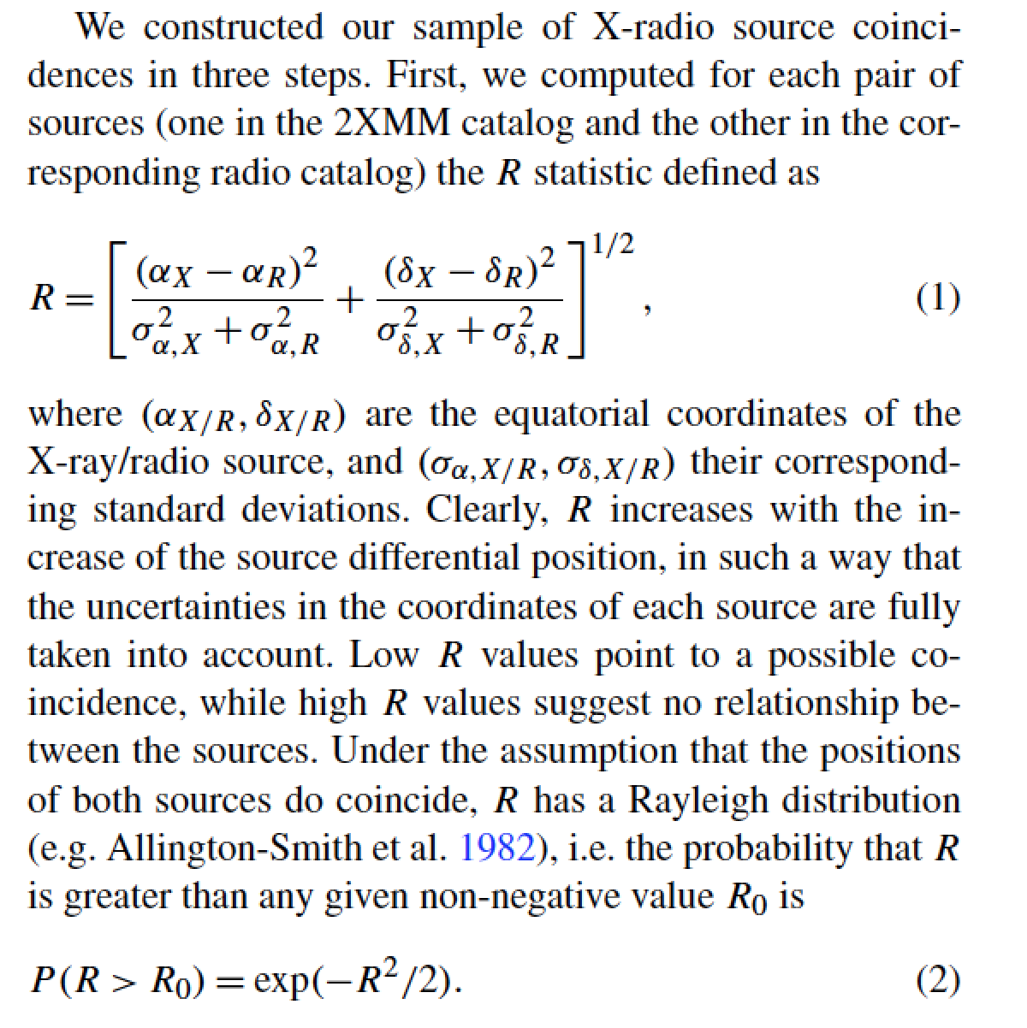
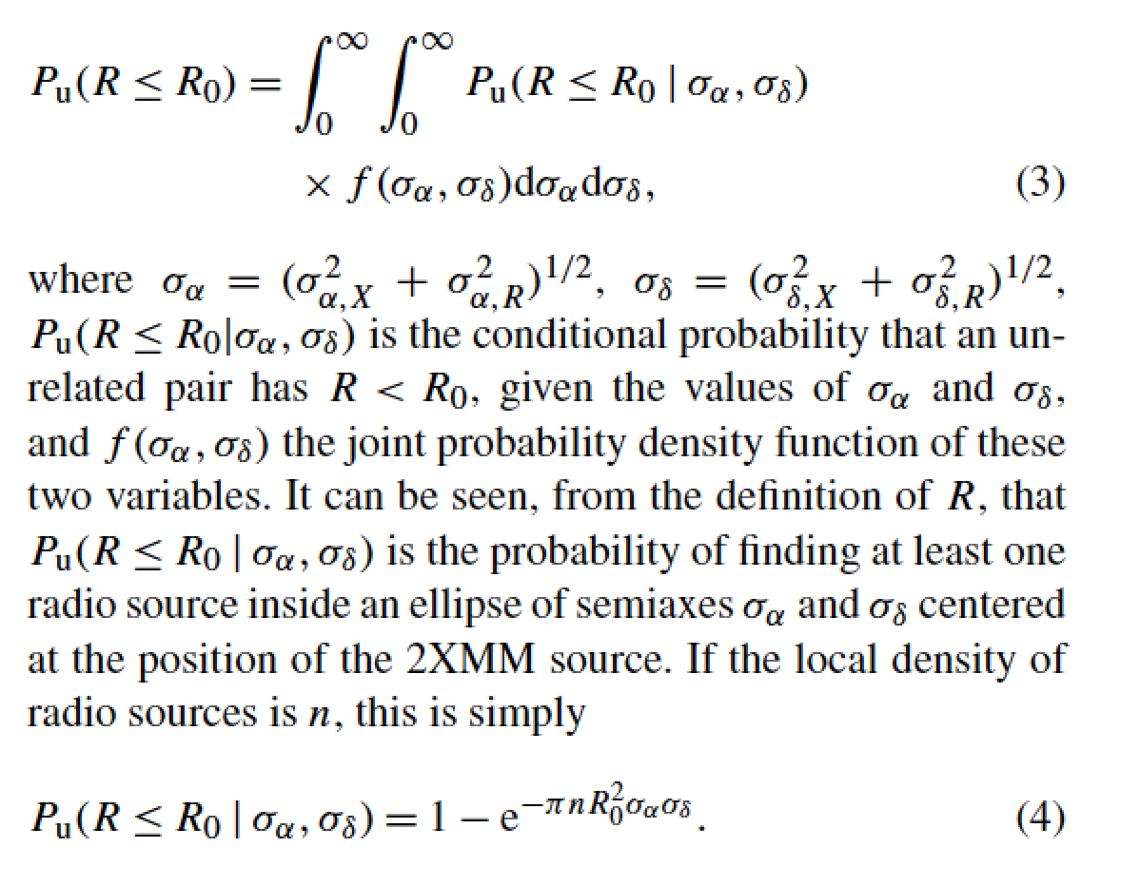
First sample of possible coincidences
Accounting for unrelated coincidences
Combi et al. 2011

Slide 11
2. Search for new gamma-ray binaries using archival data

Slide 12
The ideal gamma-ray binary/microquasar candidate would be an early-type star found to be consistent in position with:
A gamma-ray source (unassociated)
An X-ray source.
A non-thermal radio source.
With correlated multi-λ variability.
In practice not all requirements are easily fullfilled. The cross-Id process is still going one. Some interesting objects found so far are listed in the next Table.

Slide 13
Gamma-ray source | Candidate γ-ray binary | Remarks
1FGL J2056.7+4938/ 2FGLJ2056.7+4939 | LS III +49 13 | Star already proposed as possible microquasar by Paredes et al. (2002); Haakonsen et. (2009) suggest 47% chance coincidence with ROSAT source; Fermi-LAT source could be an AGN.
1FGL J0608.1-0630c/2FGLJ0607.5-0618c | LS IV -06 1 | Unassociated Fermi-LAT source; Star in nebula; Possible NVSS radio counterpart; no X-ray detection.
1FGL J1823.2-1336c/2FGLJ1823.1-1338c | LS 4995 | Unassociated Fermi-LAT source; candidate star is an early-type supergiant; no X-ray nor radio detection in archives.
1FGL J0220.0+6257/ 2FGLJ0221.4+6257c | VES 737 | Fermi-LAT could be associated with SNR but this is not clear; VES 737 is an emission line star with a possible X-ray detection by EINSTEIN.

Slide 14
Gamma-ray source | Candidate γ-ray binary | Remarks
1FGL J2056.7+4938/ 2FGLJ2056.7+4939 | LS III +49 13 | Star already proposed as possible microquasar by Paredes et al. (2002); Haakonsen et. (2009) suggest 47% chance coincidence with ROSAT source; Fermi-LAT source could be an AGN.
1FGL J0608.1-0630c/2FGLJ0607.5-0618c | LS IV -06 1 | Unassociated Fermi-LAT source; Star in nebula; Possible NVSS radio counterpart; no X-ray detection.
1FGL J1823.2-1336c/2FGLJ1823.1-1338c | LS 4995 | Unassociated Fermi-LAT source; candidate star is an early-type supergiant; no X-ray nor radio detection in archives.
1FGL J0220.0+6257/ 2FGLJ0221.4+6257c | VES 737 | Fermi-LAT could be associated with SNR but this is not clear; VES 737 is an emission line star with a possible X-ray detection by EINSTEIN.

Slide 15
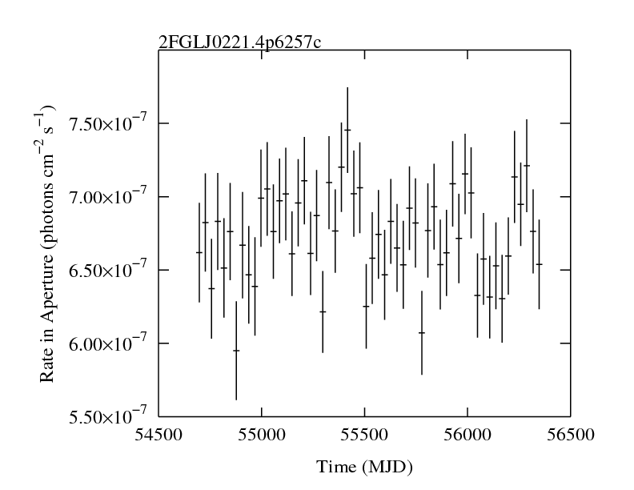
http://fermi.gsfc.nasa.gov

Slide 16
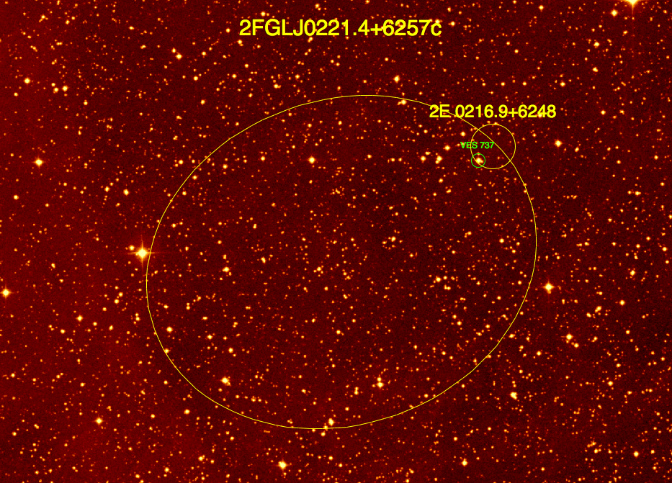
Optical (R-band)
VES 737, a B-type star consistent with both an HEAO 2 X-ray source and a Fermi-LAT detection

Slide 17
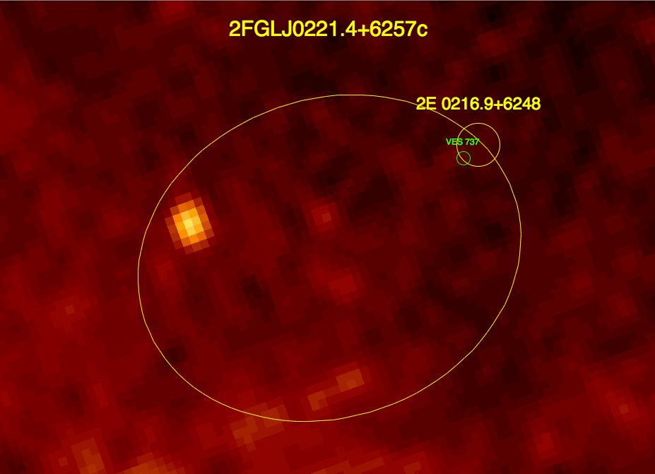
NVSS (20 cm)
VES 737, a B-type star consistent with both an HEAO 2 X-ray source and a Fermi-LAT detection

Slide 18
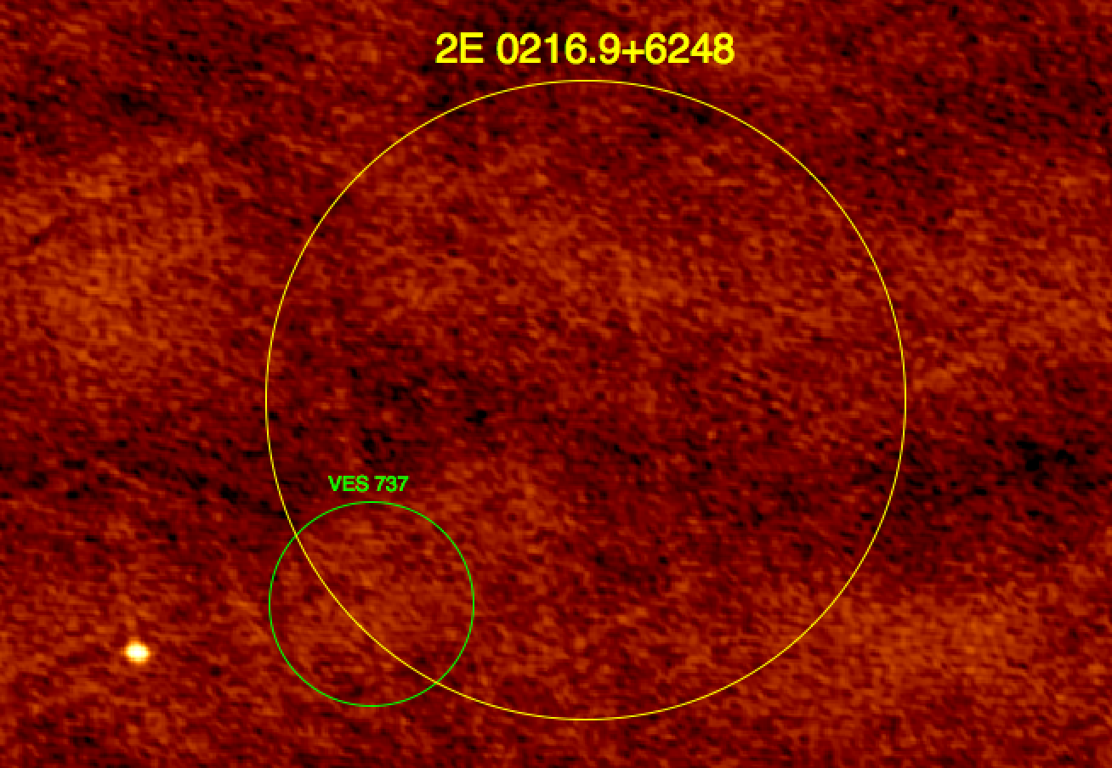
Jansky EVLA observations of the 2E 0216.9+6248/VES 737 field of view,
carried out in 2011 at the 20 cm wavelength. No radio counterpart detected (so far).

Slide 19
3. Search for new kinds of gamma-ray sources in star forming regions

Slide 20
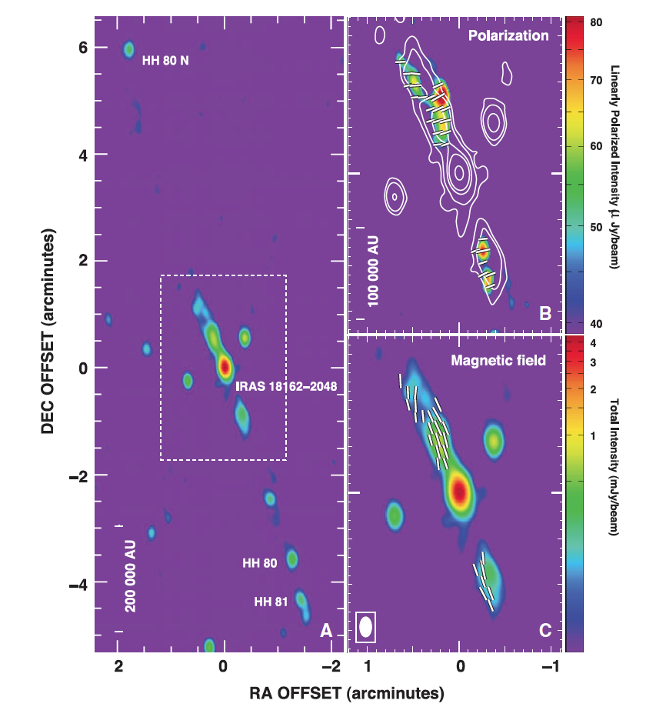
Evidence of relativistic particles in stellar jets from massive protostars have been reported (e.g. HH 80-81, Carrasco-González et al. 2010, Science, 330, 1209).

Slide 21
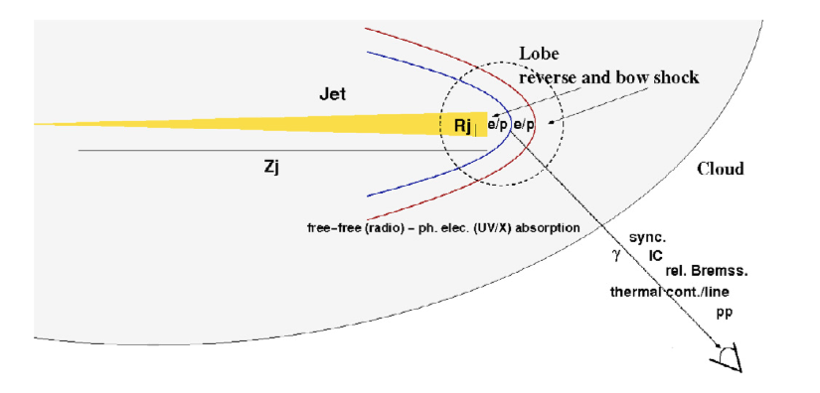
Bipolar outflows of massive protostars also produce strong shocks that have been proposed as acceleration sites of gamma-ray emitting particles (Bosch-Ramon et al. 2010, A&A, 511, A8).

Slide 22
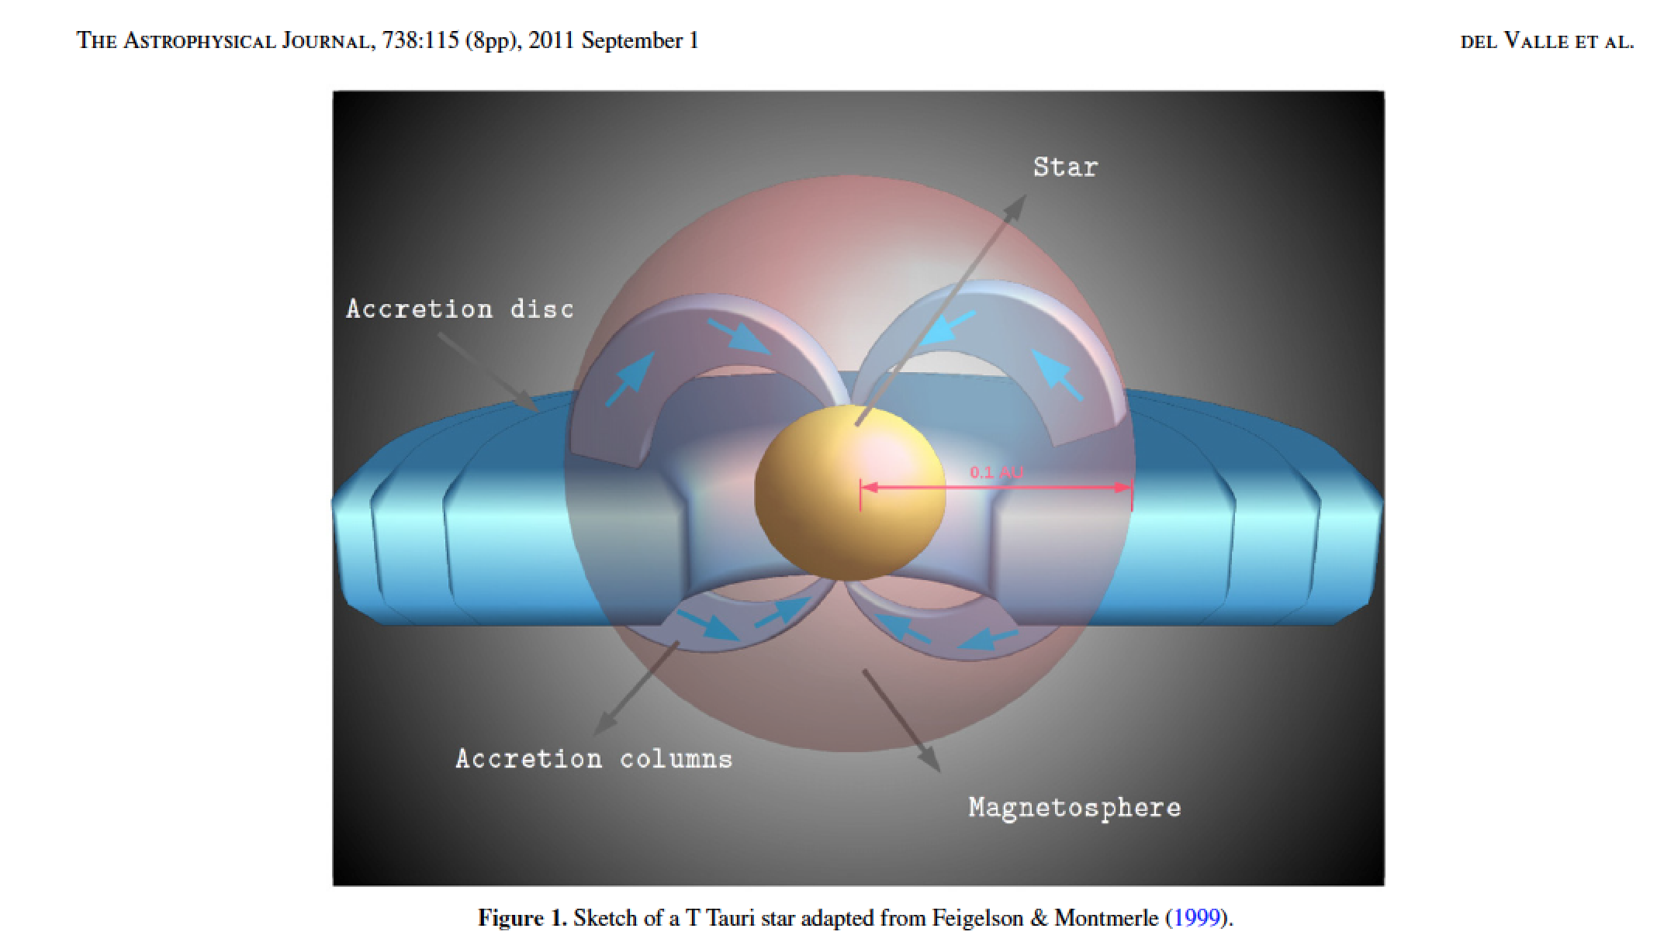
Del Valle et al. (2011)

Slide 23
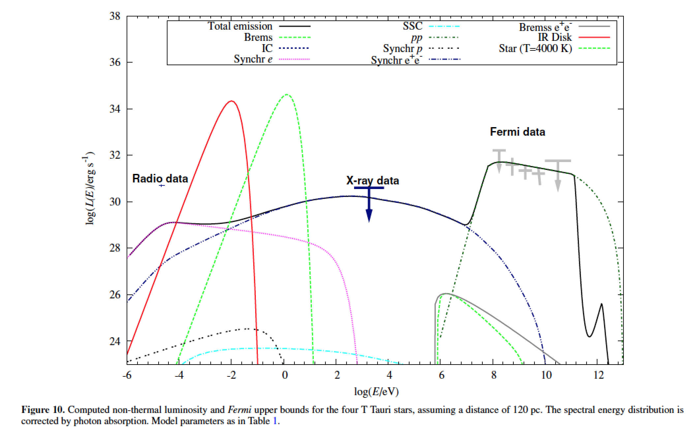
ρ-Ophiuchi
Del Valle et al. (2011)

Slide 24
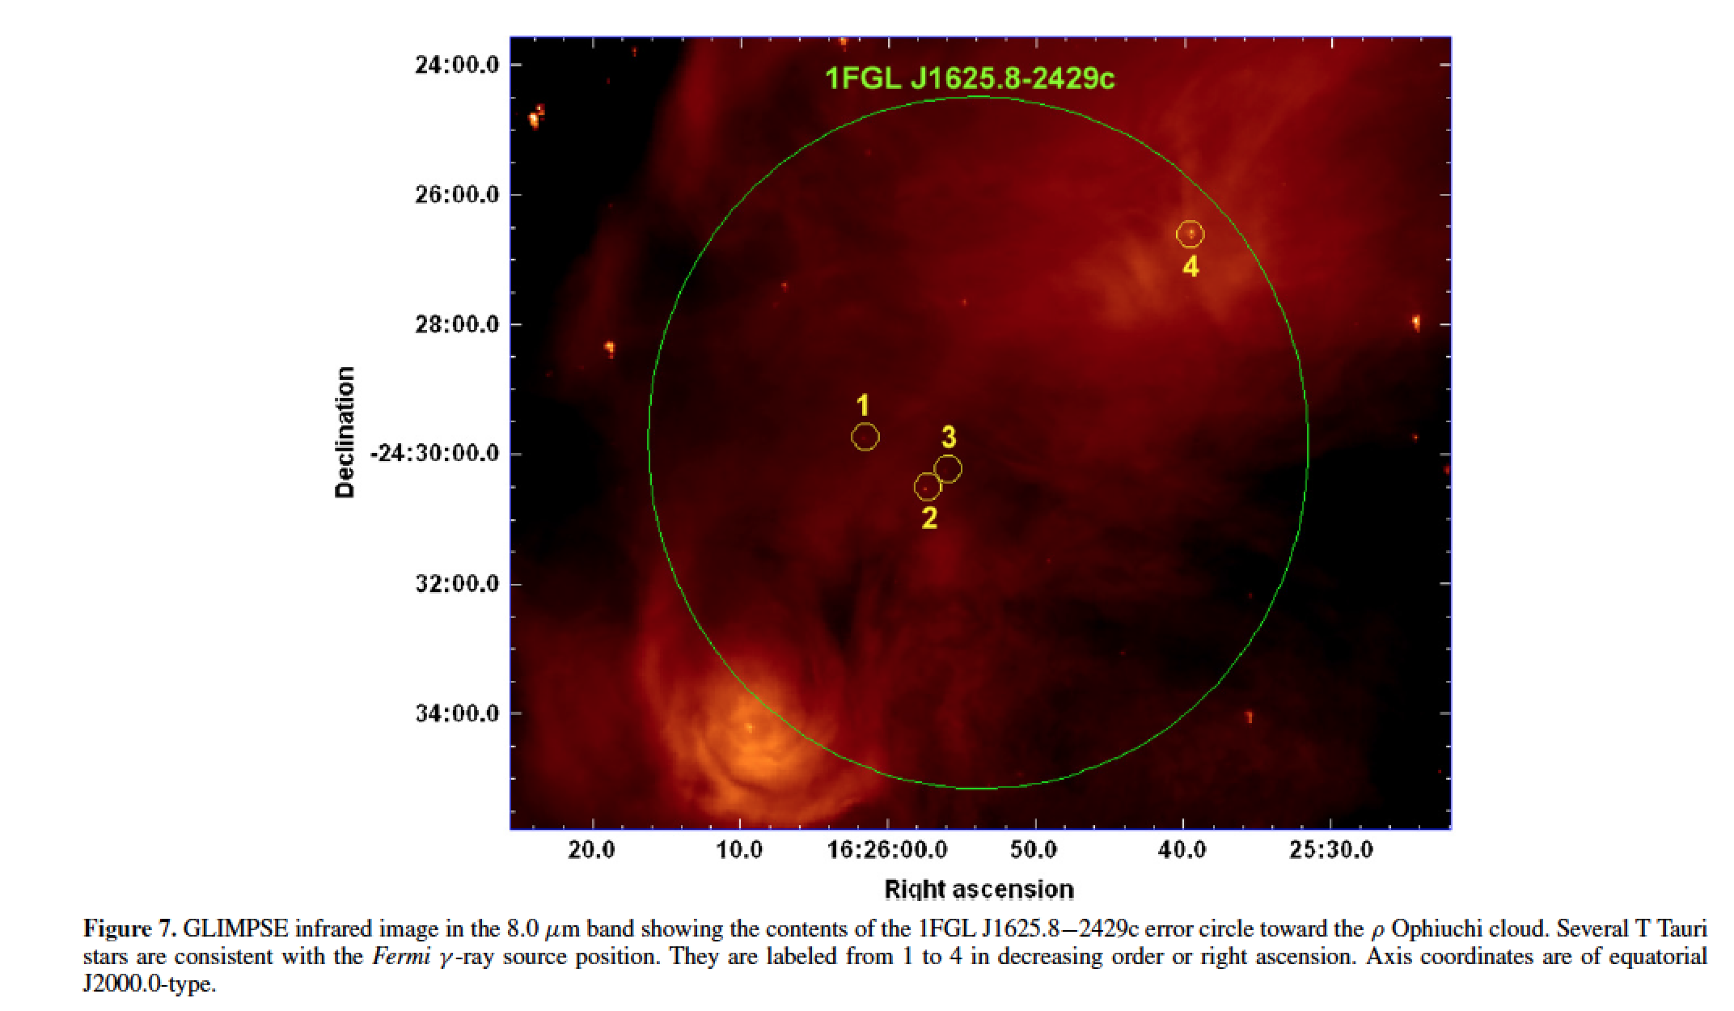
ρ-Ophiuchi
Del Valle et al. (2011)

Slide 25
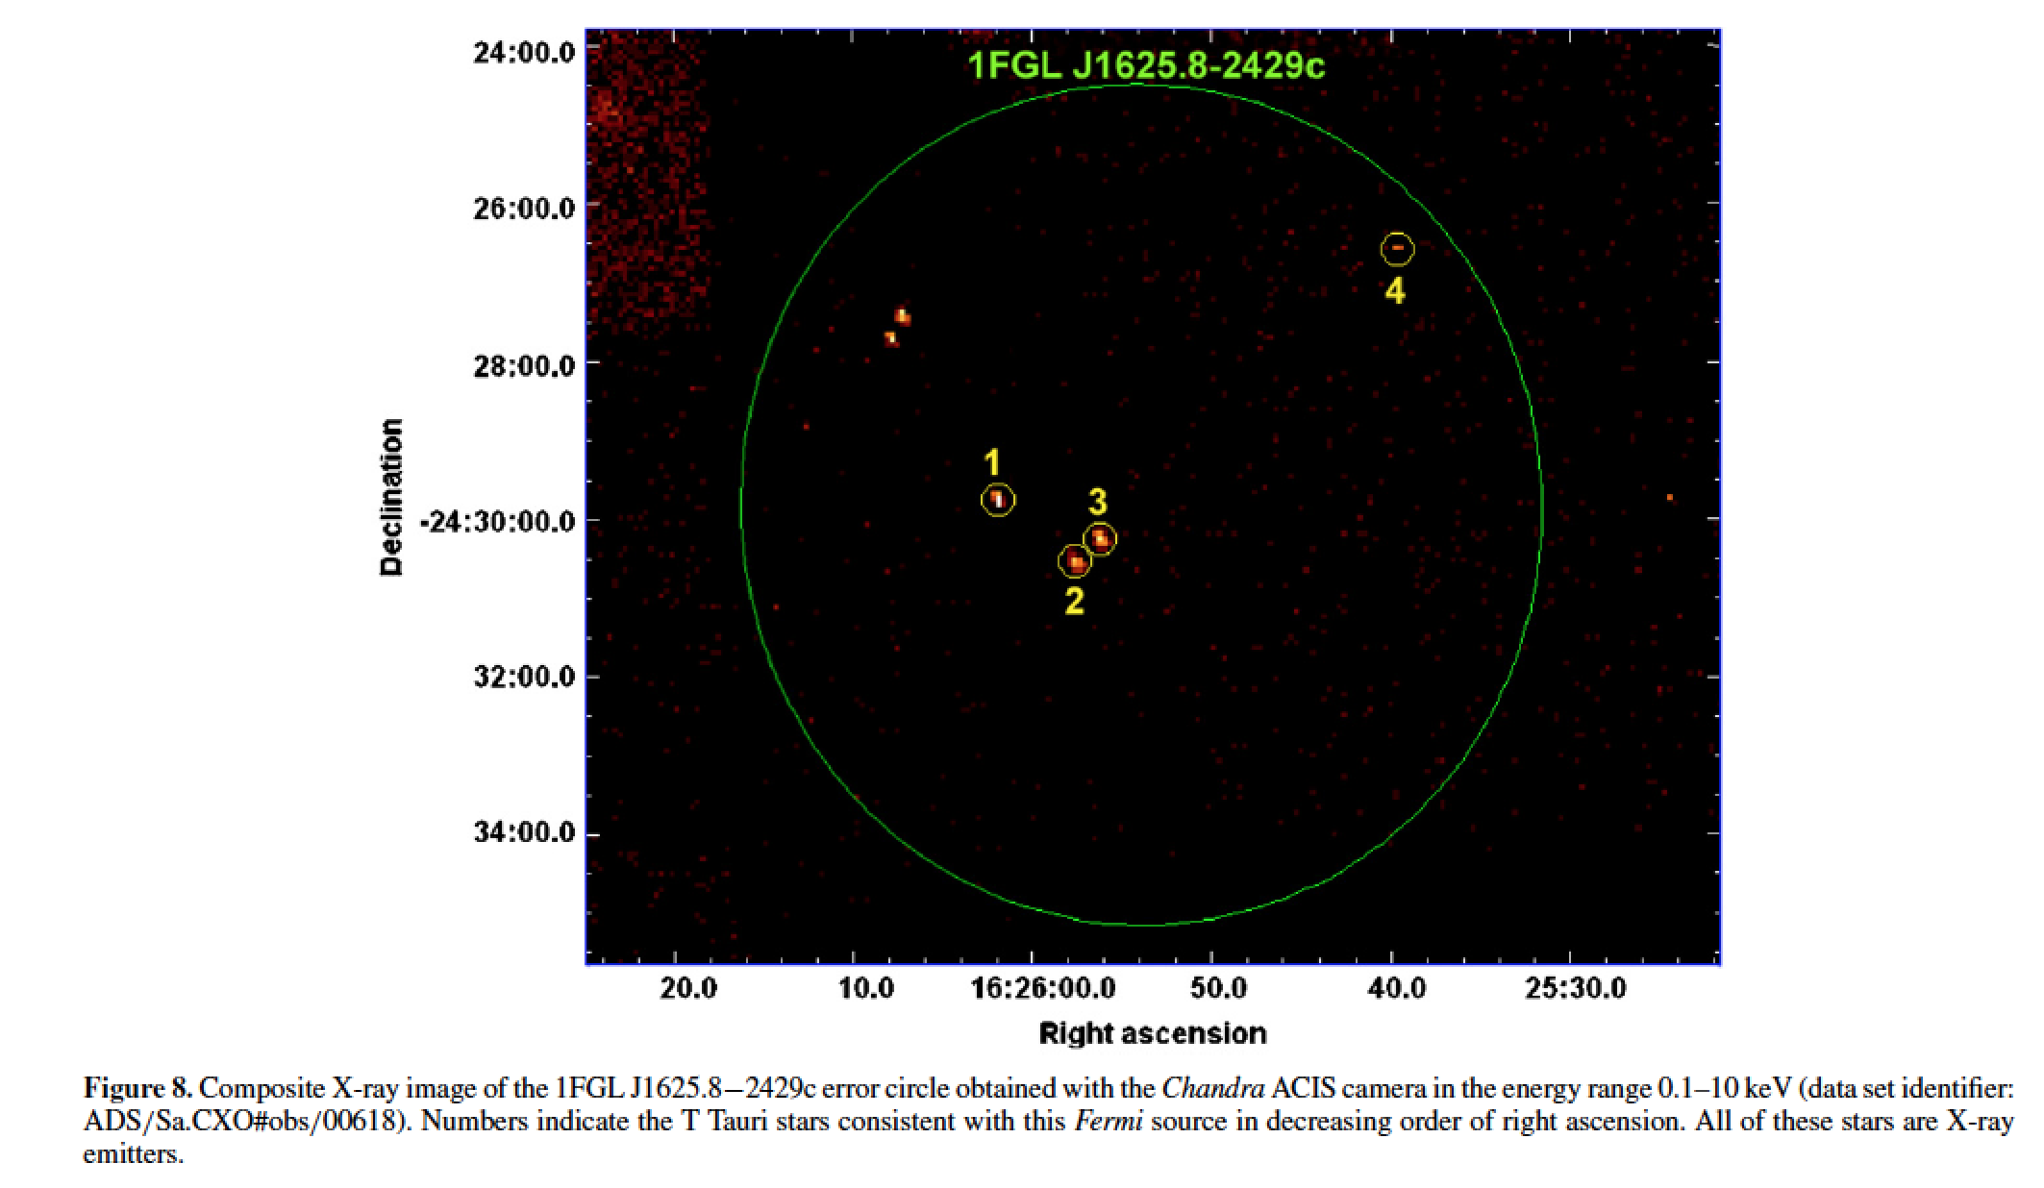
ρ-Ophiuchi
Del Valle et al. (2011)

Slide 26
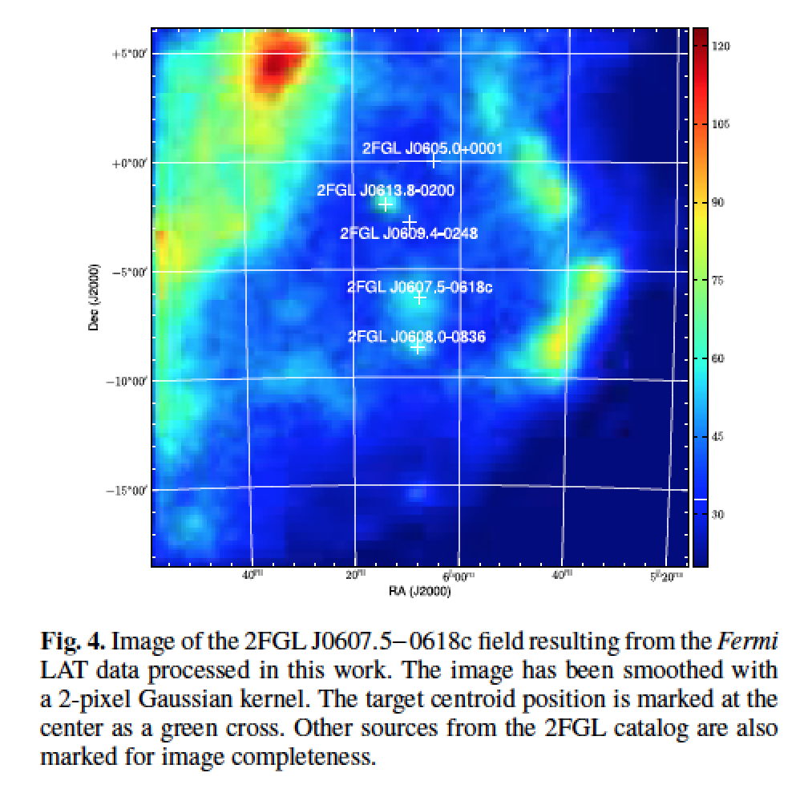
Monoceros R2

Slide 27
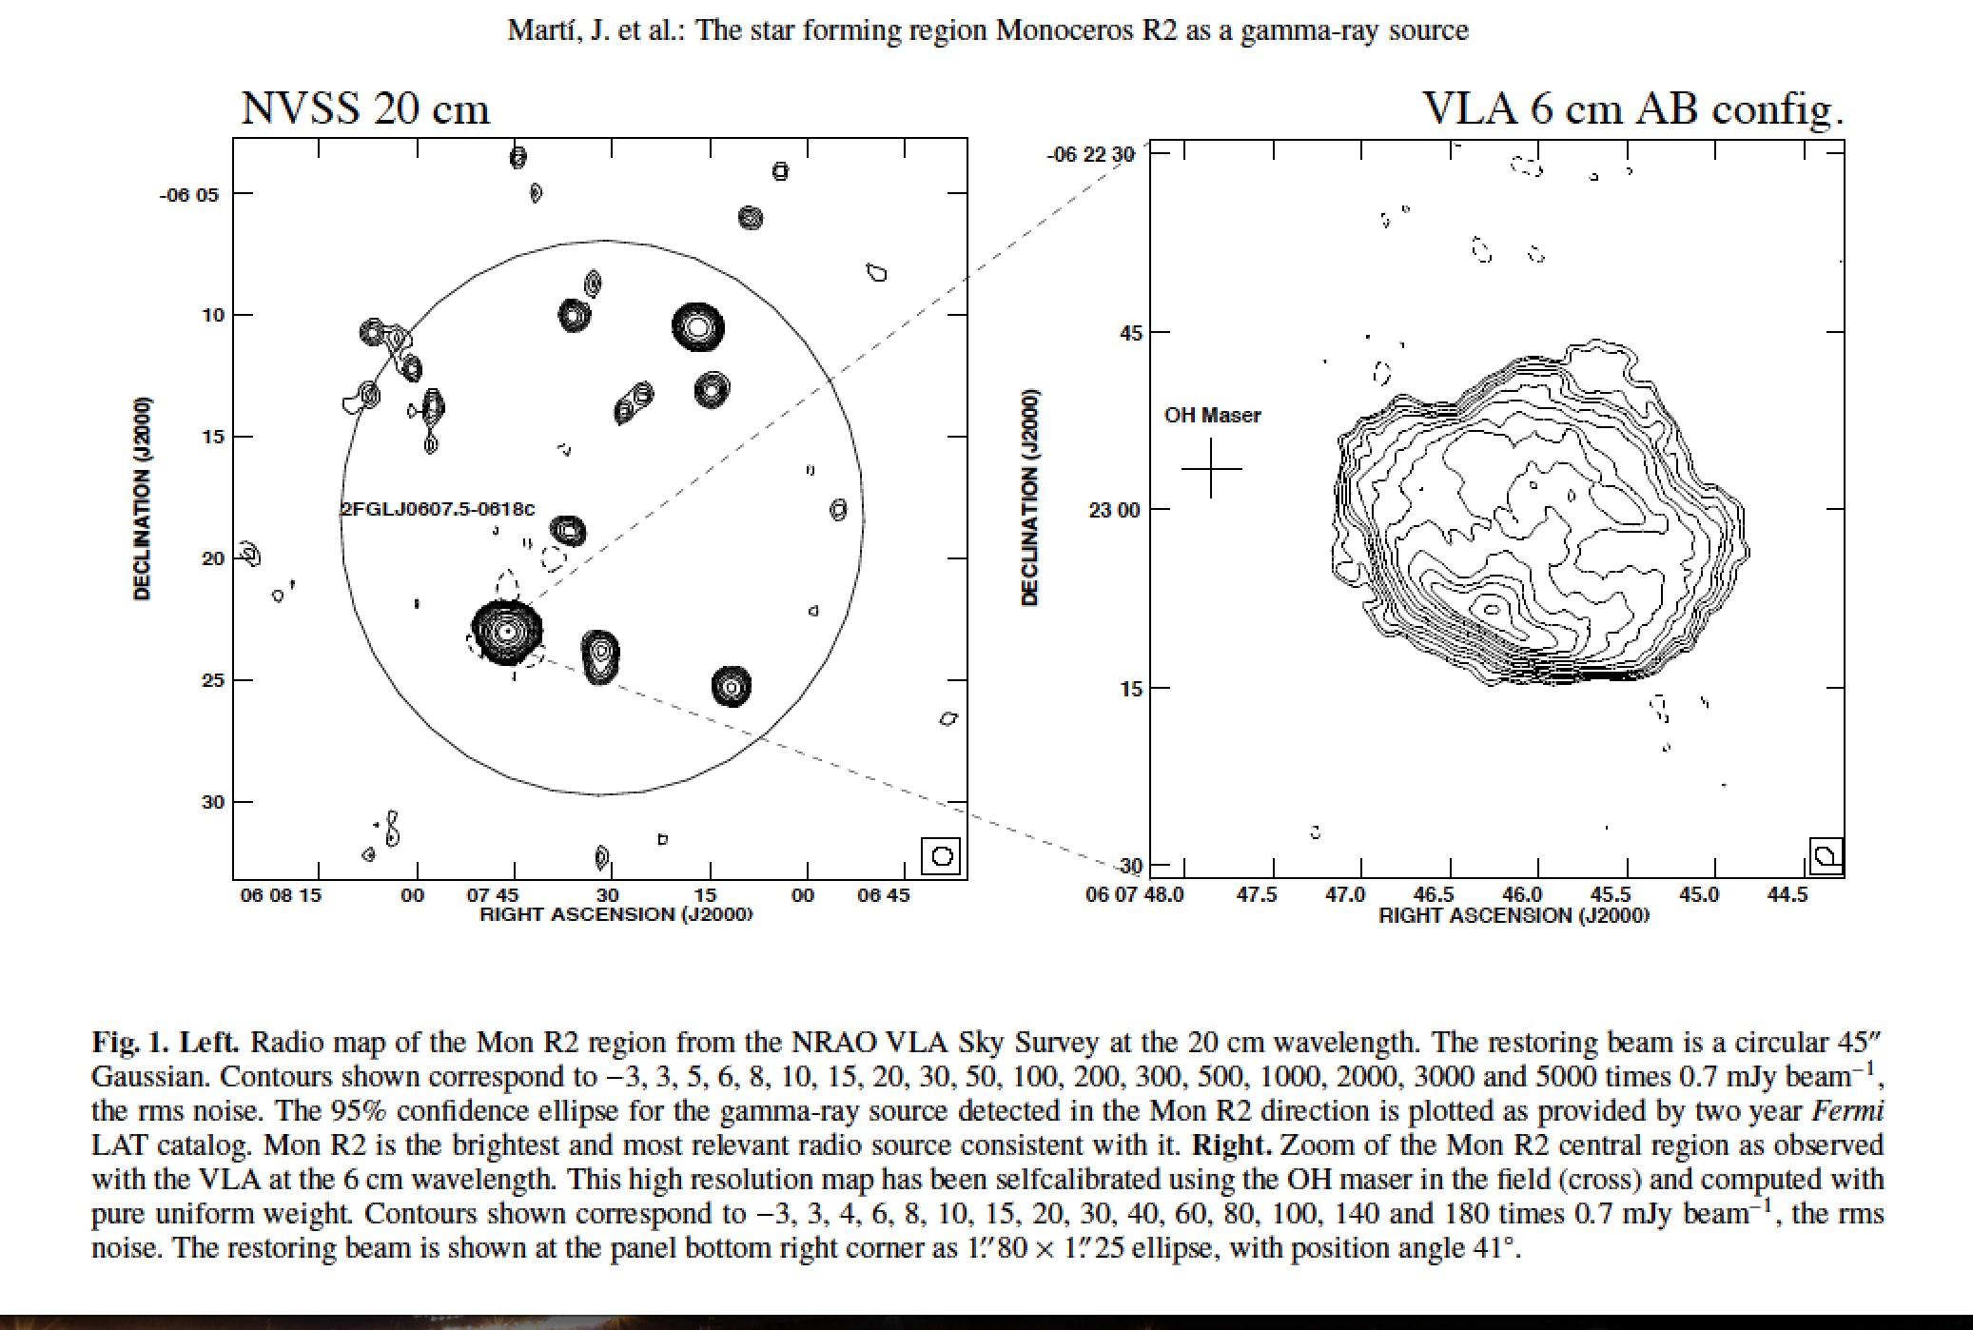
Monoceros R2

Slide 28
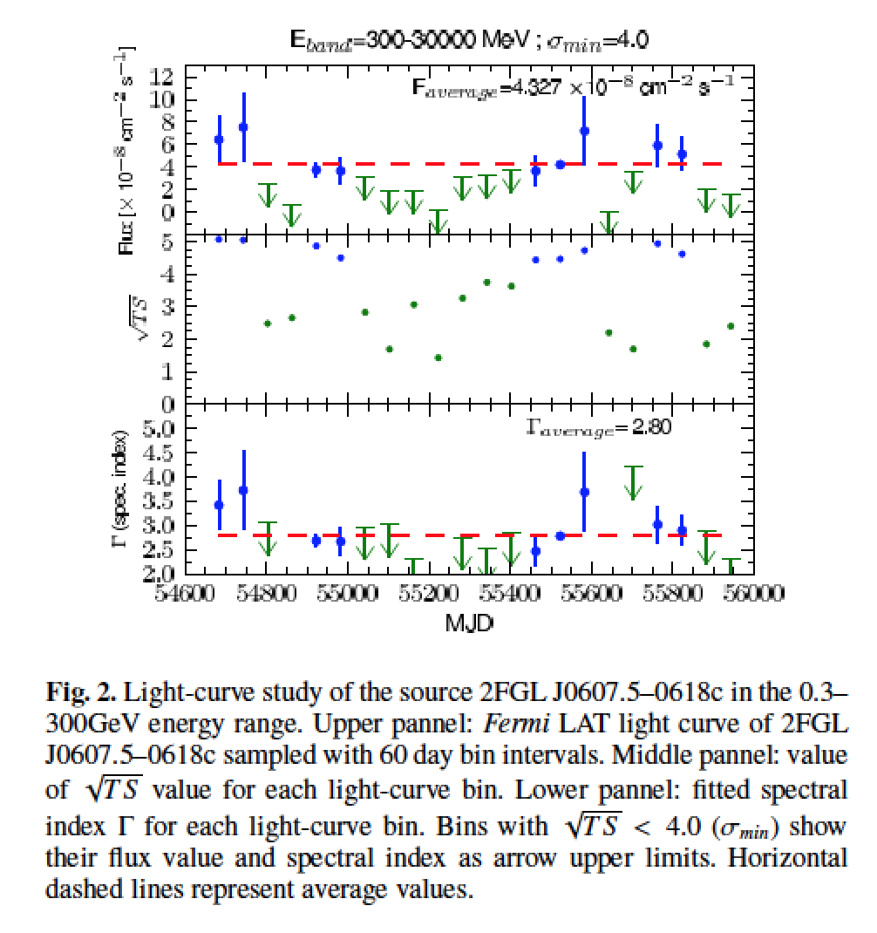

Slide 29
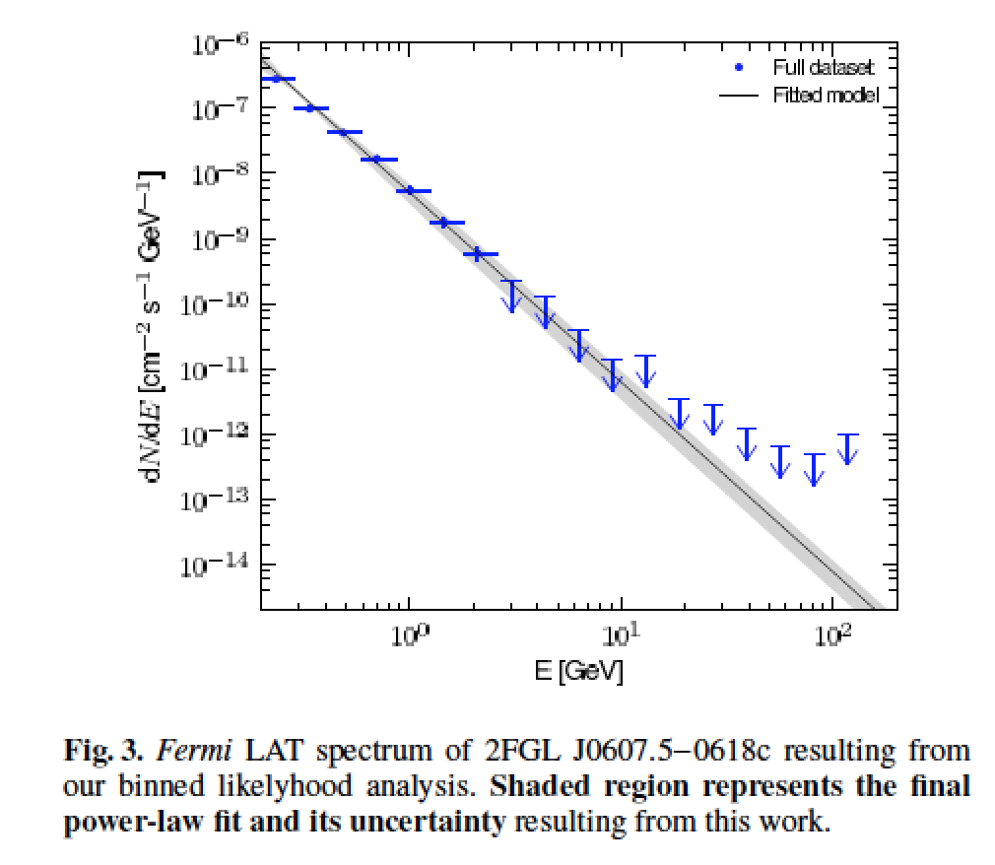

Slide 30
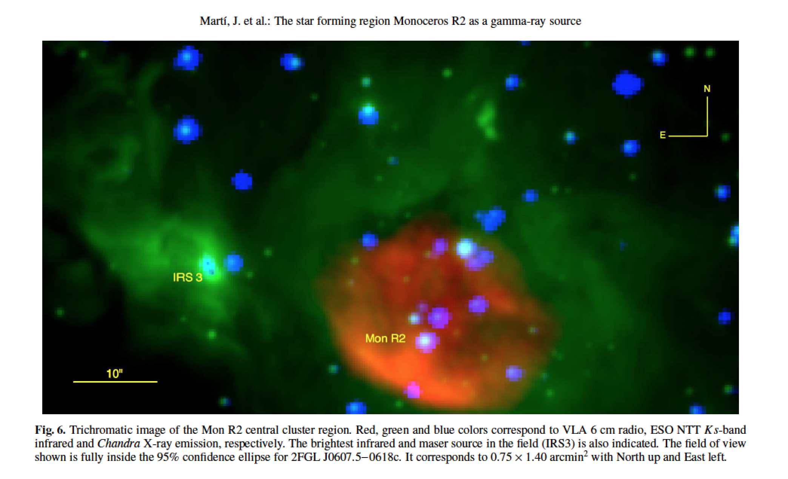
Monoceros R2

Slide 31
4. Conclusions and future perspectives
Old catalogs of luminous/peculiar stars could still hide very relevant sources for high-energy astrophysics.
When combined with modern surveys, cross-Id work has revealed a few luminous stars worth to follow-up as possible gamma-ray binary candidates.
New kinds of stellar gamma-ray sources are likely to exist (and be detectable) in nearby star-forming regions (e.g. ρ-Ophiuchi, Monoceros R2).
Fermi-LAT data accumulated over the years will play a major role to test the proposed associations.

Slide 32
Thank you!

