Slide 1
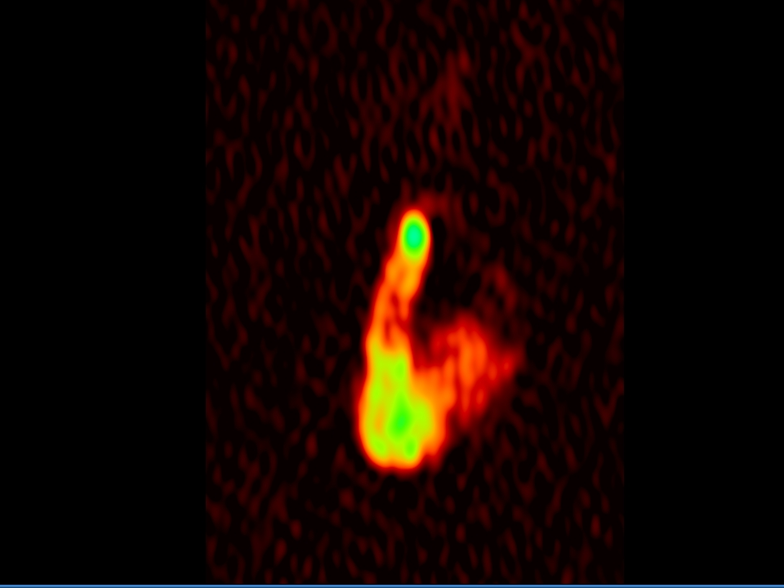
Probing the Radio Counterpart of Gamma-ray Flaring Region in 3C 84
Hiroshi Nagai
(National Astronomical Observatory of Japan)
In collaboration with
Monica Orienti, Motoki Kino, Kenta Suzuki, Keiichi Asada, Akihiro Doi, Gabriele Giovannini, Marcello Giroletti, Jun Kataoka, Filippo D'Ammando, Takafumi Haga, Makoto Inoue,
Anne Lahteenmaki, Merja Tornikoski, Jonathan Leon-Tavares, Seiji Kameno, Uwe Bach

Slide 2
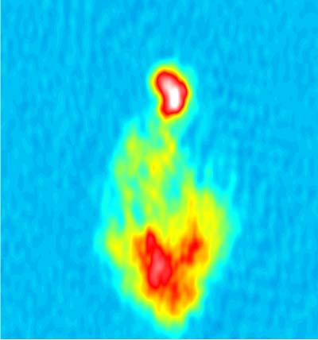
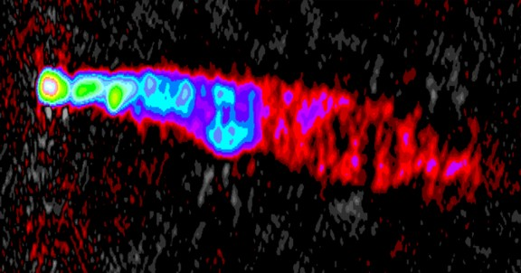
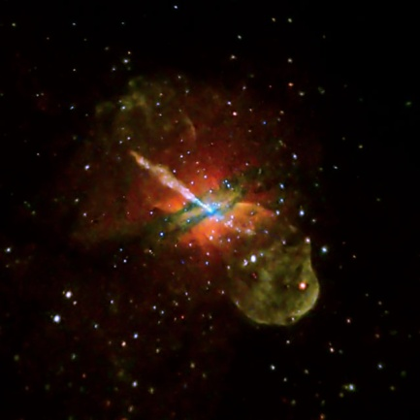
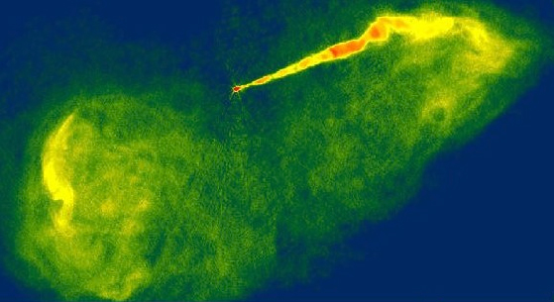
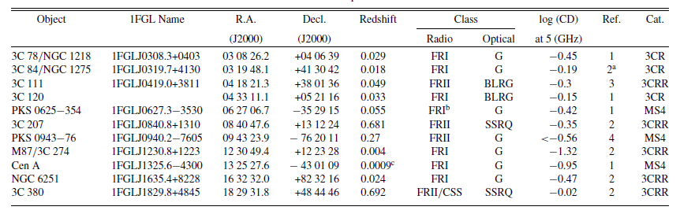
Gamma-ray bright RGs
More than 10 RGs have been detected in GeV band by Fermi-LAT
3C84/NGC1275, M87, Cen A are also detected in VHE gamma-ray band
The study of gamma-ray emission mechanism in RGs is important in the context of unification for the radio-loud AGN
NGC1275/3C84
(z=0.0176)
3C120
(z=0.033)
Courtesy: NRAO
Asada+
CenA
(z=0.0018)
M87
(z=0.00436)
Courtesy: NRAO
Courtesy: Chandra
Abdo+ 2010

Slide 3
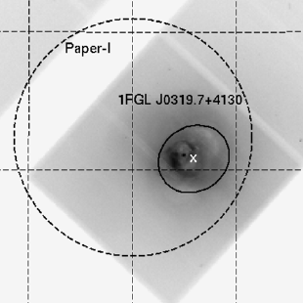
Gamma-ray view of 3C 84
gamma-ray and radio lightcurve of 3C84
COS-B
Fermi
γ-ray
EGRET/CGRO
Fermi error circle
Radio
Kataoka+ 2010
Abdo+ 2009 (Corresponding author: J. Kataoka)

Slide 4
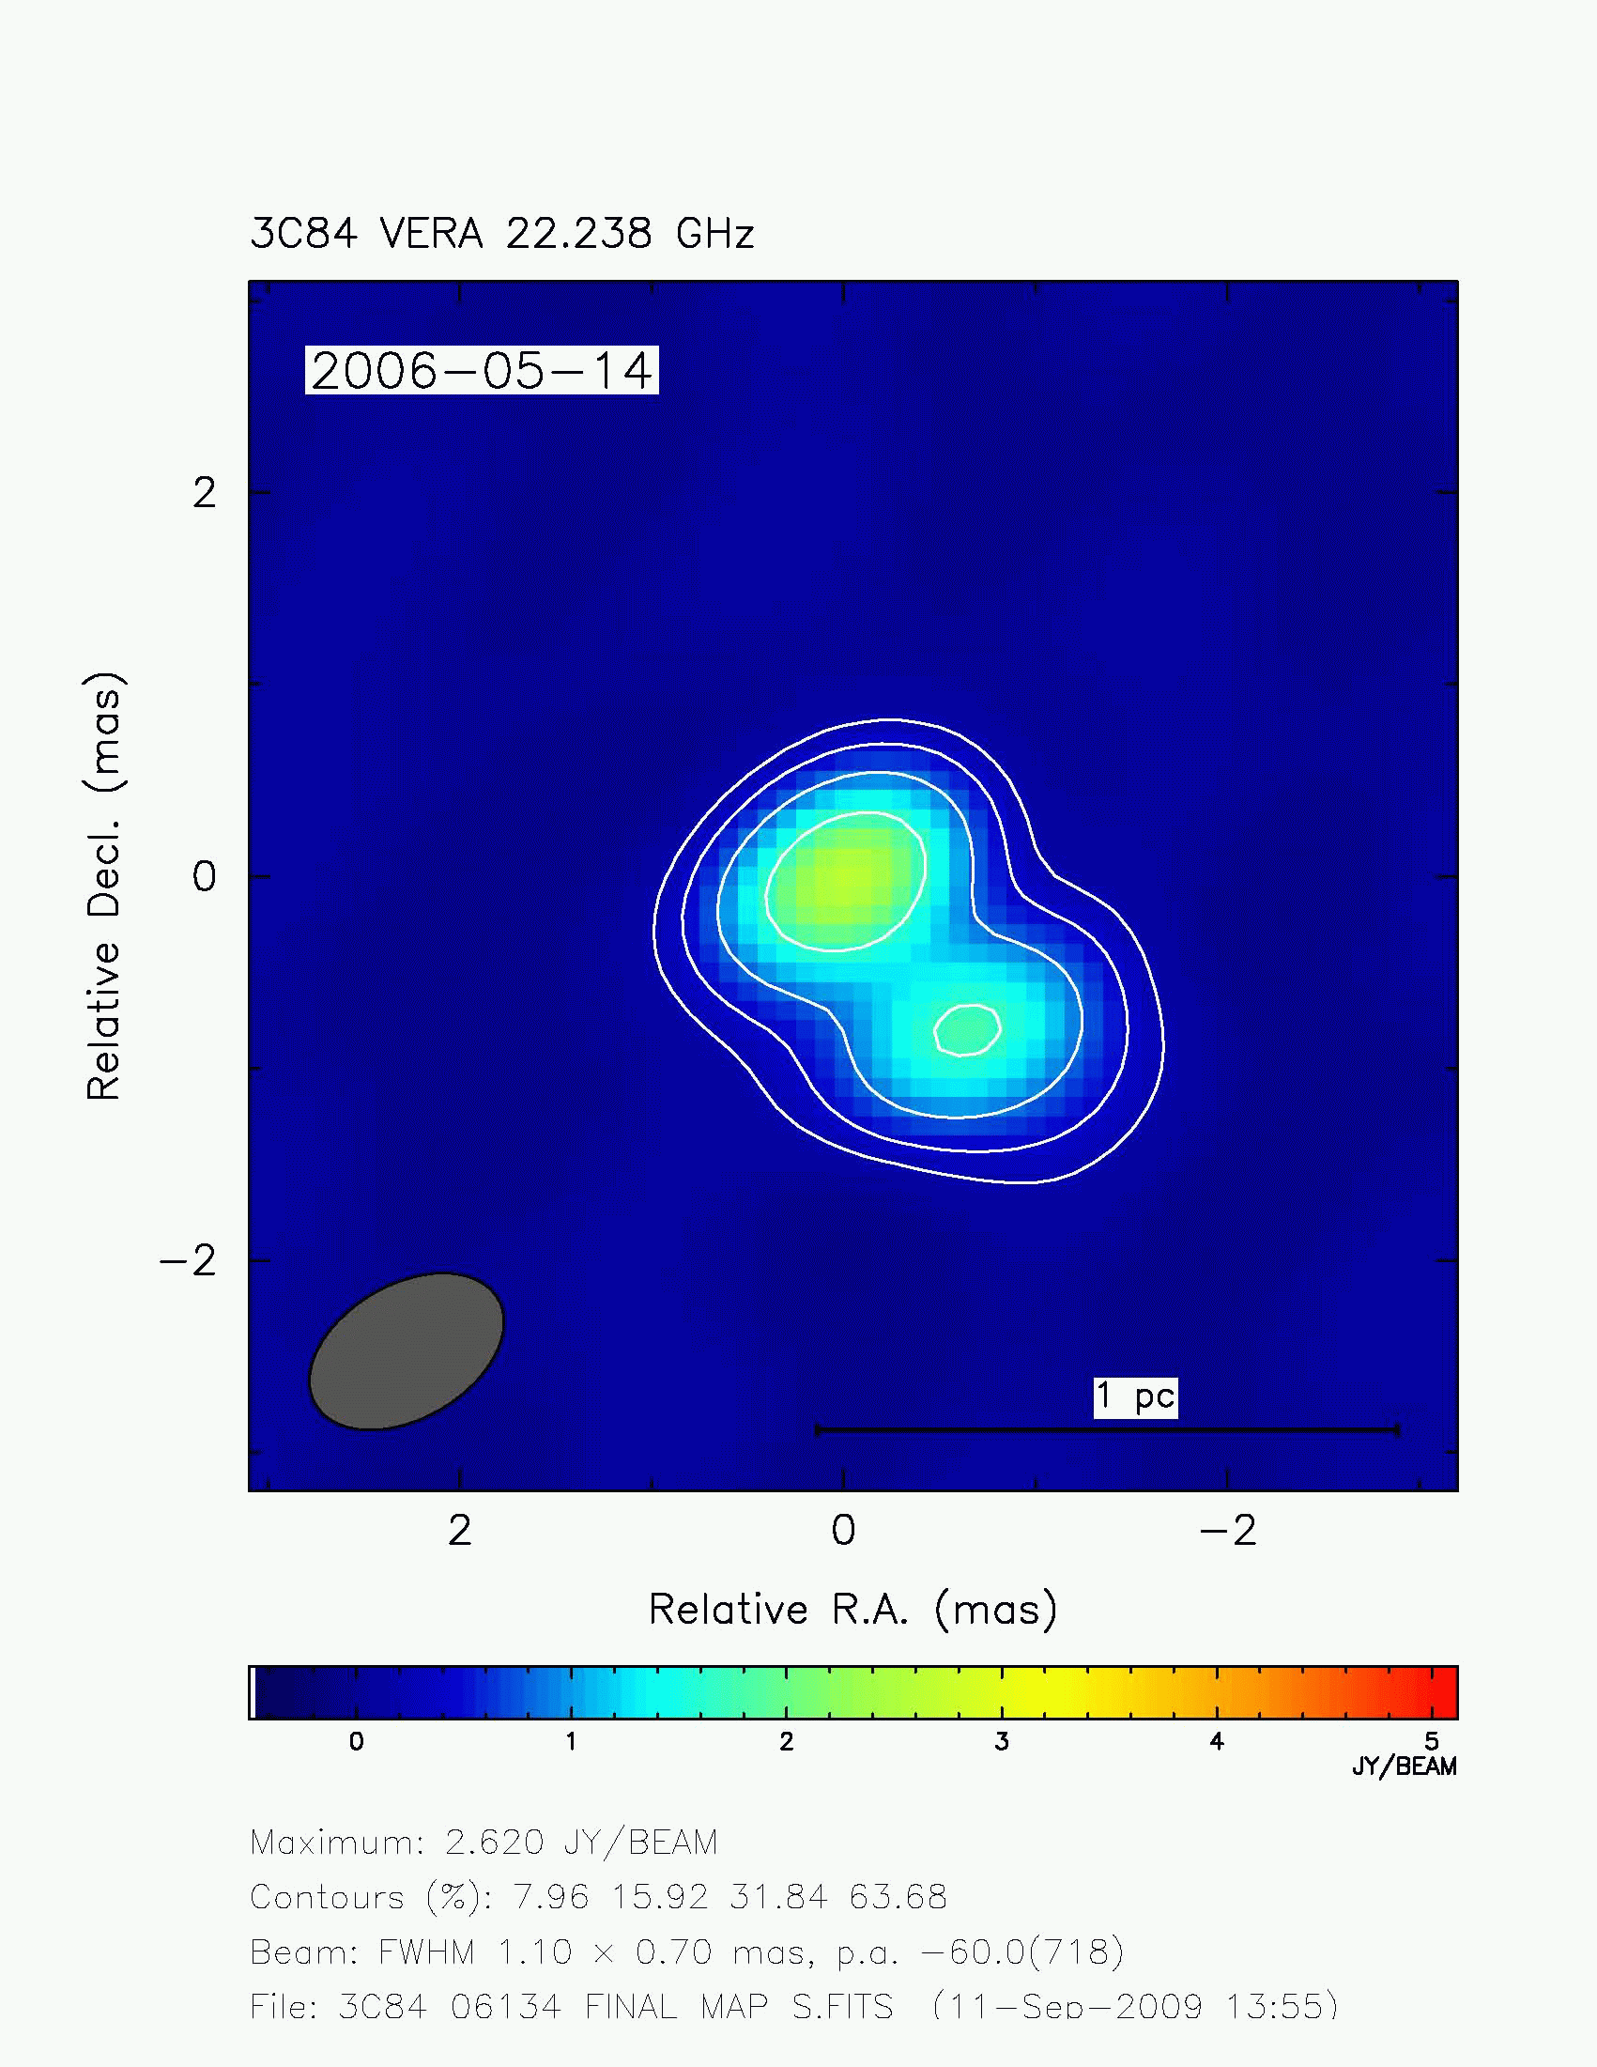
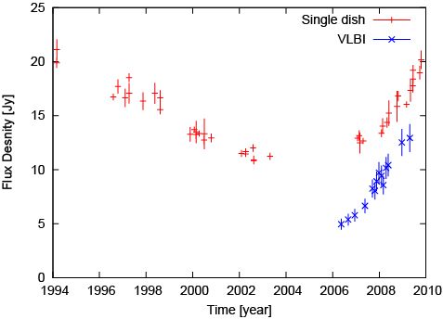
VLBI movie
5GHz image as of 1998
VERA@22GHz
Assumed northern component is stationary
Asada+ 2006
1 pc
Nagai et al. 2010

Slide 5
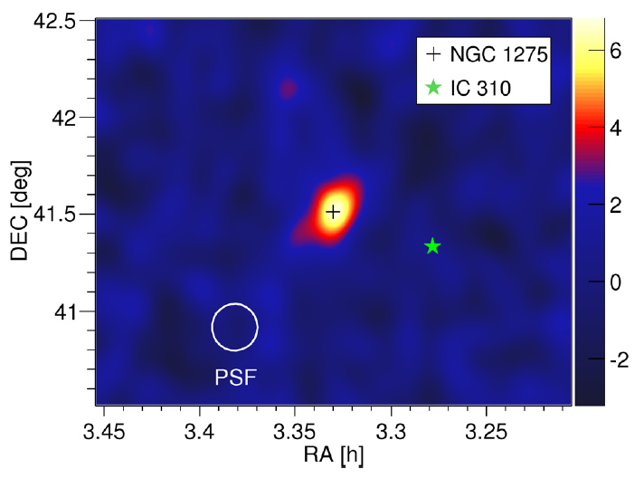
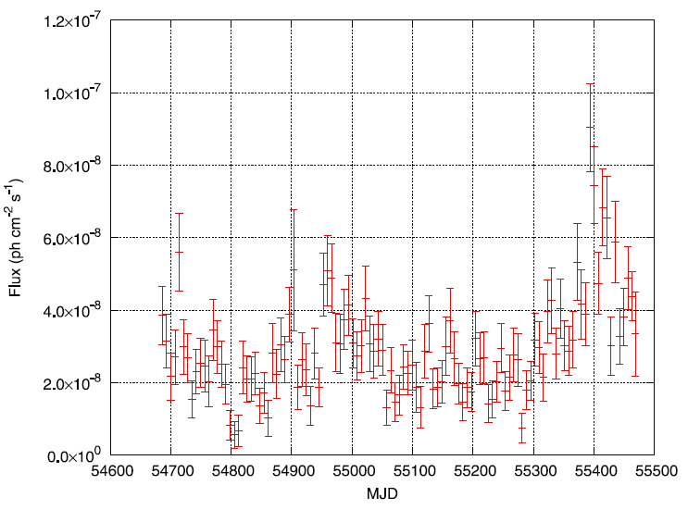
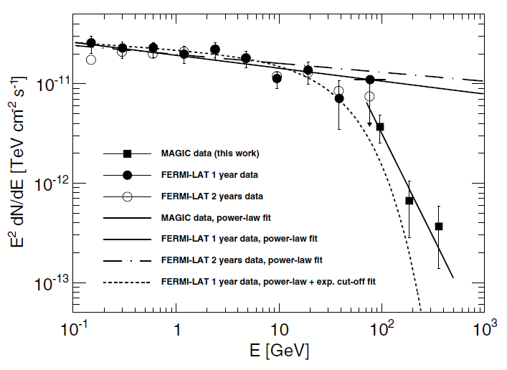
2-years light curve
Fermi
2010 June-July
2009 April-May
Brown & Adams 2011
VHE gamma-ray by MAGIC
(Aleksic+ 2012)
A factor of ~2-3 flares in 2009-2010 periods

Slide 6
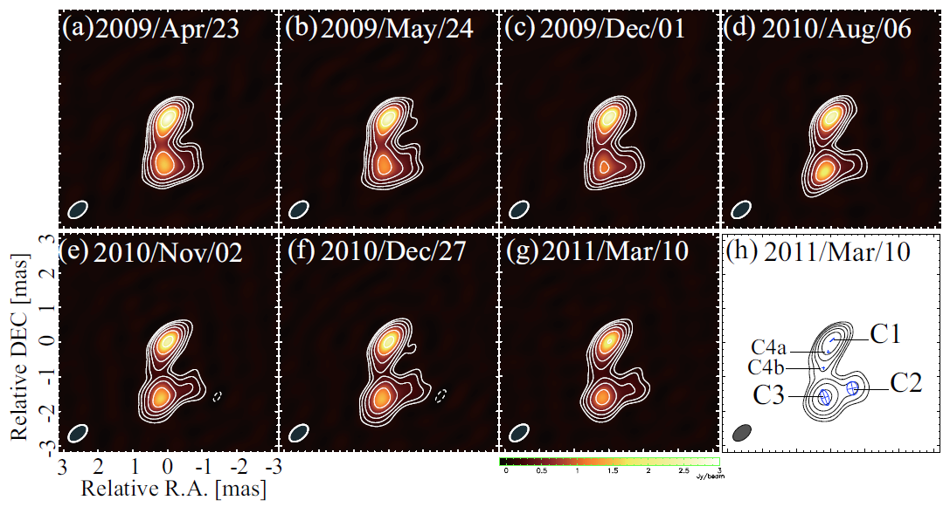
Structural change
VERA 43GHz images
γ-ray flare
γ-ray flare
1 pc
Nagai et al. 2012

Slide 7
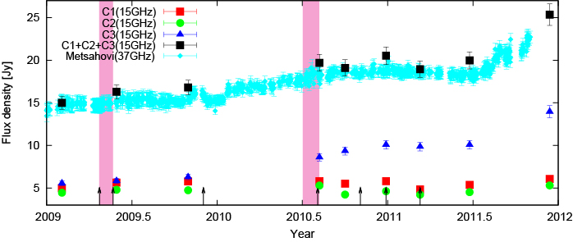
Light curve
γ-ray flare
γ-ray flare
Nagai et al. 2012

Slide 8
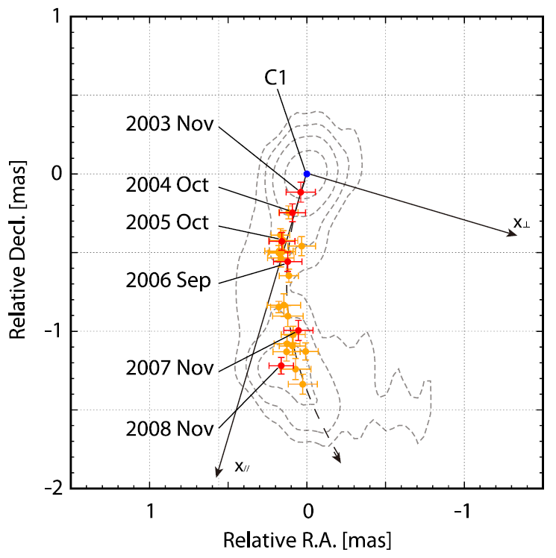
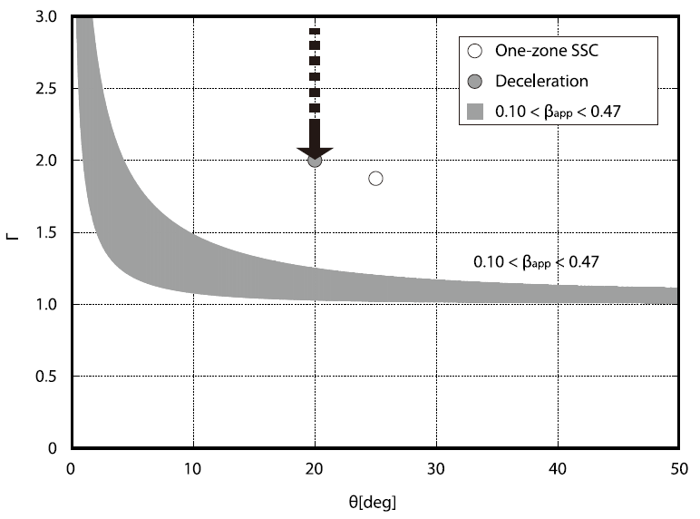
Apparent motion
SED model expectation (Abdo+2009)
VLBA 43GHz
Γ
v_{app}=0.1-0.47c
Apparent speed
θ [deg]
Suzuki, Nagai, & Kino et al. 2012
v_{app}=0.1-0.47c
Slower than the jet speed predicted from gamma-ray emission by Abdo+ 2009

Slide 9
Summary, so far…
No clear correlation between radio and gamma-ray light curves
  Monotonic increase in radio flux density
  Gamma-ray flare on the timescale of days-weeks
No significant change in VLBI-scale structure before and after the gamma-ray flares
Apparent motion is relatively slower than the ones predicted from one-zone SSC and deceleration jet model

Slide 10
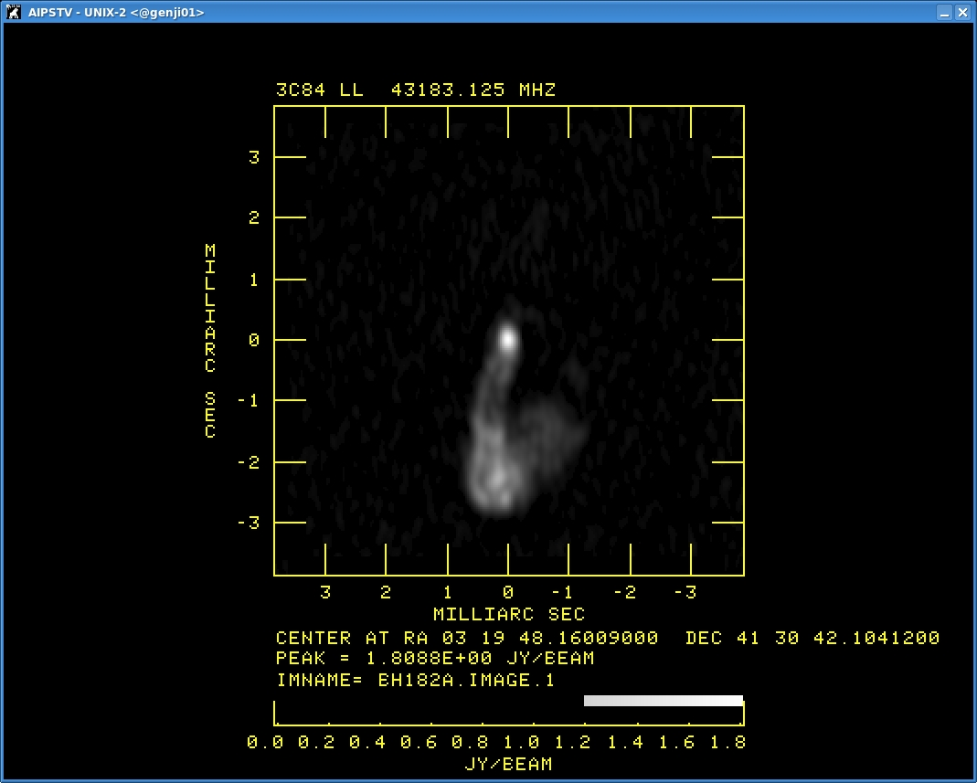
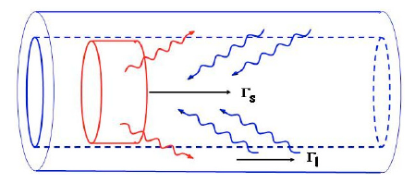
New VLBA 43GHz image
Preliminary!!!
1 pc
Data as of 2013 Jan (PI: T. Haga)
Clear limb-brightening as expected from the spine-sheath scenario (Ghisellini+ 2005)
  Velocity gradient across the jet?
Nagai+ in prep.
Ghisellini+ 2005

Slide 11
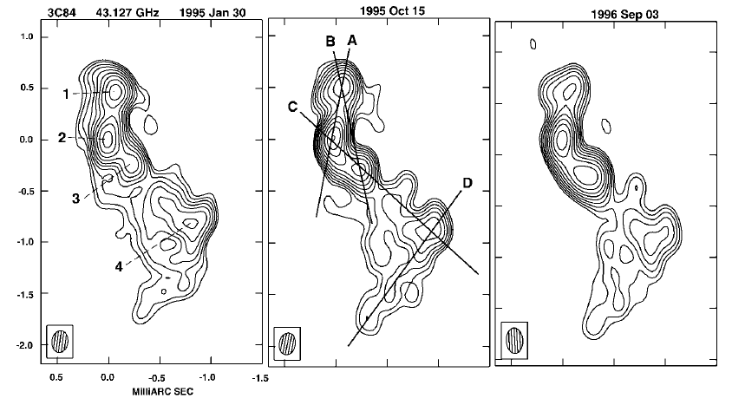
Ridge-brightening -> limb-brightening?
γ-ray light curve
Fermi
EGRET
Limb-brightening
Ridge-brightening
Dhawan+ 1998

Slide 12
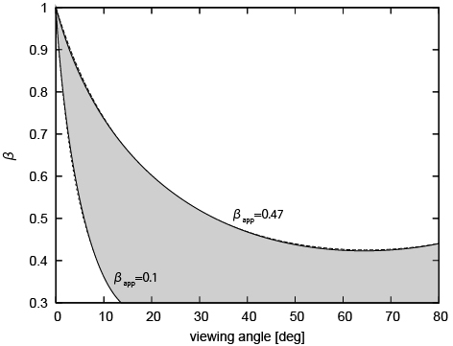
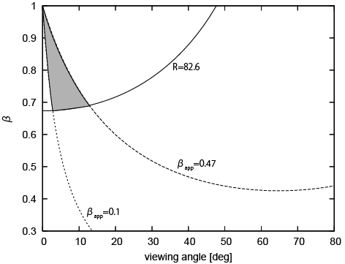
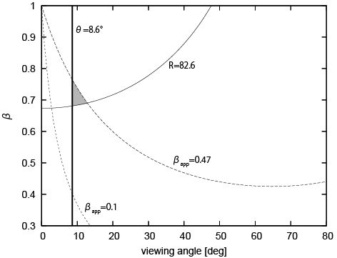
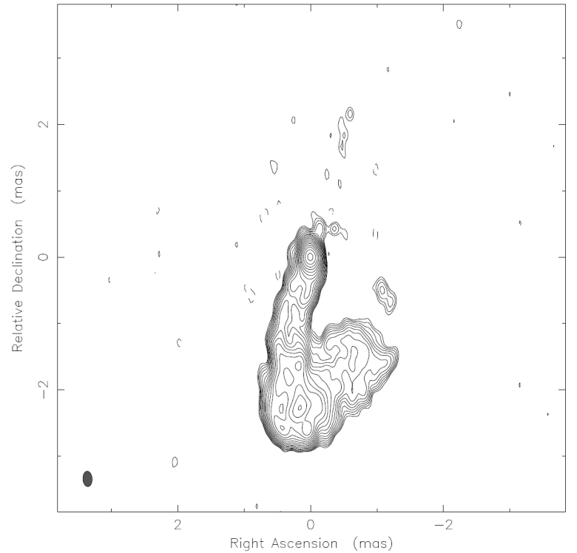
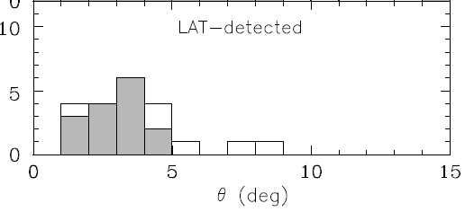
Constraint on v_{jet} and θ_{jet}
Apparent speed 0.1-0.47c
Suzuki+ 2012
Jet-counter-jet ratio lower limit#: 82.6
#: Absorption corrected using Walker+ 2000
Viewing angle cannot be too small
θ_{3C84} > θ _{blazar}
(θ_{blazar}: Savolainen+ 2010)
v_{jet}~0.7c (Γ=1.4) , θ_{jet}~ 10 deg

Slide 13
Constraint on the spine flow
If the limb-brightening results from the velocity gradient across the jet,
θ_{jet}>θ_{beaming}=sin⁻¹(1/Γ_{spine})
Γ_{spine}>5.8
Γ_{stheath}=1.4
Γ_{spine}>5.8

Slide 14
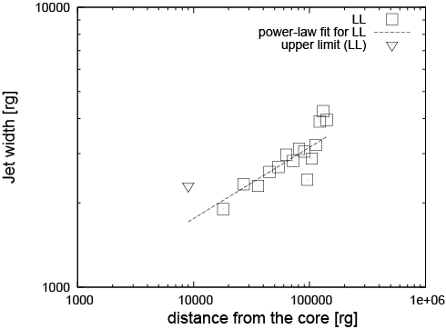
Jet width profile
W∝r^{0.25+/-0.03}
Viewing angle =10 deg
Power-law index is flatter than that of M87
  α=0.58-1.04 (Asada & Nakamura 2012)
Due to different circumnuclear environment ??

Slide 15
Conclusion
No clear correlation between radio and gamma-ray light curves
VLBI-measured apparent speed is relatively slower than the one expected from the SED modeling
  Gamma-ray emission is more beamed than the Lorentz factor as indicated by the VLBI motion?
Clear Limb-brightening as expected from the spine-sheath model
Are we seeing slower sheath of jet at radio wavelengths?

Slide 16
appendix

Slide 17
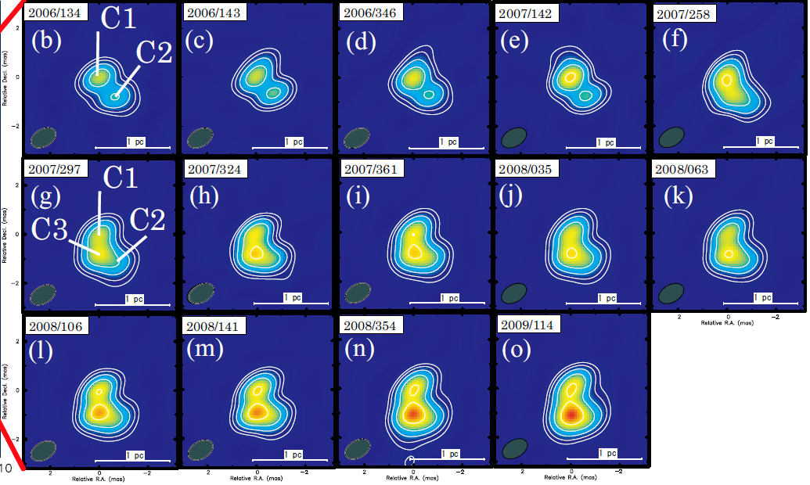

Slide 18
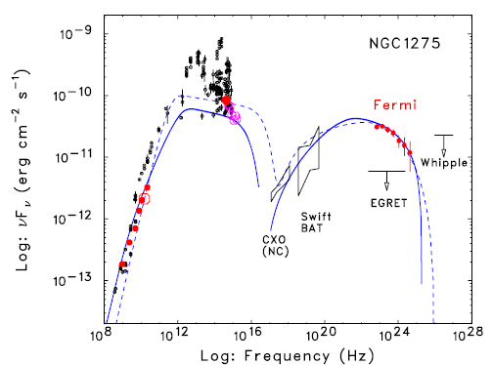
SED model bby Abdo+ 2009

Slide 19
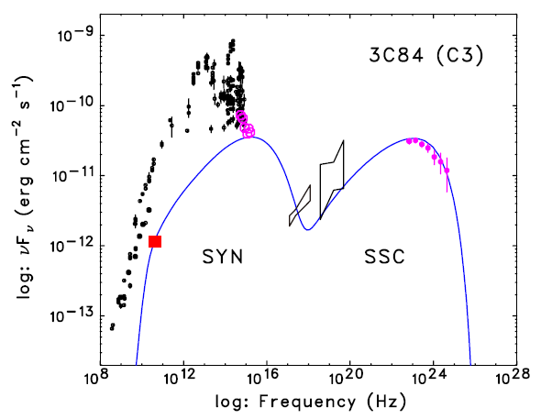
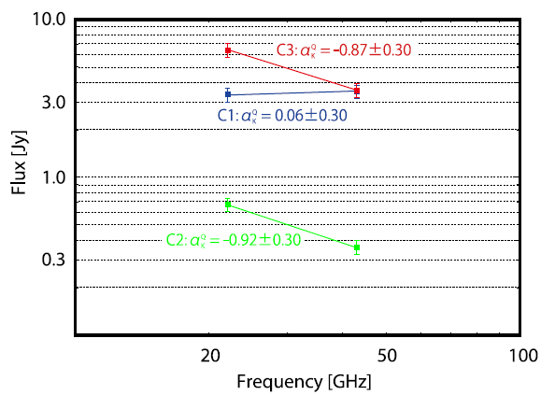
LEC
43GHz data lies below the low energy cutoff (α~1/3)
Observed spectral index of C3 disagree with α=1/3

Slide 20
What is the bridging structure between C1 and C3?
Equipartition magnetic field of C3 is ~0.3G.
t_{syn}~1.5 yr (at 43GHz)
  Bridging structure is probably not a “remnant” of C3
Subsequent jet ejection from C1
C1
C2
C3

