Slide 1










Radiation from accelerated particles in relativistic jets with shocks, shear-flow and reconnections
Ken Nishikawa UAH/CSPAR
Collaborators: P. Hardee (Univ. of Alabama, Tuscaloosa) Y. Mizuno (National Tsing Hua University, Taiwan) I. Dutan (Institute of Space Science, Rumania) B. Zhang (Univ. Nevada, Las Vegas) M. Medvedev (Univ. of Kansas) E. J. Choi (KAIST) K. W. Min (KAIST) J. Niemiec (Institute of Nuclear Physics PAN)
Å. Nordlund (Niels Bohr Institute)
J. Frederiksen (Niels Bohr Institute)
H. Sol (Meudon Observatory)
M. Pohl (U‐Potsdam/DESY)
D. H. Hartmann (Clemson Univ.)
Marscher (Boston Univ.)
J. Gómez (IAA, CSIC)
The Innermost Regions of Relativistic Jets and Their Magnetic Fields
Granada, Spain, June 10 – 14, 2013

Slide 2
Outline
1. Magnetic field generation and particle
acceleration in kinetic Kelvin-Helmholtz
instability
2. Self-consistent radiation method using PIC
simulations
3. Synthetic spectra in shocks generated by
the Weibel instability
5. Strong magnetic field amplification with
colliding jets with magnetic fields
6. Acceleration in recollimation shock
7. Summary
8. Future plans

Slide 3
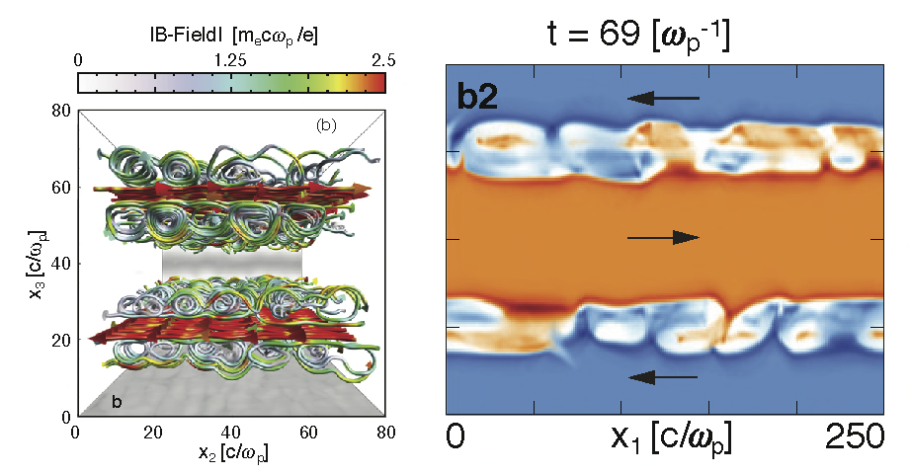
Simulations of Kinetic Kelvin-Helmholtz instability
with counter-streaming flows (γ₀ = 3, m_{i}/m_{e}=1836)
magnetic field lines
electron density
◉
◉
Alves et al. (2012)

Slide 4
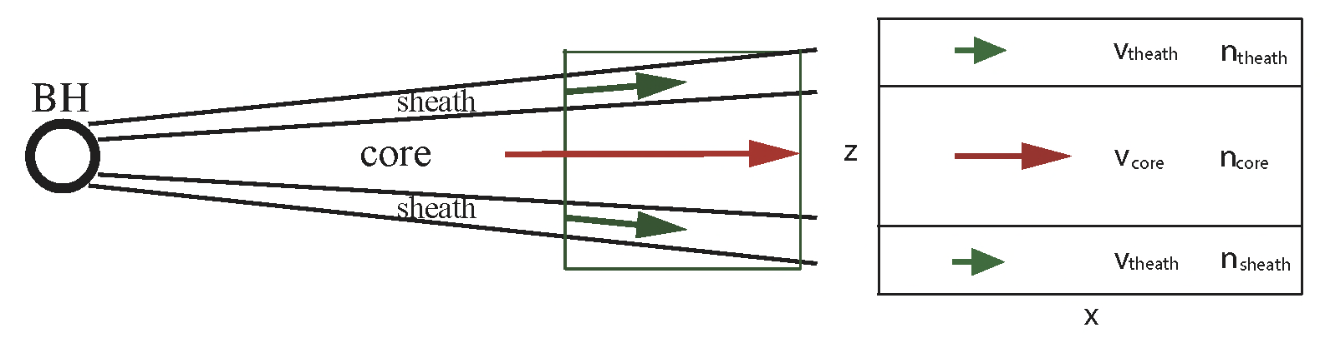
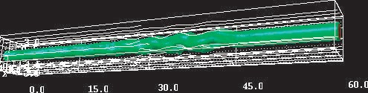
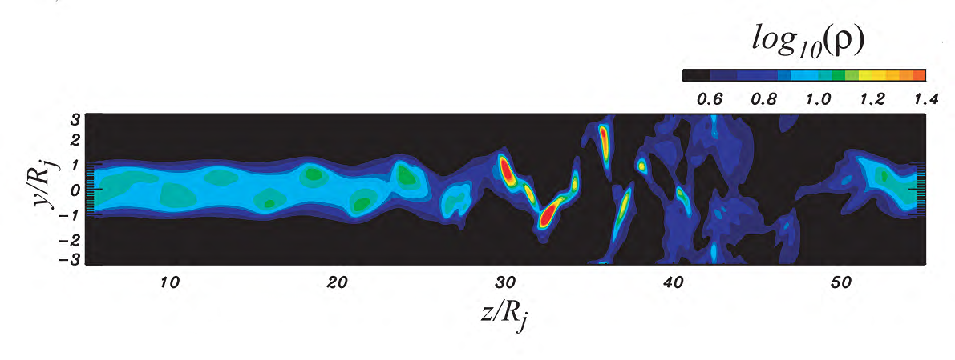
Simulations of KHI with core and sheath jets
RMHD, no wind ω=0.93, time=60.0
case of V_{theath} = 0
Mizuno, Hardee & Nishikawa, ApJ, 662, 835, 2007

Slide 5
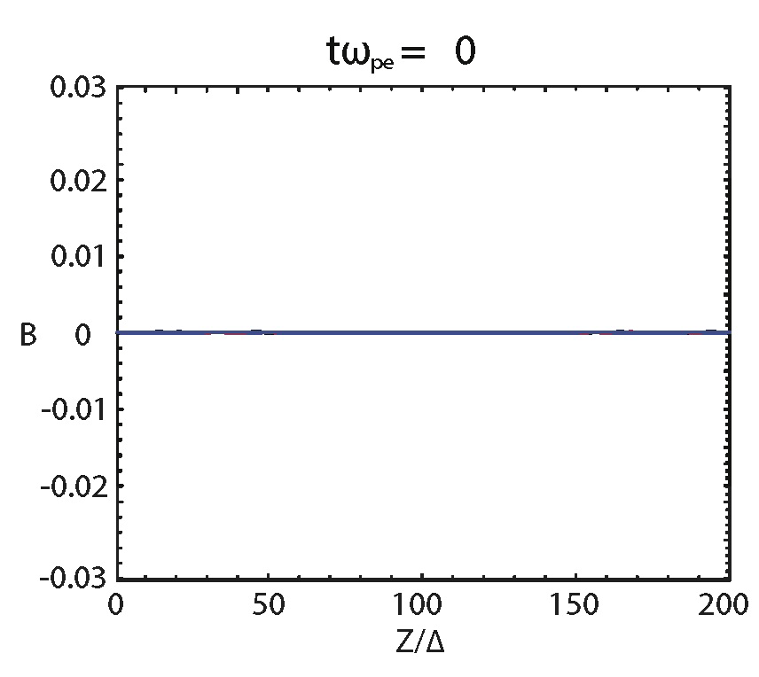
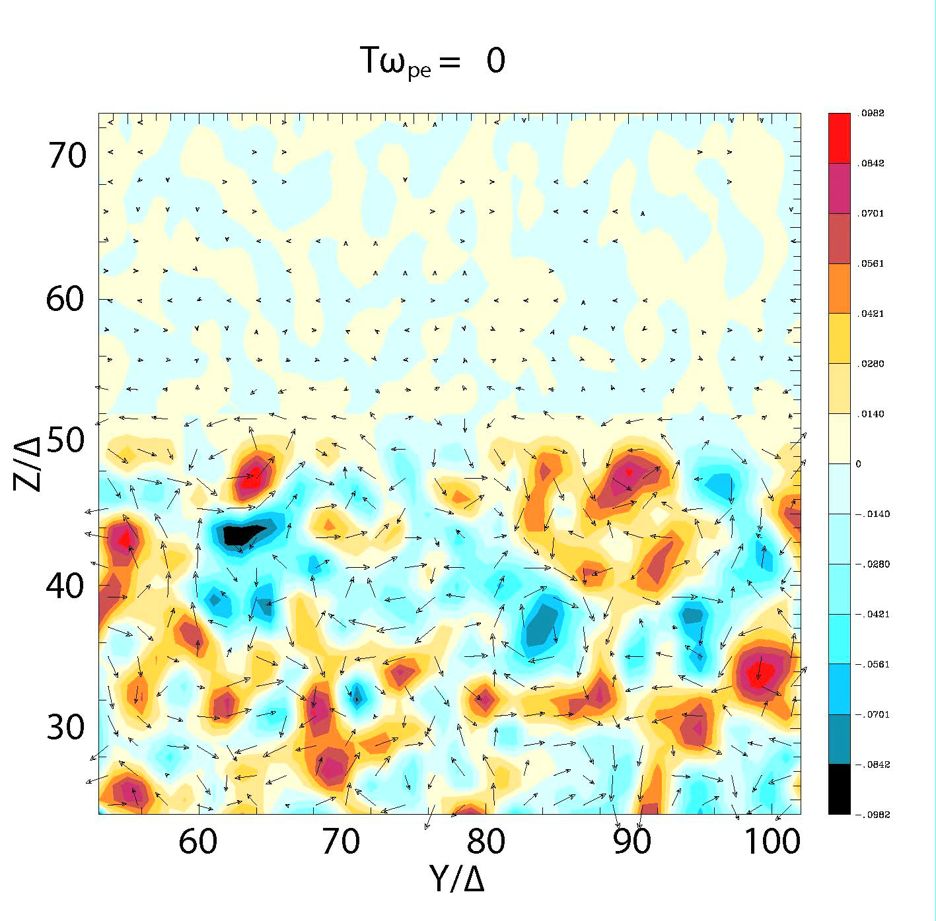
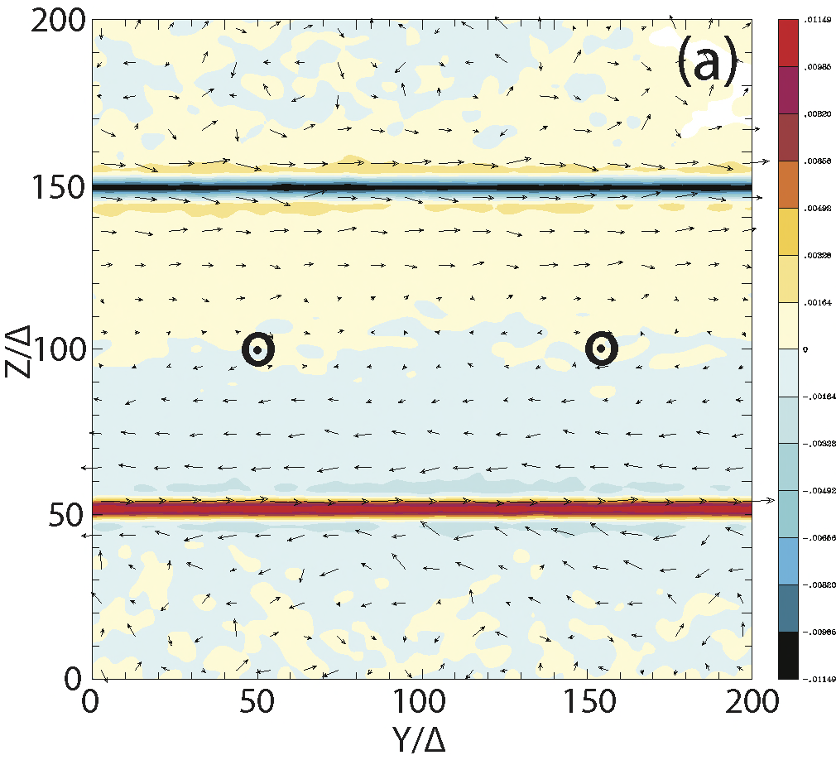
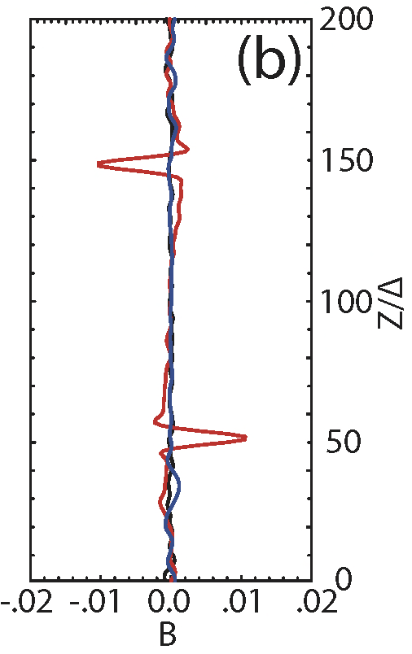
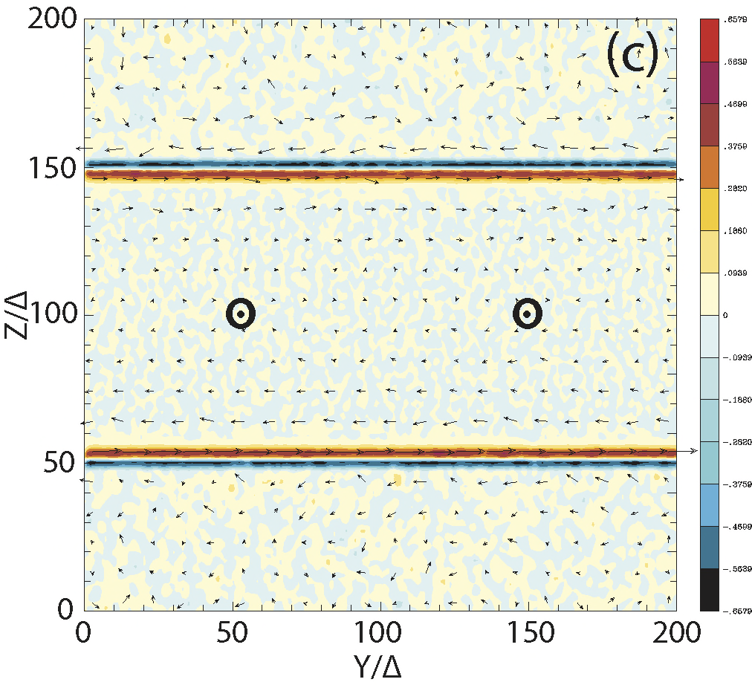
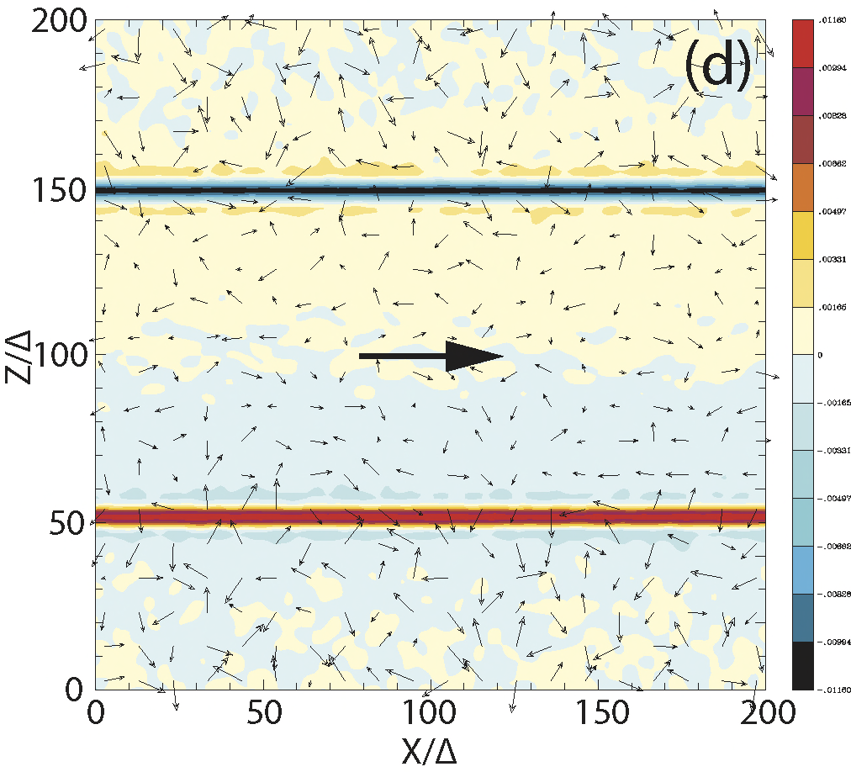
New KKHI simulations with core and sheath jets in slab geometry
γ_{j} = 15, m_{i}/m_{e} = 20
B_{y}
Nishikawa et al. 2013
eConf C121028
(arXiv:1303.2569)
B_{y}
J_{x}
B_{y}

Slide 6
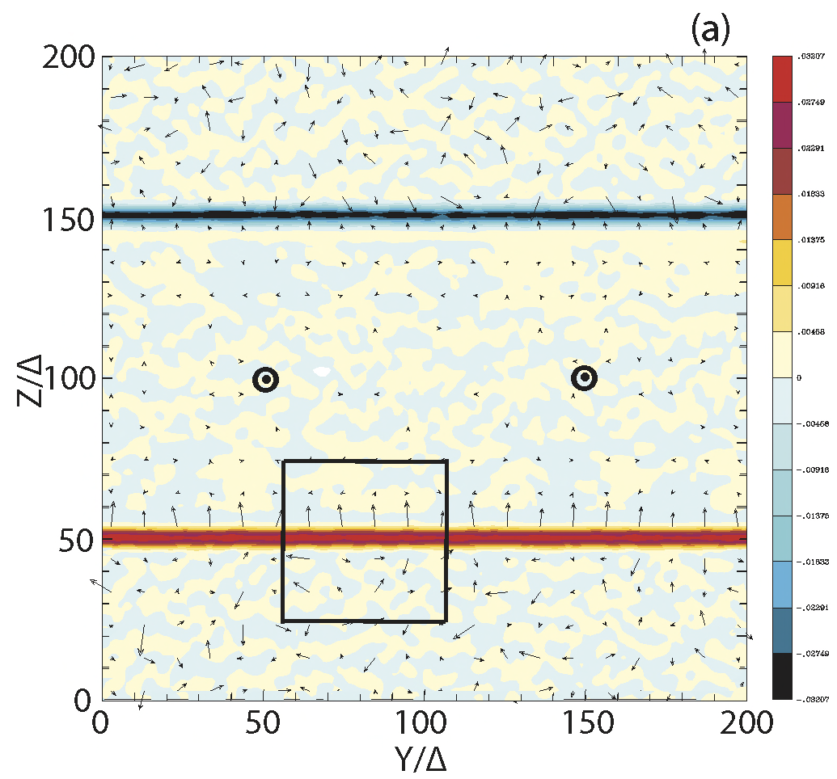
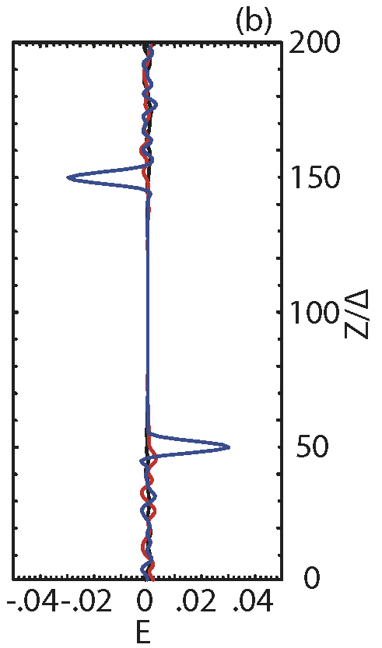
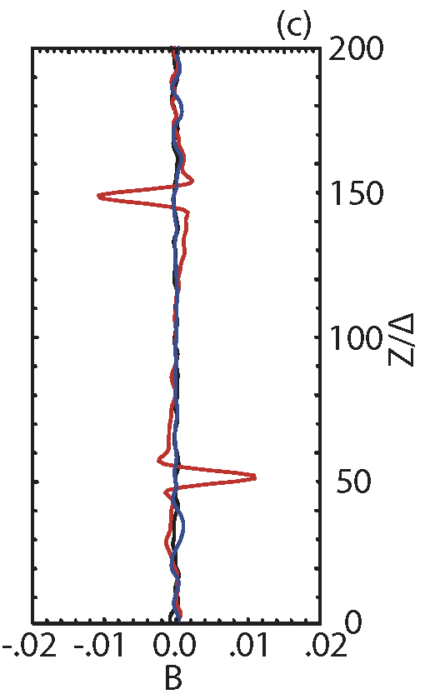
Electric field generation by KKHI
γ_{j} = 15, m_{i}/m_{e} = 1836, t = 30/ω_{pe}
t = 70/ω_{pe}
E_{z}
B_{y}
E_{z}
(Nishikawa et al. 2013)

Slide 7
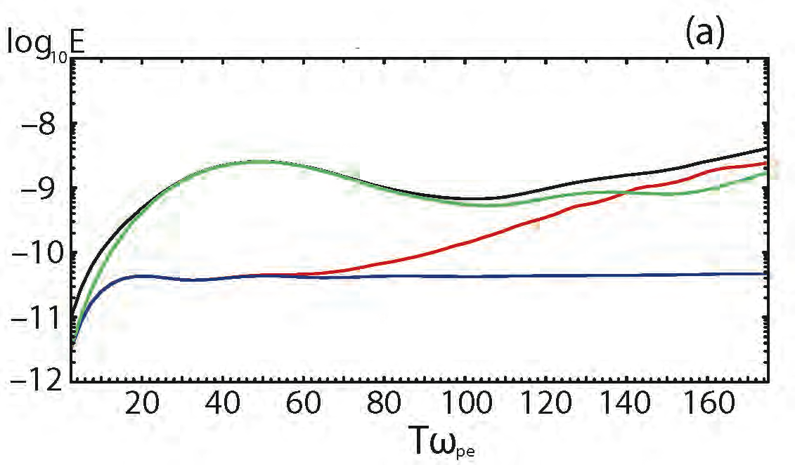
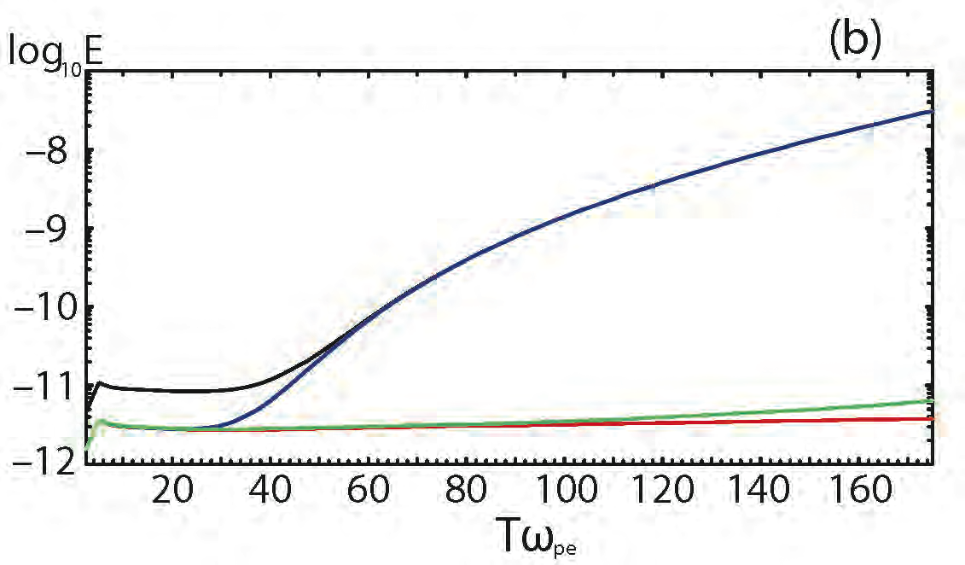
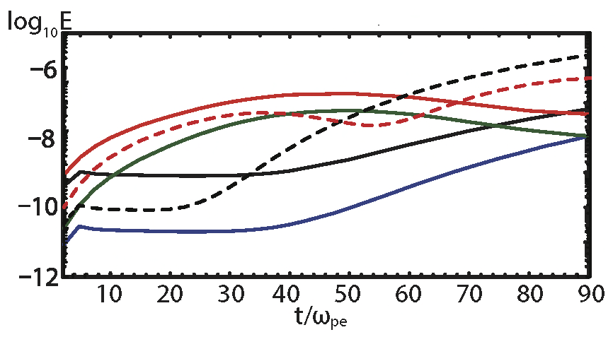
Evolution of electric and magnetic field energy
γ_{j} = 15, m_{i}/m_{e} = 1836
total E
E_{z}
E_{x}
E_{y}
total B
B_{y}
B_{z}
B_{x}
total E, γ_{j} = 15, m_{i}/m_{e} = 20
×
total B, γ_{j} = 15, m_{i}/m_{e} = 20
×
total E, γ_{j} = 15, m_{i}/m_{e} = 1836
total B, γ_{j} = 15, m_{i}/m_{e} = 1836
total E, γ_{j} = 1.5, m_{i}/m_{e} = 20
total B, γ_{j} = 1.5, m_{i}/m_{e} = 20

Slide 8
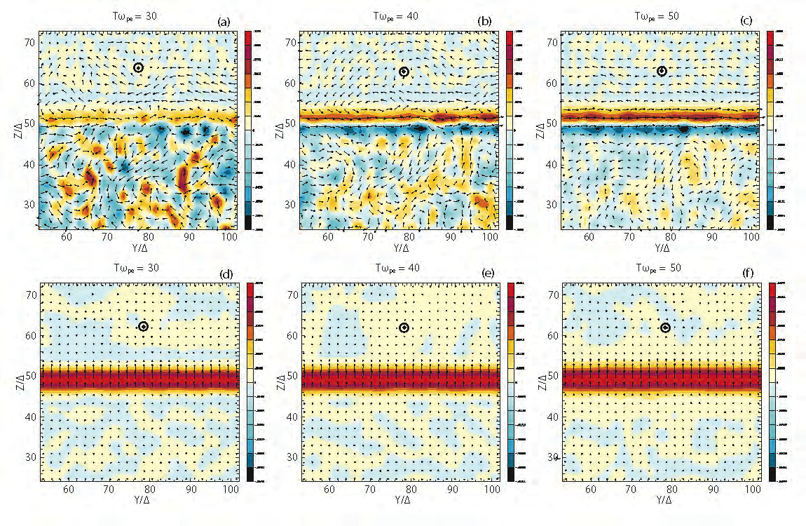
Evolution of current filaments (J_{x}) and electric field (E_{z})
γ_{j} = 15, m_{i}/m_{e} = 1836
tω_{pe} = 30 tω_{pe} = 40 tω_{pe} = 50
J_{x}
E_{z}

Slide 9
KKHI simulation of core jet-stationary sheath plasma
γ_{j} = 1.5, m_{i}/m_{e} = 20, t = 50/ω_{pe}
B_{y}
B_{y}
◉ 
J_{x}
B_{y}
◉ 

Slide 10
Time evolution of current filaments (J_{x}) generated by
KKHI in the small box in y – z plane
γ_{j} = 1.5, m_{i}/m_{e} = 20
◉
◉
J_{x}
◉
◉

Slide 11
Motion of the electrons across the shear surface produce electric
currents which generate magnetic field
t = 30/ω_{pe}
γ_{j} = 1.5, m_{i}/m_{e} = 20
◉
J_{x}
◉
B_{y}

Slide 12
Kinetic Kelvin-Helmholtz Instability
Static electric field grows due to the charge separation by the
negative and positive current filaments
Current filaments at the velocity shear generate magnetic field
transverse to the jet along the velocity shear
Jet with high Lorentz factor with core-sheath case generate higher
magnetic field even after saturated in the case counter-streaming
case with moderately relativistic jet
Non-relativistic jet generate KKHI quickly and magnetic field grows
faster than the jet with higher Lorentz factor
For the jet-sheath case with Lorentz factor 15 the evolution of
KKHI does not change with the mass ratio between 20 and 1836
6. Strong magnetic field will affect electron trajectories and create
synchrotron-like (jitter) radiation which will be investigated
7. KKHI need to be investigated with shocks

Slide 13
Self-consistent calculation of radiation
Electrons are accelerated by the electromagnetic field
generated by the Weibel instability and KKHI (without
the assumption used in test-particle simulations for
Fermi acceleration)
Radiation is calculated using the particle trajectory in
the self-consistent turbulent magnetic field
This calculation includes Jitter radiation (Medvedev
2000, 2006) which is different from standard
synchrotron emission
Radiation from electrons in our simulation is reported
in Nishikawa et al. Adv. Sci. Rev, 47, 1434, 2011.

Slide 14
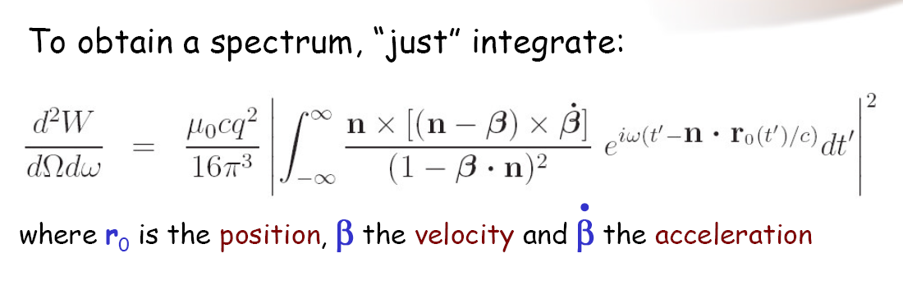
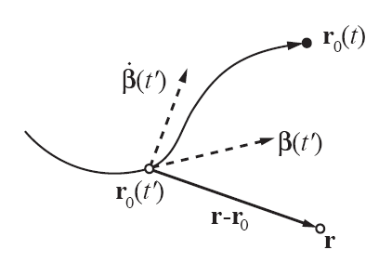
Radiation from particles in collisionless shock
New approach: Calculate radiation from integrating position, velocity, and acceleration of ensemble of particles (electrons and positrons)
Hededal, Thesis 2005 (astro-ph/0506559) Nishikawa et al. 2008 (astro-ph/0802.2558) Sironi & Spitkovsky, 2009, ApJ Martins et al. 2009, Proc. of SPIE Vol. 7359 Frederiksen et al. 2010, ApJL

Slide 15
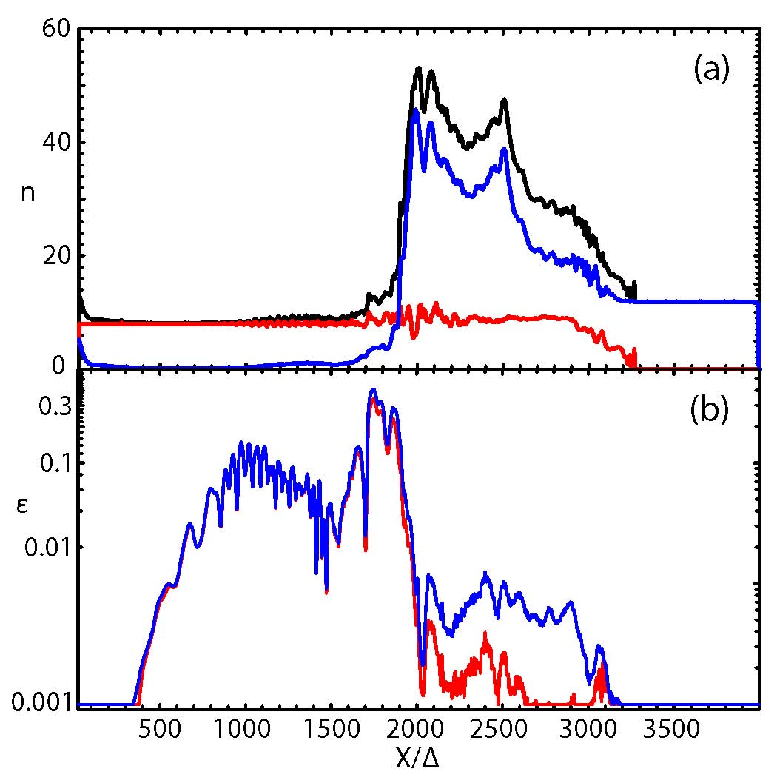
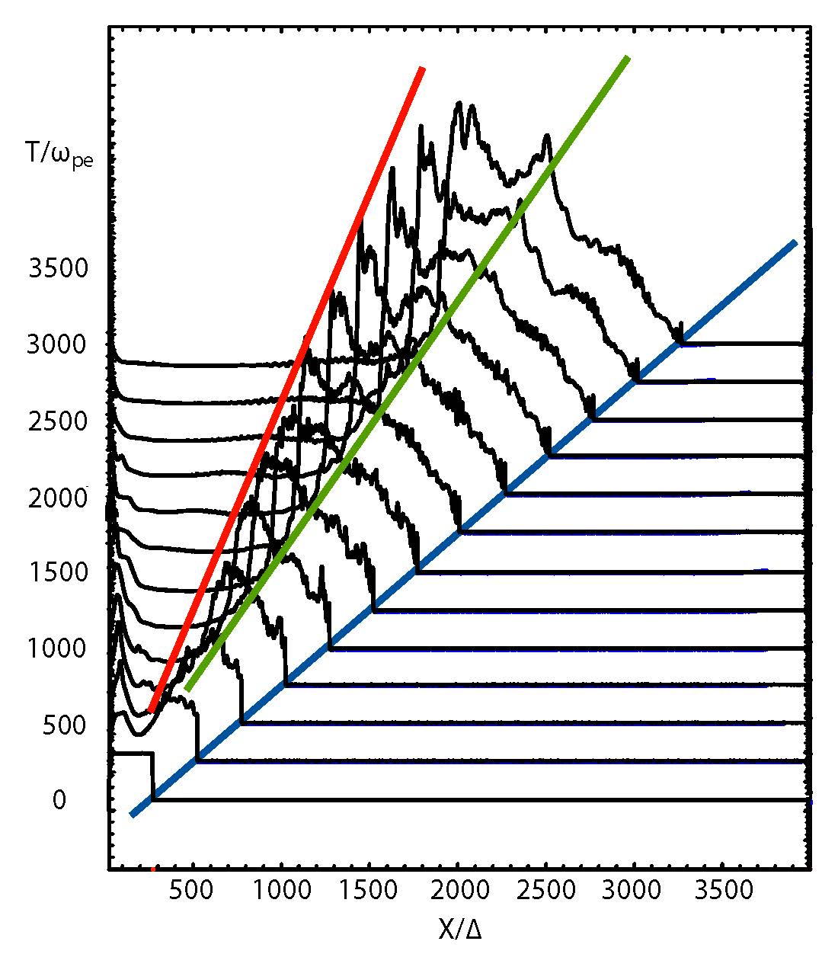
Shock formation, forward shock, reverse shock
v_{rs}=0.56c
v_{cd}=0.76c
total
(c)
ambient
v_{jf}=0.996c
jet
ε_{B}
ε_{E}
electron density and
(b) electromagnetic
field energy (ε_{B}, ε_{E})
divided by the total
kinetic energy at
t = 3250ω_{pe}⁻¹
Time evolution of the total electron
density. The velocity of the jet front is ~c,
the predicted contact discontinuity speed
is 0.76c, and the velocity of the reverse
shock is 0.56c.
(Nishikawa et al. ApJ, 698, L10, 2009)
Shock formation, forward shock, reverse shock
v_{cd}=0.76c
v_{rs}=0.56c
v_{cd}=0.76c
v_{rs}=0.56c
(c)
(c)
total
total
ambient
v_{jf}=0.996c
ambient
jet
jet
ε_{B}
ε_{B}
ε_{E}
ε_{E}
electron density and (b) electromagnetic
field energy (ε_{B}, ε_{E}) divided by the total
kinetic energy at t = 3250ω_{pe}⁻¹
electron density and (b) electromagnetic
field energy (ε_{B}, ε_{E}) divided by the total
kinetic energy at t = 3250ω_{pe}⁻¹
Time evolution of the total electron density.
The velocity of jet front is nearly c, the predicted
contact discontinuity speed is 0.76c, and the
velocity of trailing shock is 0.56c.
Time evolution of the total electron density.
The velocity of jet front is nearly c, the predicted
contact discontinuity speed is 0.76c, and the
velocity of trailing shock is 0.56c.
(Nishikawa et al. ApJ, 698, L10, 2009)
(Nishikawa et al. ApJ, 698, L10, 2009)

Slide 16
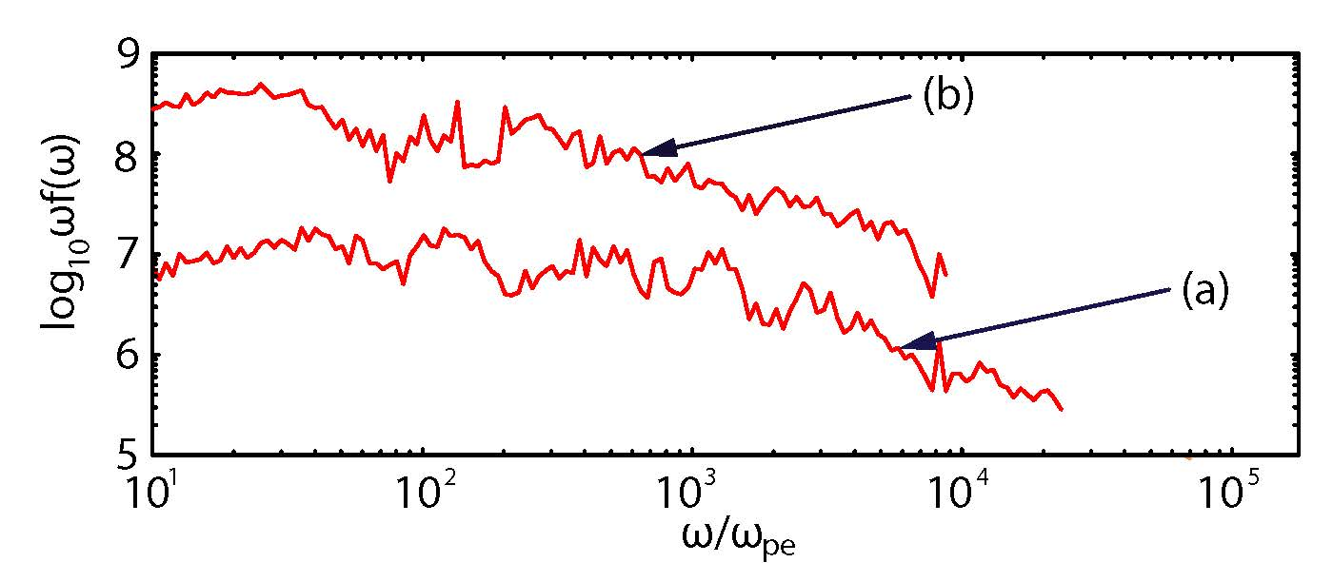
Radiation in a larger system at early time
System size: 8000 × 240 × 240
Electron-positron: γ = 15
Sampled particles 115,200
(a)150 ≤ t ≤ 225
(b) 200 ≤ t ≤ 275
Nishikawa et al. in progress

Slide 17
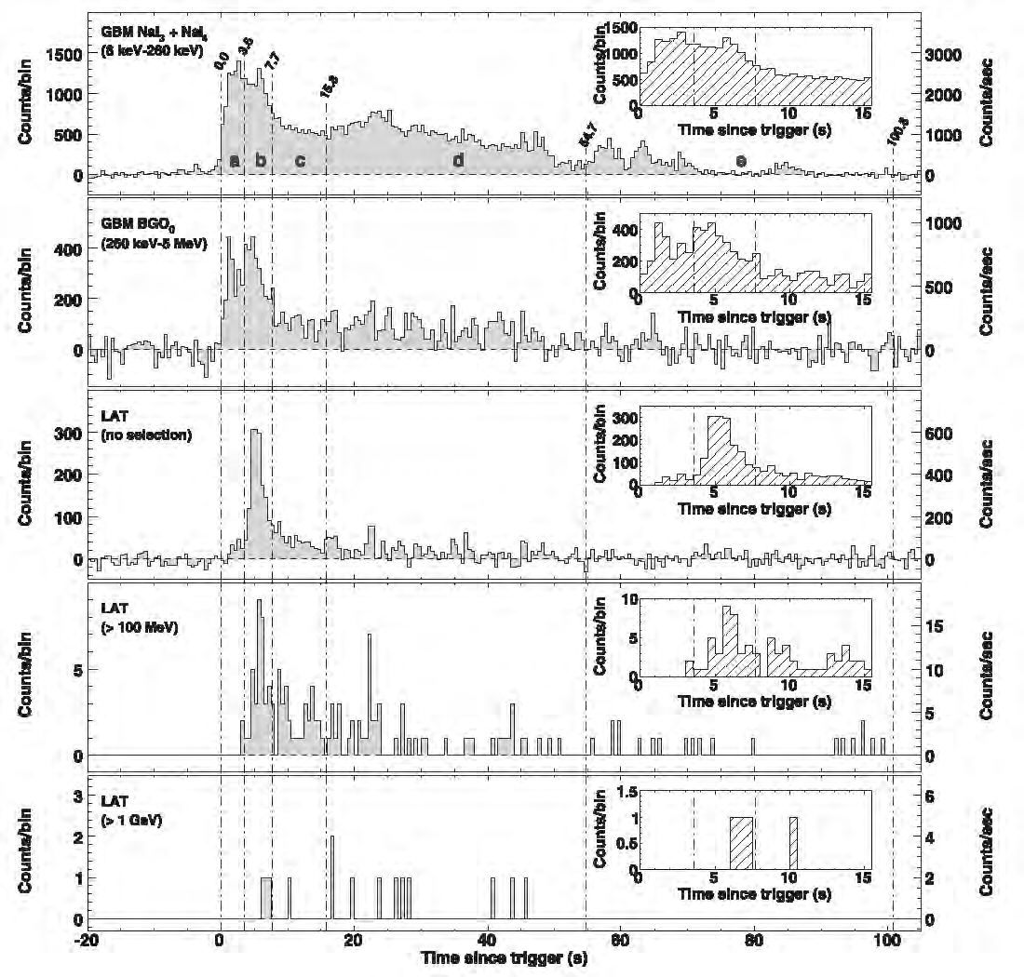
Fermi Observations of High-Energy Gamma-Ray Emission from GRB 080916C
Light curves for GRB 080916C observed with the GBM and the LAT (Abdo et al. 2009)
a
c
b
d
e

Slide 18
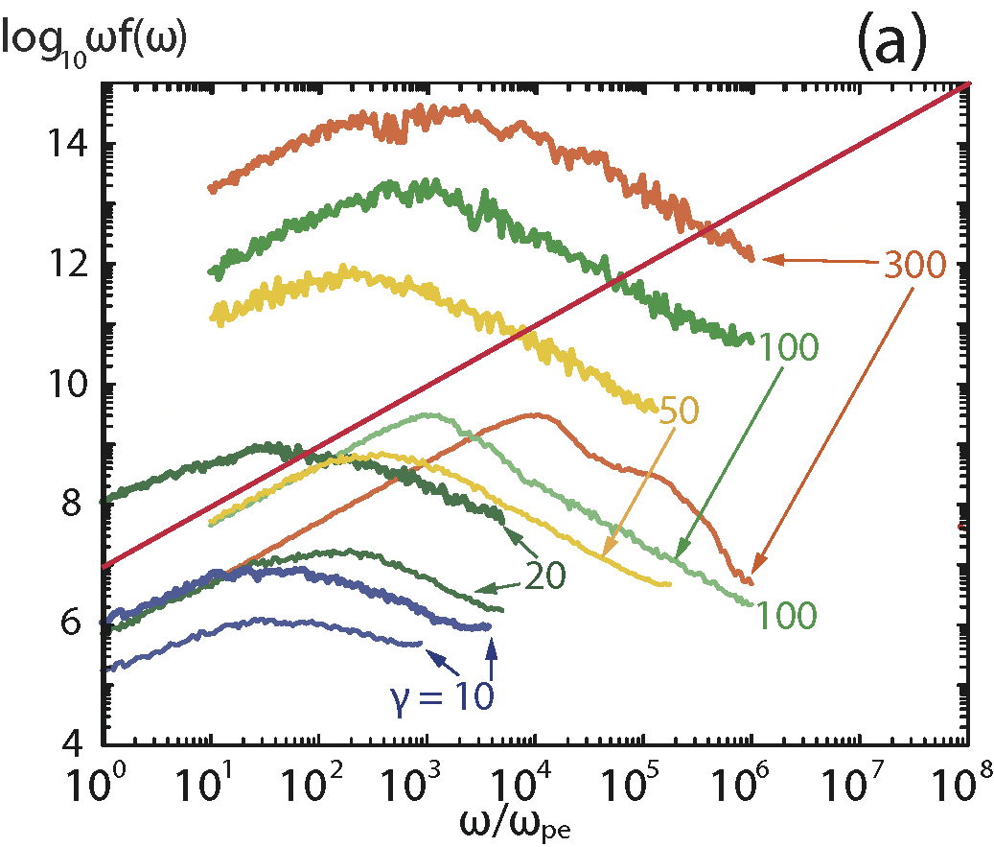
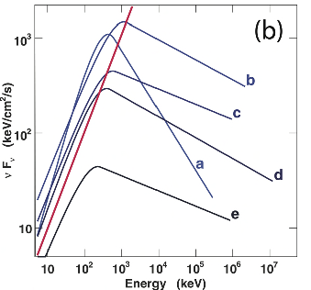
Synthetic spectra with different Lorentz factors
with cold and warm thermal temperatures
synthetic spectra
modeled Fermi spectra in νF units
(thin lines) and warm (thick lines) electron jets.
The red lines indicate slope in νF ∼ 1
(Abdo et al. 2009)
(Nishikawa et al. 2012)

Slide 19
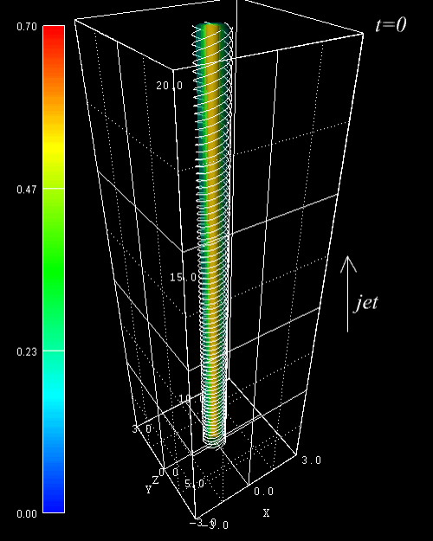
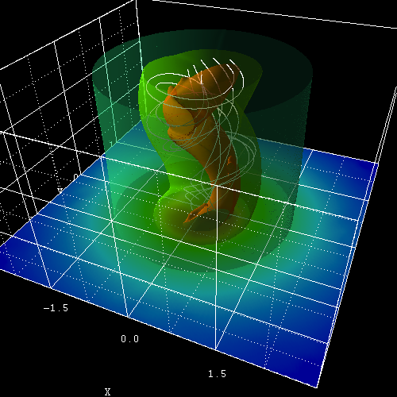
3-D kink instability with helical magnetic field
Relativistic jet with
helical magnetic field,
which leads to the
kink instability and
subsequent
reconnection, can be
simulated using
resistive relativistic
MHD (this simulation
was performed with
ideal RMHD code).
(Mizuno et al. ApJ, 734:19 (18pp), 2011)

Slide 20
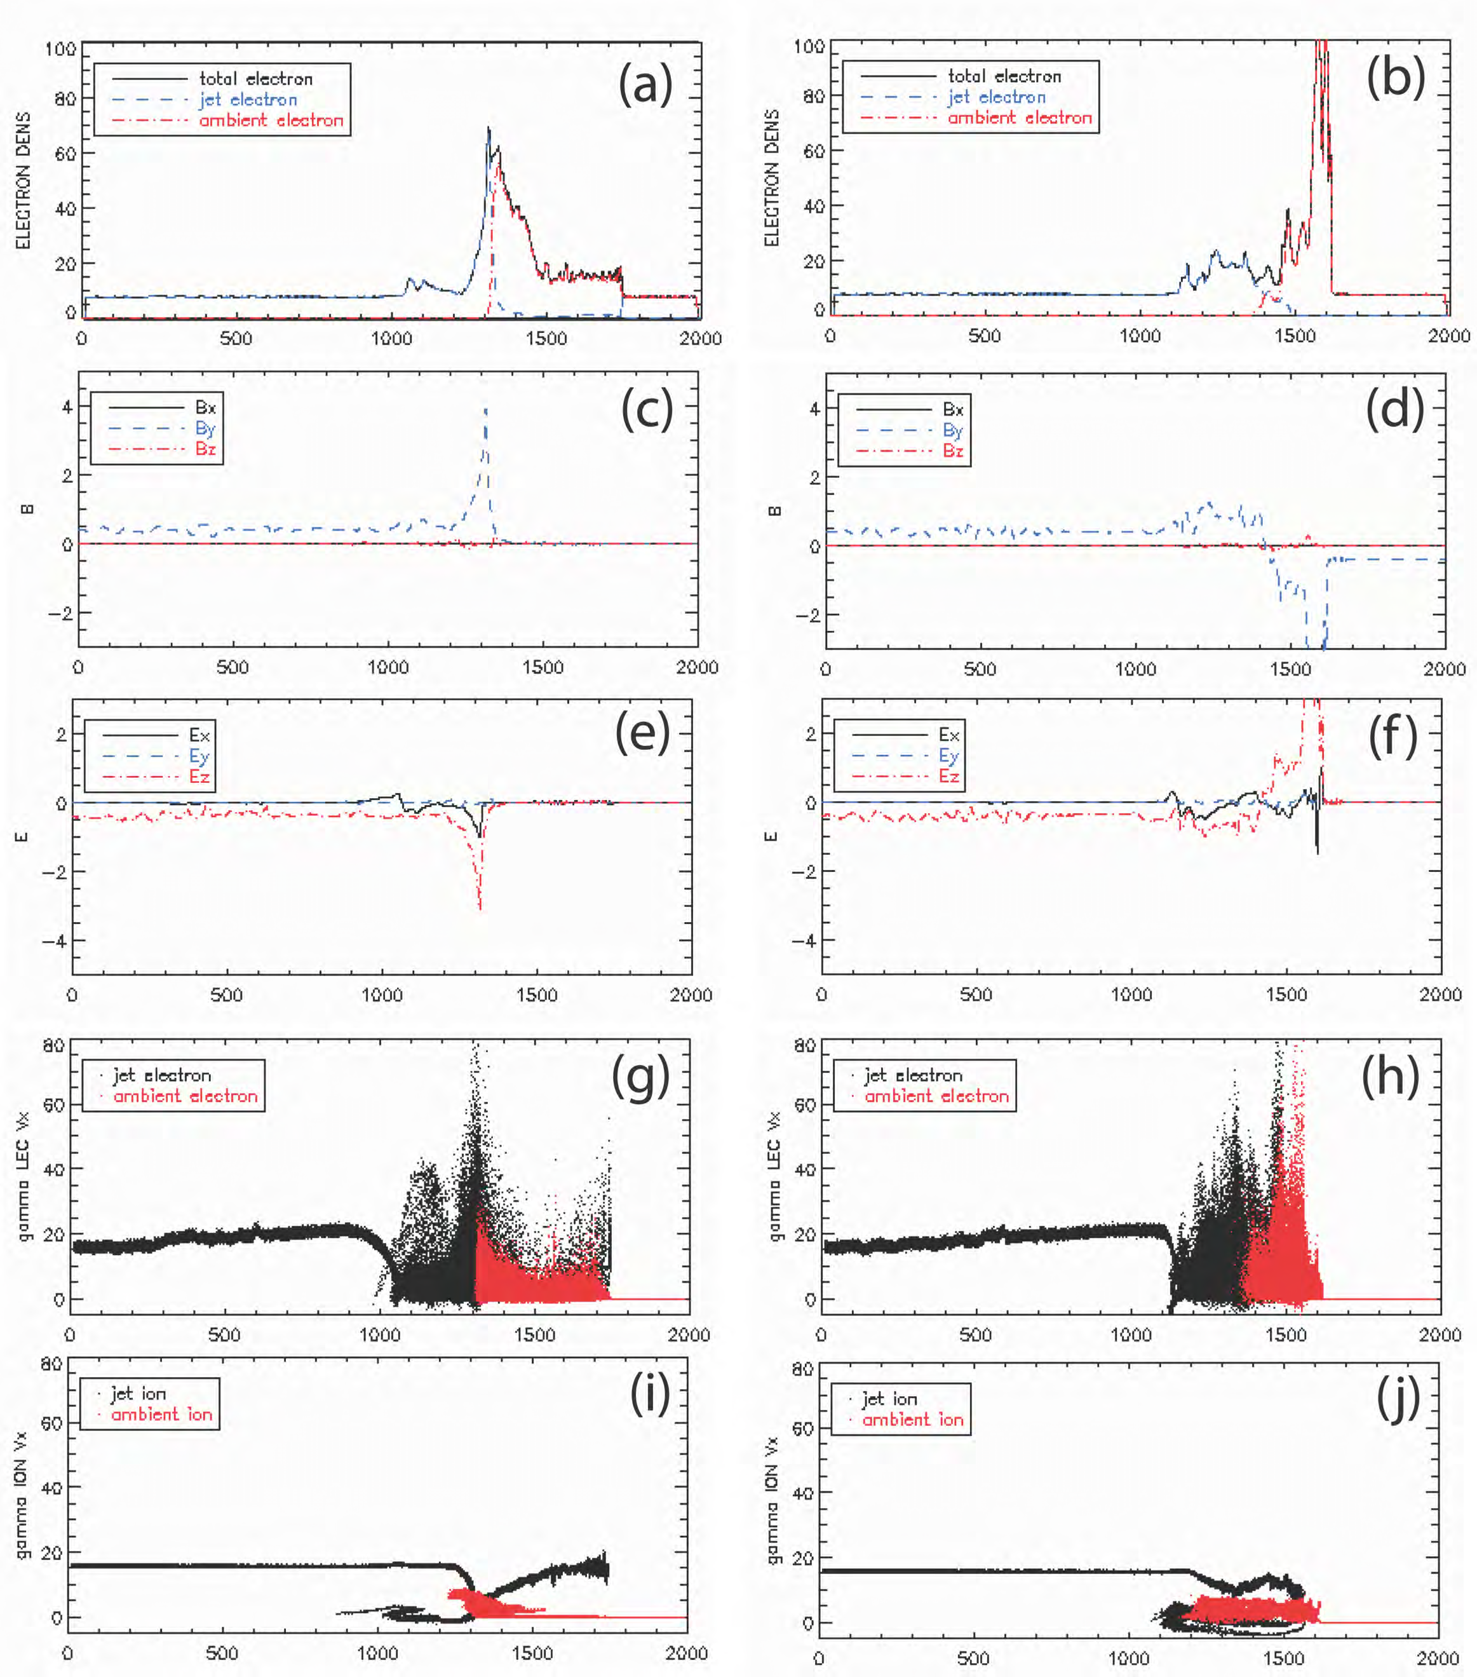
Simulations with magnetic field in jets
no magnetic field
anti-parallel magnetic field
Snapshots for unmagnetized
ambient plasma (left column) and
anti-parallel magnetic field in the
ambient plasma (right column) at
t = 1450
(Choi, Min, and Nishikawa, 2012).
The averaged values of electron
density (a) and (b), magnetic field
(c) and (d), electric field (e) and (f),
phase space of electrons (g) and (h),
and phase space of ions (i) and (j).
Reconnection occurs for the case of
anti- parallel magnetic fields and is
indicated by the positive E_{y}
component in (f).
Choi, Min, KN, 2013 (in progress)

Slide 21
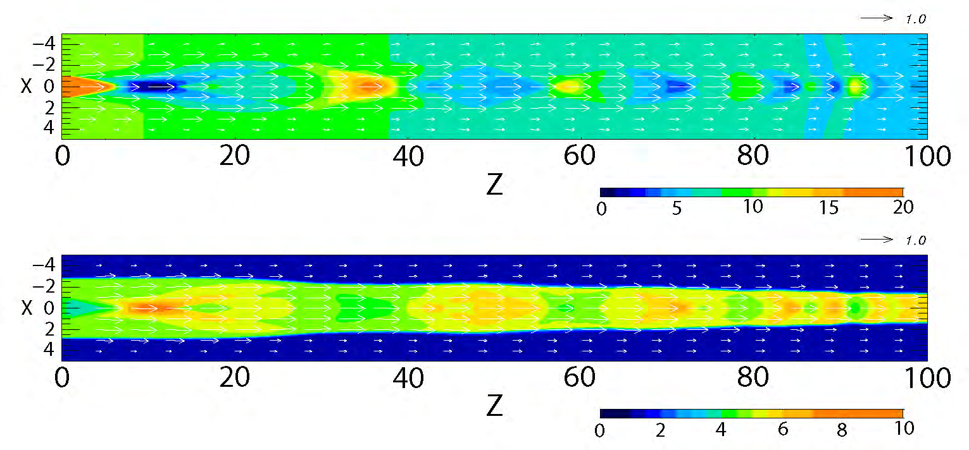
3D RHD simulation of recollimation shock
similar parameters of Gómez et al. (1997)
t = 100 R_{jet}/c
gas pressure
Lorentz factor
Mizuno et al. in progress, 2013

Slide 22
Summary of Results
The Weibel instability creates filamented currents and density
structure along the propagation axis of the jet.
The growth rate of the Weibel instability depends on the Lorentz
factor, composition, and strength and direction of ambient B fields.
The presence of ions in the ambient plasma enhances the strength of
the generated magnetic fields due to the excitation of the ion Weibel
instability.
This enhanced magnetic field with electron-ion ambient plasma may
be the cause of large upstream magnetic fields in GRB shocks.
In order to understand the complex shock dynamics of relativistic
jets, further simulations with additional physical mechanisms such
as radiation loss and inverse Compton scattering are necessary.
Spectra from two electrons were calculated for different conditions.
The magnetic fields created by the Weibel instability generate
highly inhomogeneous magnetic fields, which are responsible for
Jitter radiation (Medvedev, 2000, 2006; Fleishman 2006; Frederiksen et al.
2010, Medvedev et al 2011).
Our new numerical approach of calculating radiation from electrons
based on self-consistent simulations provides more realistic spectra
including jitter radiation.

Slide 23
Future plans
Further simulations with a systematic parameter
survey will be performed in order to understand
shock dynamics including reconnection and KKHI.
Further simulations will be performed to calculate
self-consistent radiation including time evolution
of spectrum and time variability using larger systems.
Investigate radiation processes from the accelerated
electrons in turbulent magnetic fields and compare
with observations (GRBs, SNRs, AGNs, etc).
Particle acceleration and radiation in recollimation
shocks

Slide 24
Present theory of Synchrotron radiation
Fermi acceleration (Monte Carlo simulations are not self-
consistent; particles are crossing the shock surface many
times and remain accelerated, the strengths of turbulent
magnetic fields are assumed), Some simulations exhibit
Fermi acceleration (Spitkovsky 2008)
The strength of magnetic fields is estimated based on
equipartition - magnetic field energy is comparable to the
thermal energy): ε_{B} ~ u(T)
The distribution of accelerated electrons is approximated
by the power law (F(γ) = γ^{−p}; p = 2.2?) (ε_{e})
Synchrotron emission is calculated based on p and ε_{B}
There are many assumptions in this calculation!

Slide 25
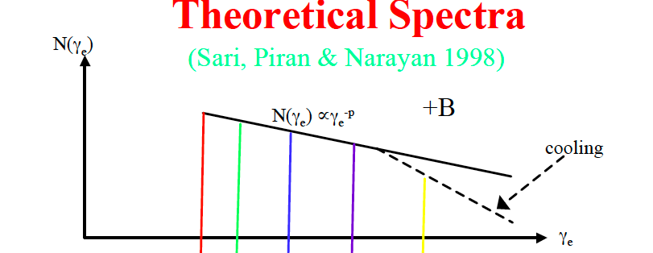
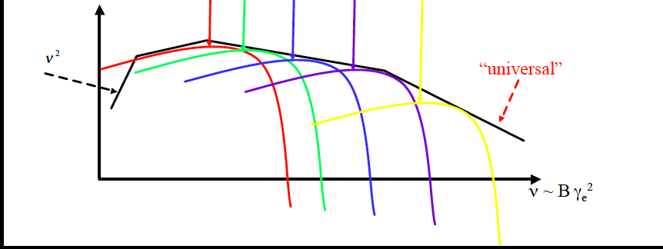
Synchrotron Emission: radiation from accelerated
adapted by
S. Kobayashi
BM, PL, BB
by talk by
S. Guiriec
Talks by G.
Vianello and
D. Guetta

Slide 26
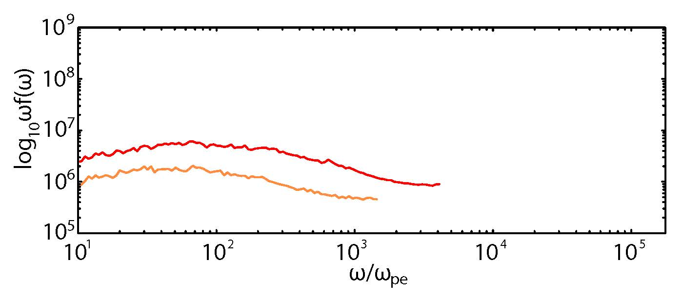
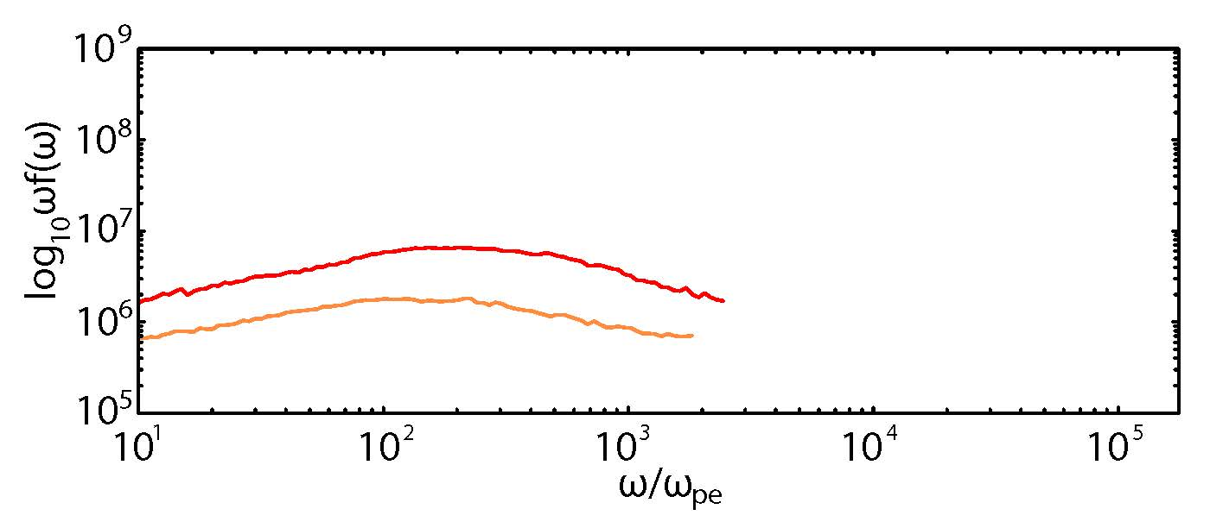
Radiation in a small system
without iteration
with iteration

Slide 27
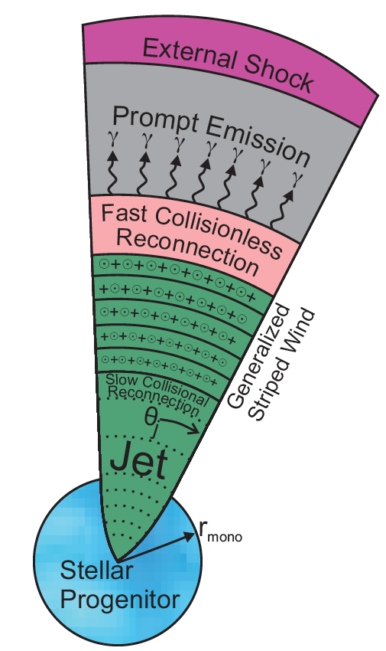
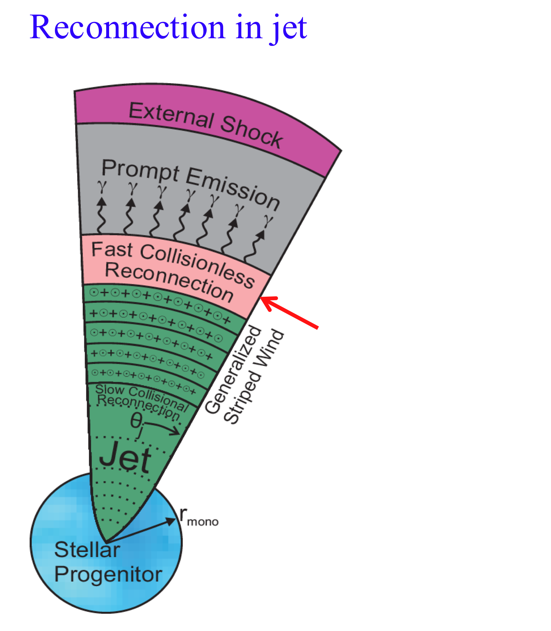
Reconnection switch concept:
Collapsar model or some
other system produces a jet
(with opening half-angle θ_{j})
corresponding to a generalized
stripped wind containing many
field reversals that develop
into dissipative current sheets
(McKinney and Uzdensky,
2012, MNRAS, 419, 573).
This reconnection needs to
be investigated by resistive
RMHD, which is in progress
within our research effort.
fast collisionless
reconnection
Talk by
A. Tchekhovskov
Reconnection in jet
Reconnection switch concept: Collapsar model or some other system produces a jet (with opening half-angle θ_{j}) corresponding to a generalized stripped wind containing many field reversals that develop into dissipative current sheets. (McKinney & Uzdensky, MNRAS, doi:10.1111/j.1365-2966.2011.19721.x2011)
Reconnection switch concept: Collapsar model or some other system produces a jet (with opening half-angle θ_{j}) corresponding to a generalized stripped wind containing many field reversals that develop into dissipative current sheets. (McKinney & Uzdensky, MNRAS, doi:10.1111/j.1365-2966.2011.19721.x2011)

Slide 28
Outline
Standard radiation mode
Self-consistent radiation method using PIC
simulations
3. Synthetic spectra in shocks generated by
the Weibel instability
4. Importance of reconnection in relativistic jet
5. Strong magnetic field amplification with
magnetic fields
6. Magnetic field generation and particle
acceleration in kinetic Kelvin-Helmholtz
instability
7. Summary
8. Future plans

Slide 29
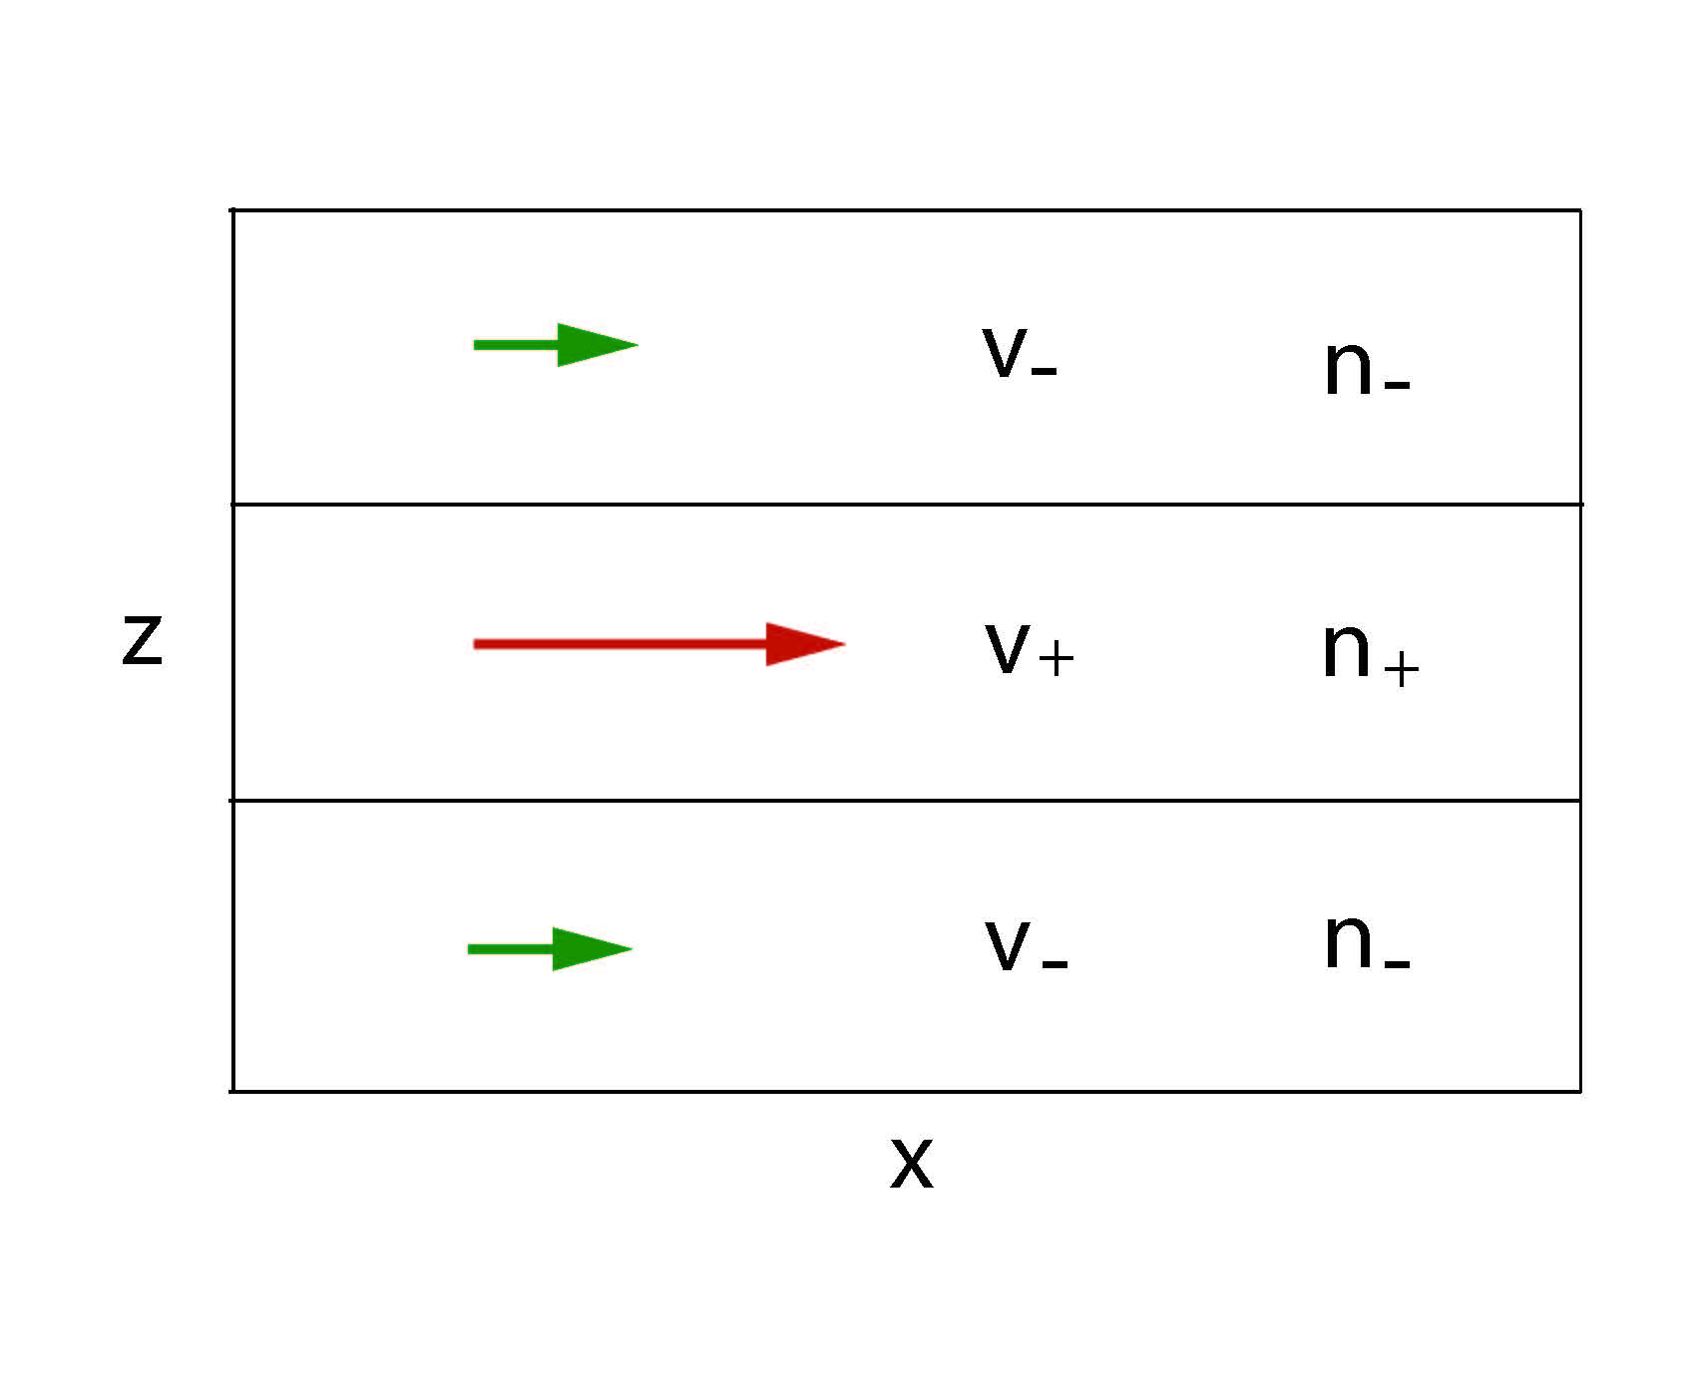
Study of the relativistic velocity shear interface KKHI instability
Low-frequency limit (V₋=0)

Slide 30
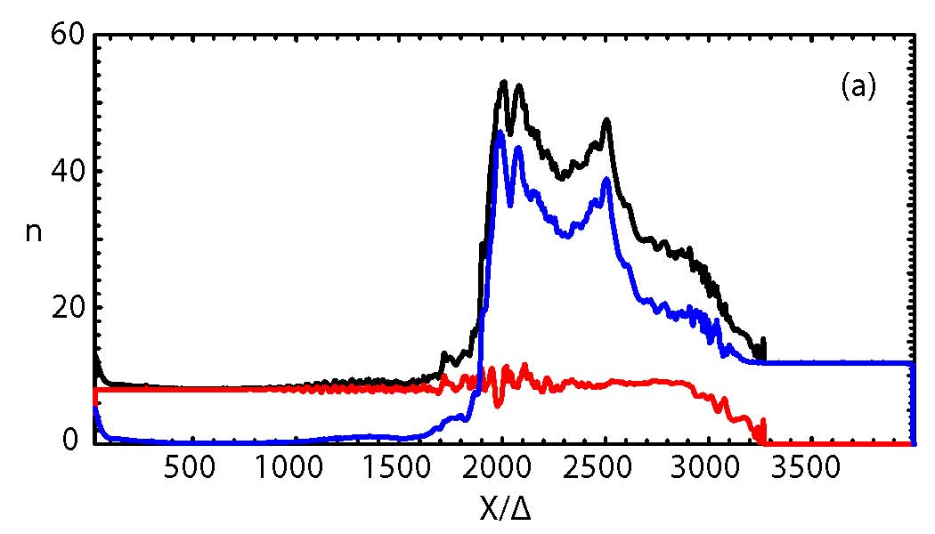

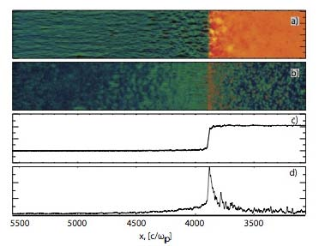

Shock velocity and structure based on
1-D HD analysis
moving contact discontinuity (CD)
reverse shock
forward shock
(Nishikawa et al. 2009)
fixed CD
Density
n₂/γ₀n₁=3.13
0
γ₀ = 15
(Spitkovsky, ApJ, 682:L5, 2008 (adapted))

