Slide 1
The Role of Magnetic Fields in the Production and Propagation of Relativistic Jets (A Review with a Suggested Paradigm)
David L. Meier
California Institute of Technology
The Innermost Regions of Relativistic Jets And Their Magnetic Fields Granada, Spain; 10 June 2013

Slide 2
Outline
N.B.: I will discuss mainly AGN jets in this brief review.
However, what we learn from AGN jets likely will affect how we view GRB, XRB, and even proto-stellar jets
Talk Summary: Class Divisions in AGN Jets
Preliminary Discussion: MHD Waves and MHD Jets
Launching, Acceleration, Collimation of MHD Jets
Beyond the Magnetosonic Horizon

Slide 3
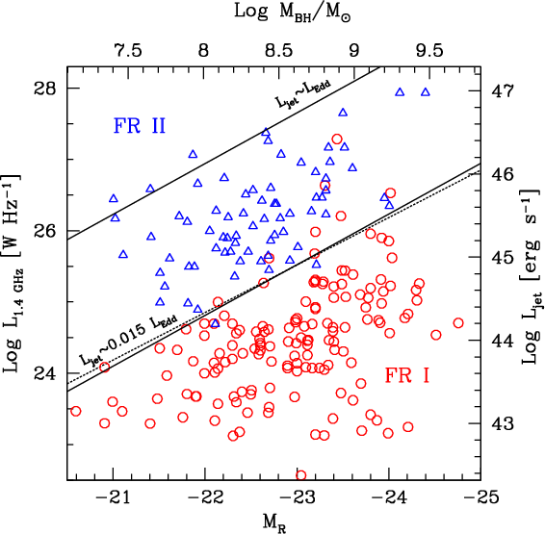
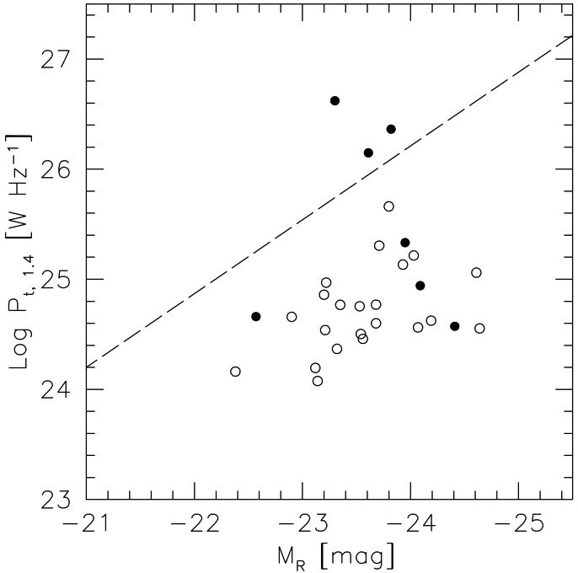
Summary: Class Divisions in AGN Jets
Two widely-held cherished beliefs…
All sources appearing as BL Lacs when viewed nearly end-on and imaged with VLBI on the parsec scale are, in fact, drawn from the same population: the class of FR I radio sources
All sources appearing as Quasars when viewed nearly end-on and imaged with VLBI on the parsec scale are, in fact, drawn from the same population: the class of FR II radio sources
…Lead to a surprising conclusion
Jets not only know early whether or not they are going to be an FR I or FR II, i.e. within only 10^{5–6} stellar (BH) radii of the jet launch point, but they also have acquired morphological and magnetic properties that are related to what type of jet they eventually will be
➔ The origin of the FR sequence lies very deep in the nucleus of the host galaxy
Ghisellini & Celotti (2001)
Giroletti et al. (2006)
LBLs
HBLs

Slide 4
Summary: The “Phoenix-Fire” Paradigm For the Birth of Astrophysical Jets
Fire = The Jet Recollimation Shock at significant distance from the BH
Phoenix (bird) = The Jet itself, which is reborn in the shock in its (nearly) final form
Tenet #1: All jets have an Acceleration & Collimation Zone (ACZ) that ends with the jets being hyper-magnetosonic and passing through a magnetosonic (MS) horizon
Tenet #2: Beyond the MS horizon, jets pass through at least one (re-)collimation shock (RCS), in which they are reborn as a new type of jet that can propagate long distances
The goal in this talk is to discuss (on the basis of observations and simulations) the possible properties of the RCS and the post-shock jet:
Is the jet super-, trans-, or sub- (magneto-)sonic ( V_{j} vs. c_{ms} = [c_{s}² + V_{A}²]^{1/2} )?
Is it Kinetic (KFD) or Poynting (PFD) Flux Dominated ( ½ ρ₀ V_{j}³ vs. ρ₀ R_{j}Ω_{f} V_{A}² )?
What is the jet’s internal magnetic properties ( U_{p} vs. U_{mag} or c_{s} vs. V_{A} ) ?
Could processes in the RCS be the origin of the Fanaroff & Riley sequence?

Slide 5
Preliminary Discussion: MHD Waves and MHD Jets

Slide 6
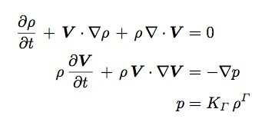
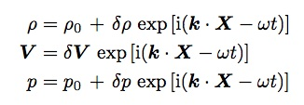
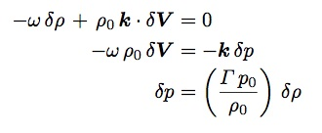
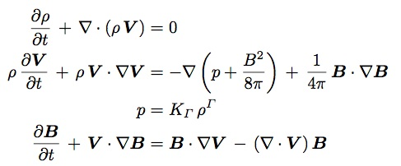
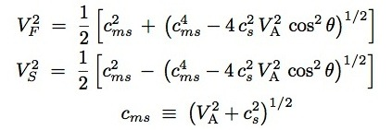
Preliminaries: MHD Waves
It is more important for jet astronomers to understand MHD waves than for (optical) stellar astronomers to understand nuclear reactions.
Why? Because MHD waves are potentially observable in jets.
HD Dispersion Relations
HydrodynamicWaves (NR):
Magnetohydrodynamic Waves (NR):
HD Equations
HD Linear Perturbations (V₀ = 0)
HD Linearized Equations
Sound (Acoustic) Waves
MHD Dispersion Relations
MHD Equations
Alfven Waves
Magneto-Acoustic Waves

Slide 7
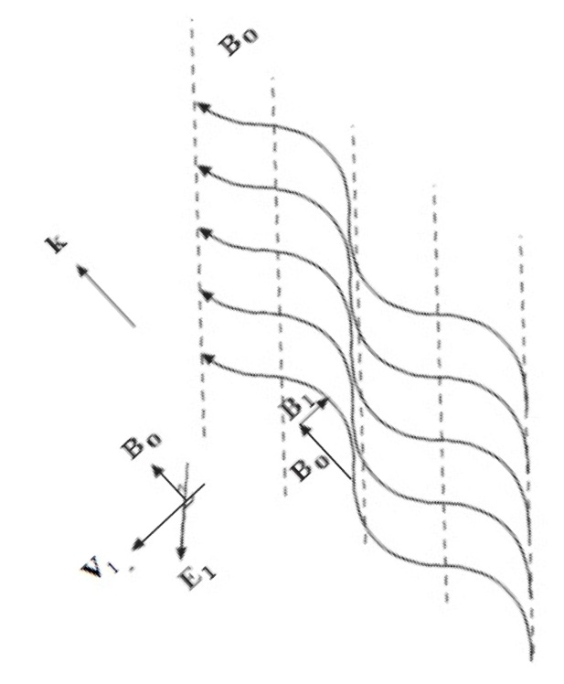
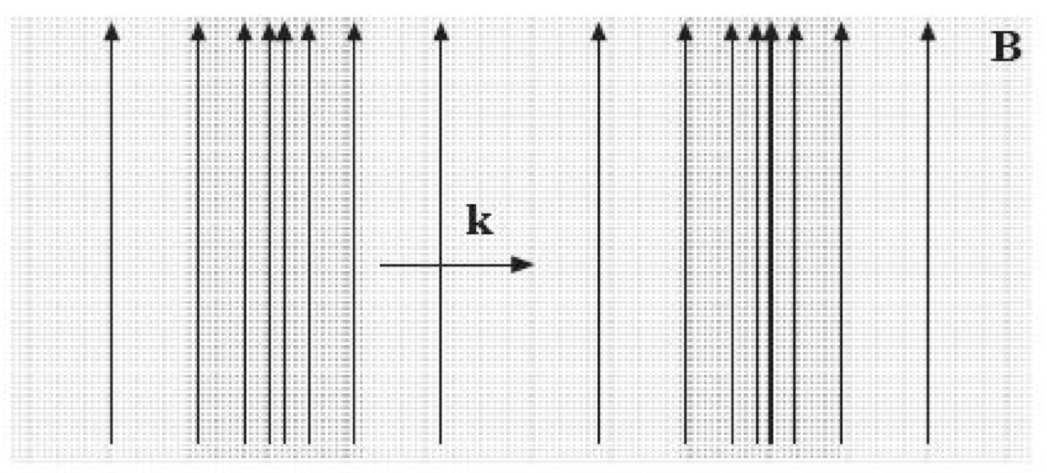
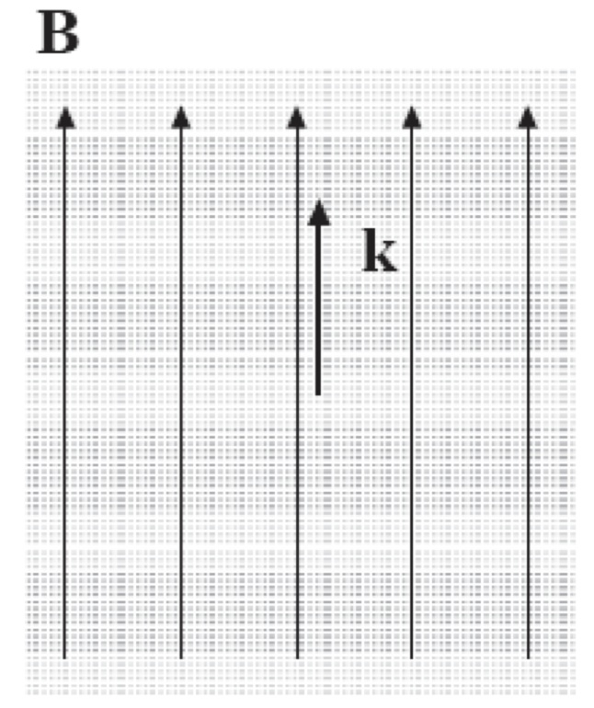
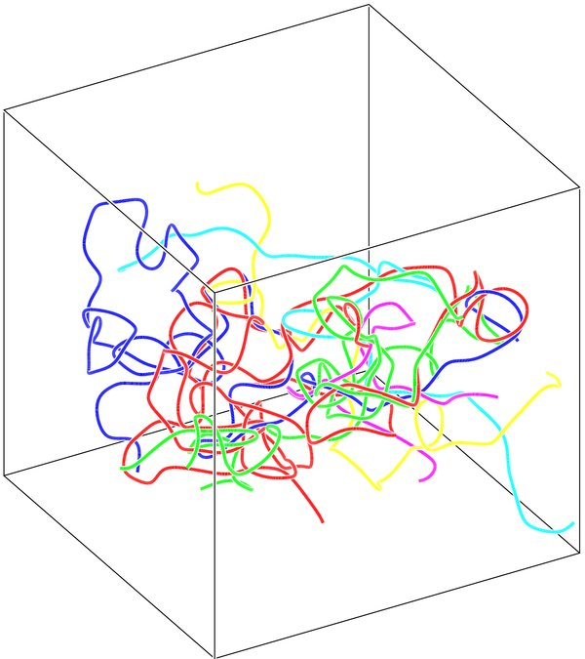
Preliminaries: Properties of MHD Waves
MHD Waves in Magnetically-Dominated Plasmas (U_{mag} >> U_{p} ; V_{A} >> c_{s})
MHD Waves in Particle-Dominated Plasmas (U_{p} >> U_{mag} ; c_{s} >> V_{A})
NOTE: When V_{A} ~ c_{s} (equipartion), all 3 types (Alfven, fast, slow) are important
Alfven Wave (V_{ph} = V_{A} cos θ)
V_{ph, A, ||} = V_{A} ; V_{ph, A, perp} = 0
Fast Wave (V_{ph} = V_{F})
V_{ph, F, ||} = V_{A} ; V_{ph, F, perp} = (V_{A}²+c_{s}²)^{1/2}
Slow Wave (V_{ph} = V_{F})
V_{ph, S, ||} = c_{s} << V_{A} ; V_{ph, S, perp} = 0
k
k
k
Alfven Wave (unimportant)
V_{ph, A, ||} = V_{A} << c_{s} ; V_{ph, A, perp} = 0
Fast (~Sound) Wave
V_{ph, F} = c_{ms}
(cf. Hughes et al. 1985)
Slow Wave (unimportant)
V_{ph, S, ||} = V_{A} << c_{s} ; V_{ph, S, perp} = 0

Slide 8
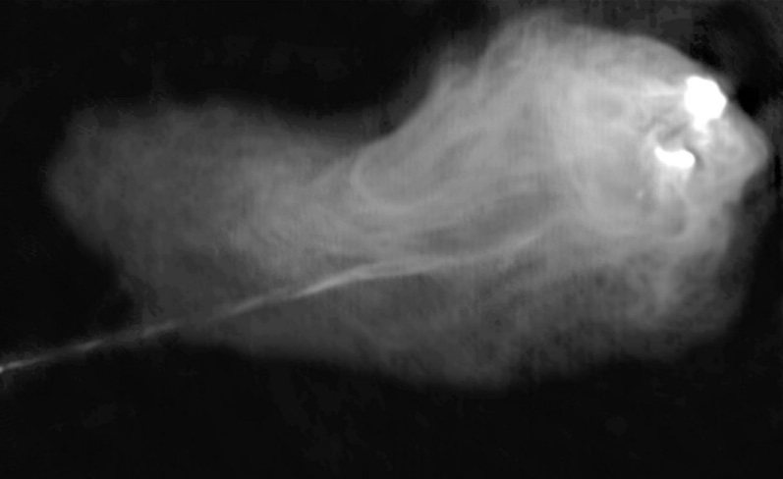
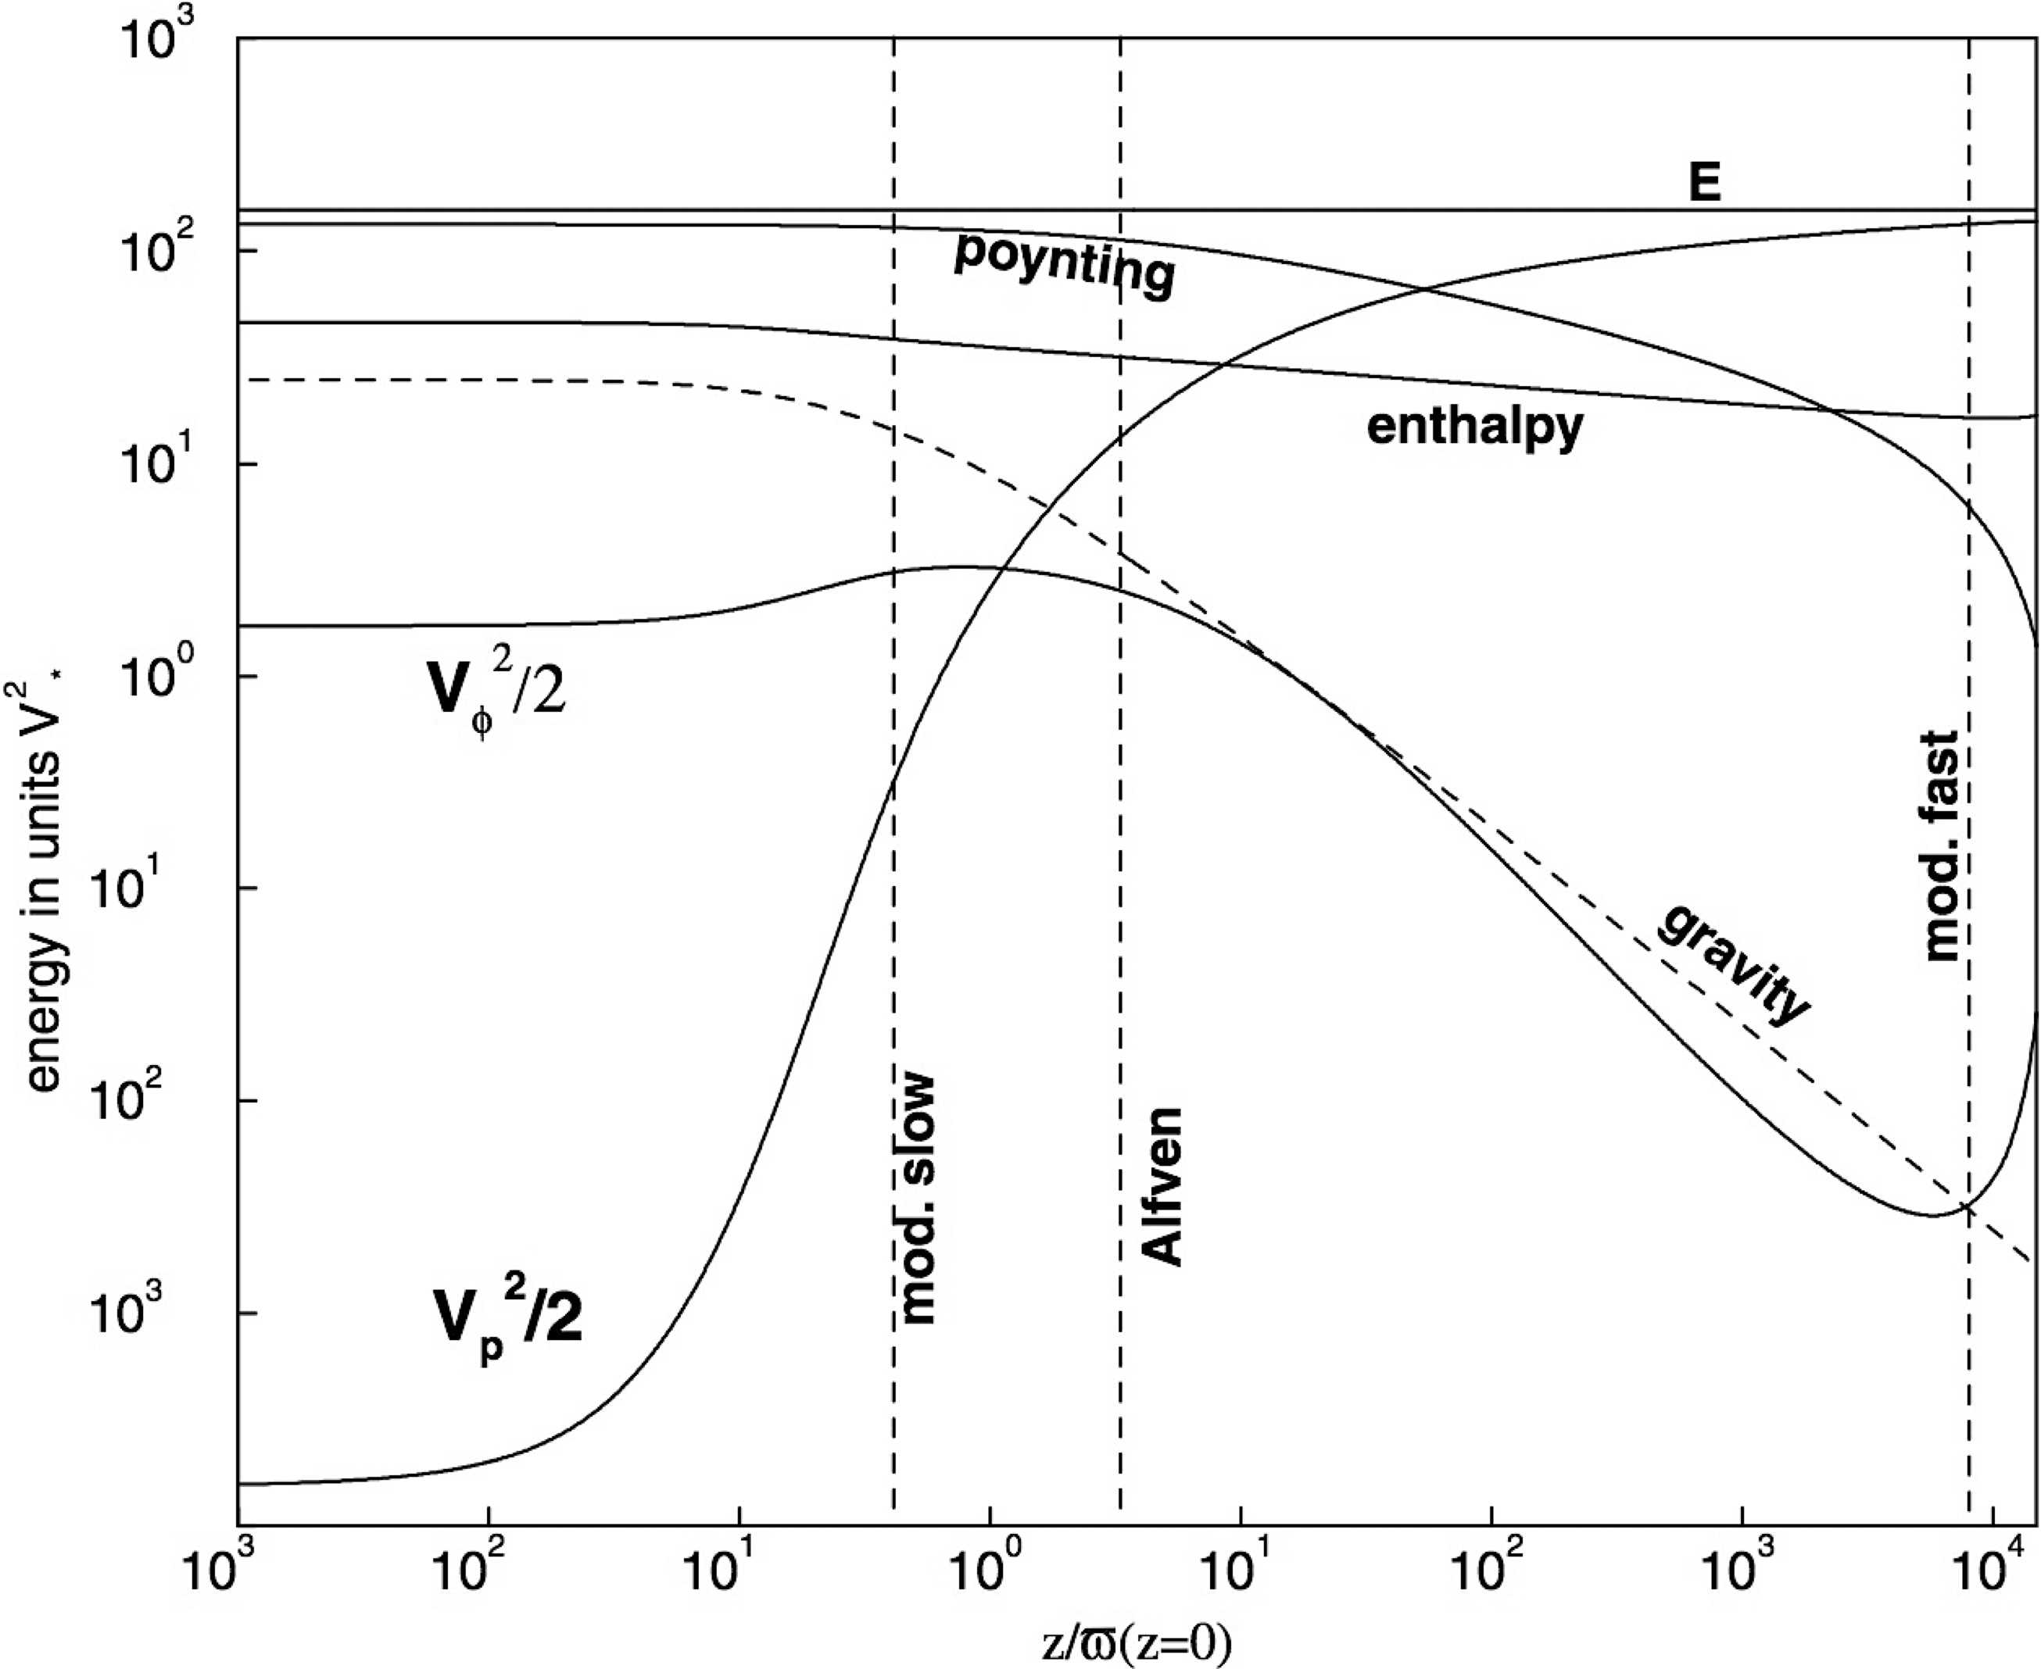
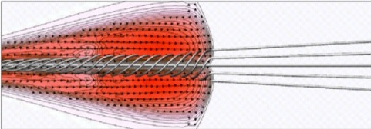
Types of MHD Jets
Kinetic Flux Dominated (KFD; V_{j} >> [V_{A}² max(R_{j}Ω_{f}, V_{j})]^{1/3})
EXAMPLE: Cyg A, probably all other FR IIs
Morphology similar to unmagnetized HD simulations (Norman et al. 1982)
Hot spots of FR IIs are below equipartition (U_{p} >> U_{mag} ; Werner et al. 2012)
Jet propelled forward by ram pressure of plasma flow
F_{Kinetic} = γ (γ -1) ρ₀ c² V_{j} ≈ ½ ρ₀ V_{j}³
Poynting Flux Dominated (PFD; V_{j} << [V_{A}² max(R_{j}Ω_{f}, V_{j})]^{1/3})
EXAMPLE: Acceleration and Collimation Zone (ACZ)
Jet plasma propelled forward by rotating torsional Alfven wave “turbine”
F_{Poynting} = ρ₀ R_{j}Ω_{f} V_{A}² (cos α sin α) (α = pitch angle)
Hybrid (V_{j} ~ [V_{A}² max(R_{j}Ω_{f}, V_{j})]^{1/3})
Possible EXAMPLE: Vir A (M87), maybe many other FR Is
Dreher et al. (1987)
Norman et al. (1982)
Nakamura (2001)
Vlahakis et al. (2000)
Perlman et al. (1999)

Slide 9
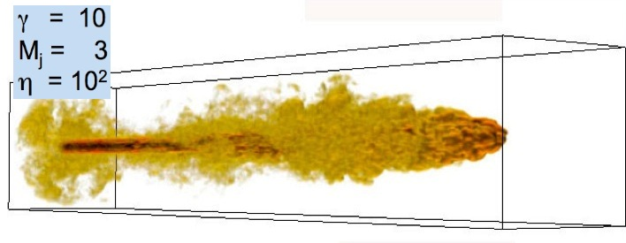
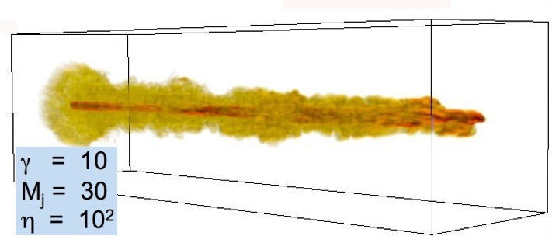
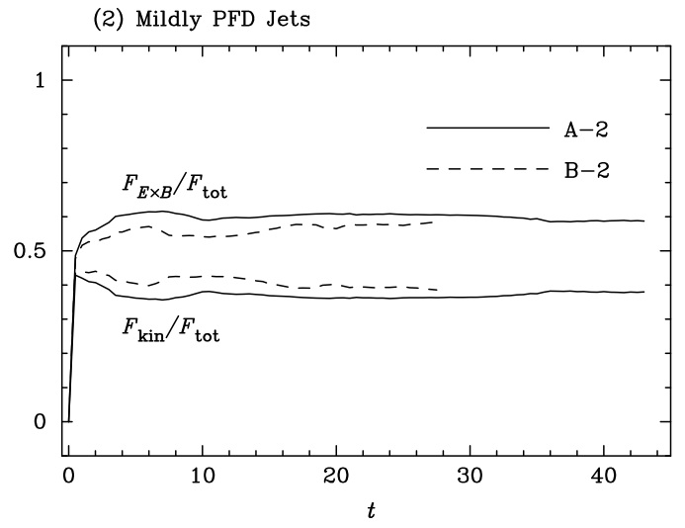
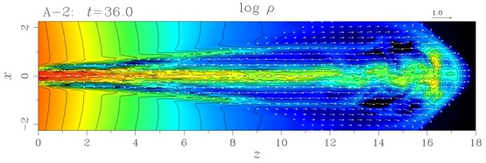
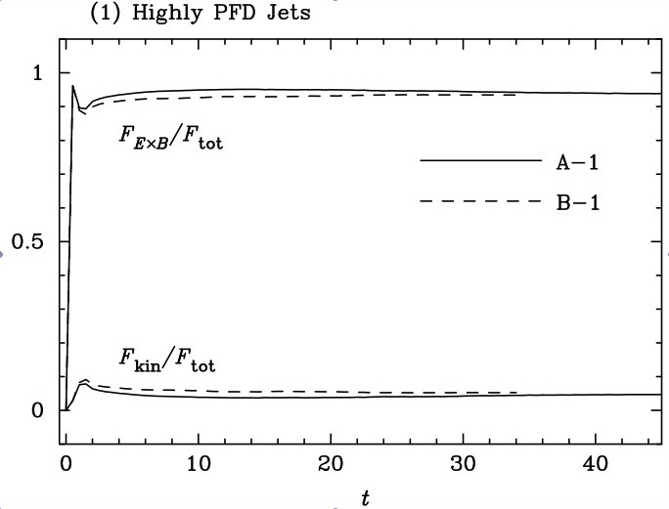
Helical Kink Instabilities in MHD Jets
Highly KFD jets (V_{j} >> [V_{A}² max(R_{j}Ω_{f}, V_{j})]^{1/3})
Are subject to Kelvin-Helmholtz instabilities
But not the magnetic helical kink
KH stability increases with Mach number (and γ)
Hybrid jets (V_{j} ~ [V_{A}² max(R_{j}Ω_{f}, V_{j})]^{1/3})
Are subject to helical kink instabilities, but only moderately so
Highly Poynting Flux Dominated jets (V_{j} << [V_{A}² max(R_{j}Ω_{f}, V_{j})]^{1/3})
Are subject to significant helical kink instabilities
There are some indications that increasing Lorentz factor might mitigate these, but no definitive studies yet
Rossi et al.(2008)
Nakamura & Meier (2004)
Nakamura & Meier (2004)

Slide 10
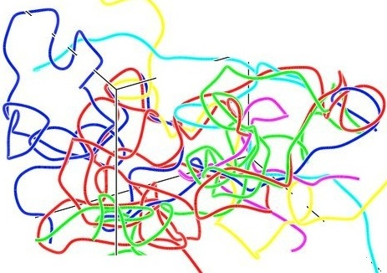
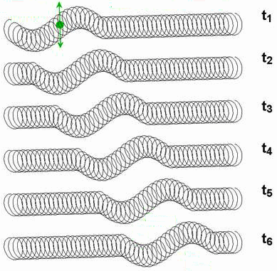
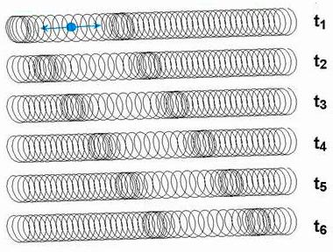
MHD Waves and Shocks in MHD Jets
MHD Waves in Particle-Dominated Jets (U_{p} >> U_{mag} ; c_{s} >> V_{A})
Alfven and Slow-mode waves are probably unimportant; only FAST (~sound) waves and shocks
MHD Waves in Magnetically-Dominated Jets (U_{mag} > U_{p} ; V_{A} > c_{s})
FAST-mode waves/shocks would appear very similar to the above, but increasing the order of a HELICAL field
ALFVEN-mode waves would be very distinctive; NOTE: there are no Alfven shocks
SLOW-mode waves/shocks would, at first, look like FAST-mode ones
Plasma is compressed, synchrotron emission enhanced
BUT, MAGNETIC FIELD STRUCTURE REMAINS UNCHANGED
However, the slow-mode wave/shock would ROTATE around the jet axis, possibly producing strong synchrotron polarization rotation
see Hughes et al. (1985)
V_{pattern} ≥ V_{F} = c_{ms} ≈ c_{s}
V_{pattern} ≥ V_{F} = c_{ms} > V_{A}
FAST- Mode Wave/Shock
ALFVEN-Mode Wave
V_{pattern} = V_{A}
SLOW-Mode Shock
FAST- Mode Shock
Nakamura (2001)

Slide 11
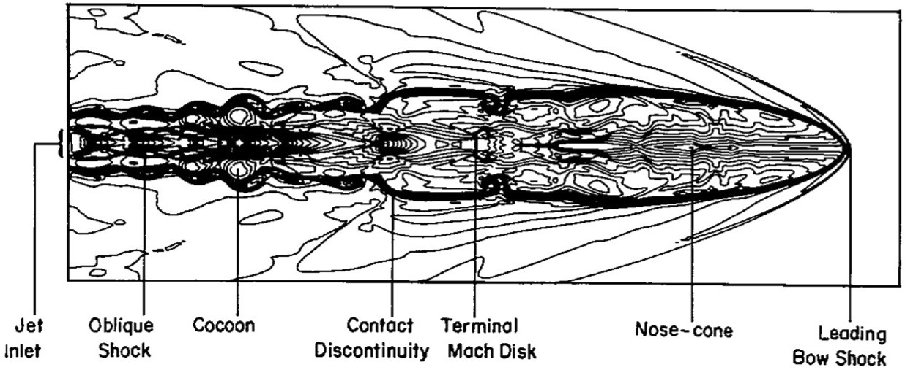
Application: Important Question for Observers
Which of these two forces dominates in the PORTION of the jet that I am observing?
Particle (Plasma Pressure) Forces (U_{p} >> U_{mag} ; c_{s} >> V_{A})?
VLBI: Ballistic component motions (whether they are shocks or “blobs”)
Spectrum: SSC analysis implies U_{mag} << U_{p} (Werner et al. 2012)
Hot Spot/Lobe Morphology: Splash-back with cocoon (Norman et al.1982)
Magnetic Forces (U_{mag} >> U_{p} ; V_{A} >> c_{s})?
VLBI:
Faraday rotation; Circular polarization; Helical magnetic field (Gabuzda et al. 2008)
NON-ballistic component motions (“pulled aside” by simultaneous Alfven wave; Cohen, this conference) V_{F,comp} / V_{wave} ≥ ~ csc α
VLBI & VLA jets:
Strong polarization (>> 10%)
Helical kinks in the FLOW (not just pattern waves)
Hot Spot/Lobe Morphology:
Forward focusing (Clarke et al. 1986; Lind et al. 1989)

Slide 12
Launching, Acceleration, and Collimation of MHD Jets

Slide 13
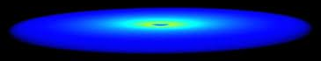
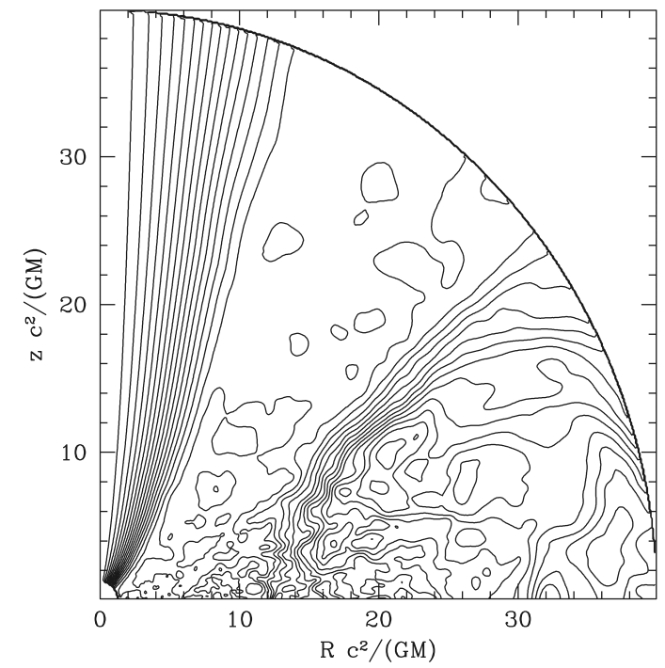
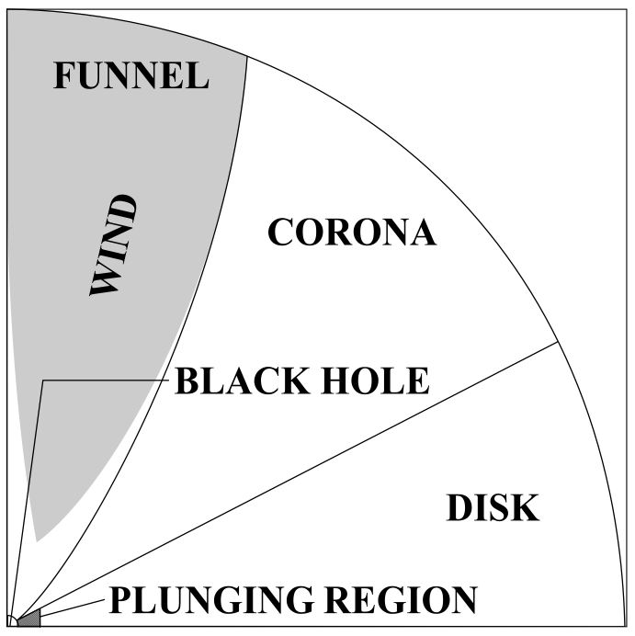
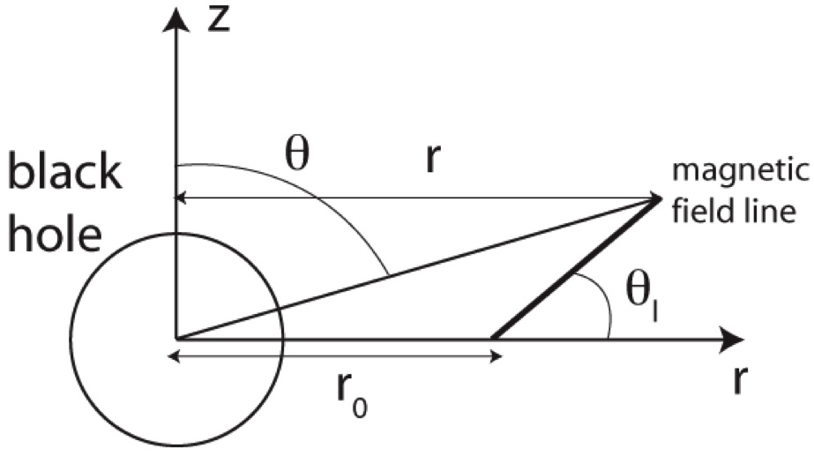
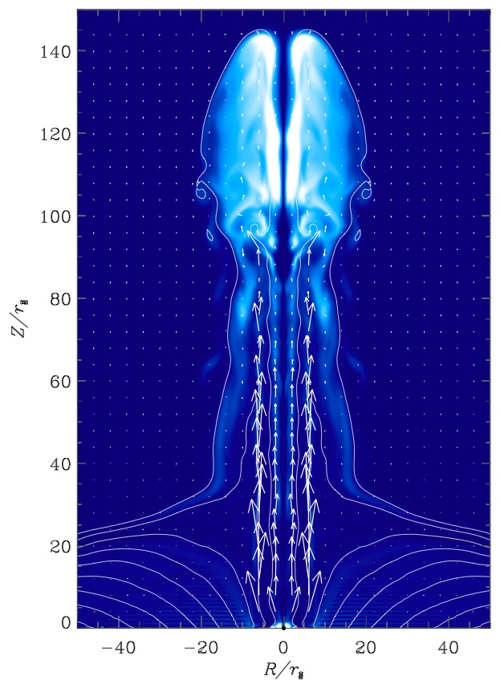
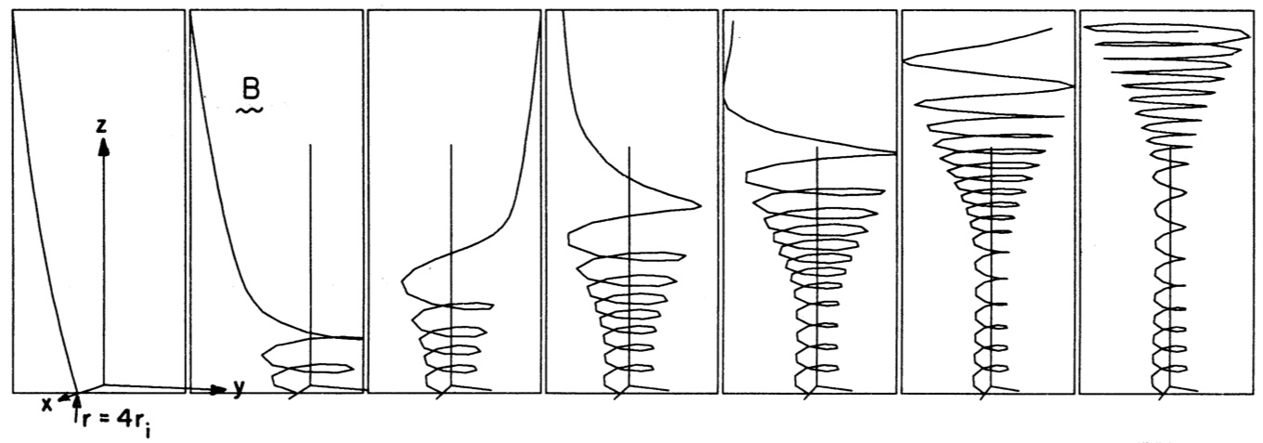
Launching of MHD Jets
Definition of Jet Launching: Lifting jet plasma out of the deep, tidal compact object potential so it can be accelerated and collimated largely free of gravitational effects
Tidal force in Z direction for constant Z << R is quark-like
– GM Z ⁄ (R²+Z²)^{3/2} ≈ – GM Z ⁄ R³ ∞ – Z
Gas Pressure (~ slow MHD mode) Launching
Typical of most hot plasma RIAF / jet simulations
Magnetized plasma lifted up to Z ~ R
Acceleration & collimation takes place for Z > R
Alfven Mode Launching (“fling”; magneto-centrifugal)
Rotating magnetic field, loaded with cold plasma
Requires θ_{l} < 60° (Blandford & Payne 1982)
Plasma is flung outward until it bends field into helix
Fast MHD Mode Launching (“spring”; mag pressure)
“Magnetic tower”
Field is coiled in Z < R
McKinney & Gammie (2004)
Lyutikov (2009)
Ustyugova et al. (1995)
Meier et al. (1997)

Slide 14
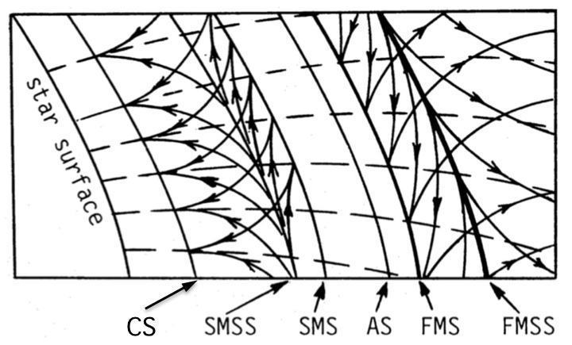
Acceleration and Collimation of MHD Jets
To first order, all jet sources should have similar ACZs: acceleration and collimation will occur as the jet passes through multiple critical and separatrix surfaces
Critical Surfaces are where V_{j} = (V_{C}, V_{S}, or V_{F}):
CS: Cusp Surface
SMS: Slow Magnetosonic Surface
FMS: Fast Magnetosonic Surface
Separatrix Surfaces (internal boundaries, from which information flows up & down stream)
SMSS: Slow Magnetosonic Separatrix Surface
AS: Alfven Surface
FMSS: Fast Magnetosonic Separatrix Surface – the “magnetosonic horizon”
A streamline crossing a separatrix surface creates a singular point
ACZ
Causally Disconnected
Bogovalov (1994); Contopoulos (1996)
Modified Slow Point (V_{θ} = V_{slow})
Alfven Point (V_{jet} = V_{Alfven})
Modified Fast Point (V_{θ} = -V_{fast})
NOTE: Beyond the magnetosonic horizon (FMSS), information flow (characteristics) points only DOWNSTREAM.
Therefore, NO EVENT OR FEATURE BEYOND THE FMSS CAN AFFECT THE STRUCTURE OF THE ACZ (via MHD waves)
ACZ
SMSS
AS
FMSS

Slide 15
Beyond the Magnetosonic Horizon: How the Jet is Dispatched in its Final Form

Slide 16
What is the State of the Jet Beyond the Magnetosonic Horizon?
Kinetic energy Flux Dominated (V_{j} >> [V_{A}² max(R_{j}Ω_{f}, V_{j})]^{1/3})
Plasma internal energy still dominated by helical magnetic field (U_{mag} >> U_{p} ; V_{A} >> c_{s})
Hyper-magnetosonic (V_{j} >> c_{ms} ~ V_{A})
2-D Simulations of this Kind of Flow All Show the Same Results
(Clarke et al. 1986; Lind et al. 1989; Komissarov 1999; Kraus & Camenzind 2001)
Flow is unstable to forming a strong, quasi-stationary magnetic pinch shock
Longitudinal compression increases toroidal field strength
Which pinches (increases hoop stress on) the plasma
Which further enhances the shock strength
The post-shock flow is slowed to trans-magnetosonic (V_{j} ~ c_{ms} ~ V_{A})
A “magnetic chamber” forms that periodically ejects plasma pulses
Lind, Payne, Meier, & Blandford (1989; NR)
Komissarov (1999; relativistic)

Slide 17
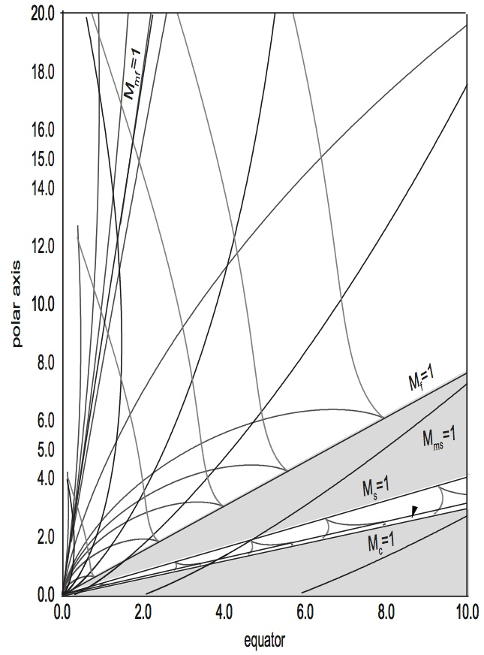
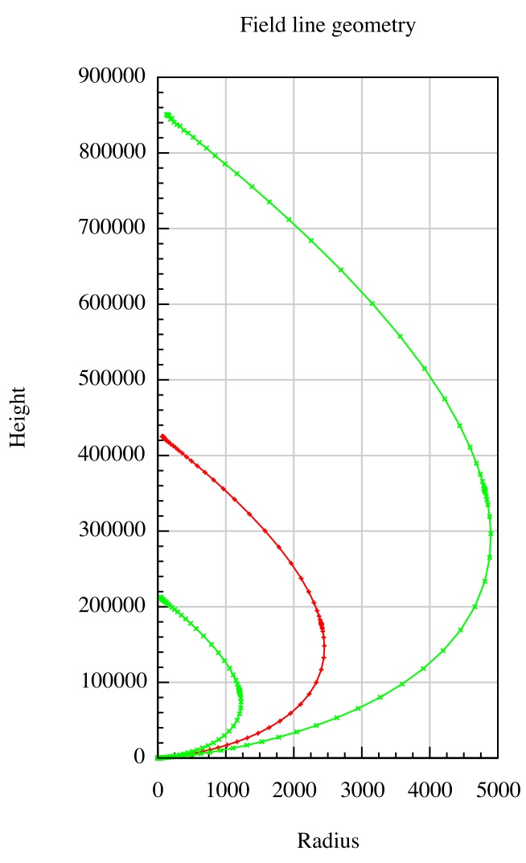
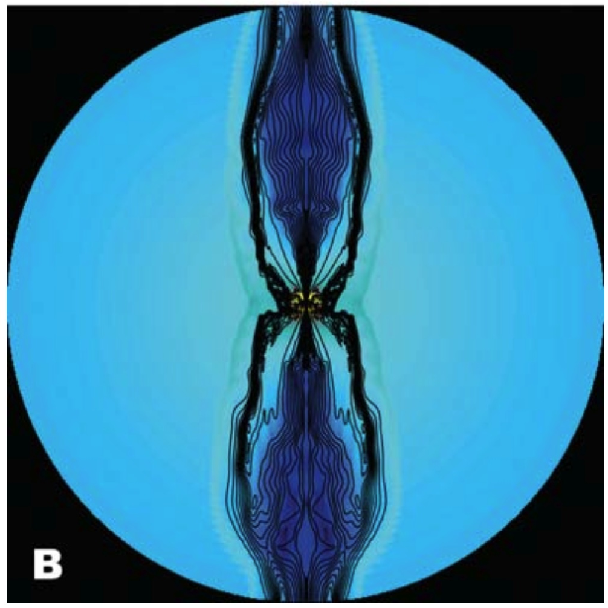
Possible Triggering of Recollimation Shocks
Self-similar models of the ACZ indicate that jets whose flow passes through the MS horizon likely will recollimate toward the jet axis, triggering the pinch shock
SHOCK
FMSS
SHOCK
FMSS
Vlahakis et al. (2000; NR)
Polko et al. (2013; Rel)
McKinney (2006; Rel)
NOTE: Some people consider self-similar models to be controversial
We therefore need many more, and much longer, simulations like McKinney (2006)
Also, 2-D GSS models, with separatrix surface enforcement, would be very useful
In these models recollimation shocks occur in the causally-disconnected region
RCS would NOT destroy the jet engine ➔ Steady state ACZ model is self-consistent

Slide 18
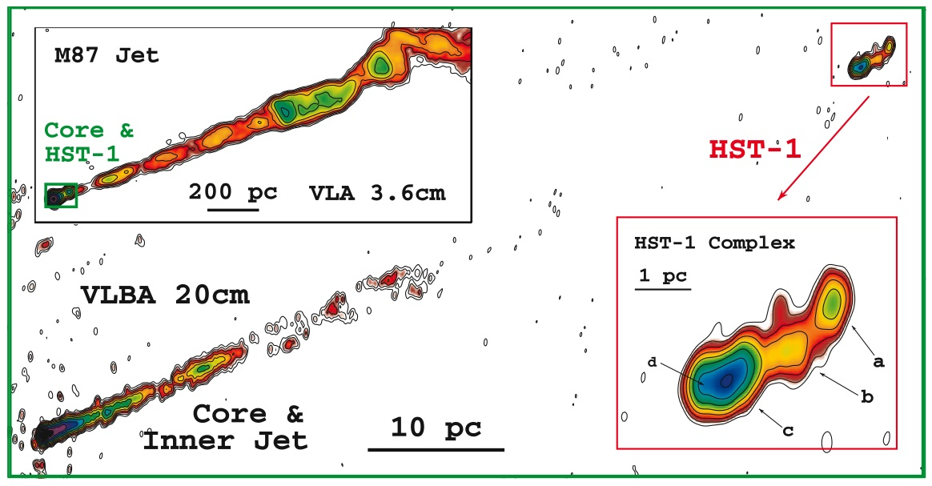
How Would an RCS and Its Post-Shock Jet Appear?
Expected observational properties of RCS
Virtually STATIONARY VLBI jet component, many parsecs from the core
A time lag between core flaring and RCS flaring
Inferred power transmission speeds >> RCS speed (e.g., Cen A, Tingay et al. 1998; BL Lac, Cohen, this conference)
Power is transmitted through ACZ primarily by Poynting flux
Expected observational properties of post-shock jet
Superluminal VLBI component ejections come from RCS, not core (Nakamura et al. 2010)
Post-shock jet should be trans-magnetosonic (V_{j} ~ c_{ms} ~ V_{A}), completely new jet type as shown in MHD simulations (Clark et al.; Lind et al.; etc.)
Helical magnetic field still very strong (V_{A} > c_{s}; U_{mag} > U_{p}; possibly >> )
EVPA will be parallel to jet axis
Large scale Alfven waves may be observable (V_{wave} = V_{A} sin α)
If V_{A} ~ c_{s}, moving components may be both
Fast MHD shocks (V_{comp} ≥ V_{F}; compress helical magnetic field)
Slow MHD shocks (V_{comp} ≥ V_{S}; compress only plasma; follow rotation of jet helix)
May observe moving components following a non-ballistic path (pulled aside by Alfven wave)
HST-1 in M 87 (Cheung et al. 2007) (See also Agudo et al. 2012; and BL Lac, Cohen, this conference)

Slide 19
What We Know
Theoretical
For a number of theoretical reasons at least one recollimation shock (RCS) is expected in a jet
Pinch-shocks form spontaneously in super-MS flows with strong helical fields
Self-similar models and some simulations of jets re-collimate far from the launch point
Simulations of such flows and shocks do re-structure the jet beyond the shock (super-MS ➔ trans-MS)
Observational
A single stationary “component”, with RCS-like properties, is seen in a number of BL Lac and FR I objects
These stationary features appear to eject classical moving components on their own – a property originally thought to be exclusive to VLBI “cores”
Shock models of these “components” work well in explaining radio flares
So, a reasonable model for BL Lac sources may be the RCS one, where super-MS flow from the ACZ is converted into a trans-magnetosonic flow

Slide 20
What about Quasars and FR IIs?
Quasars and FR IIs have traditionally been modeled as hydrodynamic (KFD) flows
FR IIs
Simple 2- and 3-D hydrodynamic simulations nicely explain the flow patterns of FR II hot spots and lobes, with no magnetic forces needed
SSC spectral synthesis of FR II hot spots shows U_{mag} << U_{p} ; so there is little need for magnetic fields to explain the dynamical forces (only the spectrum itself)
VLBI Quasars
Are modeled as having either longitudinal (EVPA normal to the jet) or tangled magnetic field, implying that hydrodynamic forces dominate
1. Very powerful QSR jets produce an even stronger RCS that becomes turbulent; it breaks, reconnects, and dissipates the magnetic field, but preserves jet momentum
2. No RCS forms at all. Instead, the jet emerging from the ACZ remains KFD, but its initially dominant magnetic field eventually decays as the jet propagates
I see two possible scenarios for Quasar / FR II sources:
Currently I favor option #1, based on a phenomenological argument:
GRB jets also seem to need rapid dissipation of the magnetic field far from the BH,
and FR IIs seem to be close cousins to GRBs
Problem: More powerful RCS in more distant Quasars may be much closer to the BH

Slide 21
The Current Proposed Paradigm
The origin of the FR I / II (and corresponding BL Lac / Quasar) sequence may lie in the strength and nature of the recollimation shock (RCS) that is predicted to form in the causally-disconnected, hyper-magnetosonic flow that emerges from the acceleration and collimation zone (ACZ)
Modest RCSs in moderate-power jets restructure the flow into a trans-magnetosonic, Poynting-dominated one, producing BL Lacs and FR Is
Strong RCSs in high-power jets actually dissipate the magnetic field, leaving a super-sonic, kinetic-flux-dominated one, producing Quasars and FR IIs

Slide 23
Can We Use This?
Parametric Instability Heating of Solar Corona & Wind
Anna Tenerani (Caltech/JPL; U. di Pisa; LPP-Paris)
Requirements
Low beta plasma (U_{mag} >> U_{p} ; V_{A} >> c_{s})
Torsional Alfven wave(s)
Outflow
Mechanism
TAW scatters sound (slow-mode) waves downstream, which steepen into shocks
Shocks dissipate, heating plasma
TAW diminishes, eventually becoming turbulent, tangled
Instability shuts off when (U_{mag} ~ U_{p} )
Relativistic jets:
Have all requirements
“Heating” = particle acceleration
Converts magnetically-dominated plasma to equipartition

Slide 25
What about Quasars and FR IIs?
Quasars and FR IIs have traditionally been modeled as hydrodynamic (KFD) flows
FR IIs
Simple 2- and 3-D hydrodynamic simulations nicely explain the flow patterns of FR II hot spots and lobes, with no magnetic forces needed
SSC spectral synthesis of FR II hot spots shows U_{mag} << U_{p} ; so there is little need for magnetic fields to explain the dynamical forces (only the spectrum itself)
VLBI Quasars
Are modeled as having either longitudinal (EVPA normal to the jet) or tangled magnetic field, implying that hydrodynamic forces dominate
Theoretically, this is still untested (but is fairly straightforward to do)
Observationally, however, it is clear that, at the parsec scale or below, jets know whether they are going to be a BL Lac or Quasar and, by inference, whether they are going to be an FR I or FR II
The implication is that powerful enough jets produce recollimation shocks that are strong enough to actually dissipate (tear apart and reconnect) the magnetic field while still conserving jet momentum. The jet, then, is reborn as a hypersonic KFD one.
That is, the origin of the FR I/II morphology difference occurs at the sub-parsec scale, and likely has to do with the nature of the recollimation shock

Slide 26
Fundamental Observational Questions
Is the VLBI jet of BL Lac truly PFD? If so, are all BL Lacs also PFD?
Are FR Is and BL Lacs EXACTLY the same class? That is, is the FR I/II break IDENTICAL to the BL Lac/quasar break?
Or, are there some quasar FR Is?
Are there BL Lac FR IIs (LBLs)?

