Slide 1
Magnetic fields and polarization
in AGN jets. John Wardle (Brandeis University)

Slide 2
OUTLINE OF REVIEW
1) Fractional polarization
2) EVPA-jet alignment
3) Models for misaligned EVPAs
4) Radio-optical EVPA alignment
5) Optical polarization
6) Rotation measures
7) Rotation measure gradients: a) observations
b) interpretation
8) Circular polarization
9) The Event Horizon Telescope
Notes:
We have seen very complicated simulations on Monday and very complicated observations on the last two days. This is going to be a simple talk. I want to look at these observations very broadly: to ask what do we really know, and what does it tell us about the magnetic field>

Slide 3
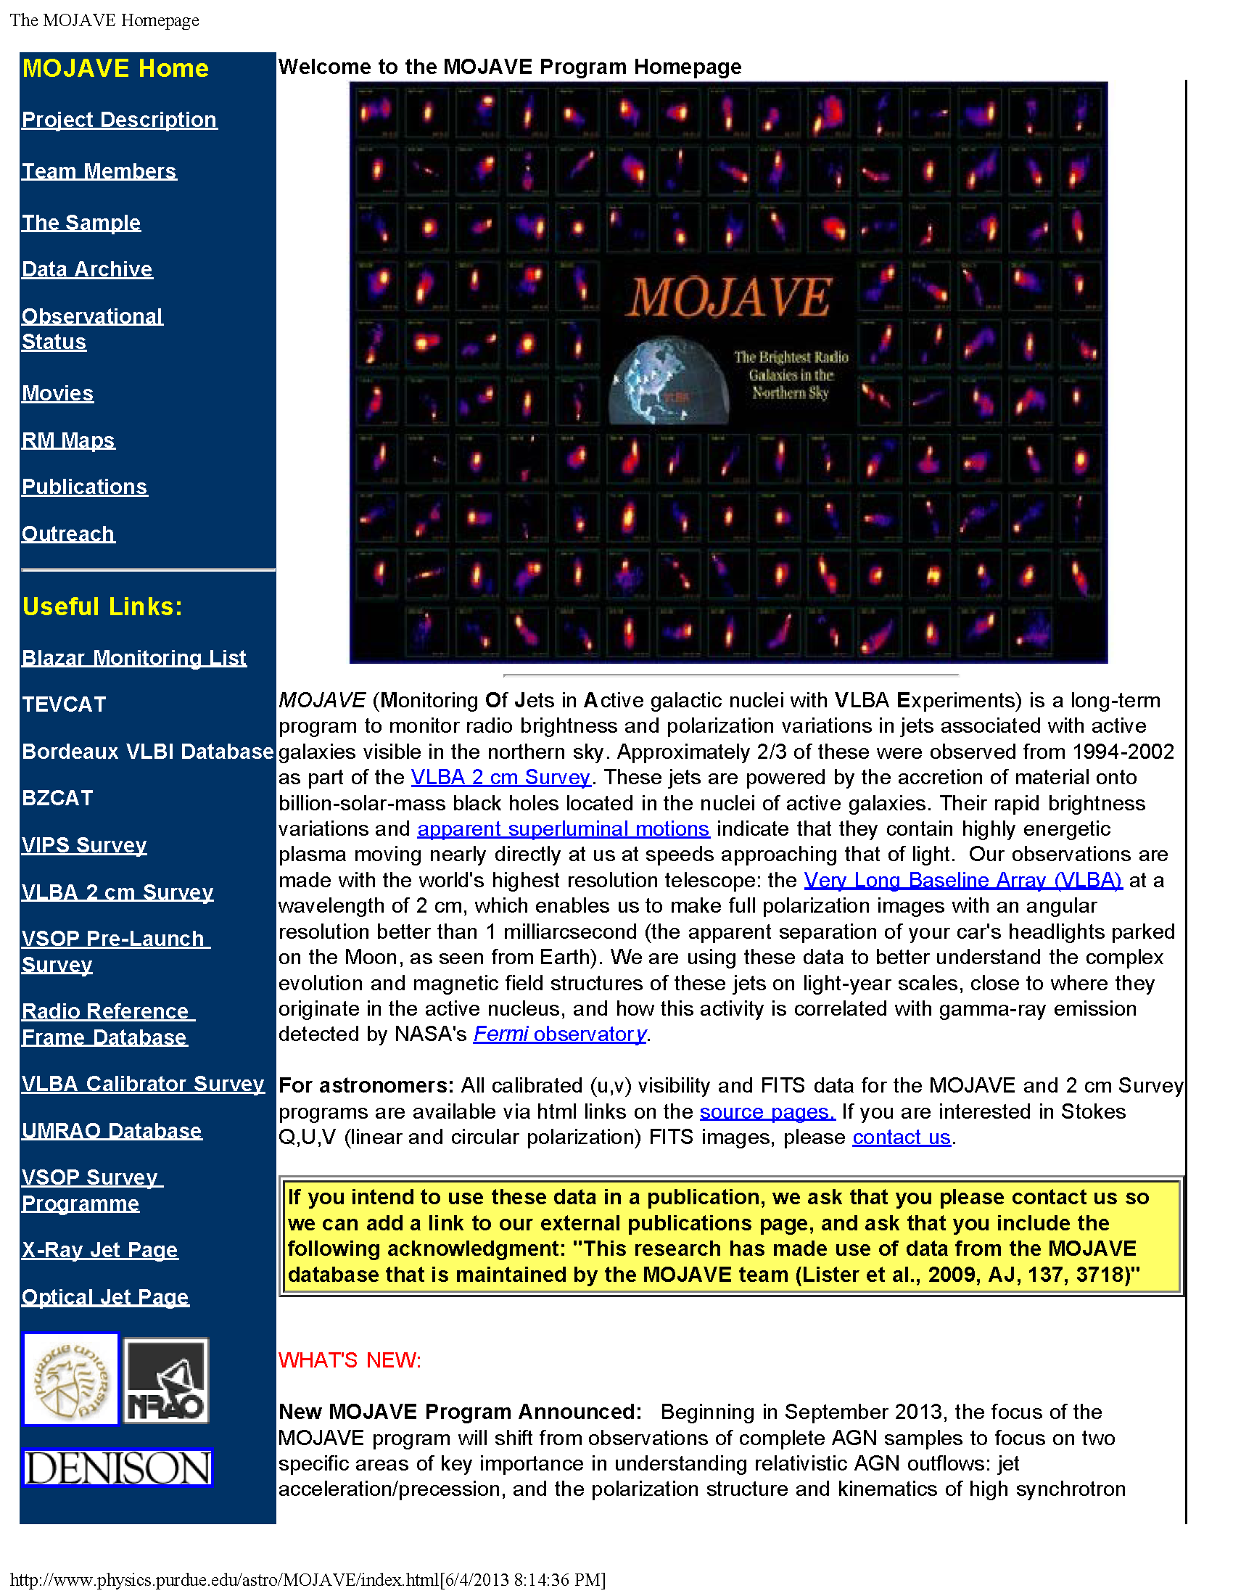

Slide 4
Linear and Circular Polarization VLBI Observations are Difficult. Understanding Your Errors Is CRUCIAL.
Discussions and simulations of linear polarization, rotation measure and circular polarization imaging and measurement errors in VLBI are essential reading. They include:
Mahud et al. 2013 (Appendix)
Hovatta et al. 2012 (Appendix)
Taylor and Zavala 2010
Homan and Lister 2006
Roberts, Wardle and Brown 1994 (Appendix)
et al.
Notes:
These are some of the least read, but most important contributions to the subject

Slide 5
1) Fractional polarization
Data from MOJAVE at 15 GHz
Lister & Homan 2005

Slide 6
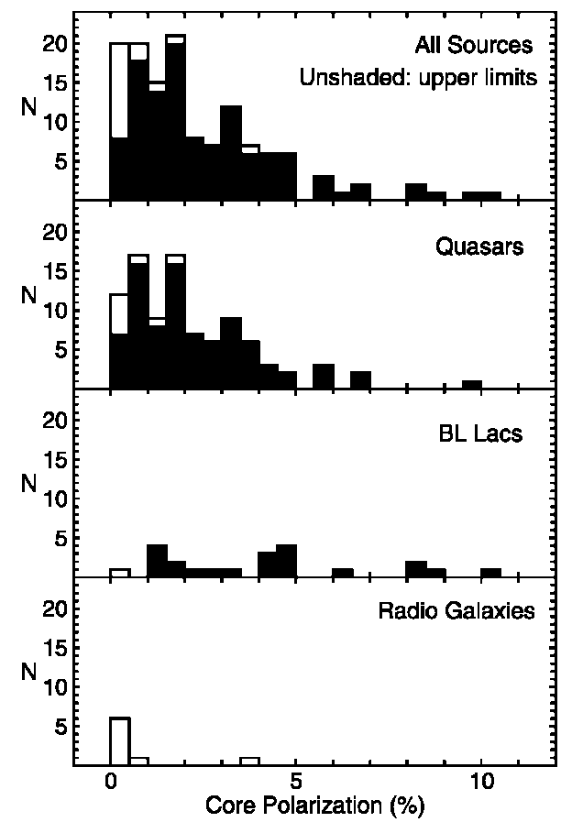
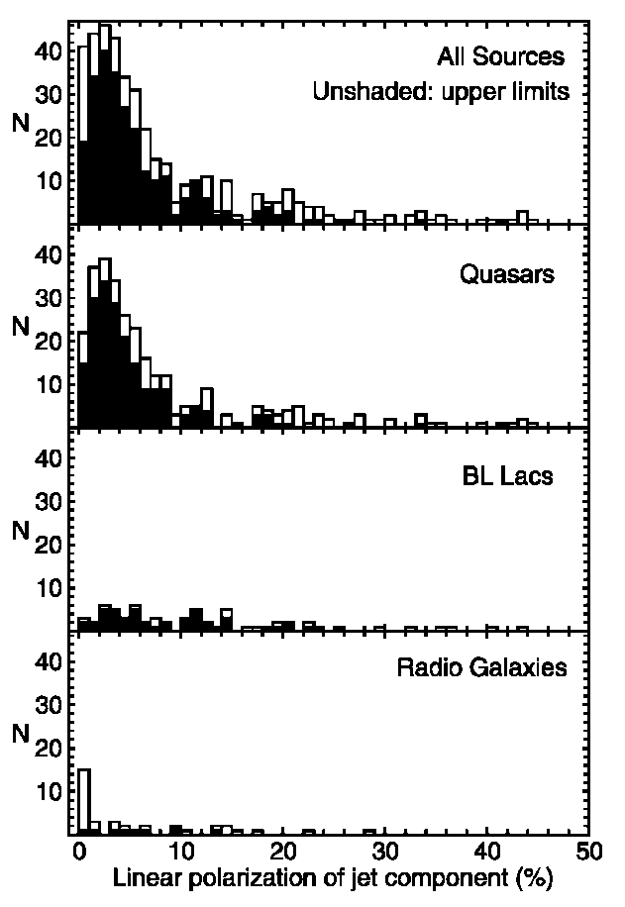
Cores
Jet components

Slide 7
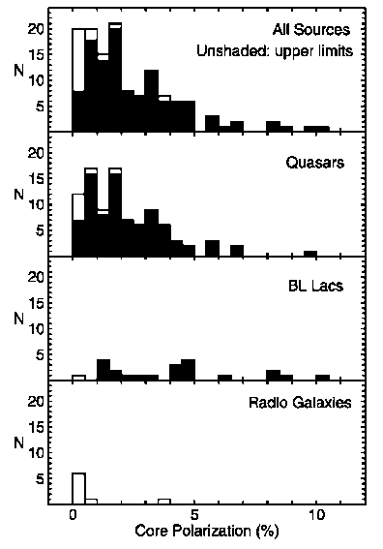
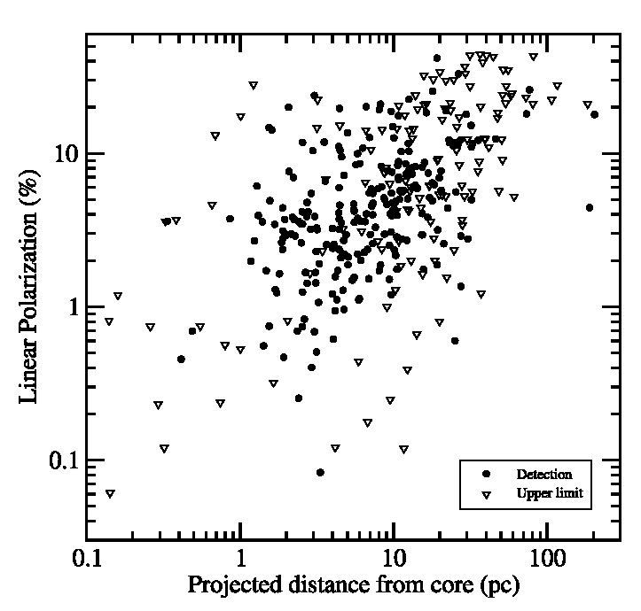

Slide 8
Real
Selection effect
se

Slide 9
Two simple field models + aberration
The jet makes an angle θ to the line of sight.
We “view” the magnetic field structure from an angle θ’ in the rest frame of the jet.

Slide 10
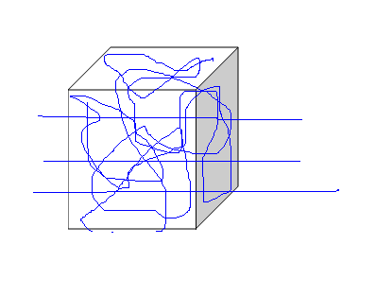
Two simple field models + aberration
Disordered field B_{r} + poloidal field B_{p}
Jet direction
E vectors transverse to jet

Slide 11
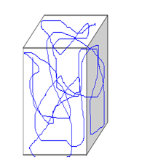
Two simple field models + aberration
(2) Disordered field compressed in one direction by a transverse shock (Laing sheet)
Jet direction
E vectors parallel to jet

Slide 12
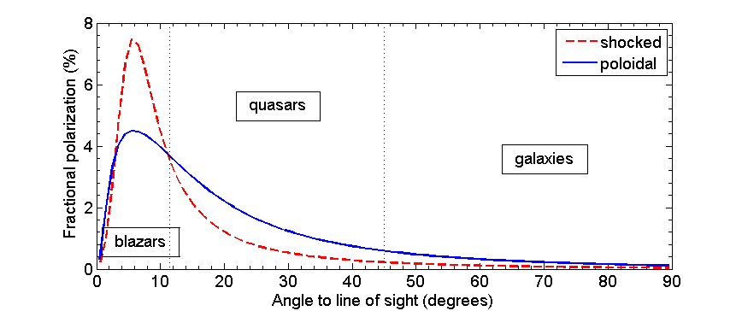
Jet Lorentz factor =10
a) At θ = arccos β = 5.7º we view the jet from the side (θ’ = 90º ), giving peak polarization.
b) For ‘galaxies’ we are looking almost straight down the jet (θ’ > 166º ), and we see mostly the tangled field.

Slide 13
Jet Lorentz factor =10
c) Aberration is crucial for interpreting polarization observations.
d) Galaxies may suffer additional depolarization in the obscuring torus, but it is probably not required.

Slide 14
2) EVPA-jet PA alignment (5 GHz)

Slide 15
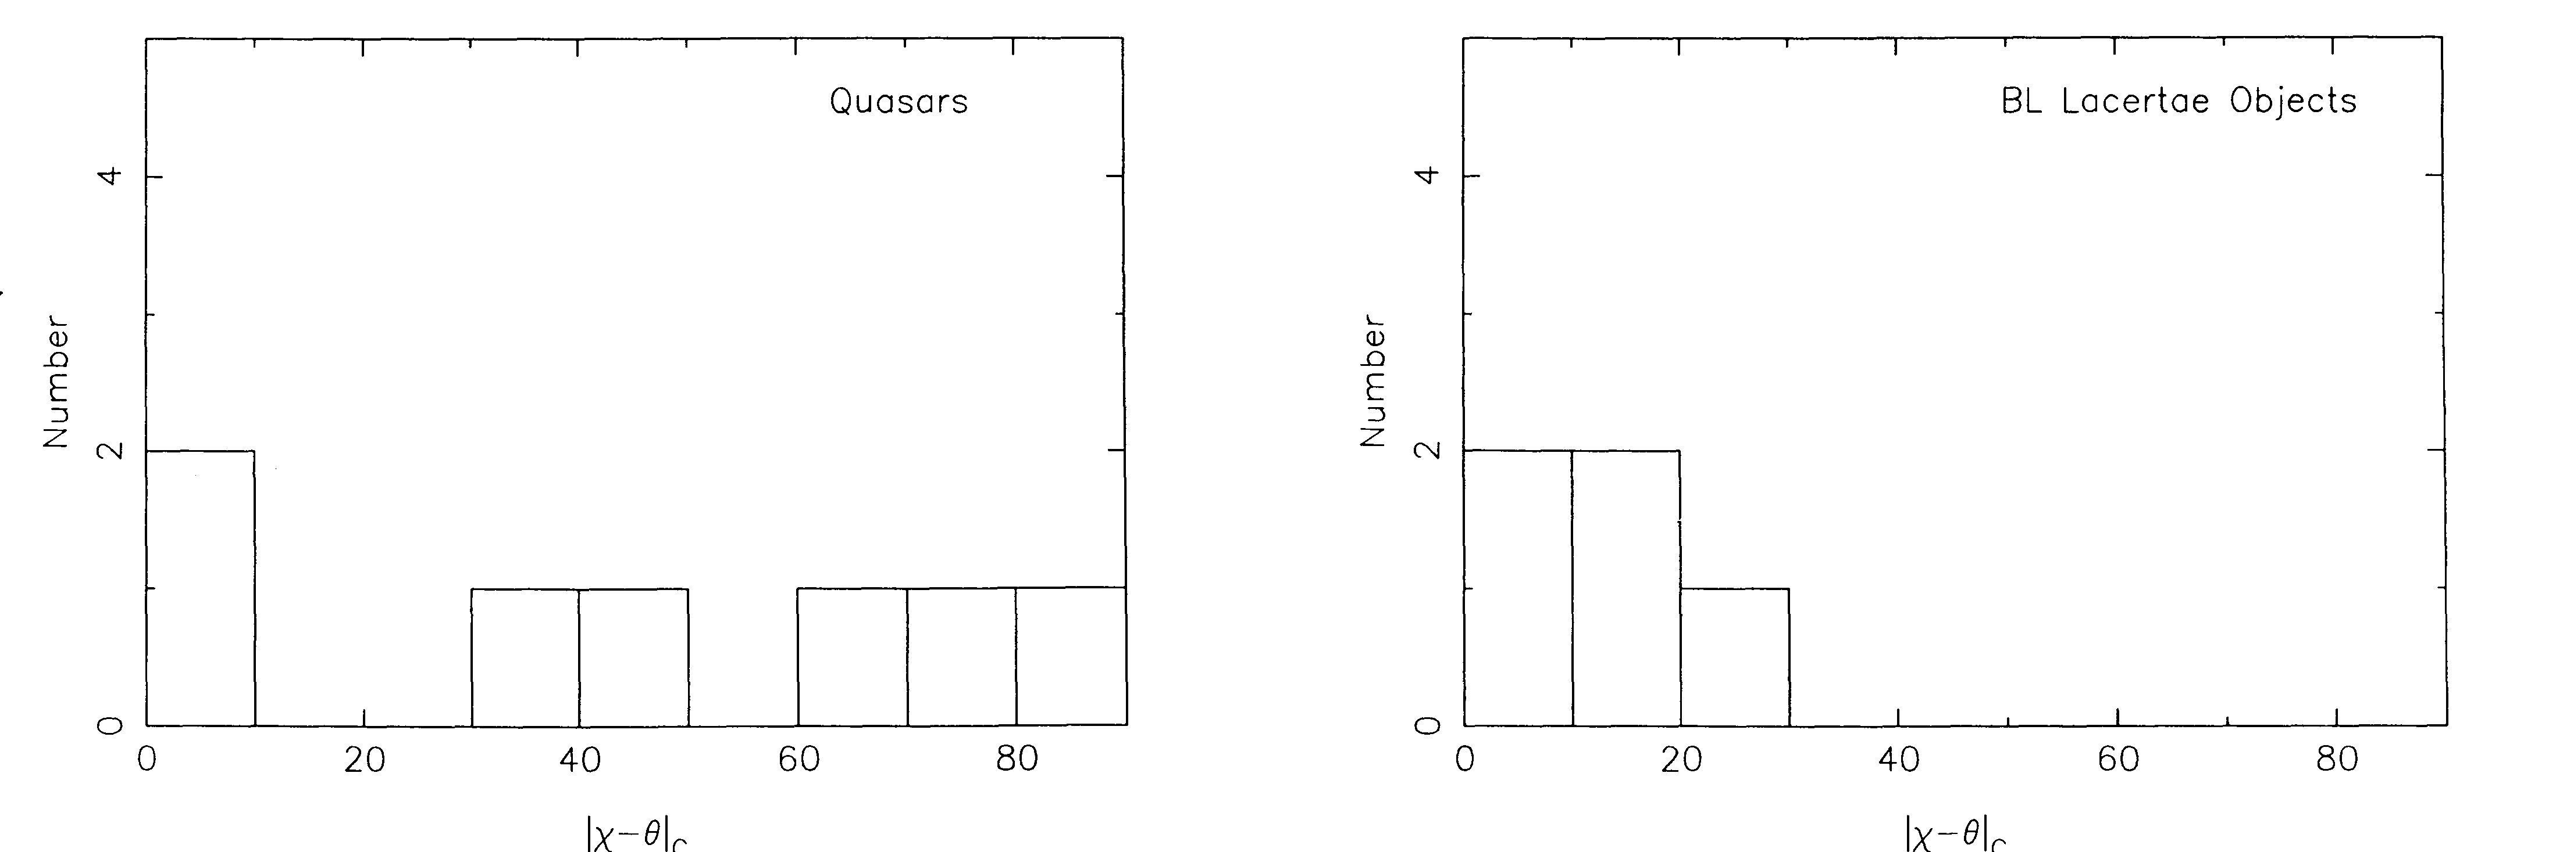
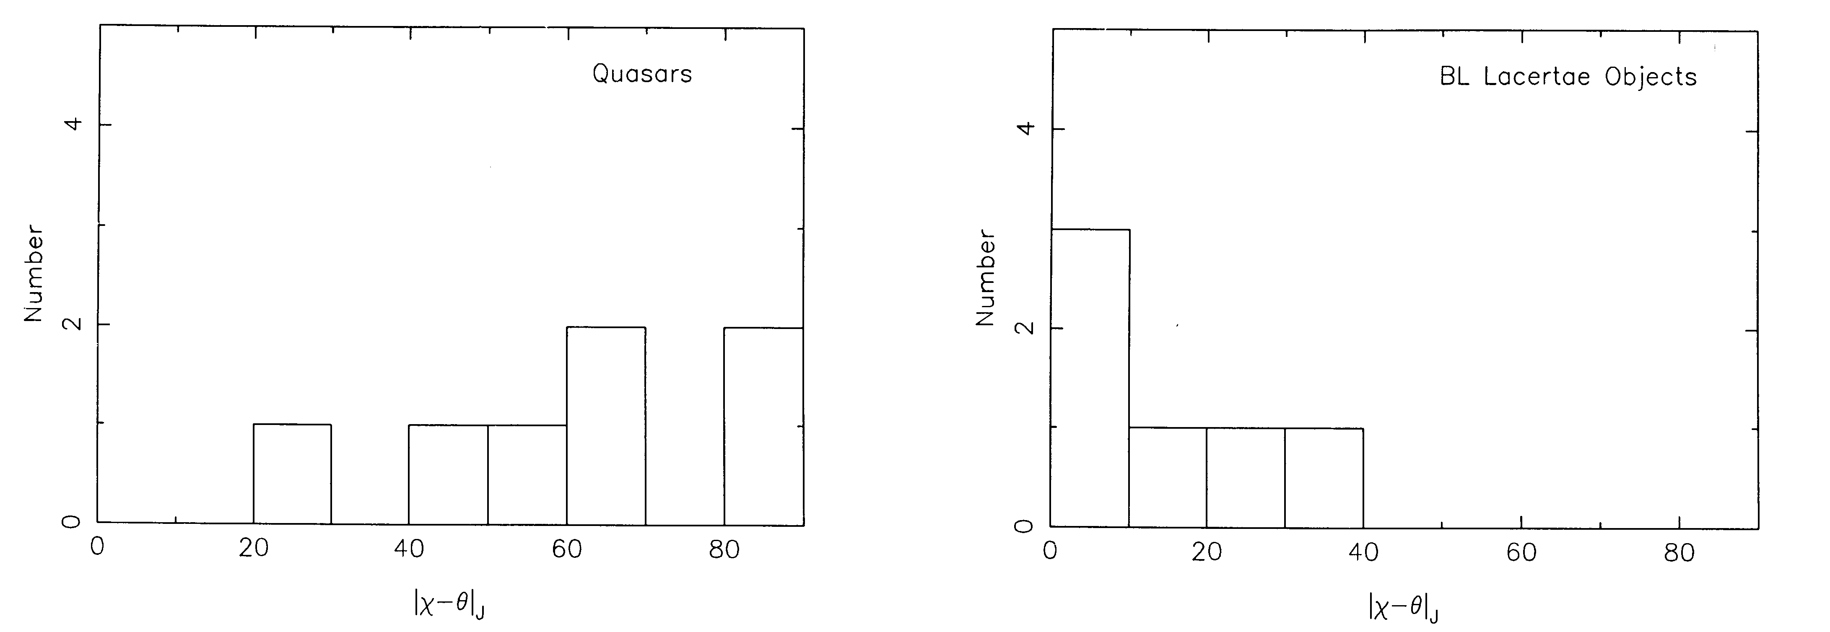
2) EVPA-jet PA alignment (5 GHz)
cores
jet features
Cawthorne et al. 1993

Slide 16
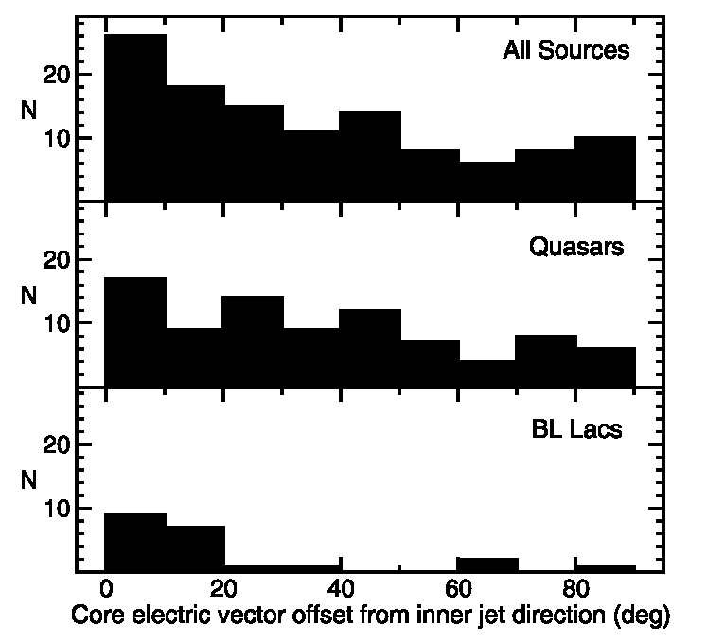
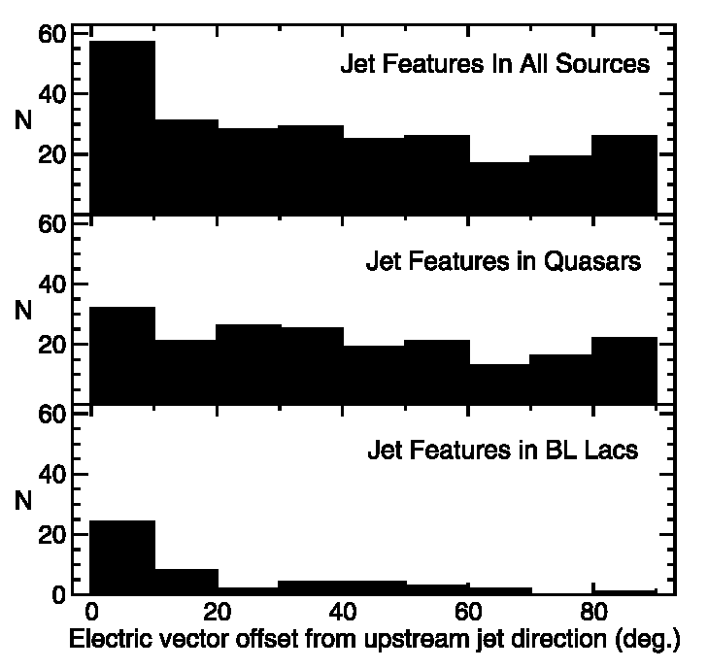
2) EVPA-jet PA alignment (15 GHz)
cores
jet features
Lister & Homan 2005

Slide 17
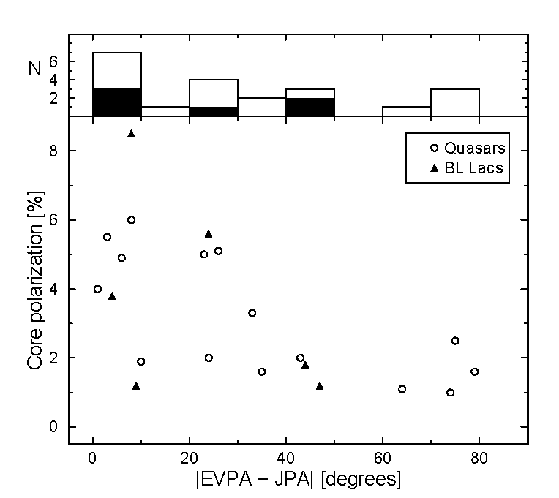
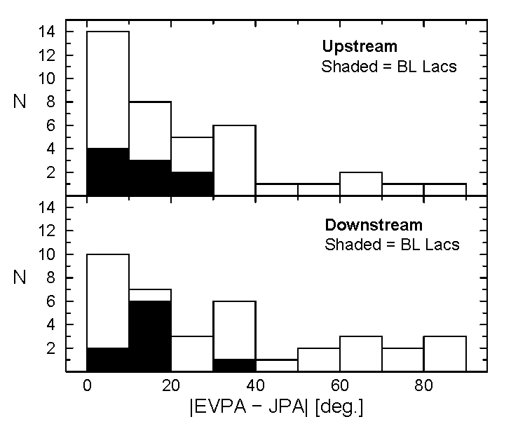
2) EVPA-jet PA alignment (43 GHz)
cores
jet features
Lister 2001

Slide 18
3) Two possible models for misaligned EVPAs
Oblique shocks
Differential Doppler effect in a conical jet

Slide 19
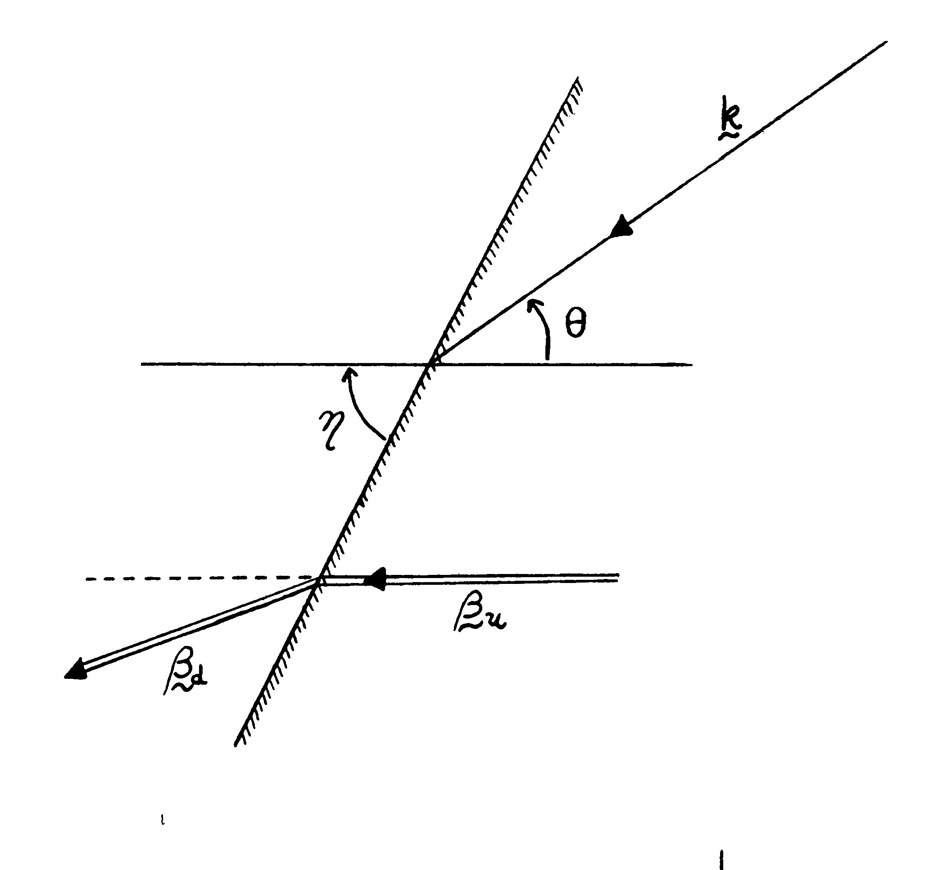
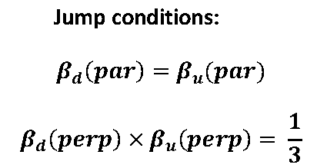
3a) Oblique shocks?
ξ
Lind & Blandford 1985
Cawthorne & Cobb 1990
Bicknell & Begelman 1996
Cawthorne 2006

Slide 20
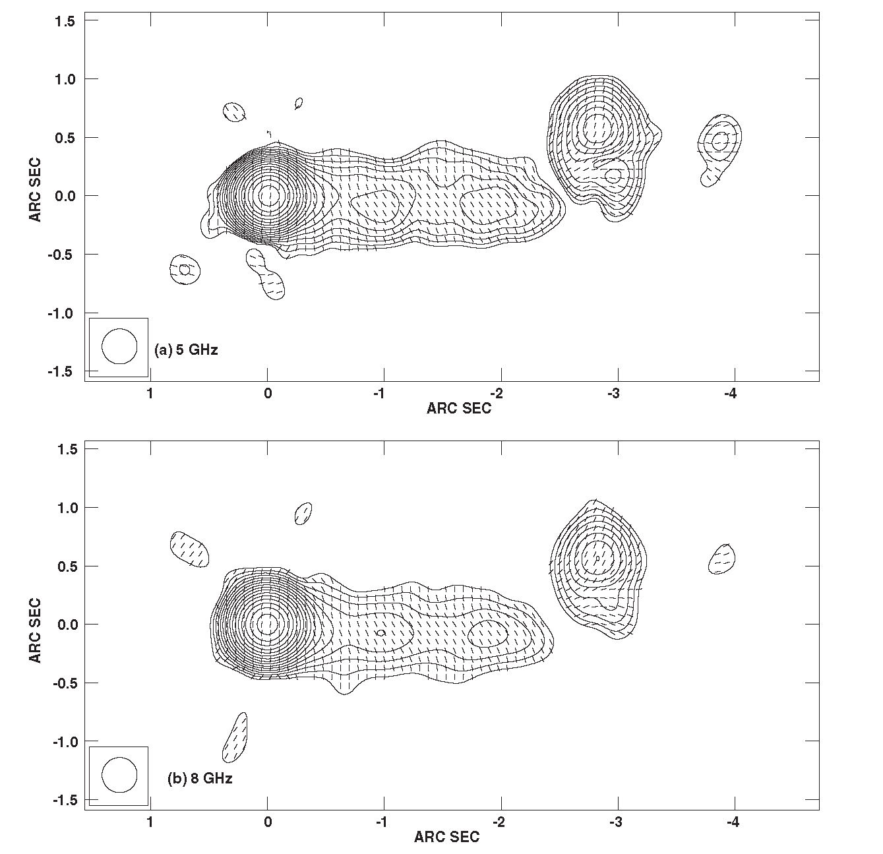
3b) Differential Doppler effect in a conical jet?
VLA images of 3C 345:
<-- 5 GHz
<-- 8GHz

Slide 21
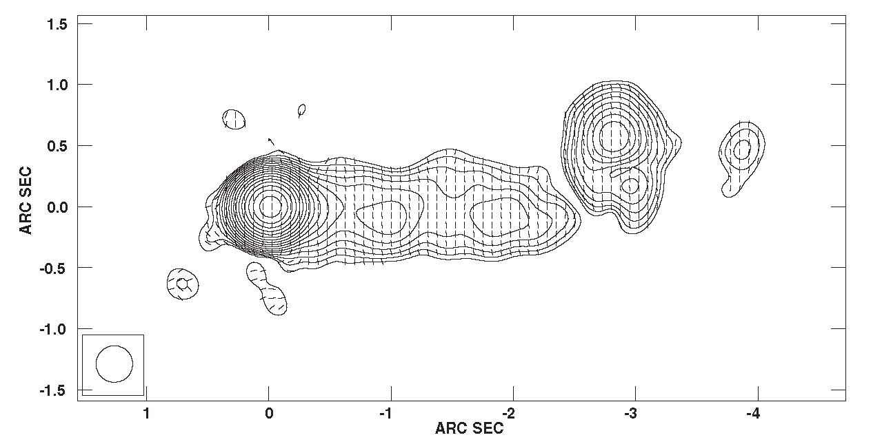
3b) Differential Doppler effect in a conical jet?
Tick marks are oriented at EVPA (5 GHz) – EVPA (8 GHz)

Slide 22
3b) Differential Doppler effect in a conical jet?
In a cylindrical jet, a helical field exhibits an EVPA of 0º or 90º, depending on the pitch angle. ( Stokes U from the back half of the jet and Stokes U from the front half of the jet cancel.)

Slide 23
3b) Differential Doppler effect in a conical jet?
In a cylindrical jet, a helical field exhibits an EVPA of 0º or 90º, depending on the pitch angle. ( Stokes U from the back half of the jet and Stokes U from the front half of the jet cancel.)
In a conical jet at a small angle to the line of sight, the difference in Doppler factors between the front and the back of the jet breaks the cancellation, Stokes U is no longer zero, and the EVPAs appear “twisted.”

Slide 24
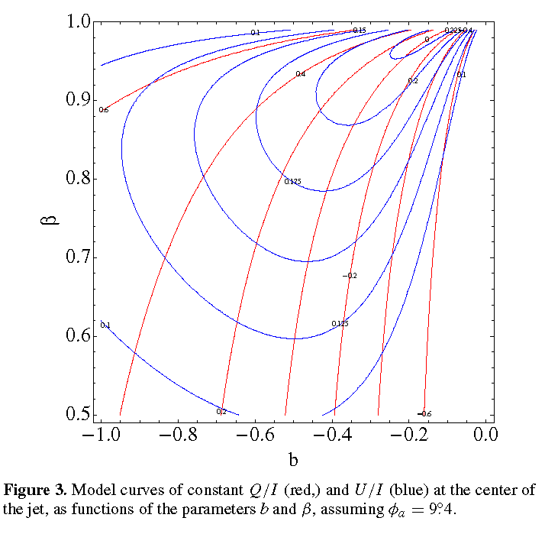
3b) Differential Doppler effect in a conical jet?
Toroidal field is generated by a uniform current density.
Add a uniform poloidal field.
b = B_{pol}/B_{tor} at surface.
observed opening angle = 9.4º
The green spot marks the region of acceptable models
Roberts & Wardle 2012

Slide 25
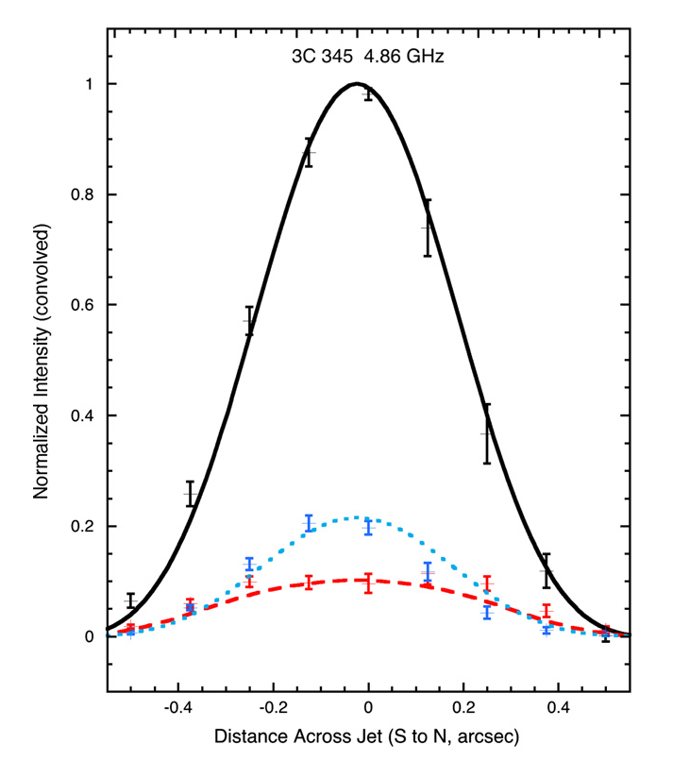
3b) Differential Doppler effect in a conical jet?
Nominal model:
B_{pol}/B_{tor} at surface = -0.19
β = 0.97 (Γ = 4.1)
Observed opening angle = 9.4º
intrinsic opening angle = 2.3º
In general, this is a way of breaking the symmetry in an axisymmetric jet, and could be applied on parsec scales too.
I ____
Q - - - -
U …….
Roberts & Wardle 2012

Slide 26
4) Radio core EVPA - optical EVPA alignment
Notes:
Suggests Faraday rotation is important. Does NOT say optical and radio are co-spatial

Slide 27
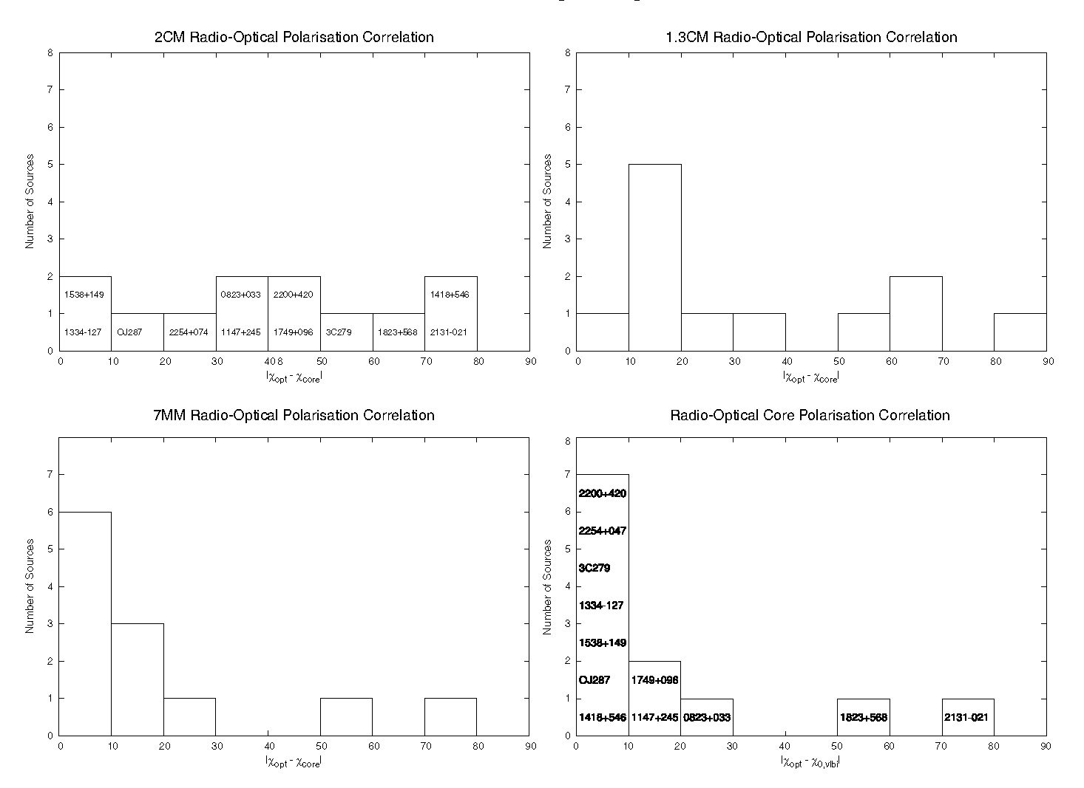
4) Radio core EVPA - optical EVPA alignment
15 GHz
22 GHz
43 GHz
Corrected for RM
Gabuzda et al. 2006 (mainly BL Lac objects)
Notes:
Suggests Faraday rotation is important. Does NOT say optical and radio are co-spatial

Slide 28
5) Optical polarization
Correlated changes would be strong evidence for co-spatial emission regions.

Slide 29
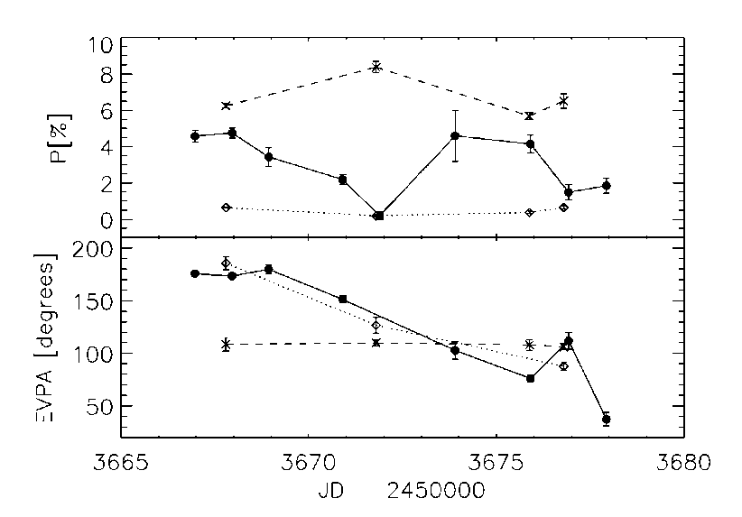
5) Optical polarization
PKS 0420-014
continuous line = optical (450-750 nm)
dotted line = 43 GHz
“pseudocore”
dashed line = 43 GHz
first jet component
optical
core
D’Arcangelo et al. 2007 also 0836+710, Jorstad, this meeting, and Troitskiy, poster #34

Slide 30
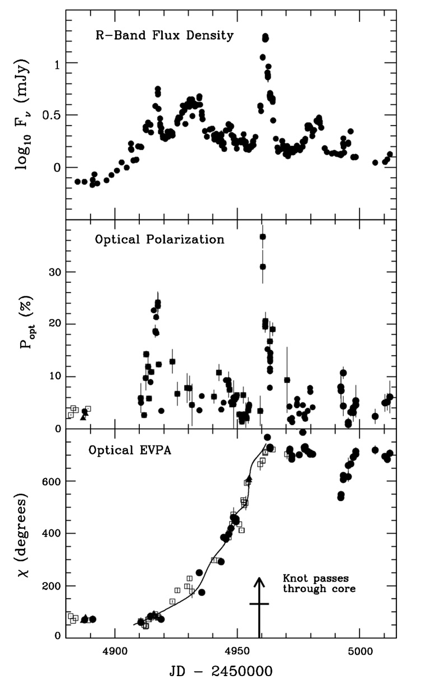
5) Optical polarization
PKS 1510-089 Marscher et al. 2010
In 2009, the optical EVPA rotated 720º just prior to a spike in flux and fractional polarization, AND a gamma-ray outburst AND the launch of a new VLBI component.
Similar behaviour is seen in other sources, e.g. 3C454.3 (Marscher, this meeting), also PKS 1510-089 in 2011 (Orienti, this meeting).

Slide 31
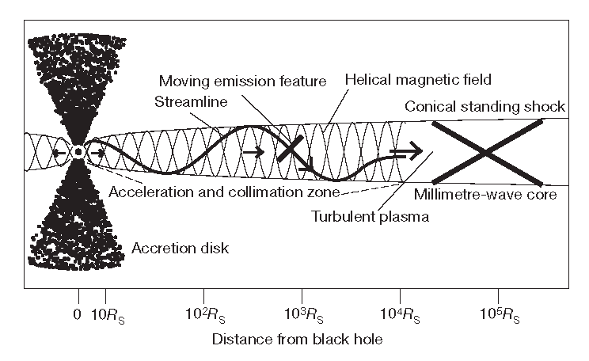
5) Optical polarization
PKS 1510-089 Marscher et al. 2010
Model from Marscher et al. 2005
Many features of this model are very plausible. Almost impossible to get here without multi-wavelength, close-spaced monitoring and imaging.

Slide 32
6) Rotation Measures

Slide 33
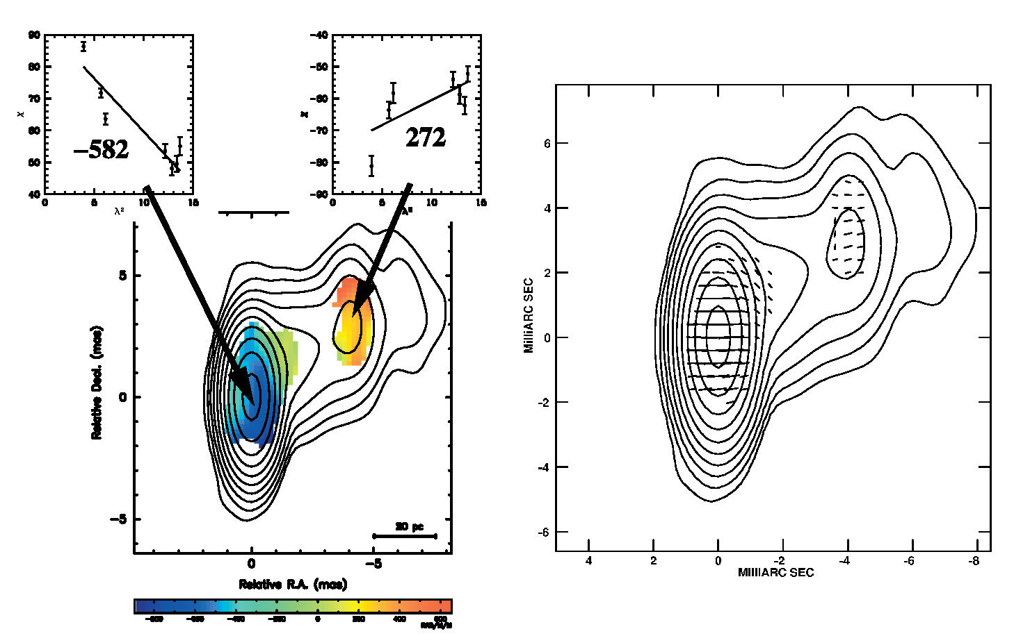
6) Rotation Measures
Zavala & Taylor 2004, peering through
“Faraday’s Fog”
PKS 0458-020
8-15 GHz

Slide 34
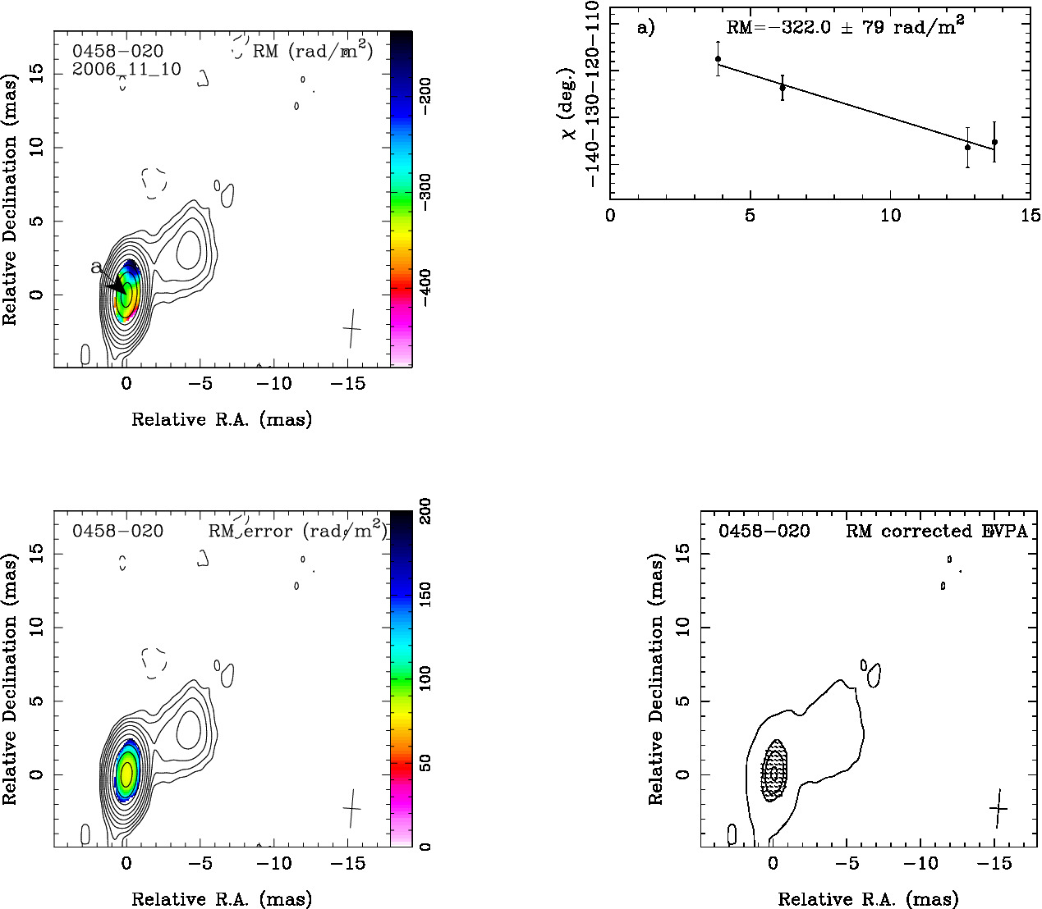
6) Rotation Measures
Hovatta et al 2012
PKS 0458-020
8-15 GHz
Note how they solve the problem of how to show error bars on a false color image.
Notes:
How variable are rotation measures?

Slide 35
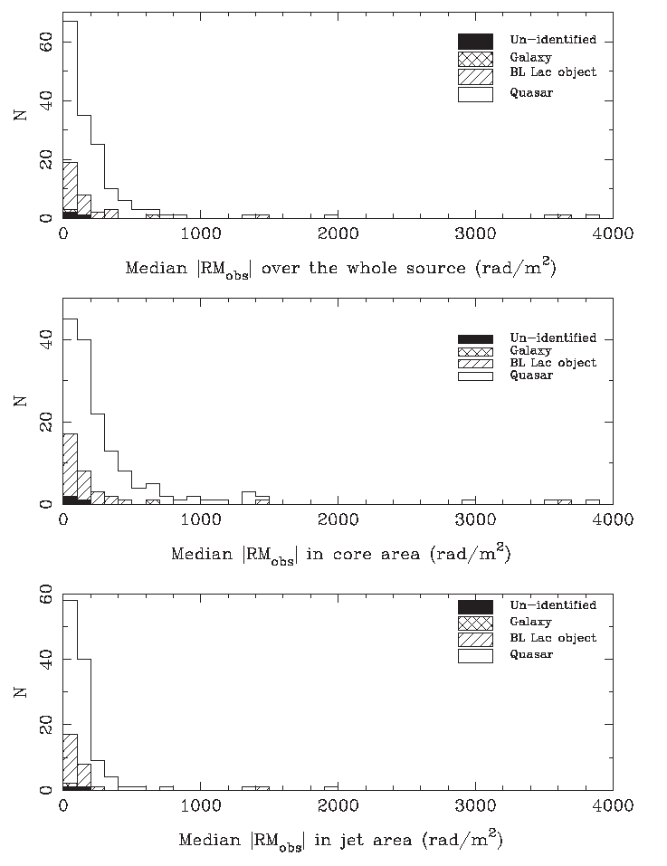
6) Rotation Measures
Hovatta et al 2012
8-15 GHz
Very few RMs are > 1000 rad/m² .
(This corresponds to 23º EVPA rotation at 15 GHz, which is not enough to align the EVPAs with the jet direction. But see Lister, next talk.)
Cores have bigger RMs than jets.
Quasars have bigger RMs than BL Lac objects
cores
jets
Notes:
RMs are not enough to solve the EVPA-jet alignment problem

Slide 36
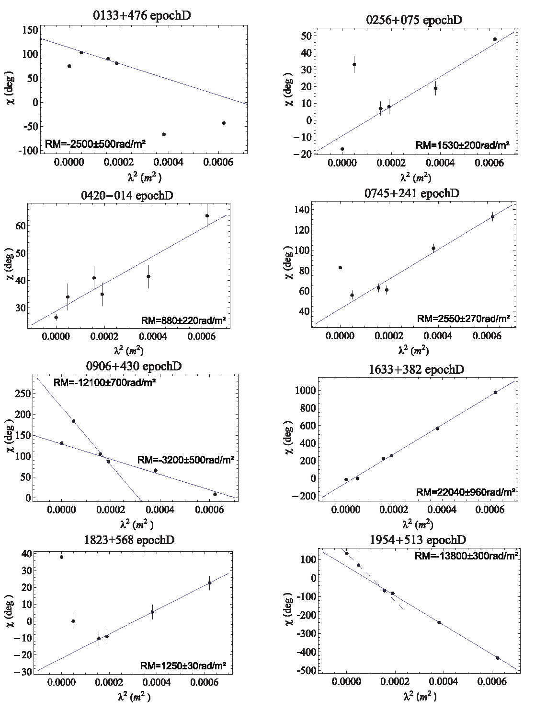
6) Rotation Measures
Algaba, Gabuzda & Smith 2012
12-43 GHz
Core RMs are much higher at higher frequencies.
For a Blandford-Königl jet, the distance of the τ = 1 surface from the apex of the jet ~ λ.
It is very plausible that at higher frequencies the lines of sight go through regions of higher density and magnetic field

Slide 37
6) Rotation Measures
The cores clearly contain complex Faraday screens which it may not be possible to resolve spatially.
This may be a good place to try wide band Faraday synthesis:
Original idea: Burn 1966
Resuscitated by Brentjens & de Bruyn 2005

Slide 38
6) Rotation Measures
The cores clearly contain complex Faraday screens that may not be possible to resolve spatially.
This may be a good place to try wide band Faraday synthesis:
Original idea: Burn 1966
Resuscitated by Brentjens & de Bruyn 2005
Illustrated by ATCA observations of PKS B 1610-771, an unresolved, 3 Jy, z=1.71 quasar,
using a 2 GHz instantaneous bandwidth from 1.1 – 3.1 GHz
O’Sullivan et al 2012

Slide 39
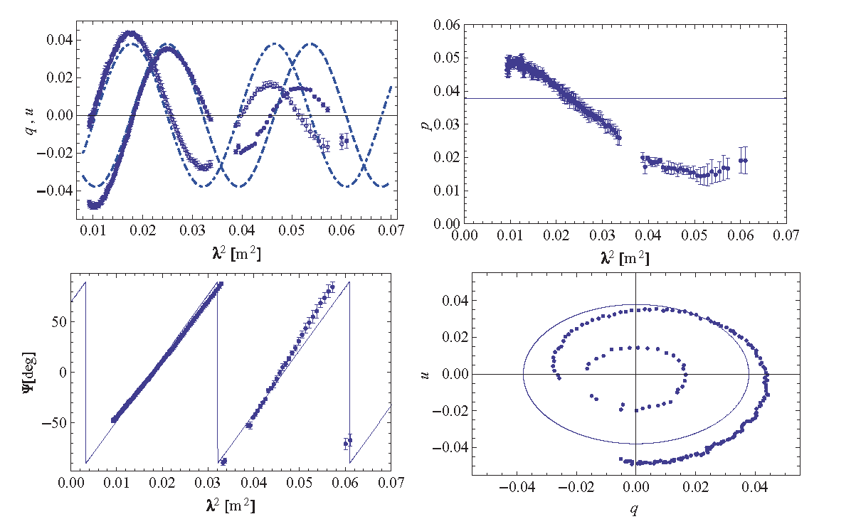
6) Rotation Measures - Faraday synthesis
First model: single RM component. Reduced χ²= 97.3

Slide 40
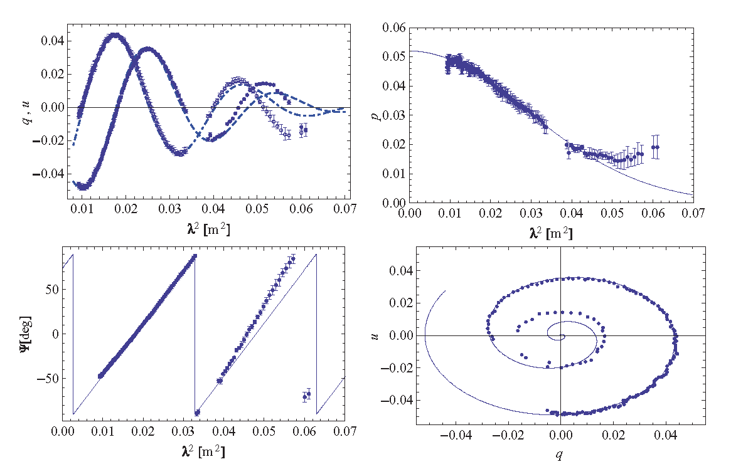
6) Rotation Measures - Faraday synthesis
Second model: single RM component plus a Burn-type depolarizing screen. Reduced χ²= 1.41

Slide 41
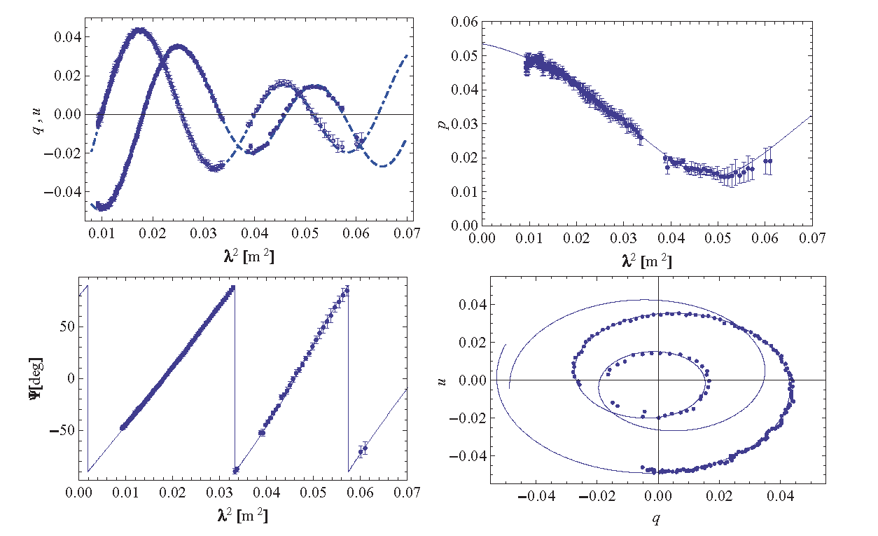
6) Rotation Measures - Faraday synthesis
Final model: two components with different polarizations and rotation measures, (107 and 78 rad/m²). Reduced χ²= 1.04

Slide 42
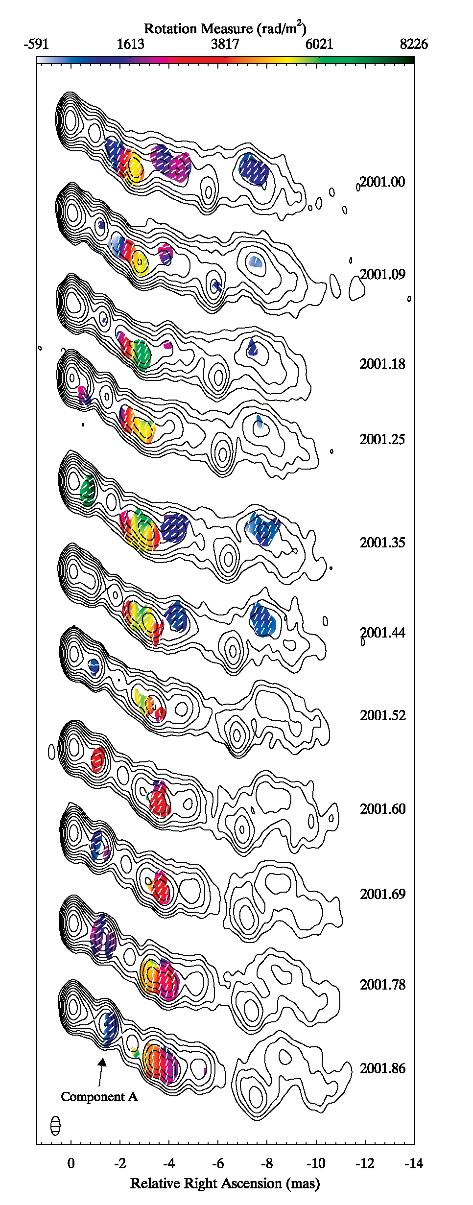
6) Rotation Measures: 3C120 (Gomez et al. 2008)
Observations at 15, 22 and 43 GHz, between 2001.00 and 2001.86
Clearly there is some variability in the small scale Rotation Measure structure.

Slide 43
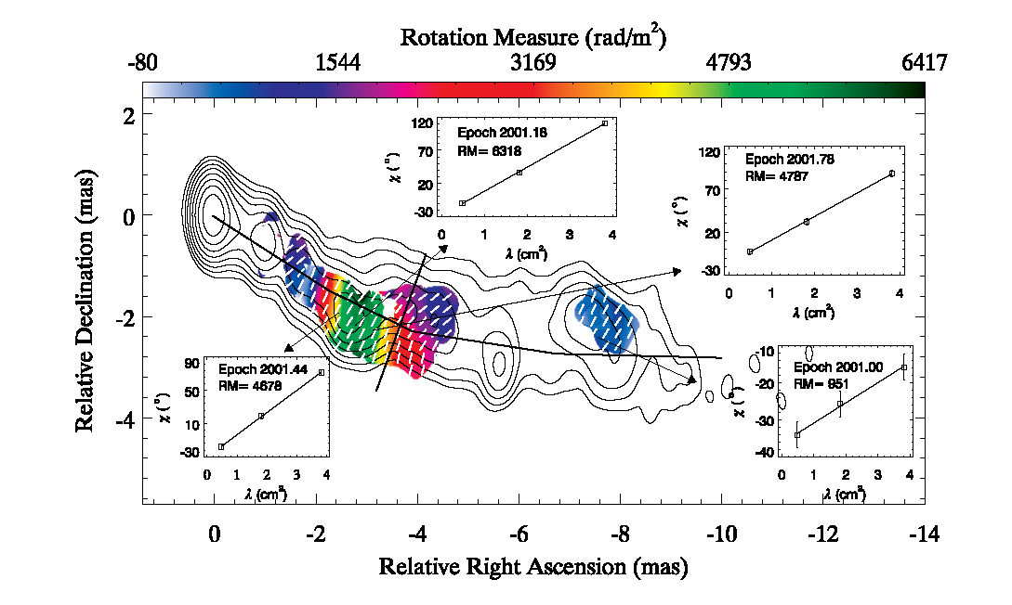
6) Rotation Measures: 3C120 (Gomez et al. 2008)
Average of all 11 RM maps together. Note the green patch of very high RM, and the transverse gradient next to it.
Note also that the magnetic field direction is everywhere aligned with the jet.

Slide 44
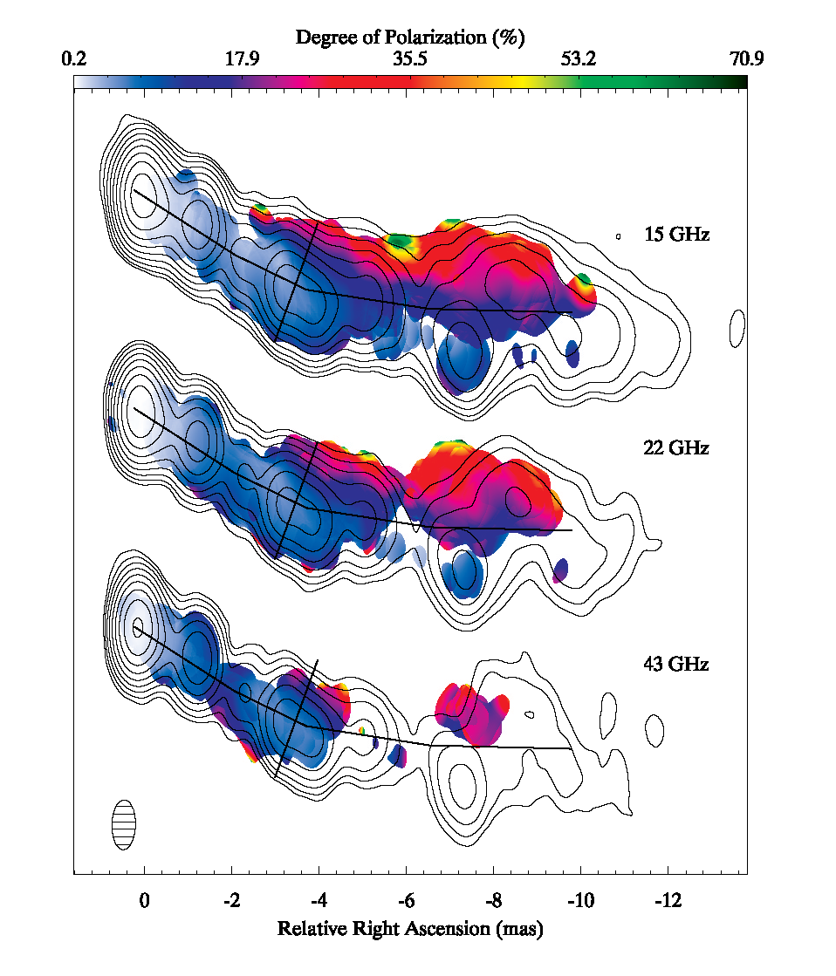
7) Rotation Measures: 3C120 (Gomez et al. 2008)
The fractional polarization structure is striated, with high fractional polarization towards the edges of the jet, and low polarization along the center line.

Slide 45
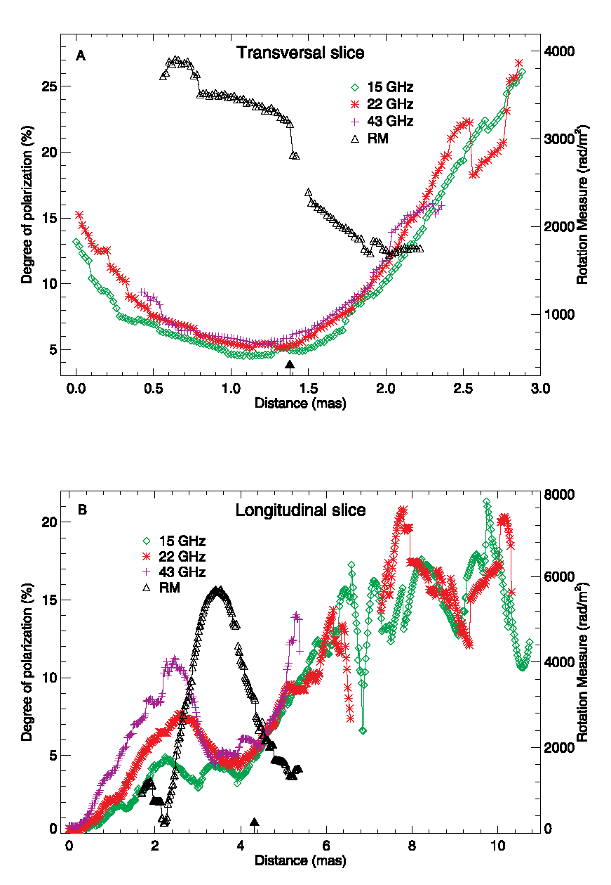
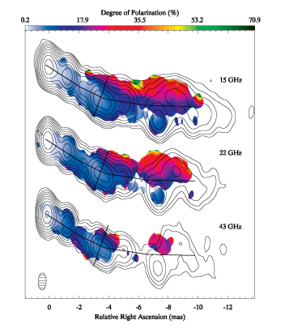
7) Rotation Measure gradients: 3C120 (Gomez et al. 2008)
Upper: transverse slices in fractional polarization at three frequencies.
The black line is Rotation Measure.

Slide 46
7) Rotation Measure gradients: 3C120 (Gomez et al. 2008)
Upper: transverse slice in fractional polarization at three frequencies.
The black line is Rotation Measure.
Lower: longitudinal slice in fractional polarization at three frequencies.
The Rotation Measure (black line) peaks at a dip in % polarization, and is most likely due to interaction with an external cloud.

Slide 47
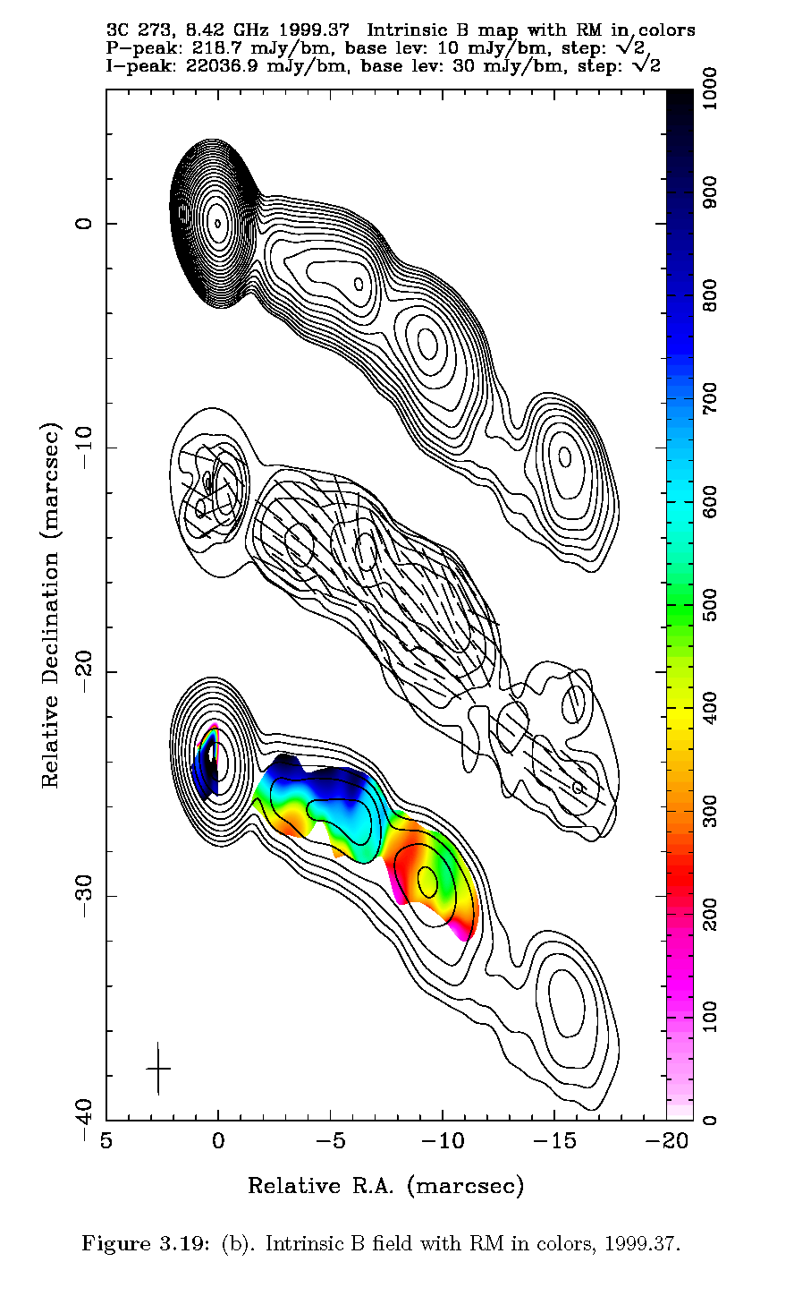
7) Rotation Measure gradients: 3C273 (T. Chen Ph.D. 2005)
6 epochs in 1999 & 2000 at 8, 15 & 22 GHz
Middle: Polarized intensity. Tick marks show the “B field” (EVPA + π/2), corrected for Faraday rotation.
The B field is nearly everywhere aligned with the jet direction.
Lower: Rotation measure. The transverse gradients are clear.

Slide 48
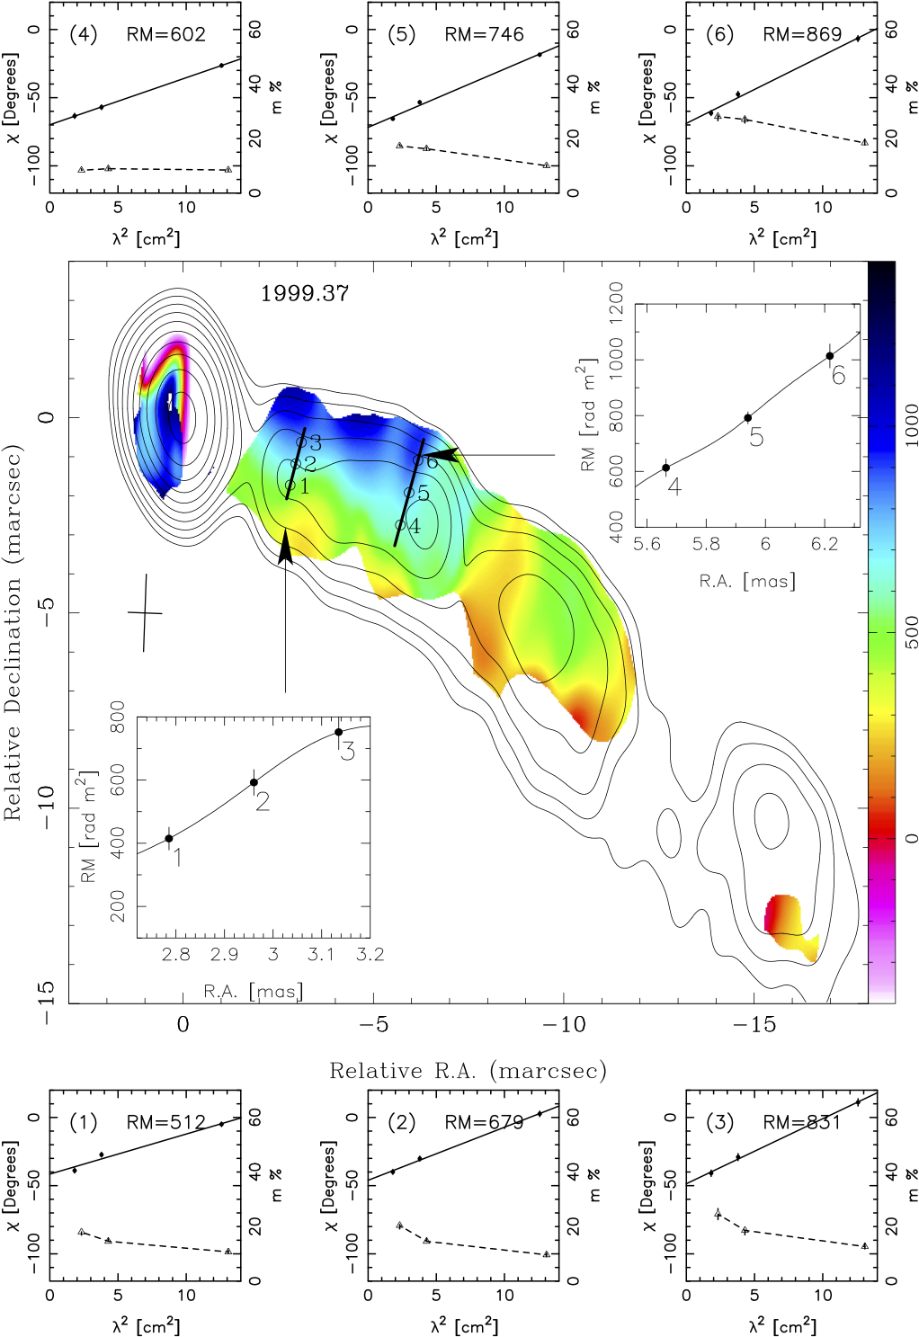
7) Rotation Measure gradients: 3C273 (T. Chen Ph.D. 2005)
Average of 6 polarization images to improve SNR
Top and bottom: plots of EVPA and p versus λ² at 6 locations.
transverse
RM slice
transverse RM slice
The transverse gradient in RM can be seen over most of the length of the jet.

Slide 49
7) Rotation Measure gradients: interpretation
A RM gradient suggests a toroidal component of the magnetic field (and hence by Ampère’s Law, a jet current)

Slide 50
7) Rotation Measure gradients: interpretation
A RM gradient suggests a toroidal component of the magnetic field (and hence by Ampère’s Law, a jet current)
A helical magnetic field requires a poloidal component of comparable magnitude that is vector ordered.

Slide 51
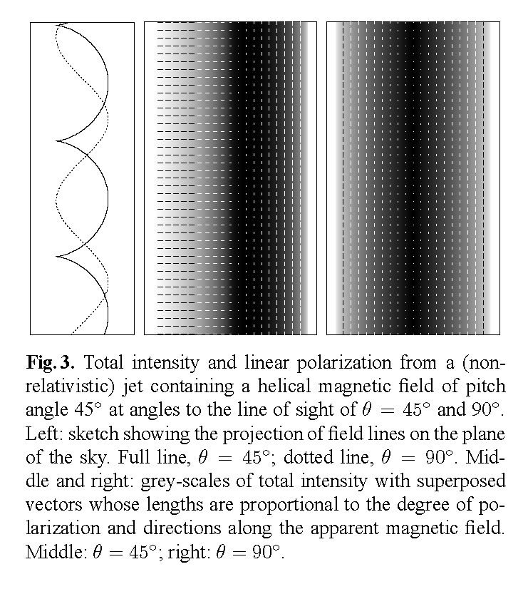
7) Rotation Measure gradients: interpretation
A RM gradient suggests a toroidal component of the magnetic field (and hence by Ampère’s Law, a jet current)
A helical magnetic field requires a poloidal component of comparable magnitude that is vector ordered.
Viewed from most directions, a helical field exhibits strong transverse asymmetries in both total intensity and polarization.
Laing, Canvin and Bridle 2006
Θ’ = 45º
Θ’ = 90º
Θ’ = 45º
Θ’ = 90º

Slide 52
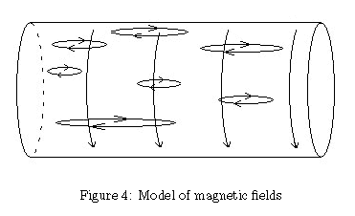
7) Rotation Measure gradients: a model (J. Mizrahi 2007)
These problems are greatly alleviated if most of the poloidal field is NOT vector ordered. Mizrahi’s model contains a uniform current density (which gives the transverse RM gradient) plus sheared loops of field (which give the net magnetic field aligned with the jet.)
Notes:
Undergraduate senior thesis

Slide 53
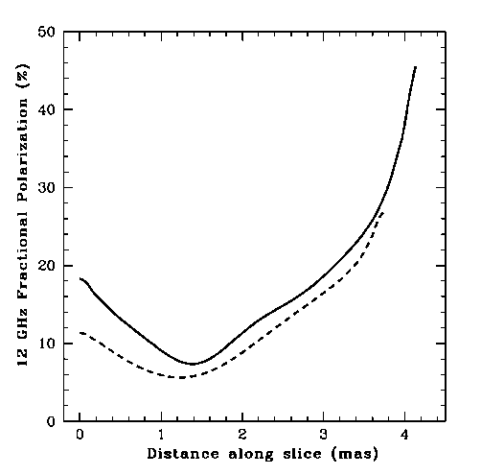
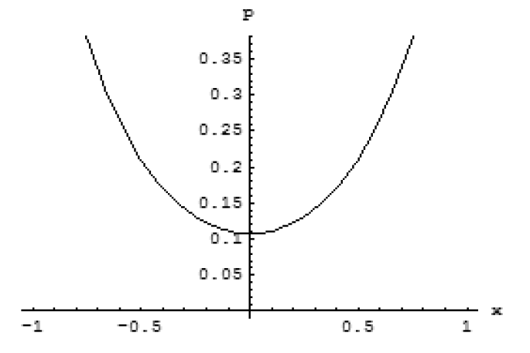
7) Rotation Measure gradients: a model (J. Mizrahi 2007)
These problems are greatly alleviated if most of the poloidal field is NOT vector ordered. Mizrahi’s model contains a uniform current density (which gives the transverse RM gradient) plus sheared loops of field (which give the net magnetic field aligned with the jet.)
The resulting polarization can be calculated analytically for α = -1.
Model (left) and observed (right) transverse slices of fractional polarization in 3C273.
model
Taylor & Zavala 2005

Slide 54
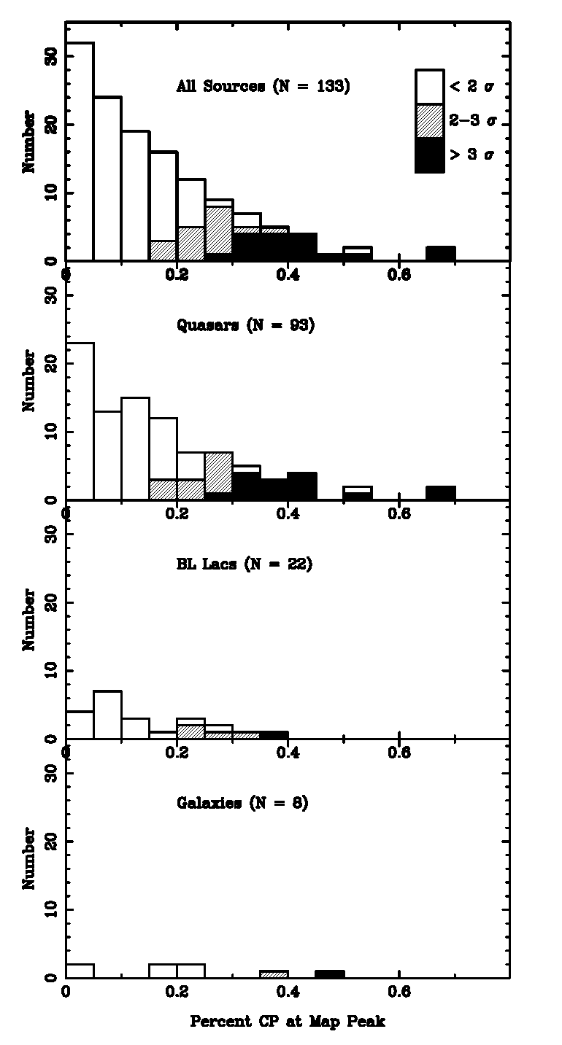
8) Circular polarization
15 GHz Homan & Lister 2006
quasars
BL Lac objects
galaxies

Slide 55
8) Circular polarization
15 GHz Homan & Lister 2006
quasars
The two main ways of generating circular polarization are
the intrinsic CP of synchrotron radiation (p_{c}~ 1/γ_{e})
Faraday conversion of linear to circular. For useful expressions see Wardle & Homan 2003.
BL Lac objects
galaxies

Slide 56
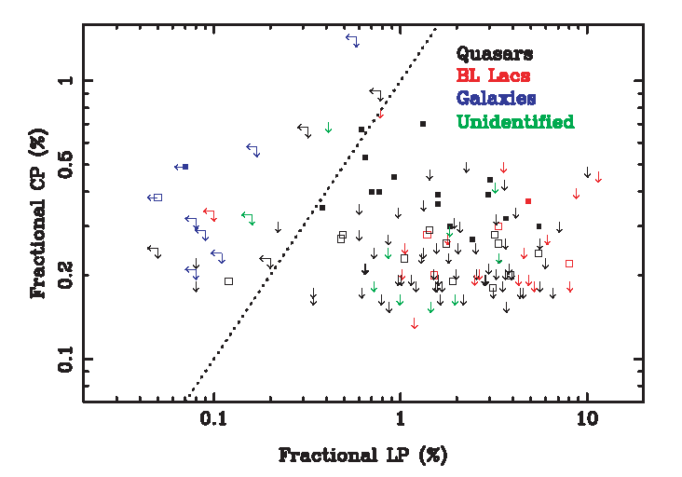
8) Circular polarization
15 GHz Homan & Lister 2006
No obvious correlation between CP and LP
(also true at 5 GHz, see Homan et al 2001, and Rayner et al 2000 (ATCA))

Slide 57
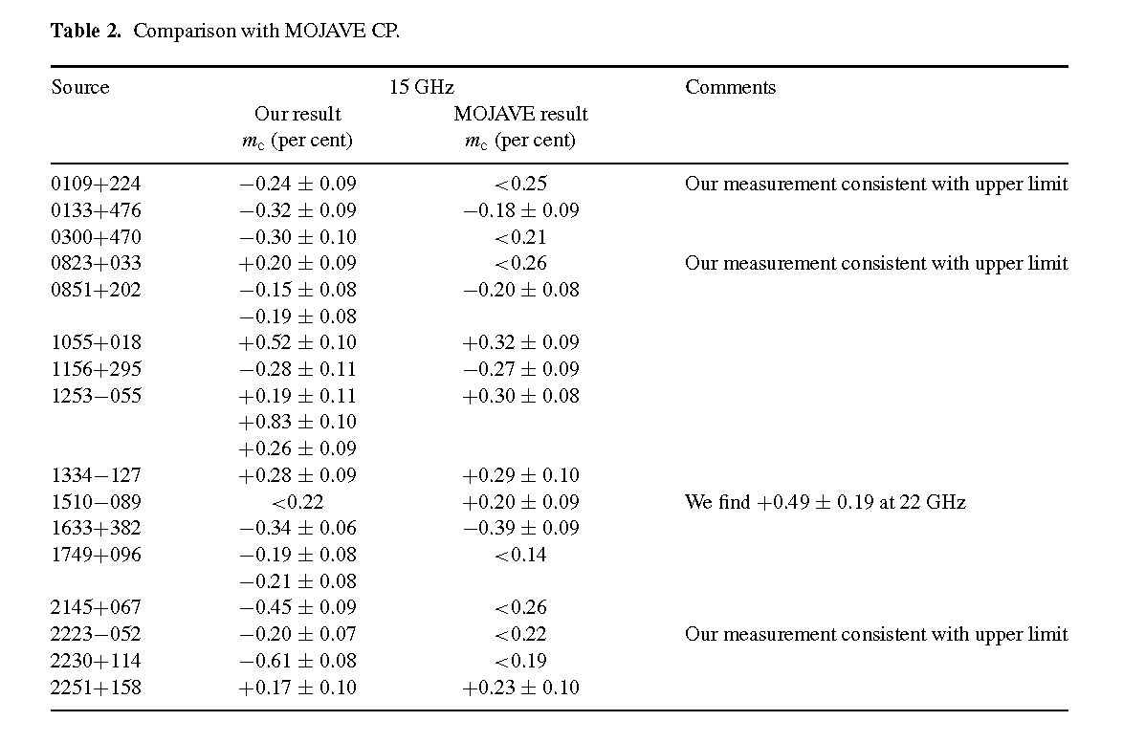
8) Circular polarization
15-22-43 GHz Vitrishchak et al 2008
Notes:
Everyone knows what they are doing Well done.

Slide 58
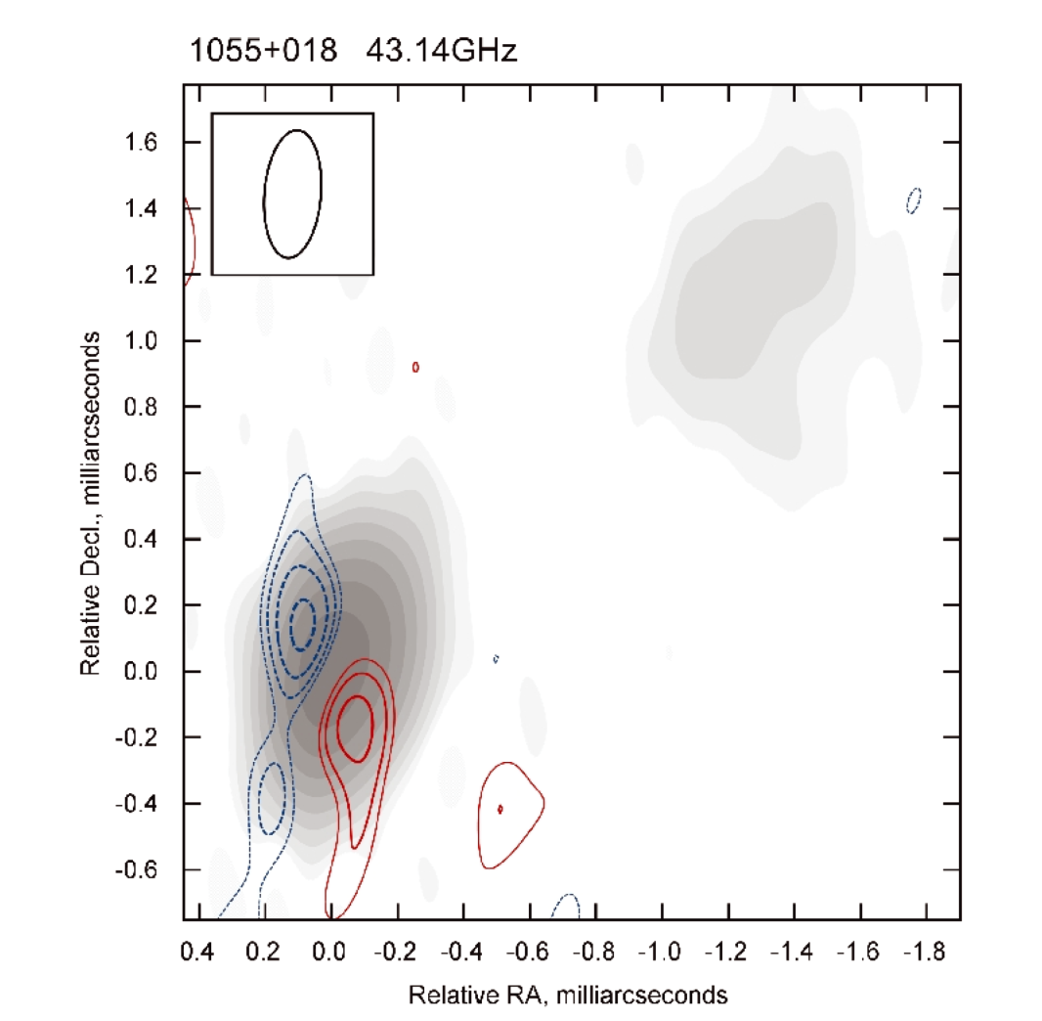
8) Circular polarization
15-22-43 GHz Vitrishchak et al 2008
Fractional CP is higher at 43 GHz. . . .
. . . This is probably the signature of an inhomogeneous Blandford-Königl type core, where we expect the CP spectrum to rise with frequency for both intrinsic and Faraday conversion mechanisms (Wardle & Homan 2003).
This image of PKS 1055+018 suggests intrinsic CP in a toroidal field.
Notes:
Everyone knows what they are doing

Slide 59
8) Circular polarization: variability
Aller 2006
Notes:
Stopped taking data last year. Over a 47 year timespan, they have made more than a million measurements. Thank you.

Slide 60
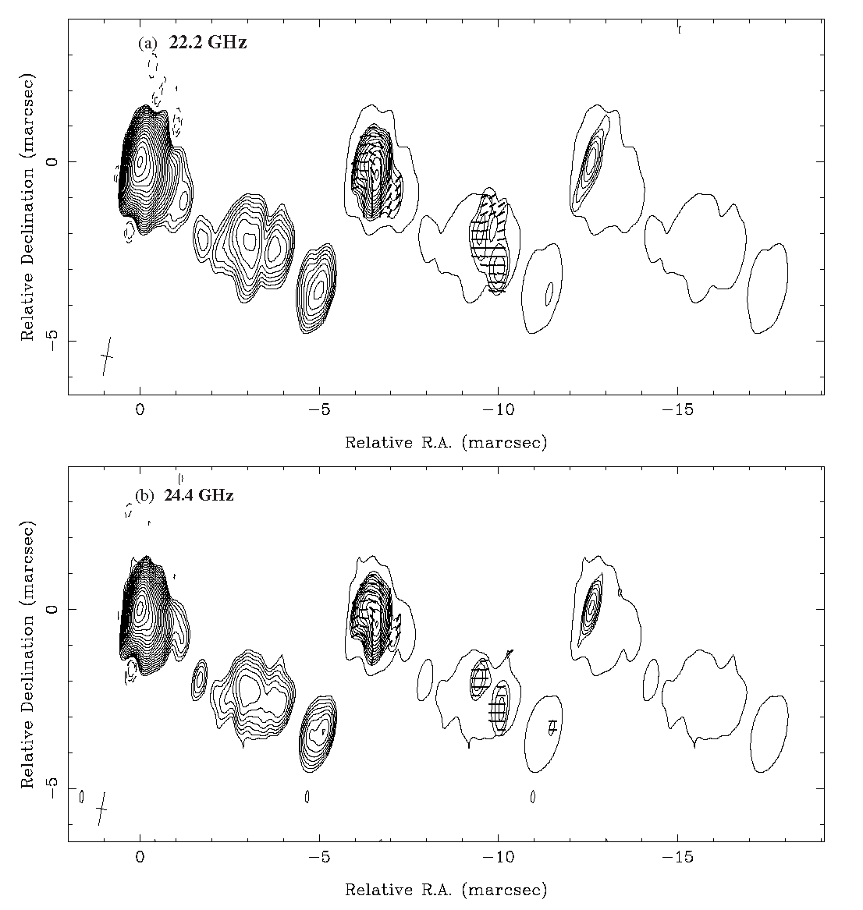
8) Circular polarization: “Full Polarization Spectra”
18 AGN observed with the VLBA at 8.0, 8.8, 12.4, 15.4, 22.2 & 22.4 GHz + detailed modeling of the spectra of all 4 Stokes parameters.
3C 279: Homan et al. 2009
Notes:
18 AGN observed

Slide 61
8) Circular polarization: “Full Polarization Spectra”
18 AGN observed with the VLBA at 8.0, 8.8, 12.4, 15.4, 22.2 & 22.4 GHz + detailed modeling.
3C 279: Homan et al. 2009
Estimate:
Vector ordering of the magnetic field;
magnetic flux (=magnetic flux at the black hole?);
positron fraction;
low-energy cutoff in the electron energy spectrum.
Notes:
18 AGN observed

Slide 62
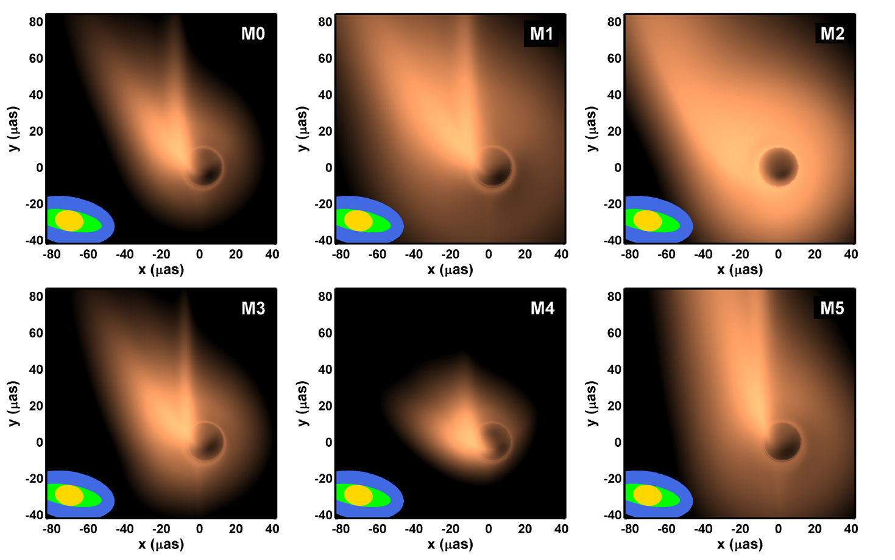
9) The Event Horizon Telescope
The theoreticians are having so much fun! M87: Broderick & Loeb 2009
Notes:
The theoreticians are having so much fun

Slide 63
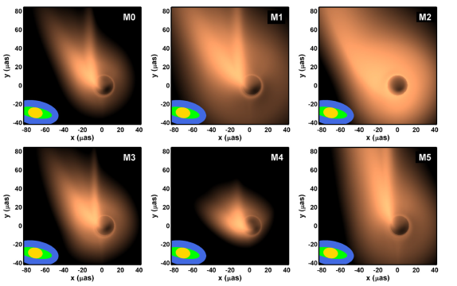
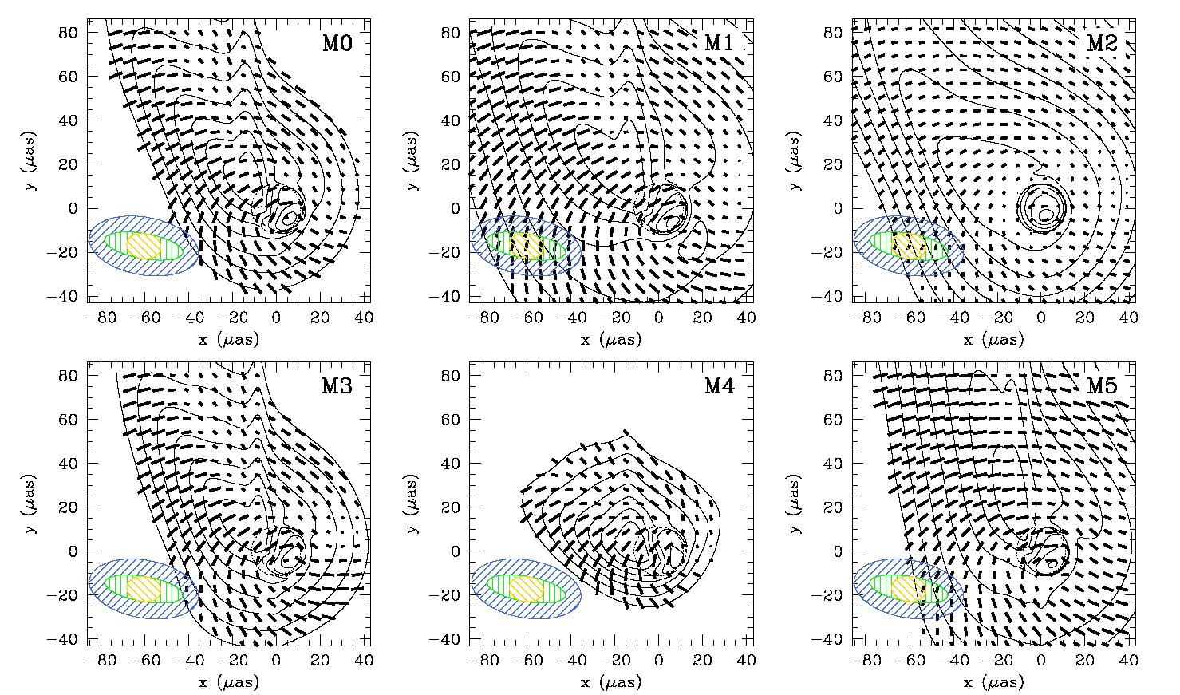
9) The Event Horizon Telescope
M87: Broderick & Loeb 2009
Notes:
Have we detected cross-polarised fringes?

Slide 64
9) The Event Horizon Telescope
Polarized fringes at 230 GHz
(λ 1.3 mm) between
Hawaii and Arizona, and
Hawaii and California.
Fish et al 2013; poster at
AAS meeting
Notes:
More antennas are joining the array

Slide 65
9) The Event Horizon Telescope
ALMA makes this very feasible. Stay tuned.

