Slide 1
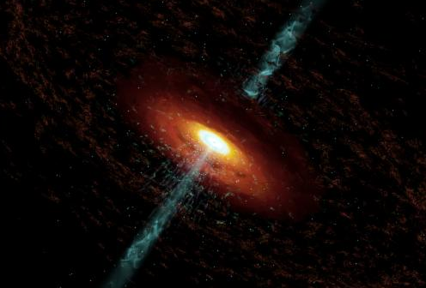
The Innermost Regions of Relativistic Jets and their Magnetic Fields: Summary
Alan Marscher
Institute for Astrophysical Research, Boston University
Research Web Page: www.bu.edu/blazars

Slide 2
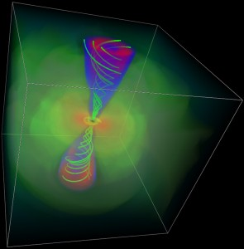
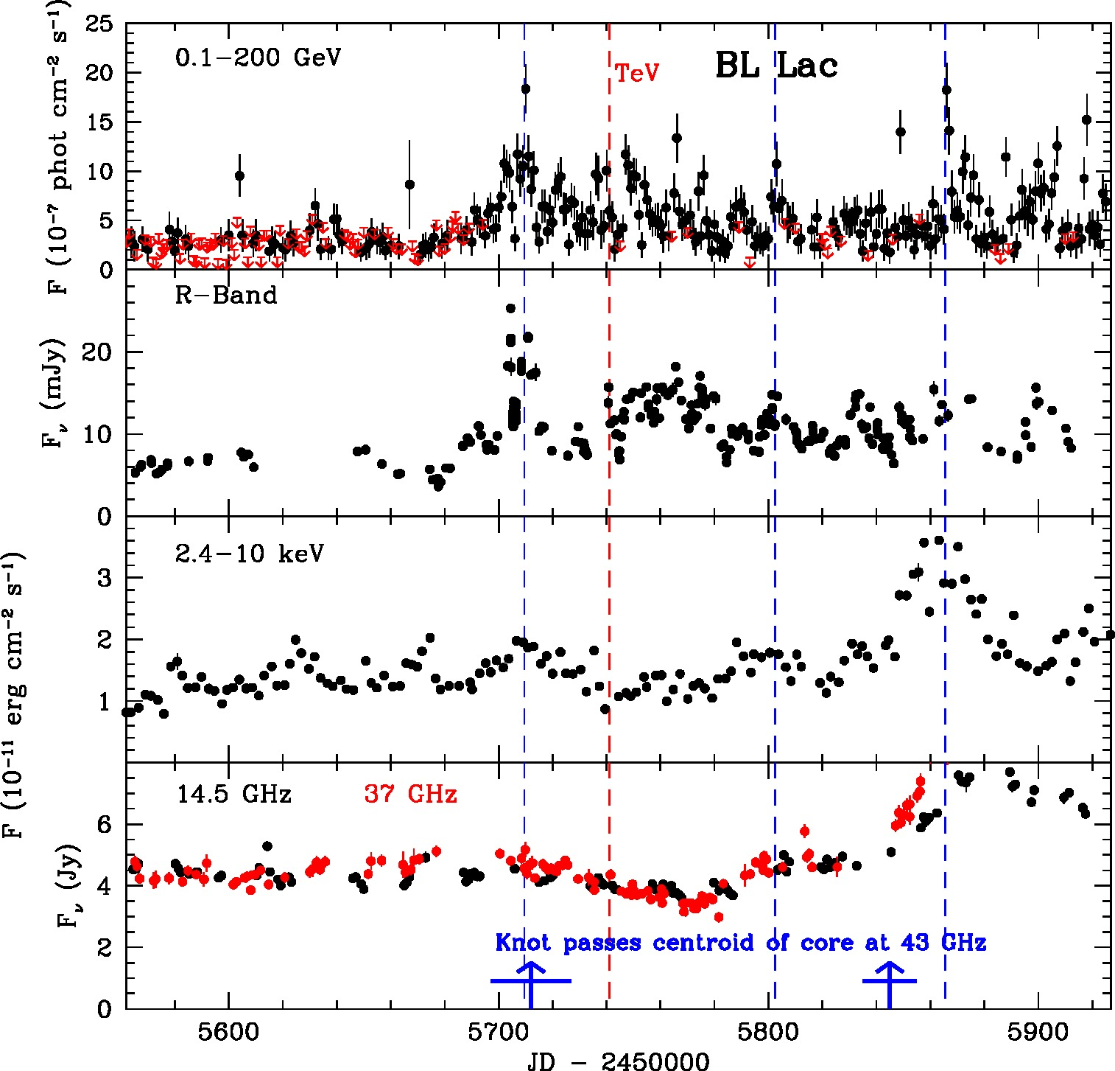
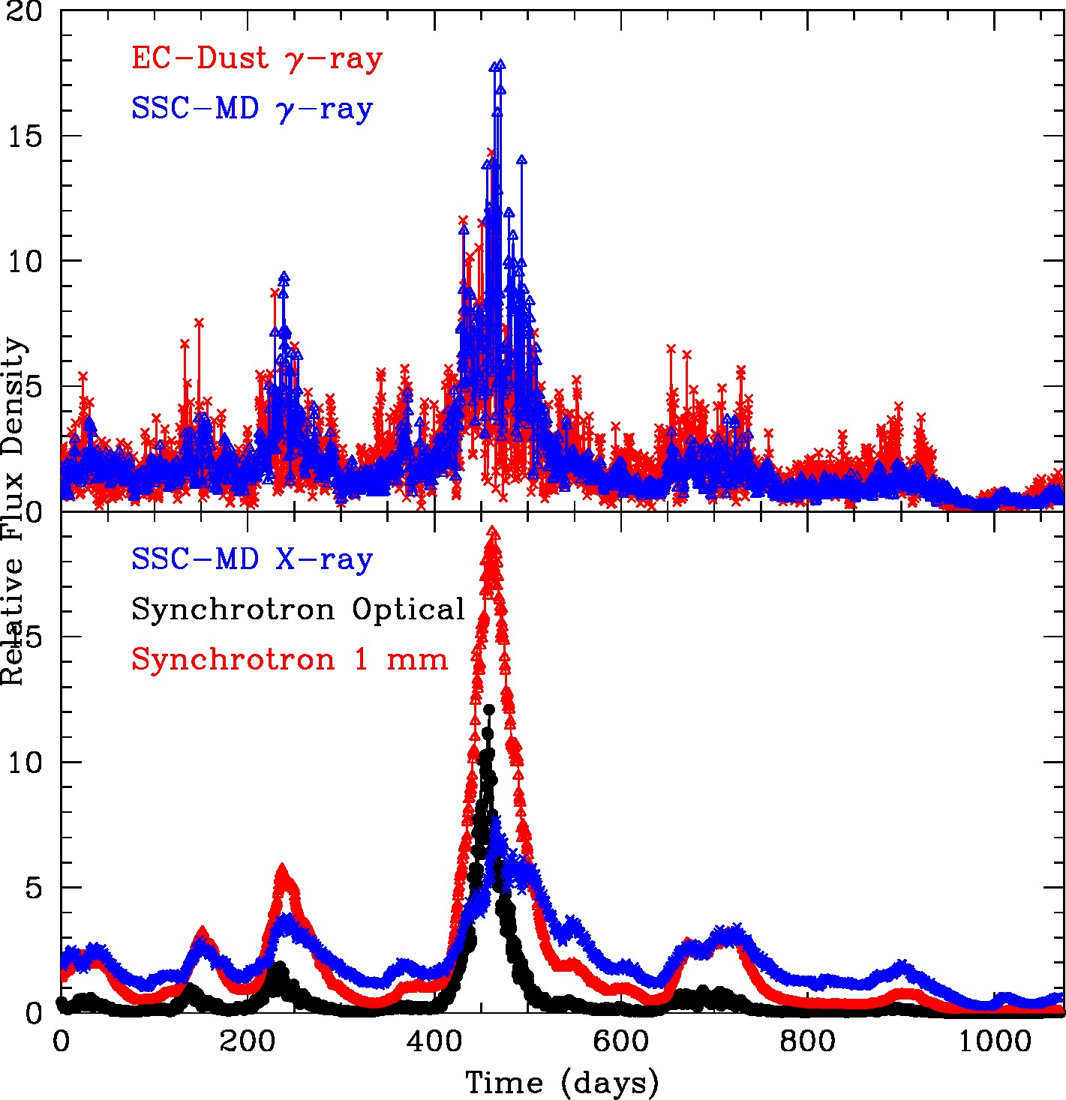
Two Universes Connected by Jets Joined by this Meeting
Shocking statement from an observer: “Monte Carlo simulations don’t lie” – D. Gabuzda
Theorists’ Universe
Observers’ Universe

Slide 3
Making and Maintaining a Jet
Hardee: jet persists despite instabilities
Rayleigh-Taylor instability (Matsumoto)
Kink instability (Vlahakis, Nishikawa, Mizuno)
Helical instability (Perucho)
Recollimation shock/pinch instability (Meier, Hada, Hardee, Marscher)
Rotating accretion disk
Ferreira: thicker disks make less powerful jets from Blandford-Payne mechanism in XRBs
Theoria (muse of theorists)
“The Magic Circle” by J.W. Waterhouse (ca. 1886)

Slide 4
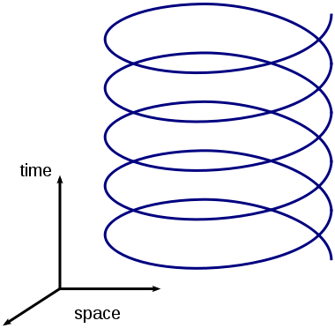
Magnetically Driven Jets
Staff: 3D MHD simulations → more open field lines produce somewhat slower jets
Bosch-Ramon: cloud/wind can enter jet → shocks, etc.
Oscillations: helical instability? (Perucho)
Nakamura: magnetic collimation in M87 better fit than conical jet
XRBs turn jets on and off (Markoff)
Swift J1644+57: jet suddenly created – tidal disruption event? (Castro-Tirado)
MAD jet maker: Sasha (Chërt) Tchekhovskoy
Jets are very, very sexy, maybe even kinky. We need a more provocative name for them. How about . . .
Magnado del Diablo

Slide 5
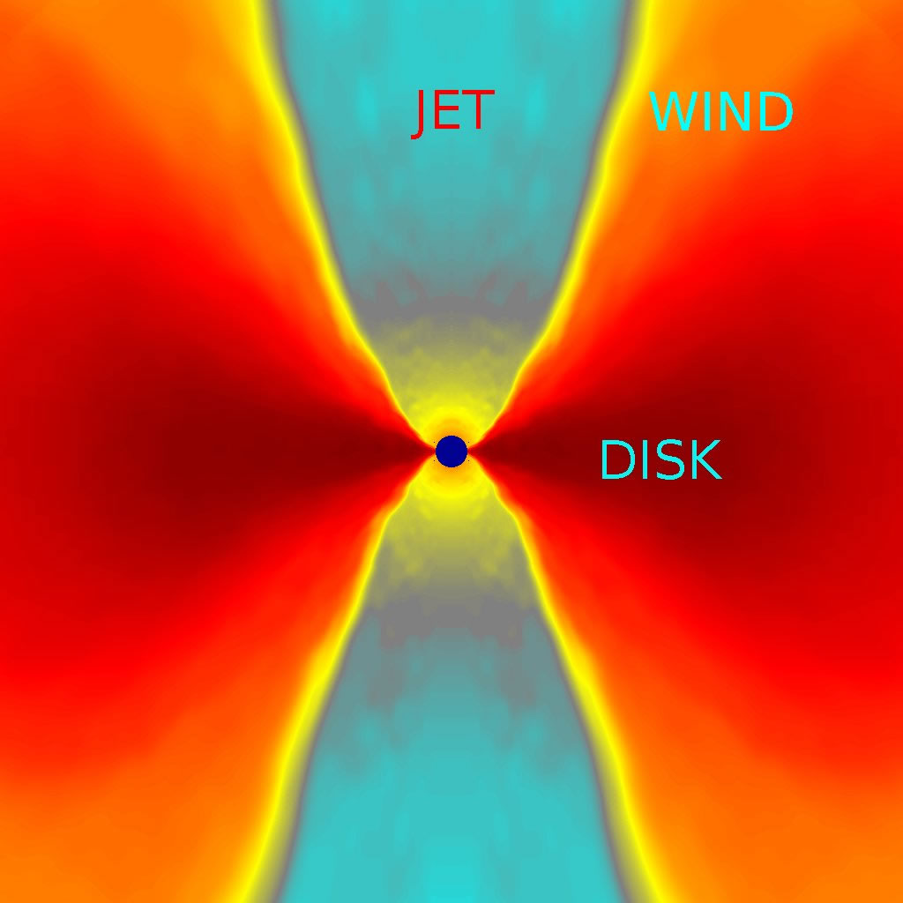
Time Scale for Making Jets
Sasha Tchekhovskoy ~ 1 year of computing time to run MAD code for Δt = 3x10⁴R_{g}/c
For BH of mass 10⁸ M_{sun} time dilation factor = 4.3
The computer was at r = 1.057 R_{s} !
Contopoulos: “I think that we are moving too fast with numerical simulations”
I don’t think so!

Slide 6
Poynting Flux Dominated vs. Kinetic Flux Dominated
Meier proposal: FR I’s remain Poynting flux dominated beyond acceleration zone, FR II’s become kinetic flux dominated
Lister: Apparent speeds of BL Lacs tend to increase with distance from “core”, not so much in quasars ✔
Wardle: BL Lac polarizations tend to have EVPA similar to jet direction, consistent with helical field expected when Poynting flux dominates, quasar EVPAs show no trend on parsec scales (but tend to be transverse to jet on kpc scales) ✔
Lister: Apparent speeds of BL Lacs tend to increase with distance from “core”, not so much in quasars ✔
Predicts that BL Lac jets should show signs of non-ballistic motions & kinks, seen by Cohen; but seem to be present in both quasars & BL Lacs, so test is not robust

Slide 7
Sites of Flares in Jets: Where Do You Stand?
Between “core” & BH: Hada (M87), Ghisellini – gamma rays (abandoned by Tavecchio)
Moving shocks: Agudo, Jorstad, Joshi, Malzac

Slide 8
Sites of Flares in Blazars: Where Do You Stand?
Potter: all along the jet
Kiloparsec scales: Grandi (radio galaxy)
Marscher, Meier
Parsec scales: Georganopoulos (< few pc), Pacciani

Slide 9
Scandal
We disagree about where the gamma-ray flares occur and what the source of the seed photons is
Sub-parsec scales, inside BLR:
+ Rapid time-scales
+ Plenty of seed photons
+ Can reproduce SEDs well
+ Can explain ~2 GeV break in spectrum
Most flares coincide with pc-scale events
Can’t get > 20 GeV photons to us without destruction from pair production
Parsec scales:
+ Most flares coincide with pc-scale events
+ Can get > 20 GeV photons to us without destruction from pair production
+ The most relativistic blazar jets are extremely narrow & only part of jet is illuminated at any given time (Claussen-Brown, Lister)
Rapid time-scales
Uncertain source of seed photons (is there enough hot dust far enough from BH?)
Difficult to explain SED from scattering synchrotron photons from sheath/Mach disk
→ All solutions can be ruled out!

Slide 10
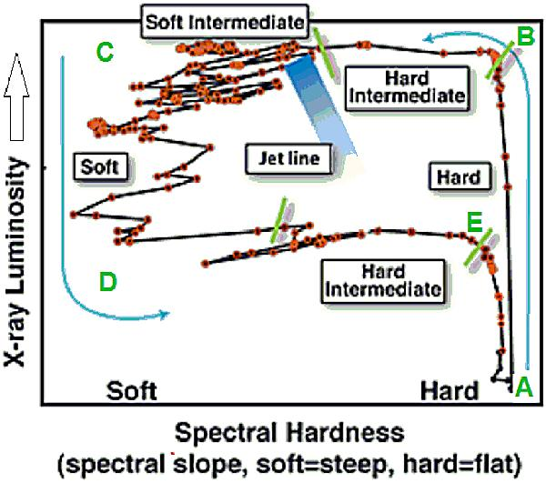
Objects with Low Accretion Power
Markoff: Section A-B may be similar to LLAGNs
Evans: Low-excitation radio galaxies also have power-law X-ray spectra, no sign of gas
→ Jet more dominant at very low accretion levels (also Fernández Ontiveros)
Logical conclusion: there should be NAKED AGN with L/L_{edd} = 0 with nothing but jets!
Maybe M87 is such an object (Casadio, Nakamura, Doi, Kino)
Q diagram for X-ray binaries

Slide 11
The (Un)importance of Spin
Tchekhovskoy: near-maximal spin needed for highest power jets; spins are prograde
Markoff: spin of XRB BH does not change spin but DOES change jet → Spin is not main determinant factor for making jets
Evans: Whatever powers jets also suppresses X-ray Fe line → MAD accretion?
The Importance of Polarization
Degree of polarization: level of (dis)order of magnetic field
EVPA: direction of magnetic field relative to jet axis, bends, etc. (Wardle)
Circular polarization: variable but polarity can persist for longer time than expected (H. Aller, O’Sullivan)
Carrasco Gonzalez (used to find synchrotron component in YSO jet)
Test BH spacetime effects with Event Horizon Telescope (Wardle)
Diagnostics for XRBs (Russell) and GRBs (Jermak)
Kiehlmann (new analysis technique), Jorstad (use to connect optical & radio emission regions), Acosta Pulido (near-IR polarimetry)

Slide 12
Rotation of Polarization Vector in Helical Field
Rotations of EVPA (e.g., Marscher, Larionov, Orienti, Beaklini, Benítez, Lee, Sasada): Spiral motion of plasma through helical field? Bending jet? Turbulence? Rotating plasma blob? Need to work on theoretical predictions!
Argument on Tuesday has been resolved: streamline of plasma flow crosses magnetic field *pattern*, not field lines

Slide 13
Rapid Variability on Parsec Scales
Gamma-rays with E > 10 GeV need to escape without pair producing off BLR photons
Quasar VHE emission needs to be on parsec scales (Pacciani, Behera)
- But time scale of TeV variabiity in 1222+216 is very short, ~20 min
Mkn421 (HSP BL Lac) TeV flare ~40 days before radio flare (Richards) → gamma-rays come from < 2 pc from BH
But most HSP BL Lacs exhibit motion <~ 2c (Piner, Richards, Lister), relatively slow variability → why is such a high Doppler factor needed to explain X-ray/TeV flares?
Exceptions: 3C 66A & 0716+714: maybe other HSPs are fast but don’t make knots on parsec scales
Marscher: blazar jets are more narrow than many theorists think, < 1º, and only a fraction of jet cross-section might emit at highest frequencies → turbulence or “jet within jet” magnetic reconnection + Doppler factors ~20-100 might provide conditions for time scales << r/c
Ghisellini: Most of luminosity should not be emitted at frequency where time scale is very short, since that would require ultra-high jet kinetic powers → time scales should be longer near peaks of SED

Slide 14
Scandal
We disagree about the geometry of the magnetic field on parsec scales
Helical
+ Magnetic acceleration & collimation requires helical field
+ Explains observed kinks, waving structure (Cohen)
+ Explains Faraday rotation gradients across jet (Gabuzda, O’Sullivan, Kravchenko, Murphy, Zamaninasab)
- Degree of linear polarization is usually low & variable in bright blazars
- EVPA is usually variable in bright blazars
Disordered
+ Explains low polarization, variations in degree & EVPA
+ Expected from current-driven instabilities as kinetic energy approaches magnetic energy
+ Explains rapid fluctuations in flux density, major flares, power-law power spectra
+ Shocking of disordered field explains polarization events in radio (M. Aller)
Does not explain Faraday rotation gradients across jet (but this could be in sheath)
Is troublesome to include in numerical emission codes

Slide 15
Hadrons vs. Leptons
Böttcher: SEDs are fit as well by hadronic models as by leptonic models
Cost: factor of ~100 in energy → not possible if blazars have an energy crisis, but perhaps OK if they are rich in accretion rate
Mastichiadis, Petropoulou: difficult for hadronic model to produce light curves similar to PKS 2155-304, but they will continue to try
Old Friends Are Still Cutting Edge
Mkn 421: Still everyone’s favorite TeV blazar (Mukherjee, Richards, Lico, Balokovic, Niinuma, Mastichiadis, Racero)
3C 84 (Nagai) M81 (Alberdi)
OJ287 (M. Aller, Agudo, Sawada-Satoh)
3C 111 (Beuchert)
to name several

Slide 16
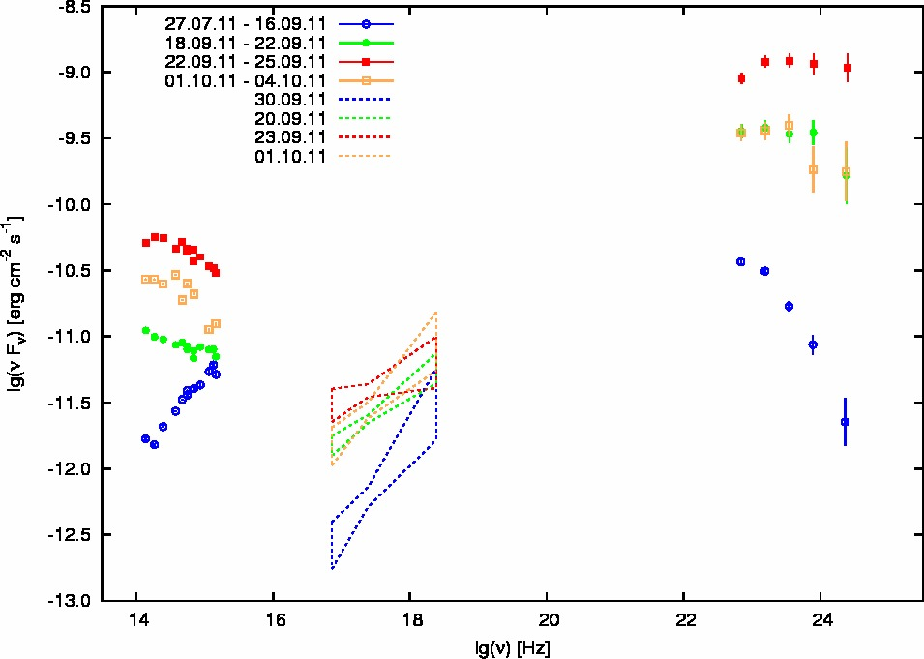
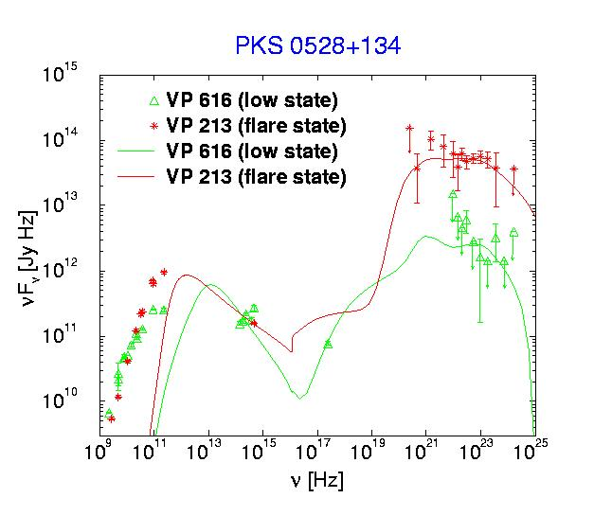
Advancements in Observations & Theory
Light curves, polarization curves, & SEDs with unprecedented time & frequency coverage ( Kaufmann, Larionov, Morozova, Troitskiy, Marscher, Racero, Raiteri, Hagen-Thorn – method for separating constant & variable component spectra, Donnarumma)
Derivation of variability Doppler factors for many blazars (Hovatta)
Computational codes now try to simulate time-dependent SEDs & light curves [Joshi, Chen, Richter, Coronado, Petropoulou, Potter (parabolic jet), Rueda Beccerril, Sorcia, Vuillaume, Weidinger], & polarization curves (Marscher)
Palma et al. 2011 ApJ
CTA102 Larionov et al.

Slide 17
Very Interesting . . .
Müller: Very unusual gamma-ray source PMN J1603-4904, VLBI structure like a CSO, IR hump like a starburst, bright & steady gamma-ray emission, maybe BL Lac type optical spectrum
There are matters that jet makers should consider, such as return currents, tilted disks, binary black holes (Contopoulos, Liu, Texeira, Vila)
Moving “internal” shocks in jets are still suspected of producing flares & superluminal knots (Joshi, Chen, M. Aller, Rueda Becerril); magnetic fields in shocks need to be considered (Mimica, Chen); multiple shocks can explain flat spectra of XRB jets (Malzac)
Supergiant stars & their winds will enter jet, could cause detectable gamma-ray emission (Araudo)
Gamma-ray and radio emission grow up together (Lister, Giroletti, Orienti, Piner)
GeV and optical emission are usually – but not always (Chen) – the best of friends (Carnerero Martin, Marscher, Jorstad, Larionov, Troitskiy, others)
There are highly beamed “fake BL Lacs” (Meyer) needed to explain blazar sequence
There are also blazars disguised as steep-spectrum radio sources (Torresi), bright double-lobed sources (Hough), and Narrow Line Seyfert 1 galaxies (D’Ammando, Kreikenbaum)

Slide 18
Very Interesting . . .
VLBI advances even as the VLBA is threatened with extinction: RadioAstron (Kovalev), 1 mm VLBI (Nakamura), maximum entropy/cross entropy image analysis (Coughlin, Motter)
Measurements of core shifts from opacity effects are becoming more refined, allowing derivation of some physical conditions (Hada, Haga, Gabuzda, Kutkin, Voytsik)
Poynting-dominated plasma turns into particle energy-dominated via waves in MHD shocks, with synchro-Compton emission, EVPA transverse to jet axis (Kirk)
Menzler: Consideration of plasma effects on behavior of secondary particles made by gamma-rays traversing intergalactic space modifies expected IC-CMB spectrum & derivation of IGM magnetic field
Migliari: new SS433-like XRB
X-ray binaries/transients: Q diagram organizes spectral & jet characteristics (Markoff), but there is a wide range of behavior (Capitanio, Del Santo, Shahbaz → need to search for more (Josep Martí) database: Cúnio
Molina: Rotational motion in jet of NRAO150 (helically twisted jet)
VLBI observations show changes in jet near times of gamma-ray flares (Marscher, Jorstad, Lisakov, Nagai) and probe velocity gradients (Mertens)

Slide 19
The Future
RadioAstron (Kovalev): Ultra-high resolution images of jets
VLBI observations of large samples of gamma-ray blazars (Giovannini)
ALMA: submillimeter-wave SEDs, variability, polarization should all be possible (if we can get the observing time!) (Hada, Evans)
Self-consistent simulations of jet physics & emission (Nishikawa et al.)
TeV observations (Mukherjee, Errando, Kaufmann, Sorcia): Cherenkov Telescope Array – higher sensitivity, lower energy threshold (very important in post-Fermi era)
BUT . . . Other time domain instruments have been or are threatened to be turned off
15 minutes after end of this talk: meeting to discuss possible ways to save the VLBA

Slide 20
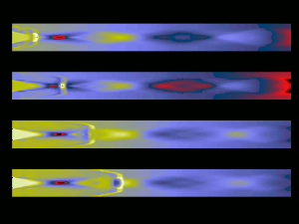
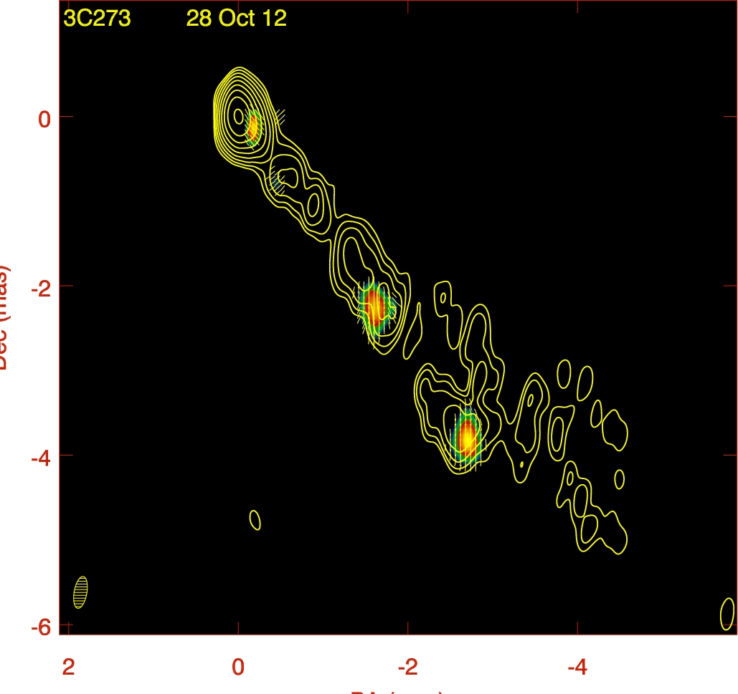
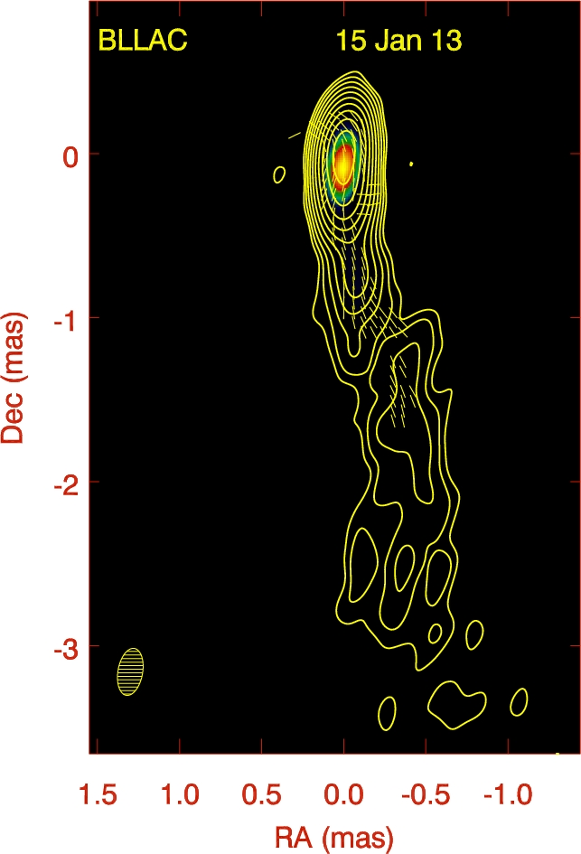
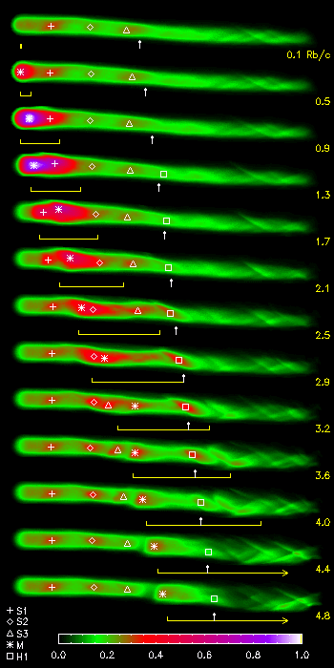
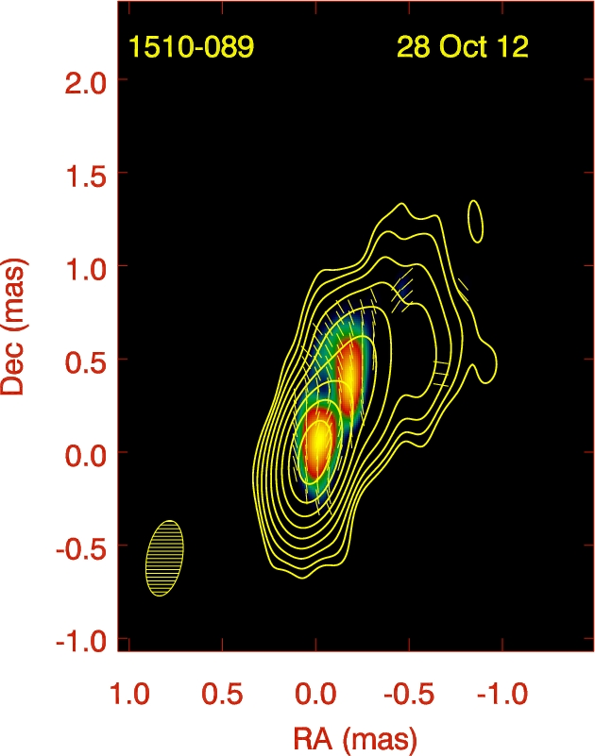
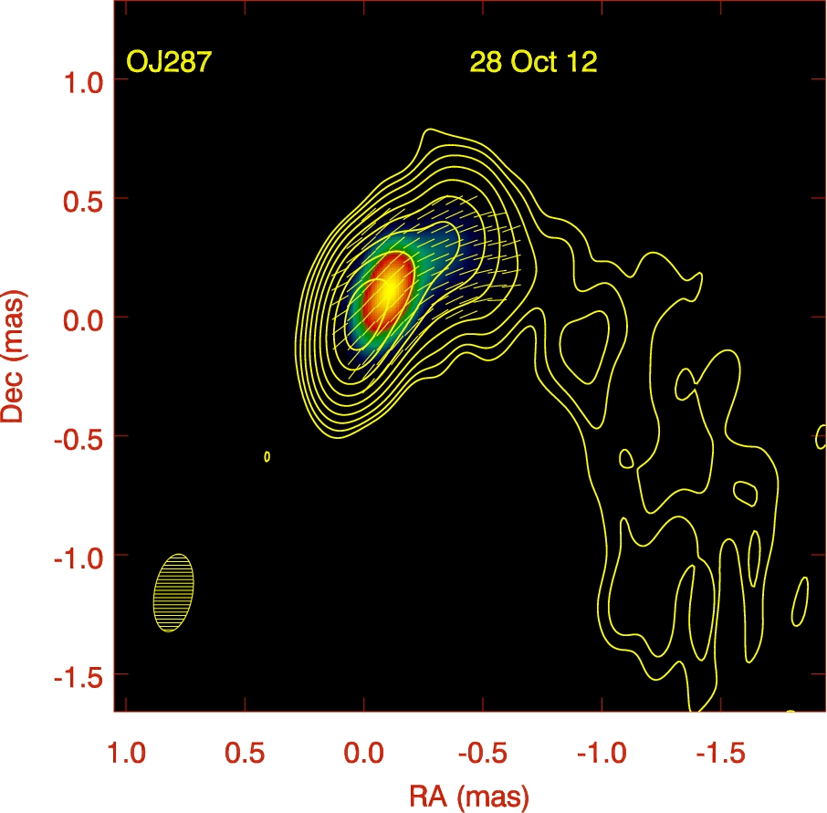
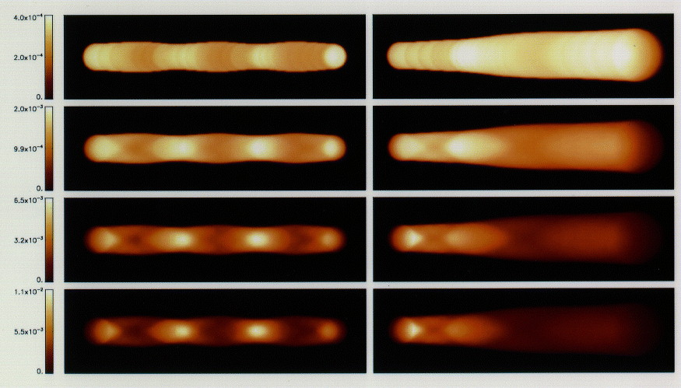
Future Virtual Observatory: JEt Simulation Telescope (JEST)
JEt Simulation Telescope (JEST)
Project: Jet Observations through Simulation Experiments: Light curves, Undulations, Images, & SEDs (JOSÉ LUIS)
VLBA Imaging of Jets: Crucial to our Studies of Jets
Muchas gracias, amigo – you are a real superluminal lover!!
Notes:
Historical motivation: Do AGN show low/high/very high states like GBHs?

Slide 21
JETS RULE!!!

