Slide 1
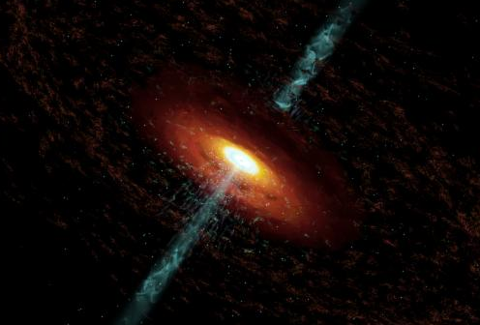
Multi-waveband Behavior of Blazars
Alan Marscher
Institute for Astrophysical Research, Boston University
Research Web Page: www.bu.edu/blazars

Slide 2
Disclaimer
The data and discussion presented here are but a small subset of the huge number of both wonderful and not-so-wonderful multi-waveband studies.
Topics are selected to minimize overlap with other talks & posters at this meeting
The author apologizes to the many people whose wonderful studies are not mentioned here, and to those whose data are shown but to whom proper credit is not given.
The author is not to be held legally liable for any representations, misrepresentations, omissions, or emissions during this presentation.

Slide 3
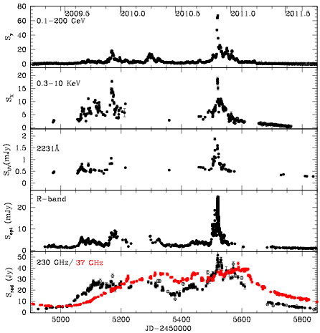
The Great Hope of Multi-waveband Variability Studies
Use details of variations & SEDs to probe structure & physics of jets close to the central engine (cf. our working model)
- Injection, acceleration, collimation of jet
Energization of relativistic particles
Dynamics of flow (shocks, stability, etc.)
Which frequencies participate in flares?
Cross-frequency correlations
Cross-frequency time delays/simultaneity
Model of a Blazar
3C 454.3, from Jorstad et al. (ApJ, submitted)

Slide 4
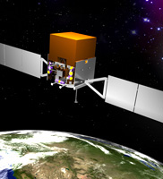
Fermi Light Curves: γ-ray Flux for Every Blazar Every 3 Hours

Slide 5
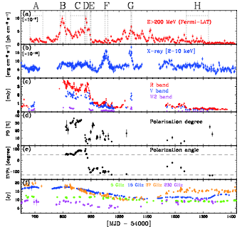
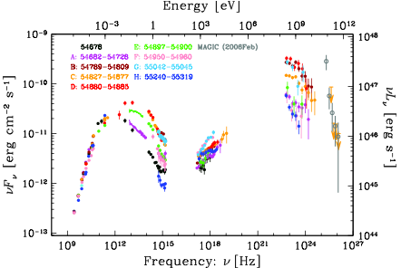
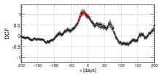
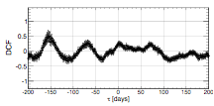
Example of Complexity: 3C 279 (Hayashida et al. 2012, ApJ)
Correlations:
- Complex or very weak
- Time delays vary
SEDs:
- Double hump (synchrotron, IC)
- Gamma-ray flux can be ~ 2 orders of magnitude higher than X-ray
Top: Gamma-optical DCF, <0 means gamma leads
Bottom: gamma/X-ray DCF
Notes:
Historical motivation: Do AGN show low/high/very high states like GBHs?

Slide 6
More Comprehensive Approach: Add VLBI Imaging
We can use sequences of VLBA images to relate multi-waveband variations with physical structures in the jet
Comes with polarization maps to compare with optical pol.
Unfortunately, the NSF plans to “divest” the VLBA after this year, i.e., close it down & dismantle the antennas, unless non-NSF funds can be found for its operations (~ $5M/year)
Also, Fermi is under serious financial stress, with a large cut in operations & guest investigator funds next year
NASA has already shut down RXTE & U. Michigan has shut down UMRAO while they were still working well
→ We need to make an even stronger case for jet studies!
Notes:
Historical motivation: Do AGN show low/high/very high states like GBHs?

Slide 7
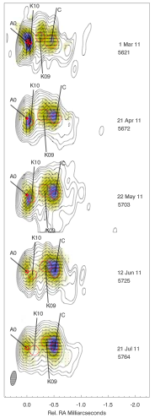
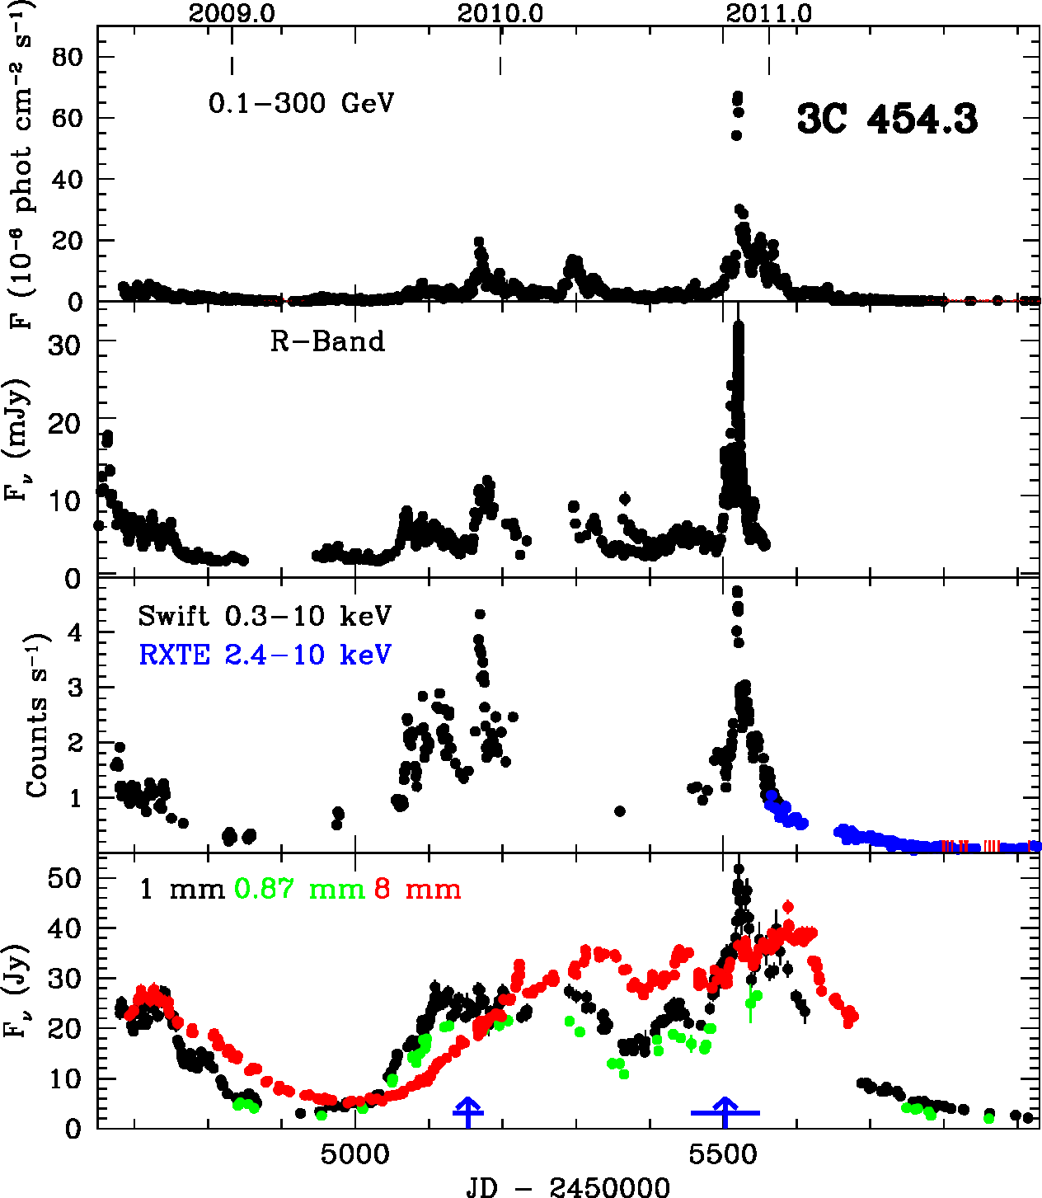
The VLBA Images Gamma-ray Emitting Region
8 mm outbursts start before gamma-ray flares (Lähteenmäki & Valtaoja 2003, León-Tavares et al. 2011)
Events in VLBI core at 43 GHz occur before/during gamma-ray flares (Jorstad et al. 2001)

Slide 8
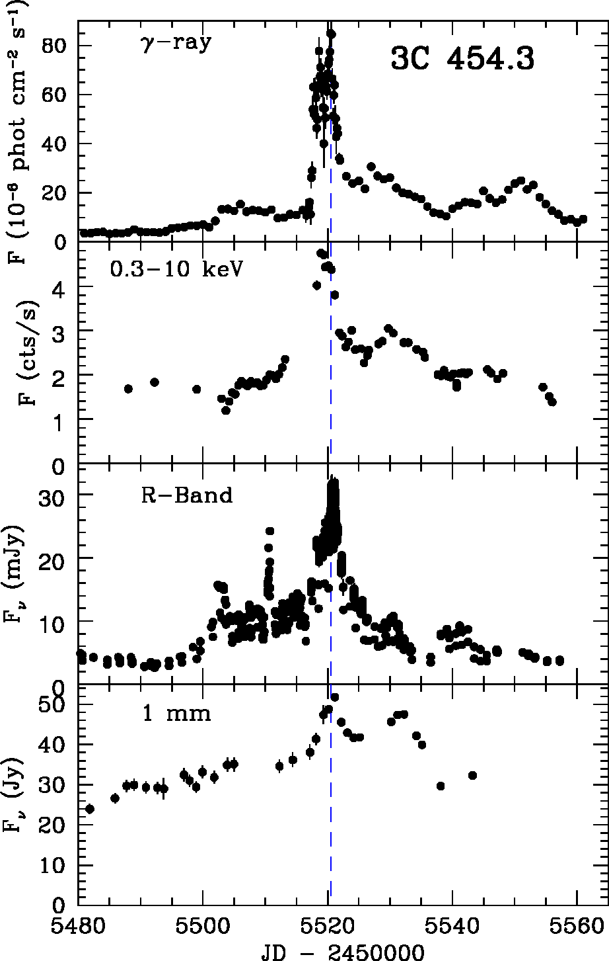
3C 454.3: All wavebands down to mm-wave peaked within 1 day during flare in VLBI core
VLBA images at 7 mm wavelength
Knot ejected in late 2009,
v_{app} = 10c
RJD=5502, 1 Nov 2010; core: 10.3 Jy
X-ray
RJD=5507, 6 Nov 2010; core: 14.1 Jy
R-band
230 GHz
RJD=5513, 12 Nov 2010; core: 14.2 Jy
Nov. 20, 2010
Wehrle et al. (2012 ApJ)
RJD=5535, 4 Dec 2010; core: 17.7 Jy

Slide 9
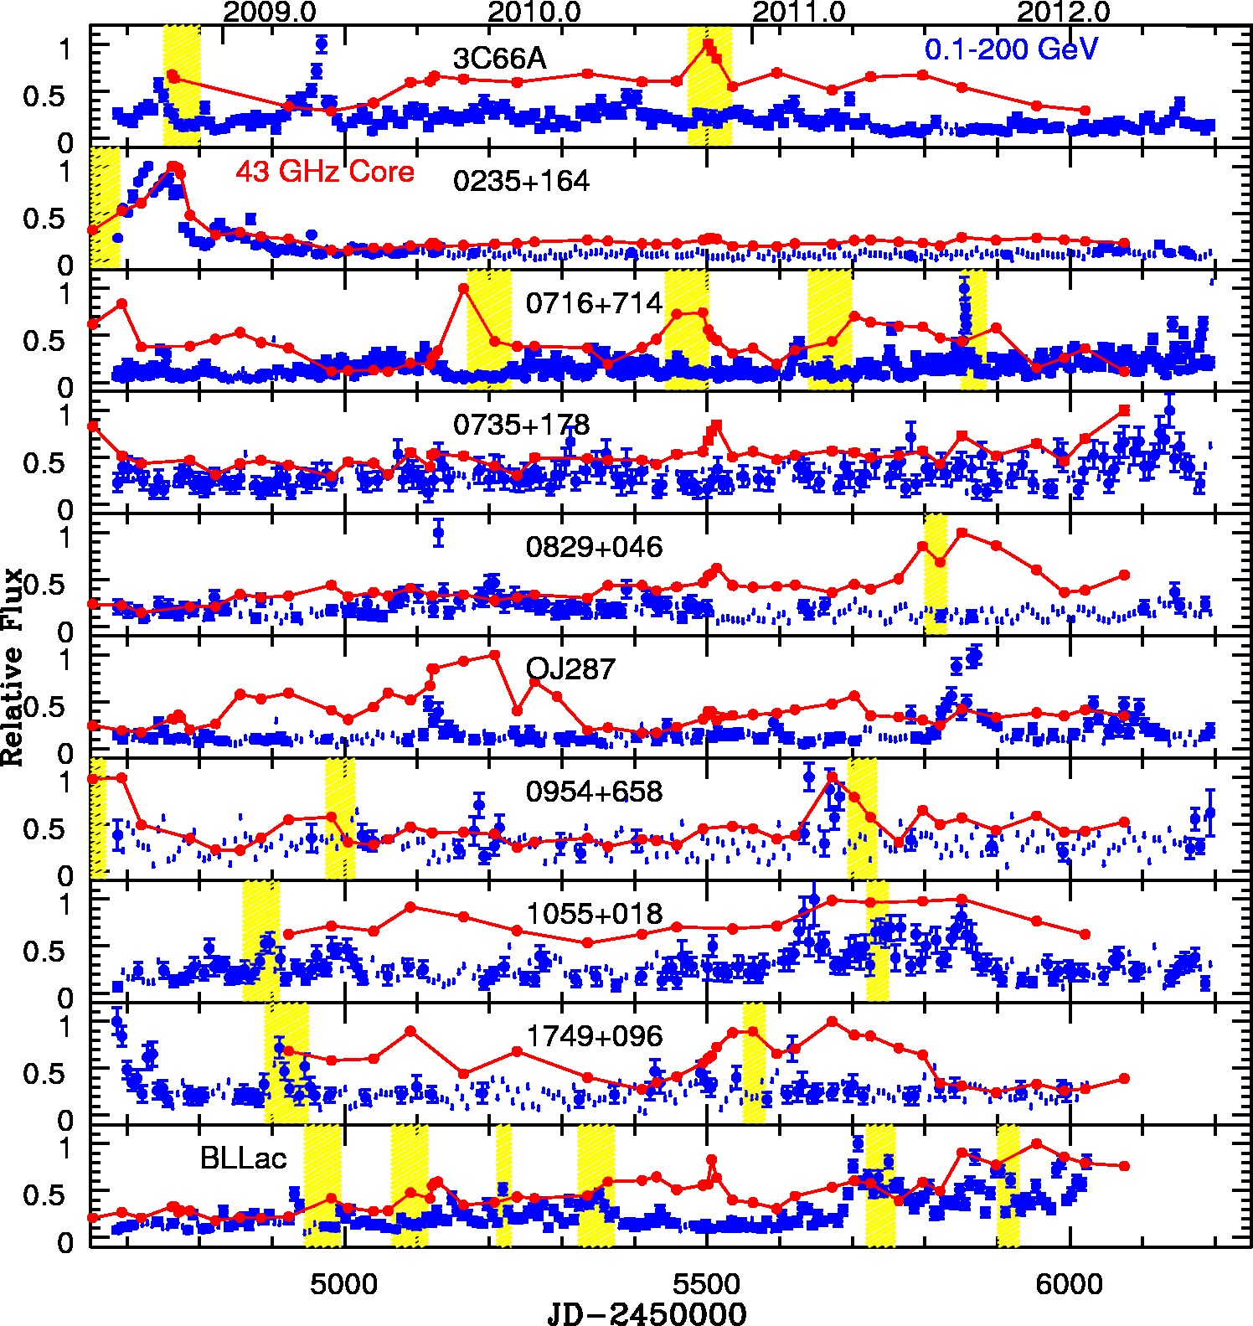
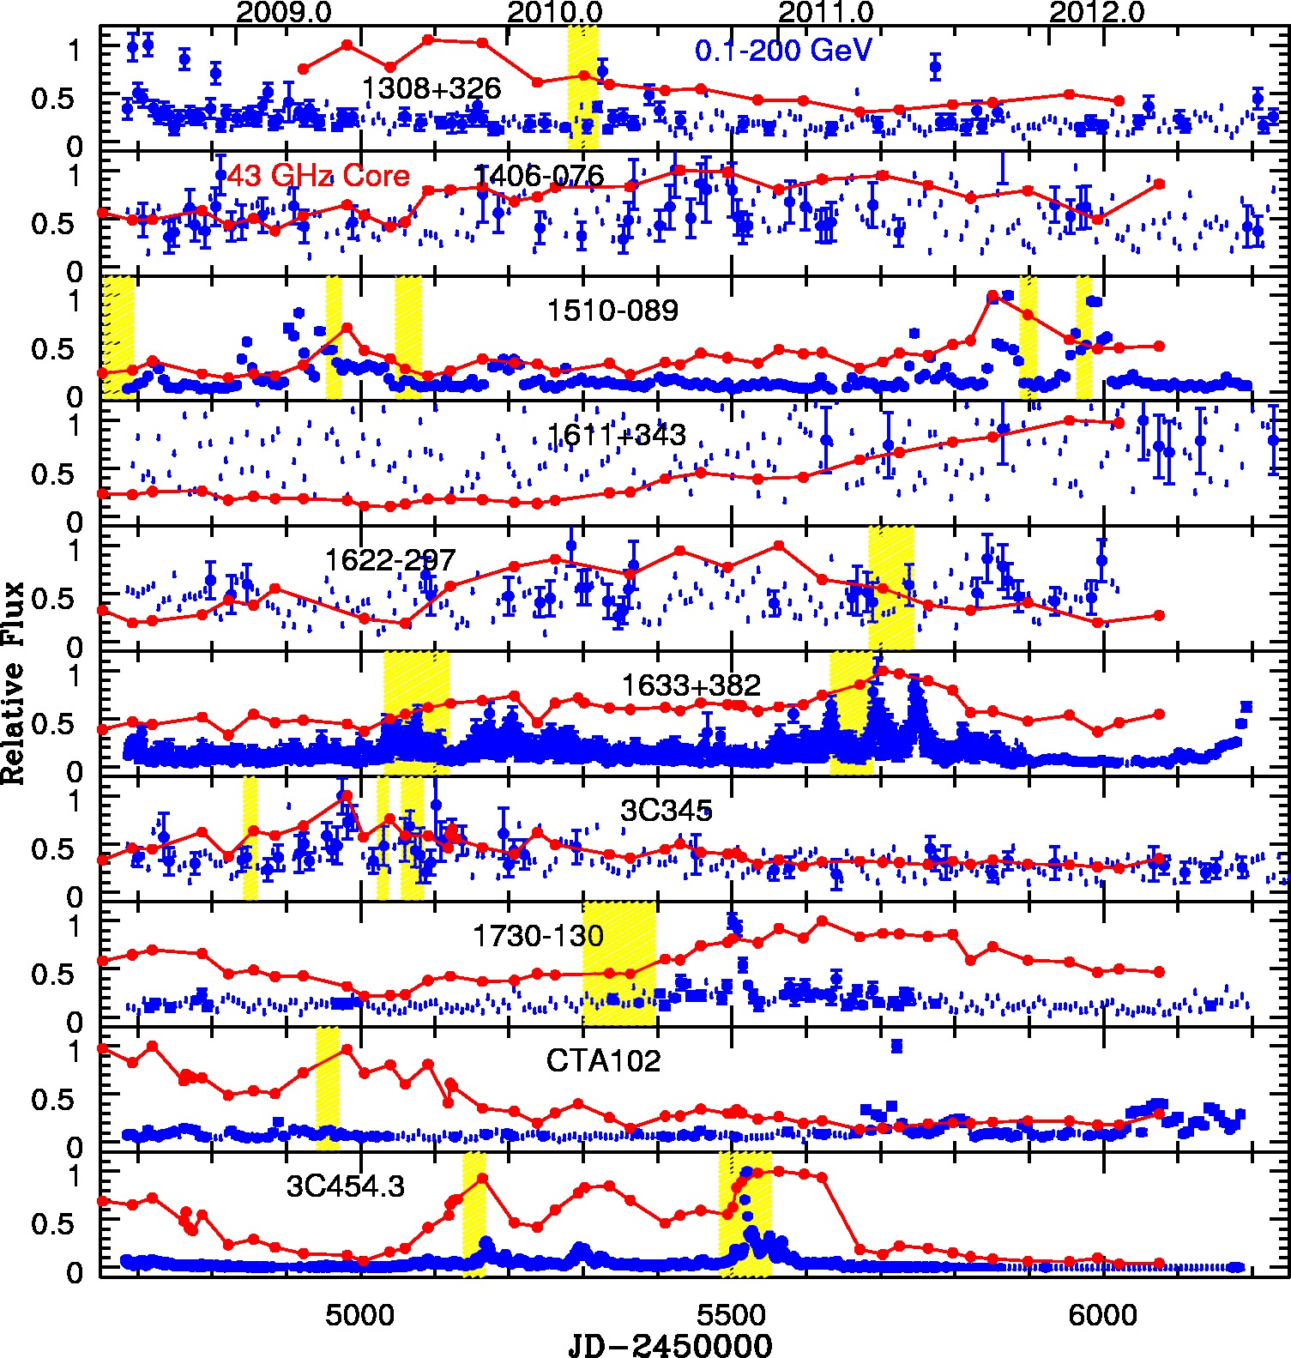
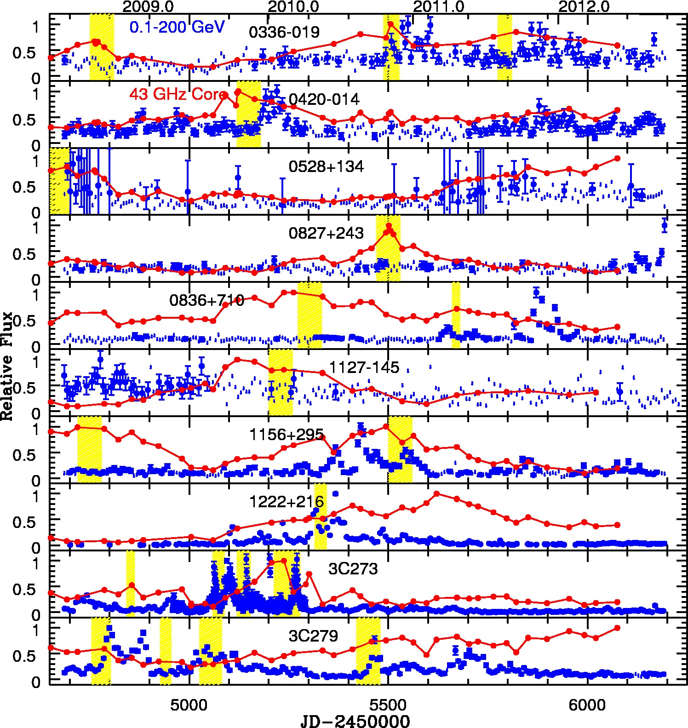
Behavior of Jet during γ-ray Flares in 34 Blazars over 4 Years
Blue: γ-ray flux Red: mm-wave “core” flux Yellow shading: new superluminal knot “ejected”
Of 62 γ-ray flares, 48 (77%) are simultaneous (within uncertainties) with a new superluminal knot or a major outburst in the core at 7 mm
(Both jet + gamma-ray emission are quiescent over 4 years in 5 sources & 86% of all sources have contemporaneous γ-ray & mm-wave quiescent periods)
Even accounting for chance coincidences, > 50% of γ-ray flares occur in the “core” seen in 7 mm images, parsecs from the black hole
← γ-ray light curves (blue), “core” light curve at 7 mm (red), & times of new superluminal knots (yellow) for 30 of the blazars in the sample
Marscher et al. 2012, Fermi & Jansky proc.

Slide 10
Location of Flares
Fermi + VLBA results: gamma-ray flares occur mostly on parsec scales, in mm-wave core or downstream
→ So do most optical flares, since gamma-ray/optical correlation is generally strong with ~ zero time delay
- Emission site outside BLR allows 10-500 GeV photons observed in some blazars to escape without pair producing off broad-line photons (e.g., 1222+216: Aleksic et al. 2011; PKS1424-418: Tavecchio et al. 2013)
Are HBLs & IBLs like Mkn421, whose pc-scales jets are usually rather quiet, exceptions? → See talks by J. Richards, R. Lico, & K. Niinuma later in the week
Do any flares in quasars or LBLs occur between core & central engine?
Notes:
Historical motivation: Do AGN show low/high/very high states like GBHs?

Slide 11
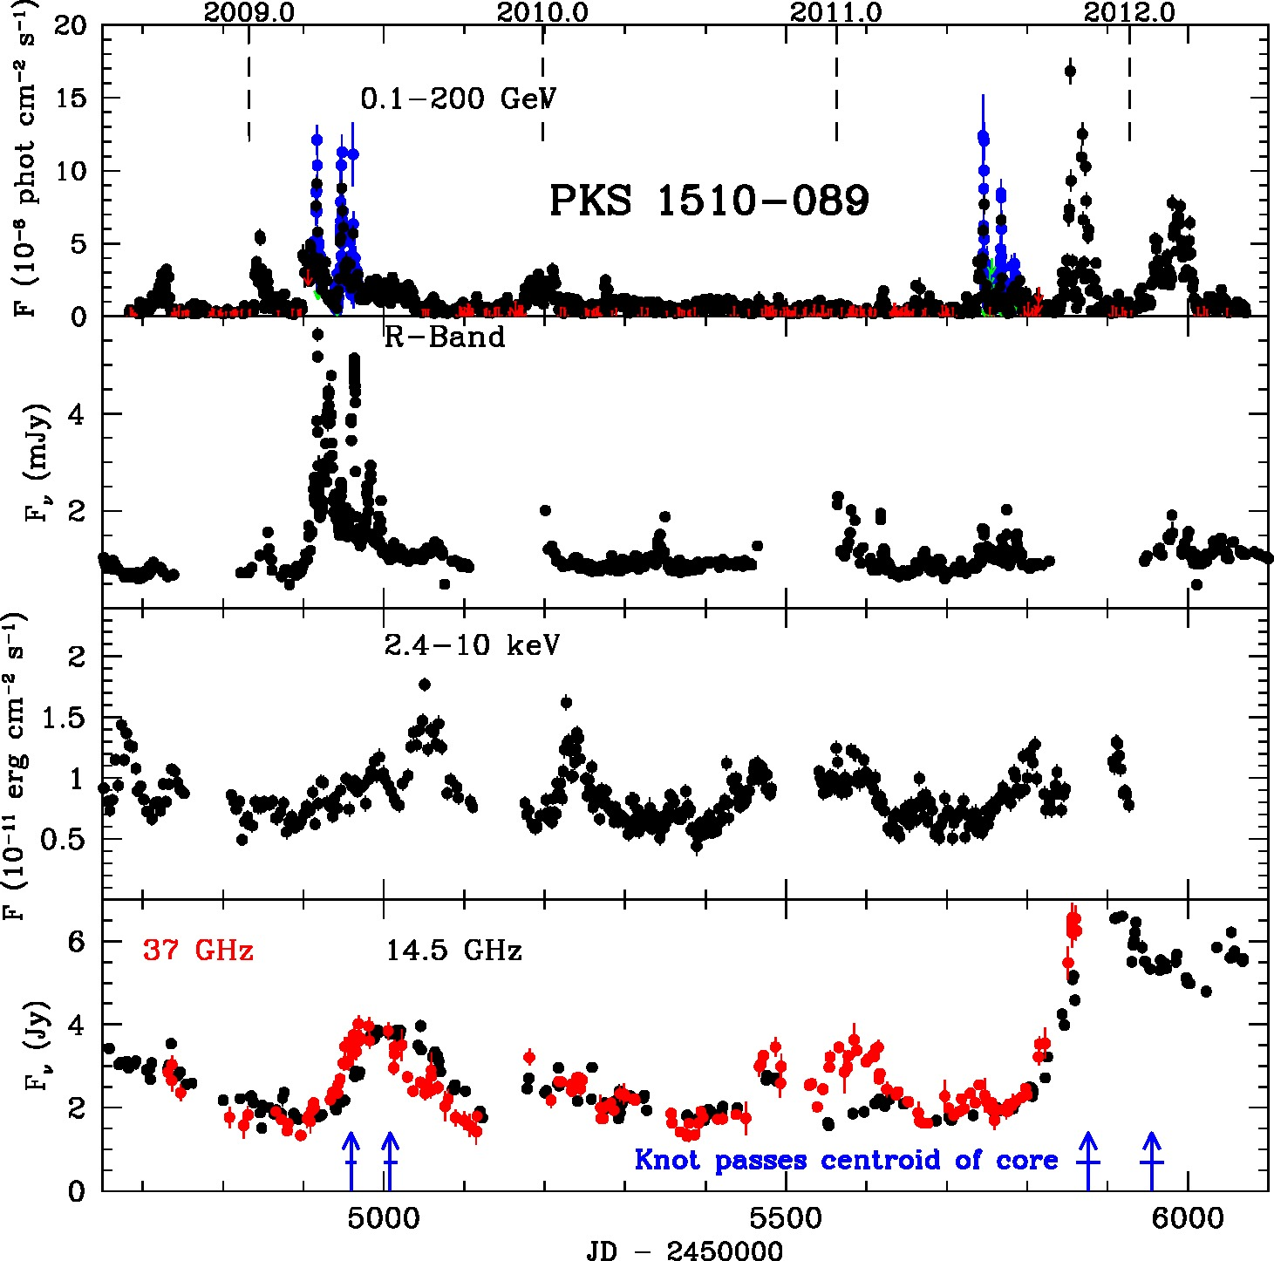
PKS 1510-089
Two episodes of multi-flare outbursts
Nalewajko et al. (2012, ApJ): different location for different flares within each episode
Interesting note: emission at 14. 5 GHz already participates in outburst during first main gamma-ray flare
Both episodes included rotations of optical polarization vector
Notes:
Historical motivation: Do AGN show low/high/very high states like GBHs?

Slide 12
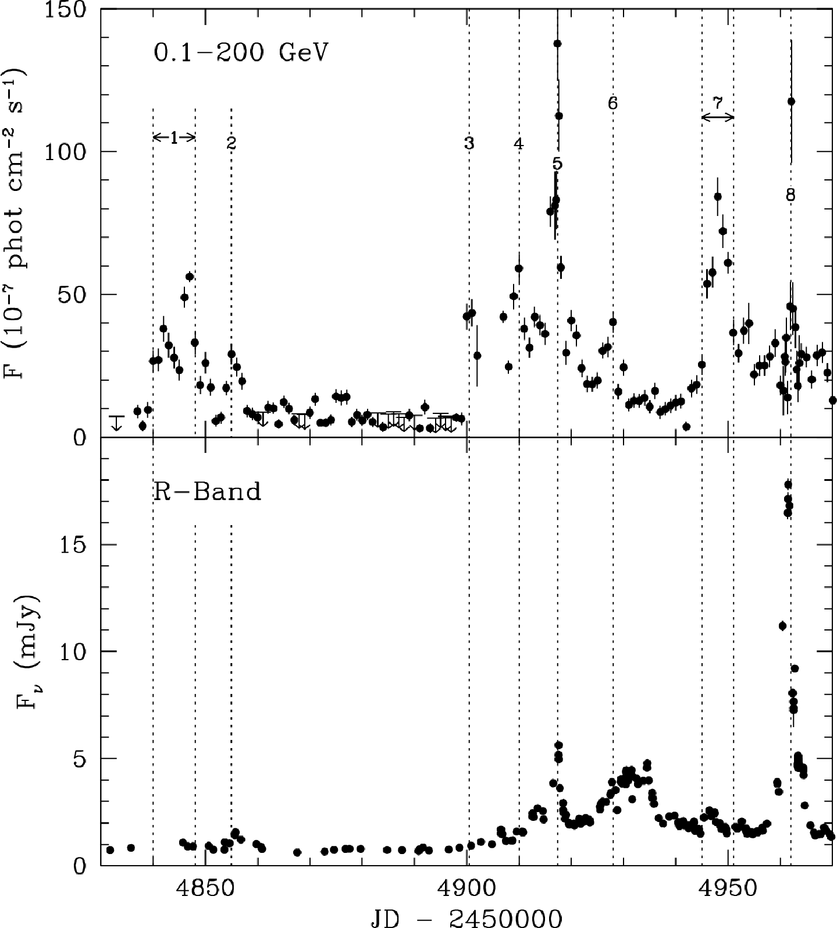
Quasar PKS 1510-089: first 140 days of 2009
γ-ray
High gamma-ray to synchrotron luminosity ratio: knot passes local source (or variable source) of seed photons that get scattered to gamma-ray energies?
Lower ratio: gamma-rays could come mainly from inverse Compton scattering of synchrotron photons produced in same region of jet
optical
Optical pol. rotation
by 720º
Superluminal knot passes “core”
Marscher et al. (2010, Astrophysical Journal Letters, 710, L126)
2009.0
2009.4

Slide 13
Sites of γ-ray Flares in PKS 1510-089 (Marscher et al. 2010 ApJL)
Mach disk
Possible local sources of beamed seed photons: sheath, Mach disk, stray emission-line cloud

Slide 14
BL Lac: Sketch
Emission feature following spiral path down jet
Feature (slow magnetosonic shock?) covers much of jet cross-section, but not all
Centroid is off-center
→ Net B rotates as feature moves down jet, P perpendicular to B
1
3
B_{net}
P vector
2
4

Slide 15
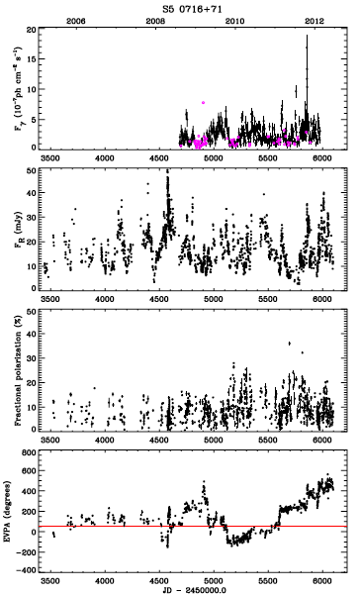
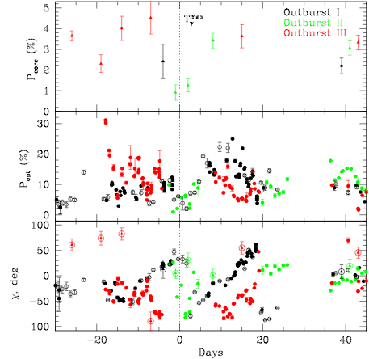
Rotations of Polarization Vector Are Common
Can be helical magnetic field, twisted jet*, or random walk of turbulence
3C 454.3
Jorstad et al. 2013, ApJ, subm.
0716+714
Larionov et al. 2013, ApJ
*Raiteri et al. (2011) & Larionov et al. (2013) relate bent trajectory of twisted jet to flux variations in different blazars
3C 279
Kiehlmann et al., in prep
Notes:
Historical motivation: Do AGN show low/high/very high states like GBHs?

Slide 16
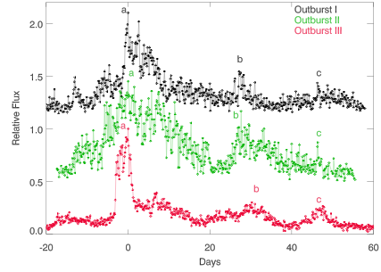
Repeated pattern in 3C 454.3 (Jorstad et al., ApJ, submitted)
Seems to be related to physical structures in the jet, within and near the mm-wave “core”, whose “super-resolved” 43 GHz images contain a triple structure
(Jorstad et al. 2010, ApJ)
→ As we build a longer data train with Fermi & other time-domain telescopes, we can look for other repeated patterns that reveal physical structure of the jet
Notes:
Historical motivation: Do AGN show low/high/very high states like GBHs?

Slide 17
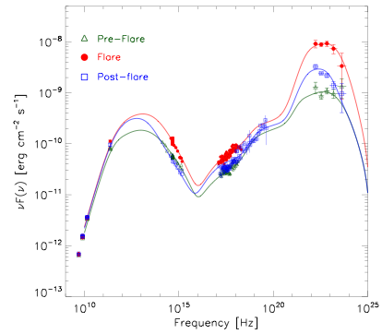
Spectral Energy Distributions (SEDs)
PKS 1510-089 (Vercellone et al. 2010, ApJ)
All authors of observational papers on multi-waveband variability hire a theorist to produce a model SED, usually single or 2 zones, to compare with data, usually single or 2-3 epochs
Pretty useless unless a model can’t reproduce the SED
Note in SED to left that L_{γ} ~ 100 L_{x}
Very challenging for an SSC model
But usual conclusion is that outburst occurs inside BLR, not supported by observations
→ Thermal seed photons from torus or stray cloud near jet?
Notes:
Historical motivation: Do AGN show low/high/very high states like GBHs?

Slide 18
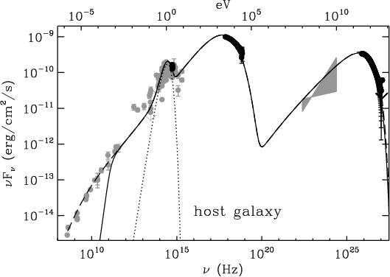
SED of an HBL/TeV Emitter
Mkn 421 (Giebels et al. 2007, A&A)
Consistent with synchrotron emission extending through X-rays, SSC in gamma-rays
Higher level of variability in these spectral regions than at radio frequencies
Notes:
Historical motivation: Do AGN show low/high/very high states like GBHs?

Slide 19
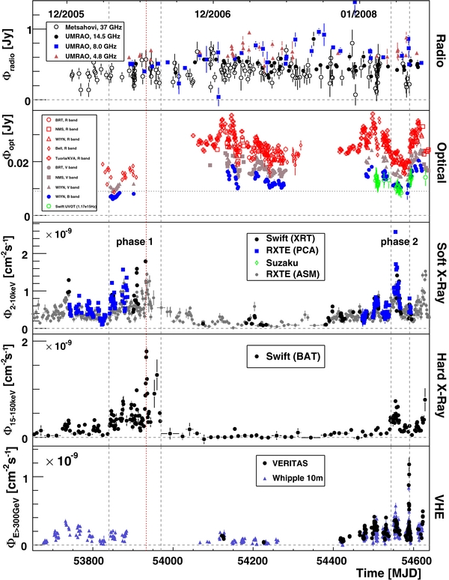
- Radio-intermediate BL Lac objects Mkn421 light curves → (Acciari et al. 2011 ApJ, 738, 25) Typical TeV-emitting BL Lac object X-ray emission consistent with synchrotron radiation by ~TeV electrons Usually – but not always – TeV variations are essentially simultaneous with X-ray variations
Intimate Relationship between X-ray and TeV Emission
Notes:
Historical motivation: Do AGN show low/high/very high states like GBHs?

Slide 20
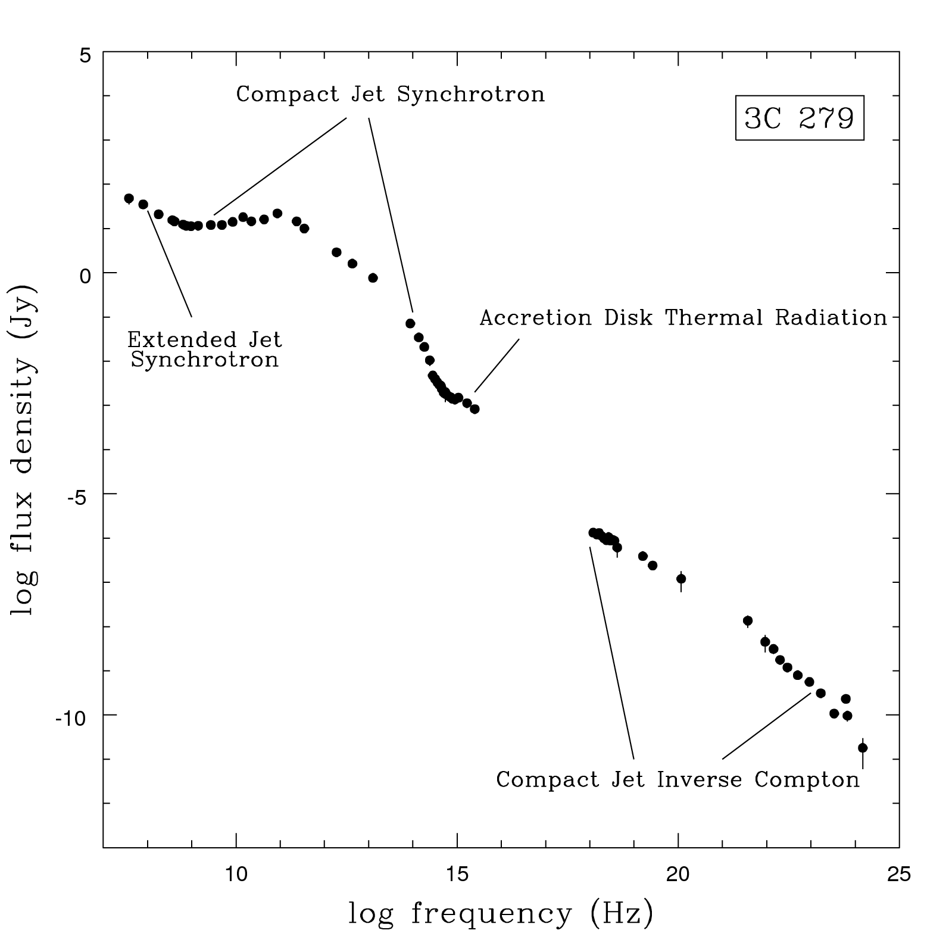
Break in Synchrotron Spectrum
SED can be roughly described by broken power law
break often by more or less than 1/2 expected from radiative losses
→ Volume filling factor decreases at higher electron energies/higher frequencies

Slide 21
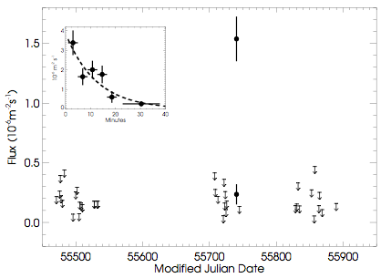
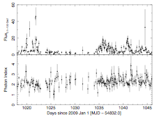
Problem: Intra-day Variability on Parsec Scales
hν > 0.2 TeV
Changes in flux are observed to occur on time-scales t_{var} as short as minutes
How can this occur parsecs from the black hole?
Size of region needs to smaller than ct_{var} [δ/(1+z)] ~ 2x10¹⁴ t_{var,hr} δ cm,
where z is the redshift of the host galaxy and δ is the Doppler factor (blueshift) from relativistic motion of plasma
Superluminal motion implies δ ~ 20 - 50
+ Jet is very narrow (~ 0.1/Γ_{flow} ; Jorstad et al. 2005, Clausen-Brown et al. 2013) so jet width 1 pc from black hole ~ 10¹⁷ cm
+ Only some fraction of jet x-section is bright at any given time
Magnetic reconnection jet-in-jet model (Giannios 2013, MNRAS), or turbulence(Narayan & Piran 2012, MNRAS; Marscher 2012, Fermi and Jansky proc.)
BL Lacertae
Arlen et al. (2013)
1 hour
Quasar PKS 1510-089 (Foschini et al. 2013): 20-minute doubling time

Slide 22
The Case for Turbulence as a Major Factor in Blazar Jets
Possible source of turbulence: current-driven instabilities at end of acceleration/collimation zone (e.g., Nalewajko & Begelman 2012, MNRAS)
Notes:
Historical motivation: Do AGN show low/high/very high states like GBHs?

Slide 23
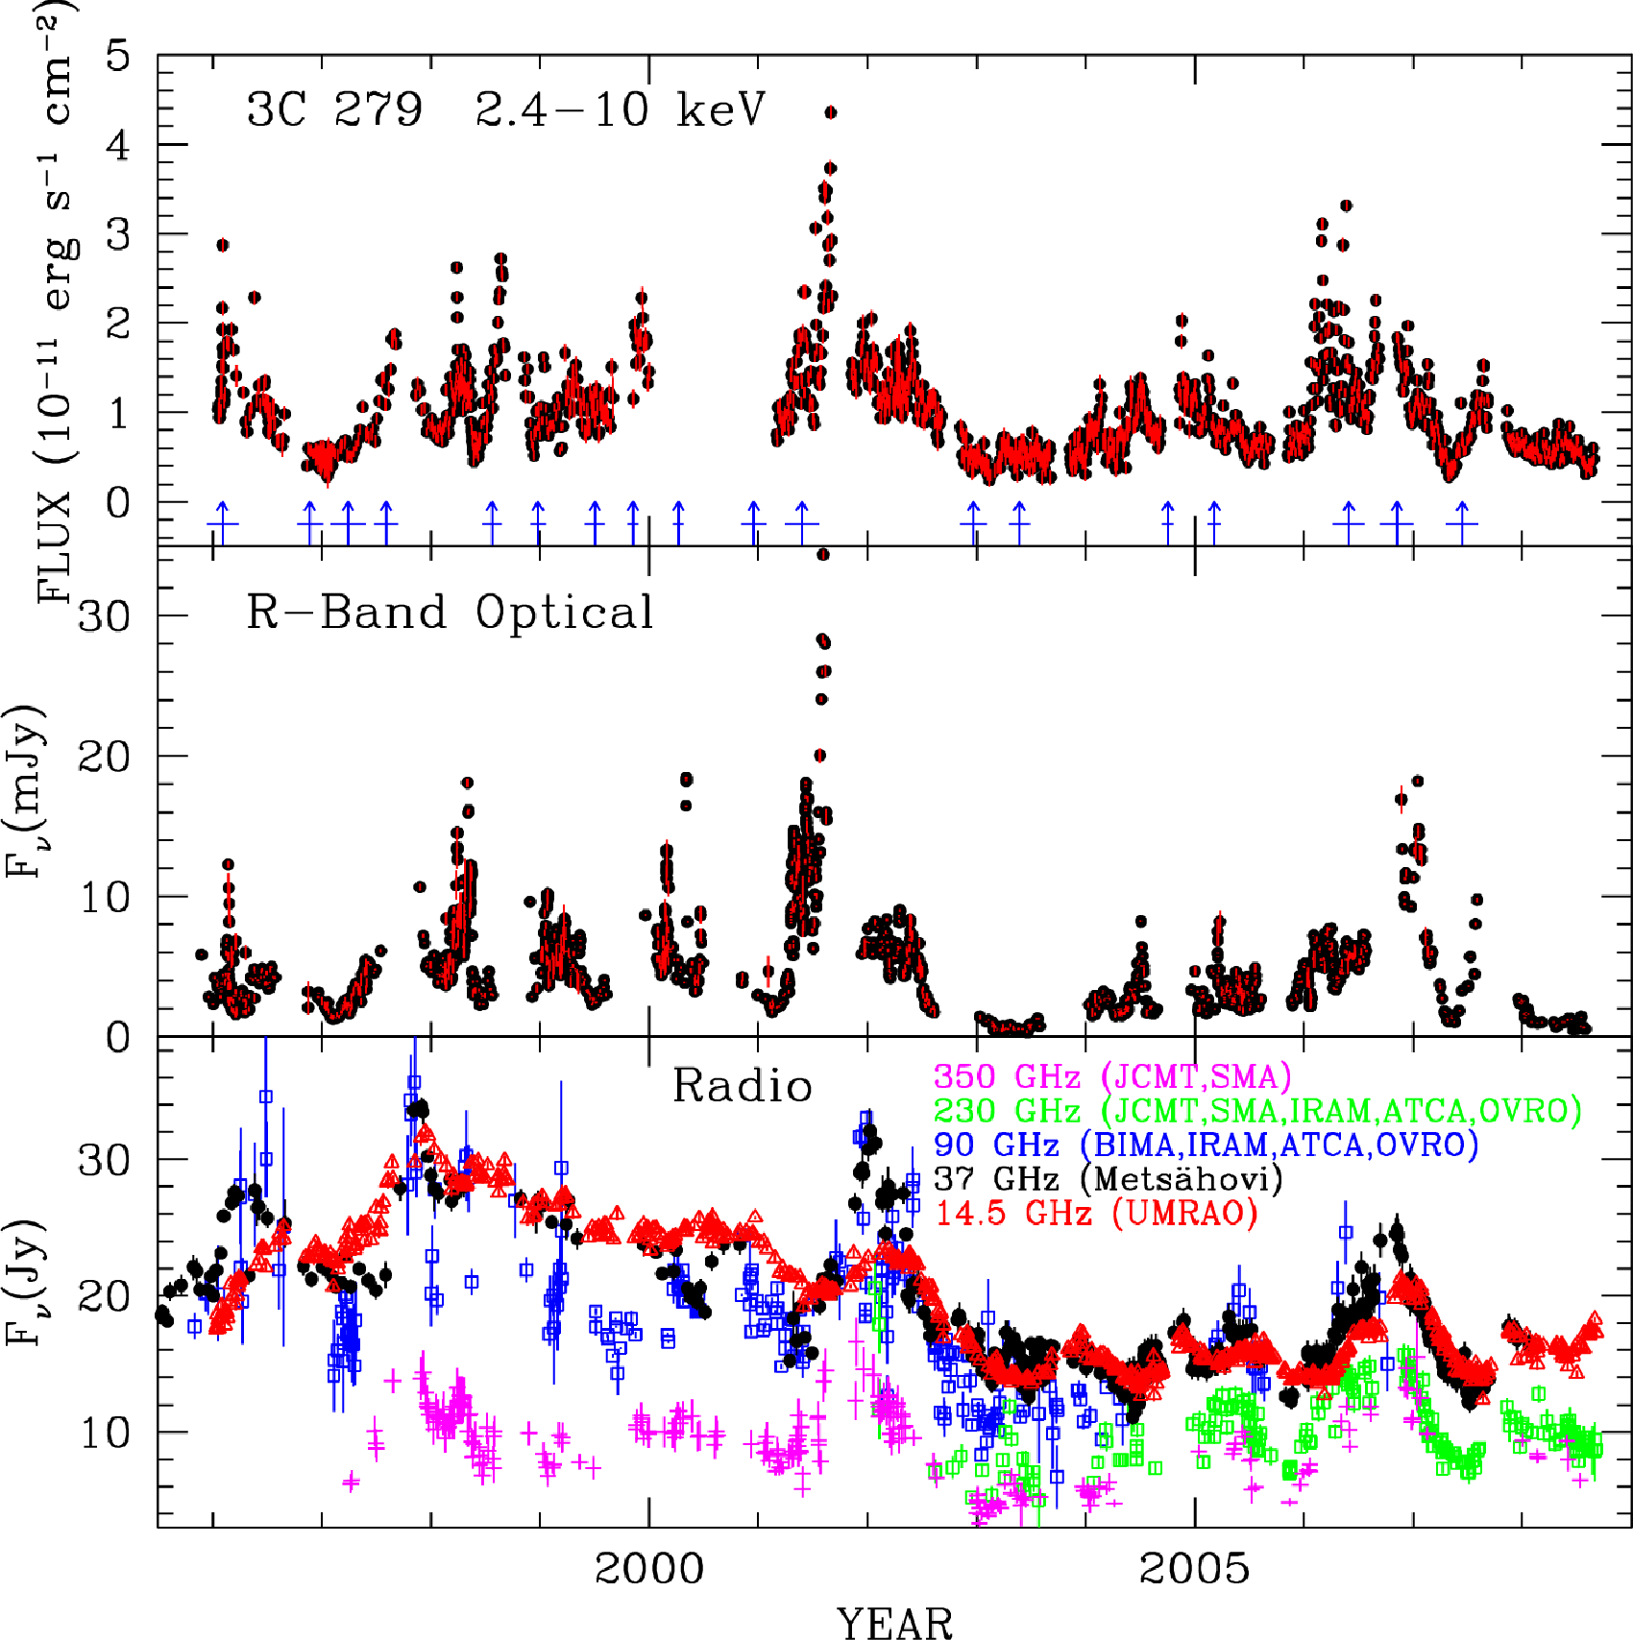
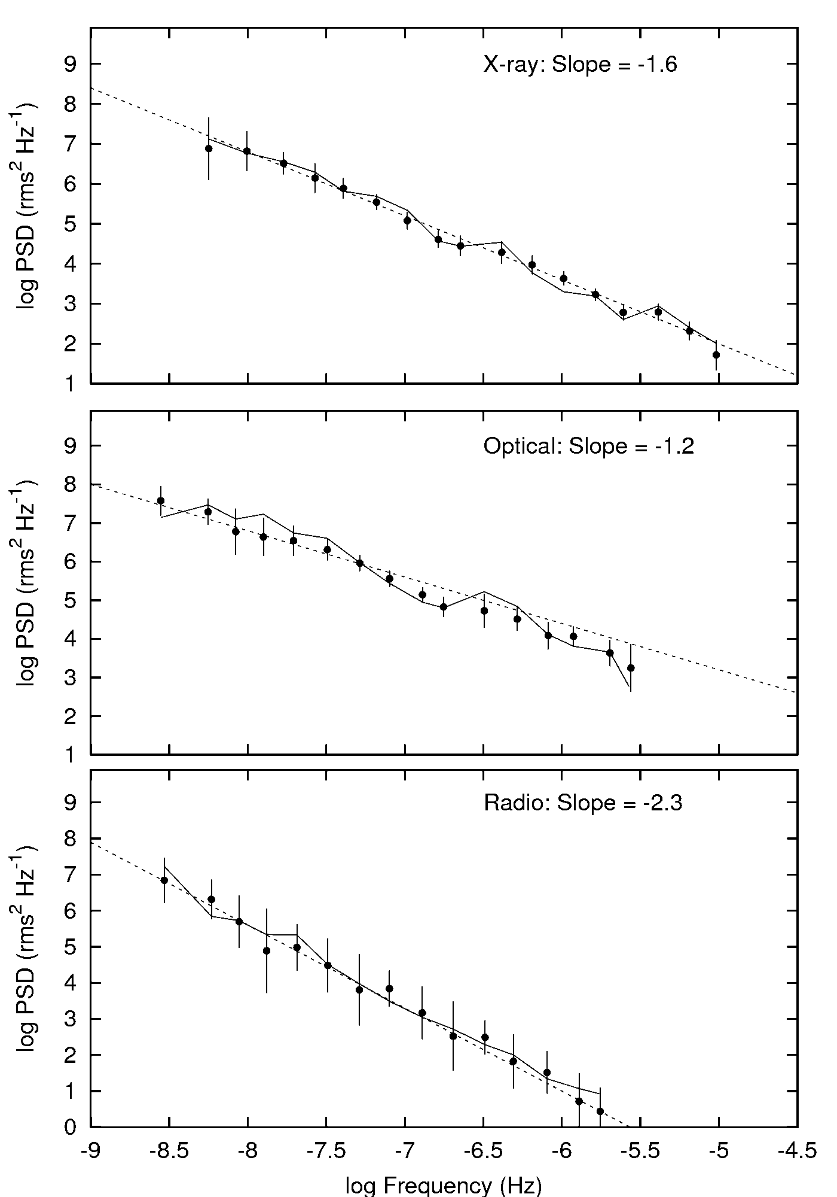
Blazars: Power-law PSDs → Noise process
- Rapidly changing brightness across the electromagnetic spectrum
Power spectrum of flux changes follows a power law → random fluctuations dominate
X-ray
Chatterjee et al. 2008 ApJ

Slide 24
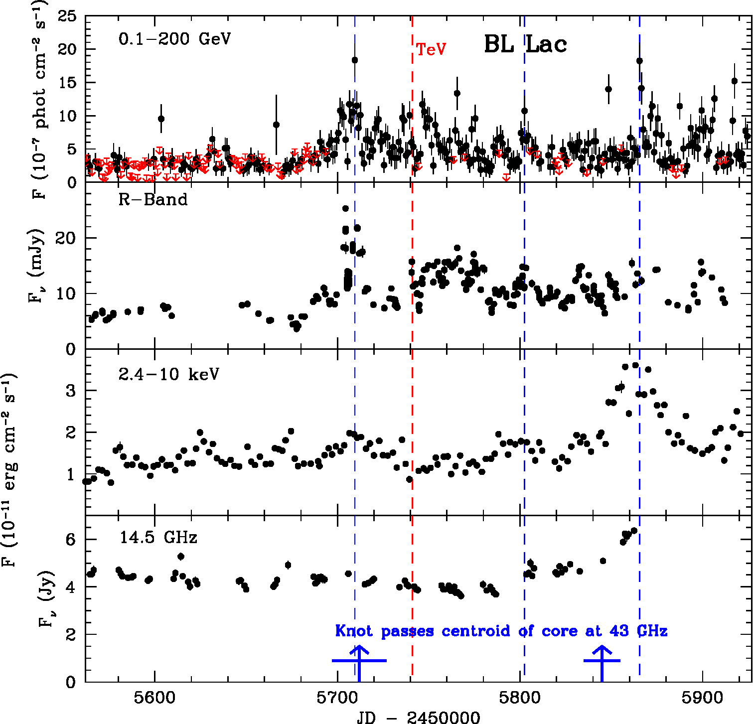
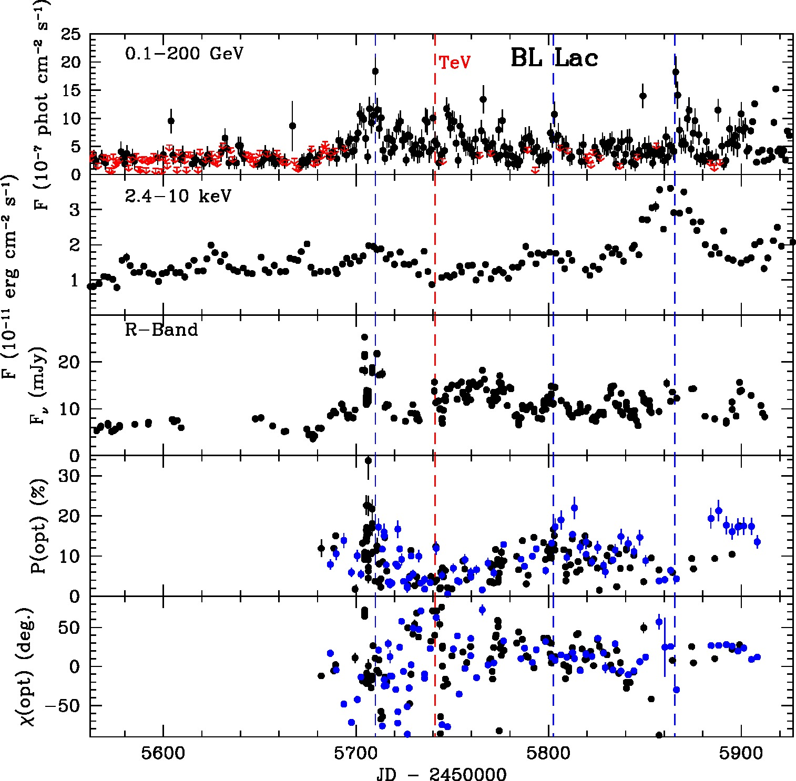
Blazar BL Lacertae in 2011
γ-rays become bright as new superluminal knots pass through “core” & through other stationary emission features on the VLBA image
Degree of linear polarization & variations in degree & position angle suggest turbulence at work
Optical polarization
Approx. location of black hole

Slide 25
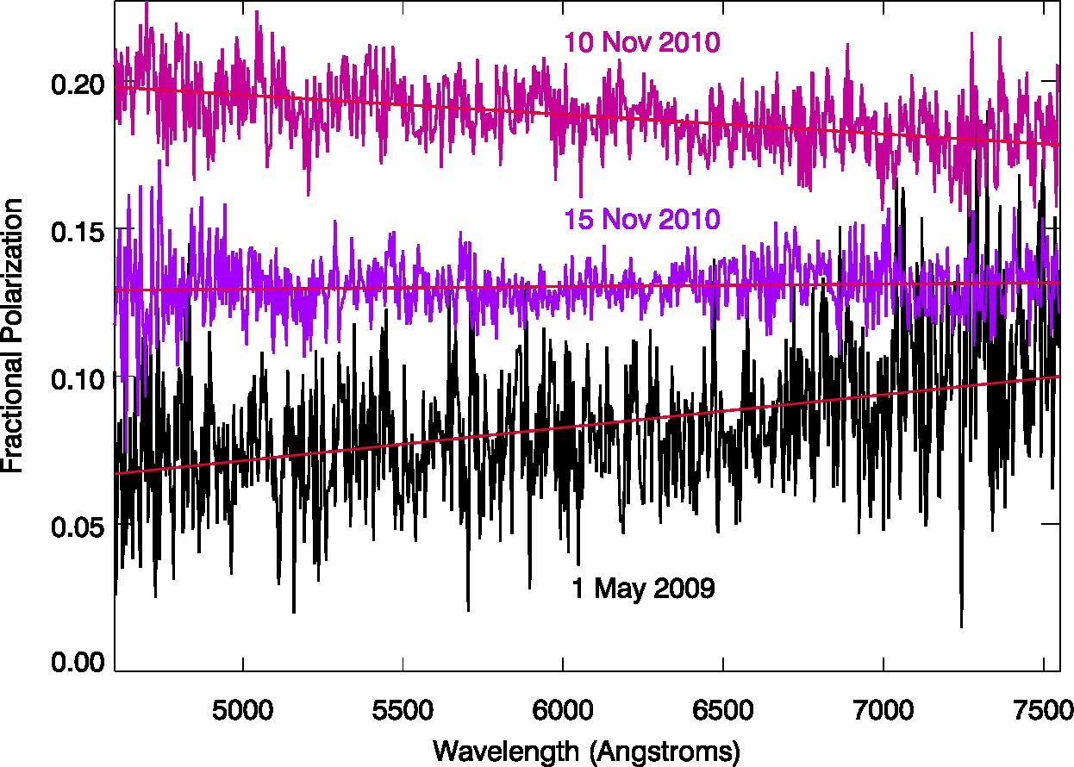
Polarization Decreases with Wavelength
3C 454.3 during brightest state (Jorstad et al. 2013)
- Expected if fewer turbulent cells are involved in emission at shorter wavelengths
Notes:
Historical motivation: Do AGN show low/high/very high states like GBHs?

Slide 26
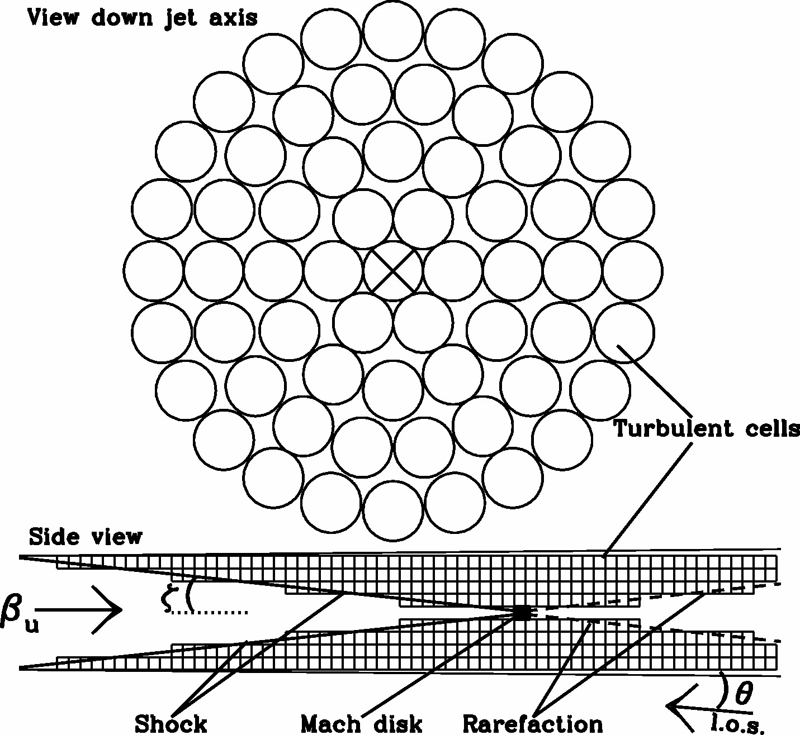
Turbulent Extreme Multi-zone (TEMZ) Model (Marscher 2012)
Many turbulent cells across jet cross-section, each followed after crossing shock, where e⁻s are energized; seed photons from dusty torus & Mach disk
Each cell has random B direction; B & number of e⁻s vary according to PSD
Important feature: only small fraction of cells can accelerate electrons up to energies high enough to produce optical & γ-ray emission
→ More rapid variability to explain intra-day flux changes
Mach disk (optional)
Conical standing shock
Looking at the jet from the side

Slide 27
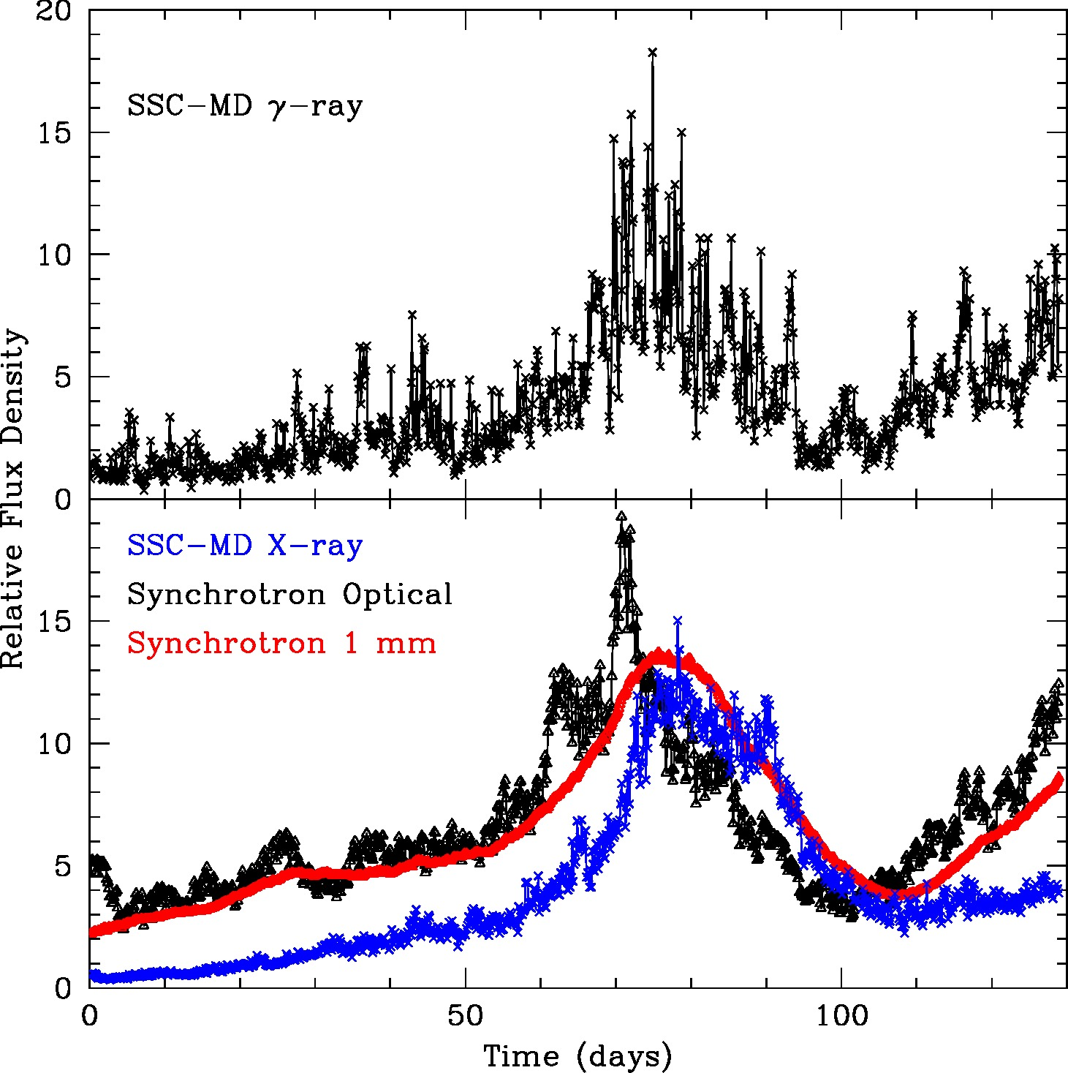
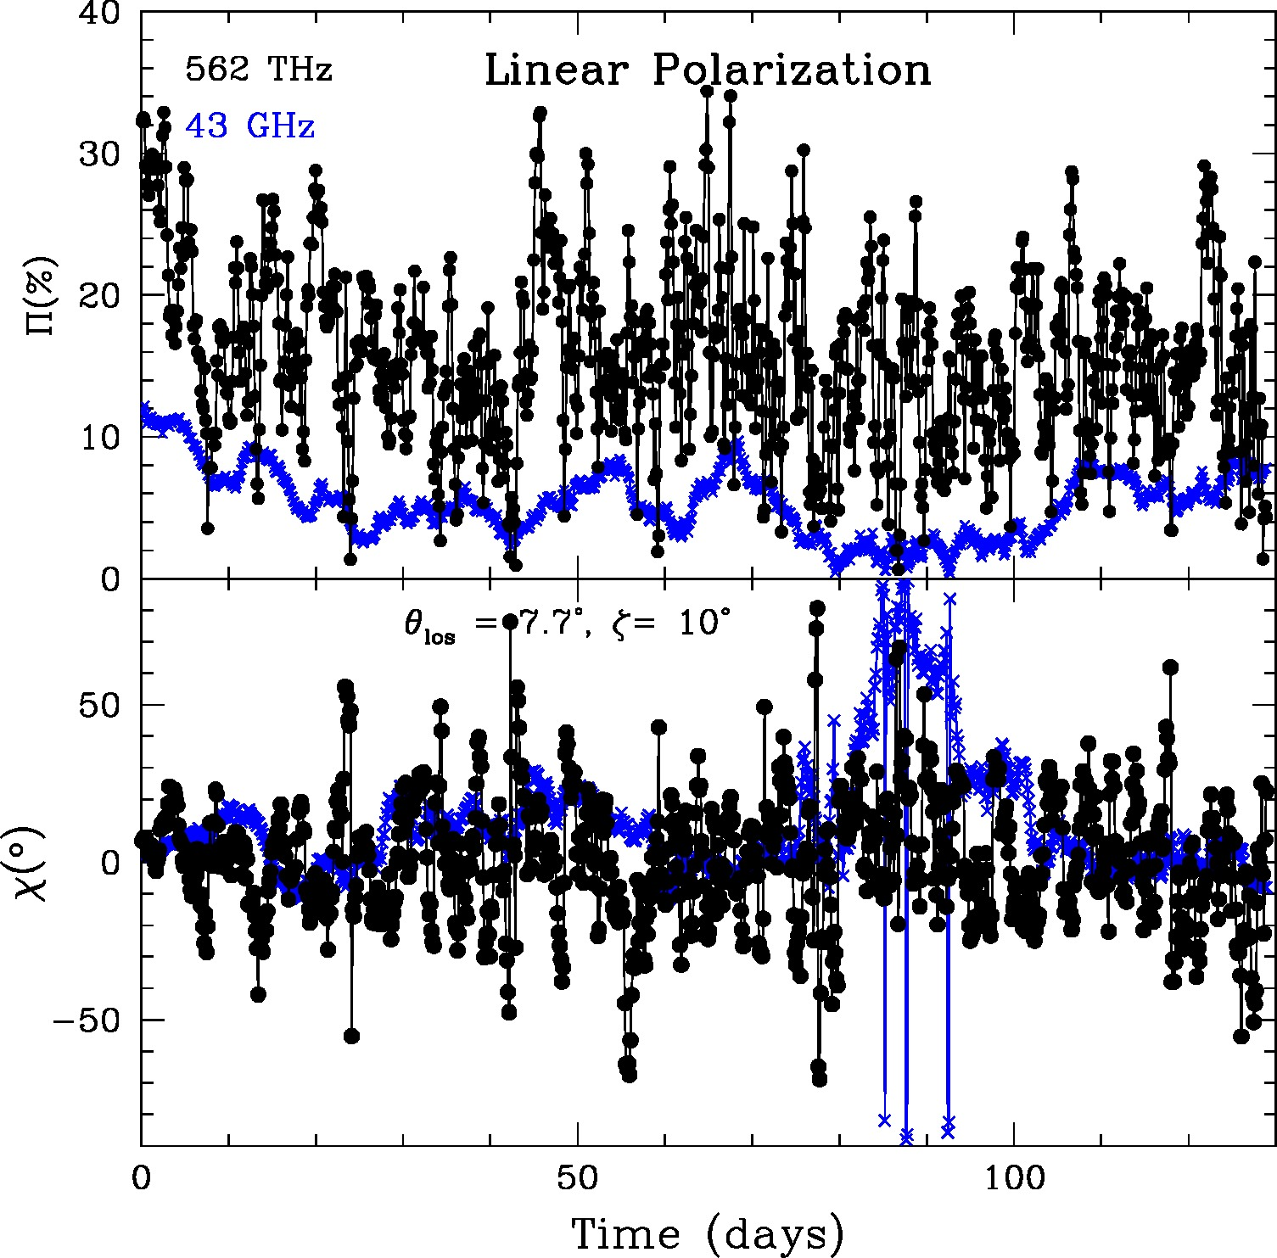
Sample Simulated Light Curve Similar to BL Lac
orphan flares
Outbursts & quiescent periods arise from variations in injected energy density
Random with probability distribution determined by red-noise power spectrum
Polarization is stronger at higher frequencies
Position angle fluctuates, occasionally rotates at random times, but is usually within 20° of jet direction (as observed in BL Lac)

Slide 28
Sketch of a Quasar-Blazar
Components as indicated by theory & observations of SED, variability & polarization
Flares from moving shocks and denser-than-average plasma flowing across standing shock

Slide 29
Conclusions
We are now accumulating an extremely rich data set
Theoretical models need to catch up to observations if they are to succeed in reproducing all of the characteristics of blazar emission
Most outbursts & flares occur on parsec scales
source(s) of seed photons for gamma-ray emission remains a difficult problem
Emission-line clouds lying along jet (León-Tavares et al. 2012, ApJ; Isler et al. 2013, in prep.; revival of Ghisellini & Madau 1996 idea)?
We need to find a way to keep our best time-domain instruments operating!!

Slide 30
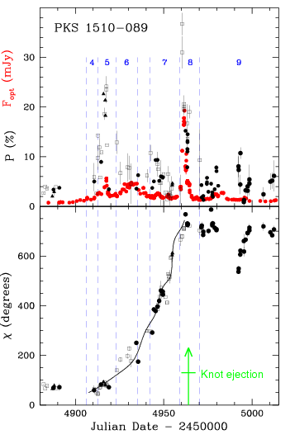
Rotation of Optical Polarization in PKS 1510-089
Rotations of optical (+ sometimes radio) polarization are common, especially during outbursts
Flux
Polarization
Optical
In 1510-089 rotation starts when major optical activity begins, ends when major optical activity ends & superluminal blob passes through core
Direction of optical polarization
Model curve: blob following a spiral path through toroidal magnetic field in an accelerating flow
Γ increases from 8 to 24, δ from 15 to 38
Blob moves 0.3 pc/day as it nears core
Core lies > 17 pc from central engine
Time when blob passes through core
2009.0
2009.5

Slide 31
Turbulence (or reconnection) Solution to Time-scales (see also Narayan & Piran 2012)
Need to understand that opening angle of jet is very narrow: ~ 0.1/Γ_{flow} (Jorstad et al. 2005; Clausen-Brown et al. 2013)
→ Half-width of jet at core ~ 0.1 d(core,pc) Γ_{flow}⁻¹ pc
If filling factor f of cells with electrons of high enough energy to emit at at optical/gamma-ray frequencies is low or blob doesn’t cover entire jet cross-section, time-scale of variability can be very short:
t_{var} ~ 120 f^{1/2} (1+z) (Γ_{flow} δ_{flow} δ_{turb})⁻¹ d(core,pc) days
For f ~ 0.1, z ~ 0.5, Γ_{flow} ~ δ_{flow} ~ 30, δ_{turb} ~ 2, d(core) ~ 10 pc,
t_{var} ~ 0.3 days
→ Minutes for smaller, less distant blazars like TeV BL Lac objects

