Slide 1
Jet dynamics and stability
Manel Perucho
Universitat de València
The innermost regions of relativistic jets and their magnetic fields
Granada, June 2013

Slide 2
Outline
Spectral evolution of CTA 102.
Possible evidence for shock-shock interaction in the core region:
Fromm et al. 2011, 2012, Fromm et al. (submitted), Fromm et al. (in preparation).
Helical patterns in 0836+710.
Detection of wave motion:
Perucho et al. 2012a,b.

Slide 3
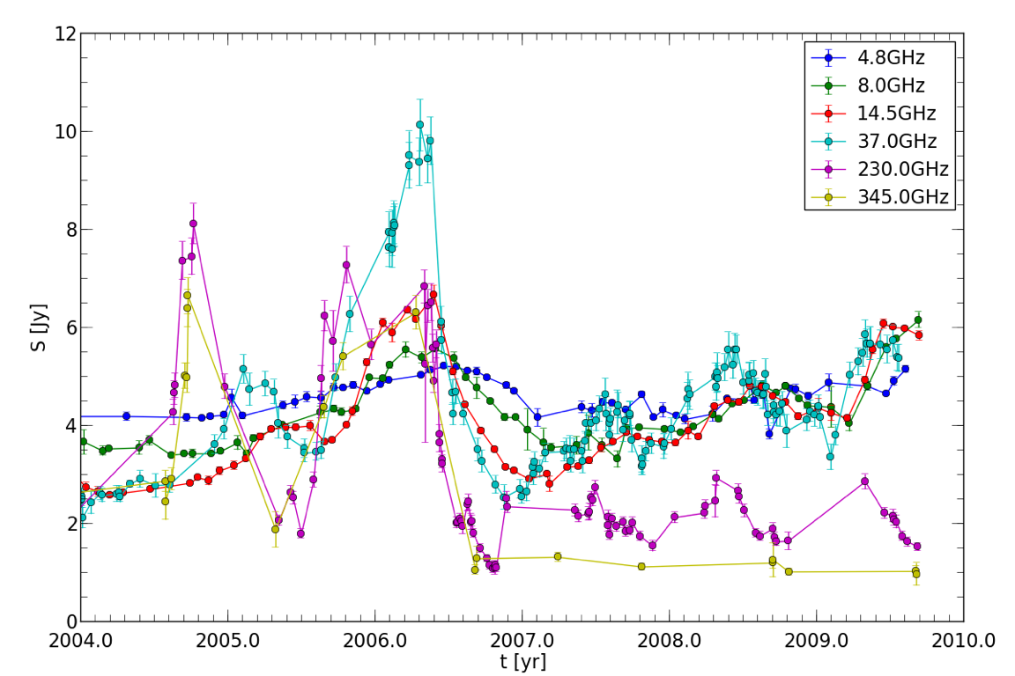
CTA 102 – light curve
Fromm, MP, Ros, et al. 2011

Slide 4
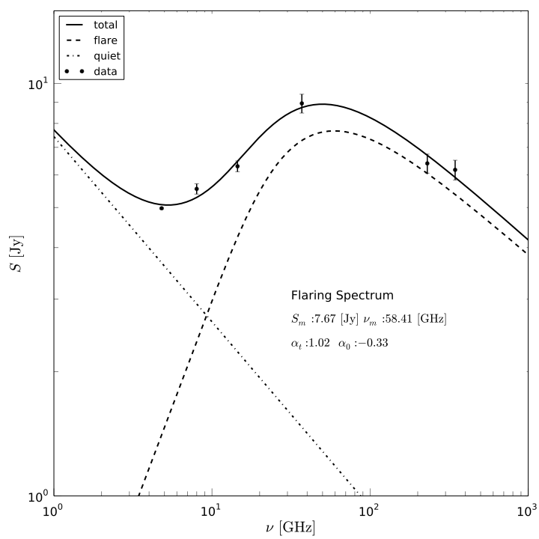
CTA 102 – spectrum
Computing a “steady state” spectrum, the flaring part can be isolated.
And derived for each
observation.
Fromm, MP, Ros, et al. 2011

Slide 5
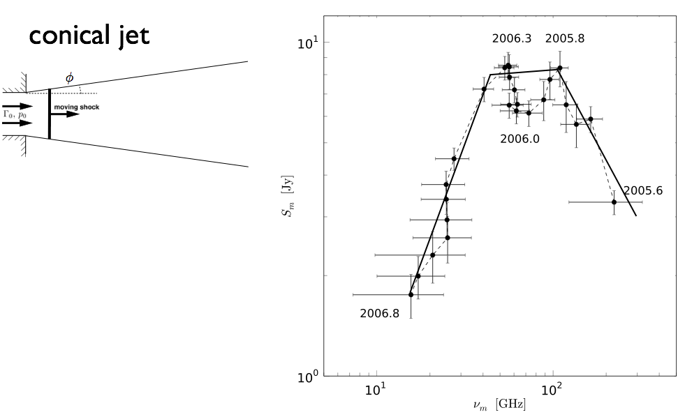
CTA 102 – spectral evolution of the flare
A simple trial to fit the
spectral evolution of the
flare within the three stages of cooling within the shock-in-jet-model (Marscher and Gear 1985): Compton, Synchrotron and Adiabatic.
It fails to explain the double peak.
Fromm, MP, Ros, et al. 2011

Slide 6
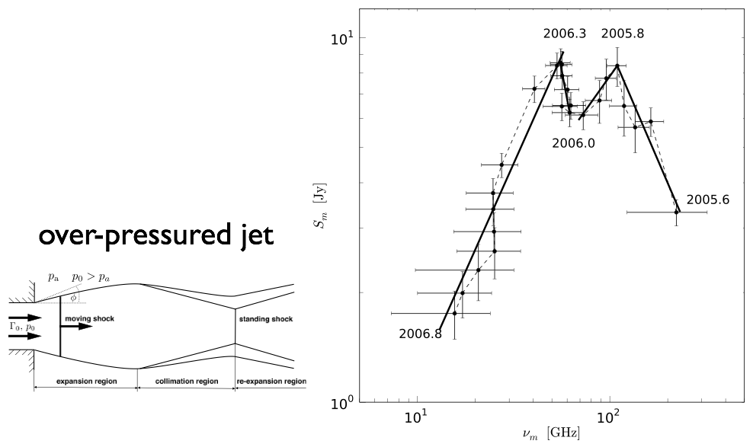
CTA 102 – spectral evolution of the flare
Fromm, MP, Ros, et al. 2011

Slide 7
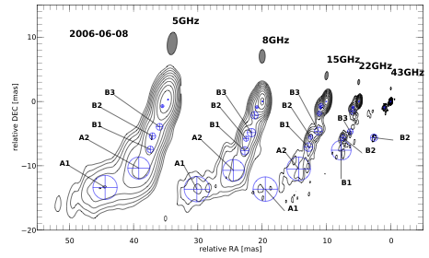
CTA 102 – VLBI observations
Fromm, Ros, MP, et al. 2012, MOJAVE (Lister et al. 2009)

Slide 8
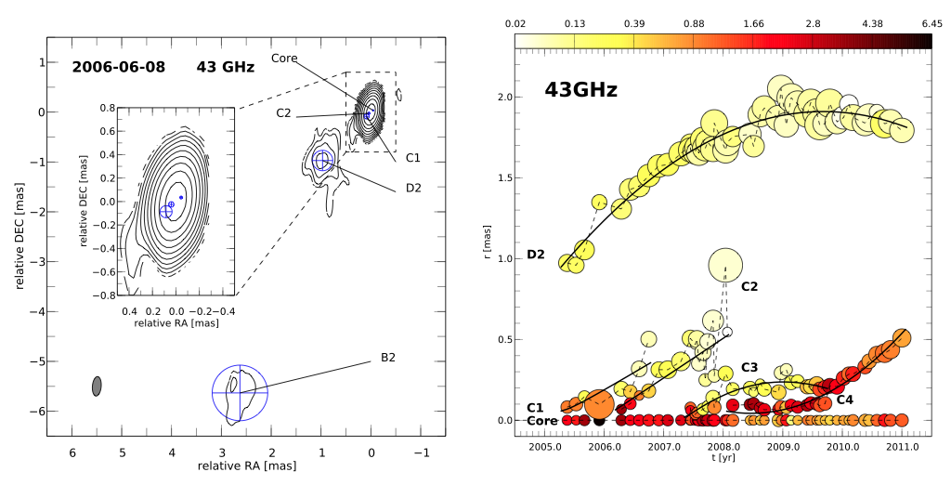
CTA 102 – kinematics
Fromm, Ros, MP, et al. 2012

Slide 9
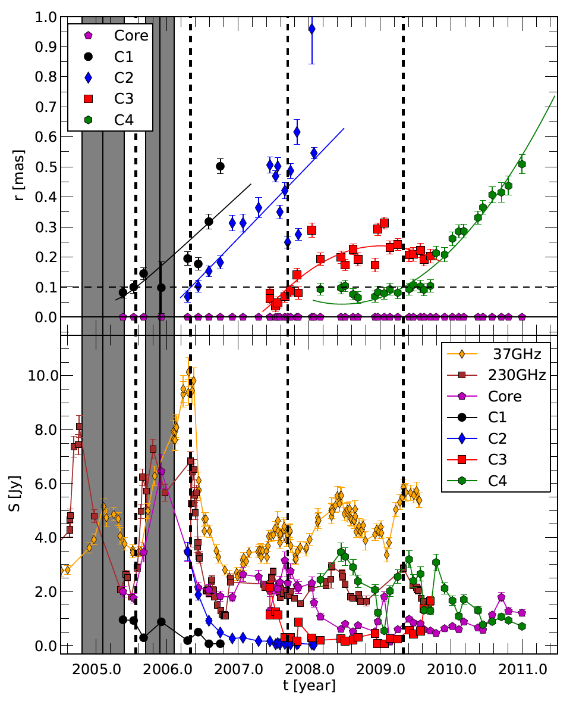
CTA 102 – kinematics
Fromm, Ros, MP, et al. 2012

Slide 10
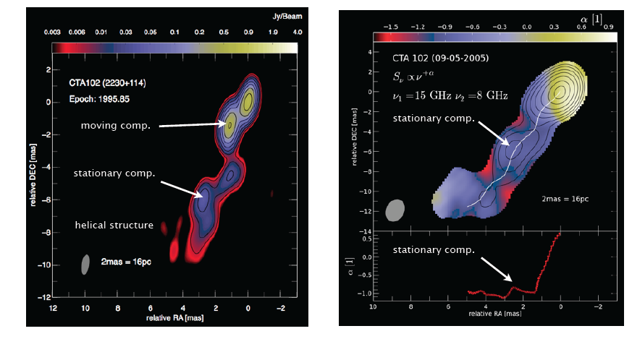
CTA 102 – kinematics and spectral analysis
Unfortunately, the resolution in the region of interest (~ 0.1 mas) is not enough
to study our hypothesis in detail. However…
Fromm, Ros, MP, et al. 2011, Fromm, Ros, MP, et al., submitted

Slide 11
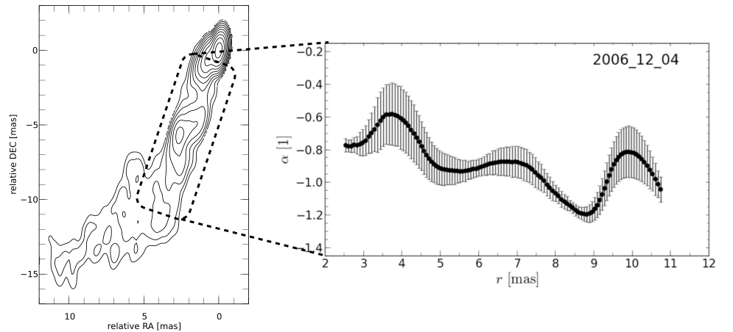
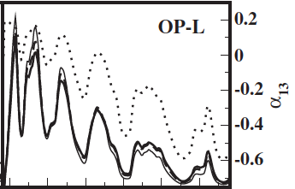
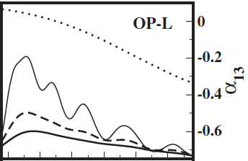
CTA 102 – hints of standing shocks
Spectral index
in a region with
small errors.
Fromm, Ros, MP, et al., submitted
Possible standing shocks at 3-10 mas
Mimica et al. 2009
Spectral index from a simulation
of an over-pressured jet (without and with convolution).
Reconfinement shocks are indicated by increases in flux and spectral index (if enough resolution).

Slide 12
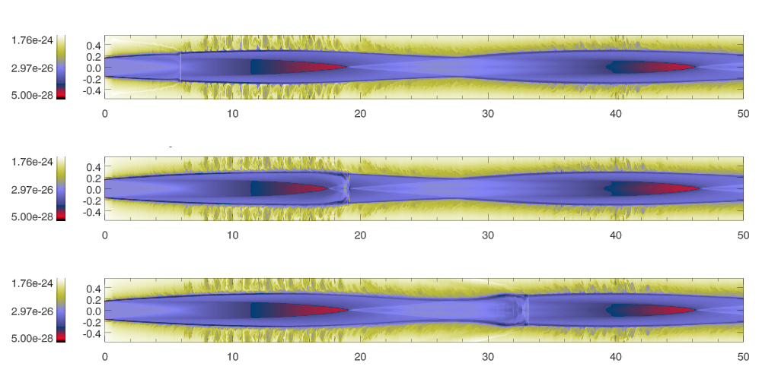
CTA 102 – numerical experiment
Numerical simulation of the evolution of a perturbation propagating through
an overpressured jet
performed at Tirant, node of the Spanish Supercomputational Network at
the University of València.
Fromm, MP, et al., in preparation

Slide 13
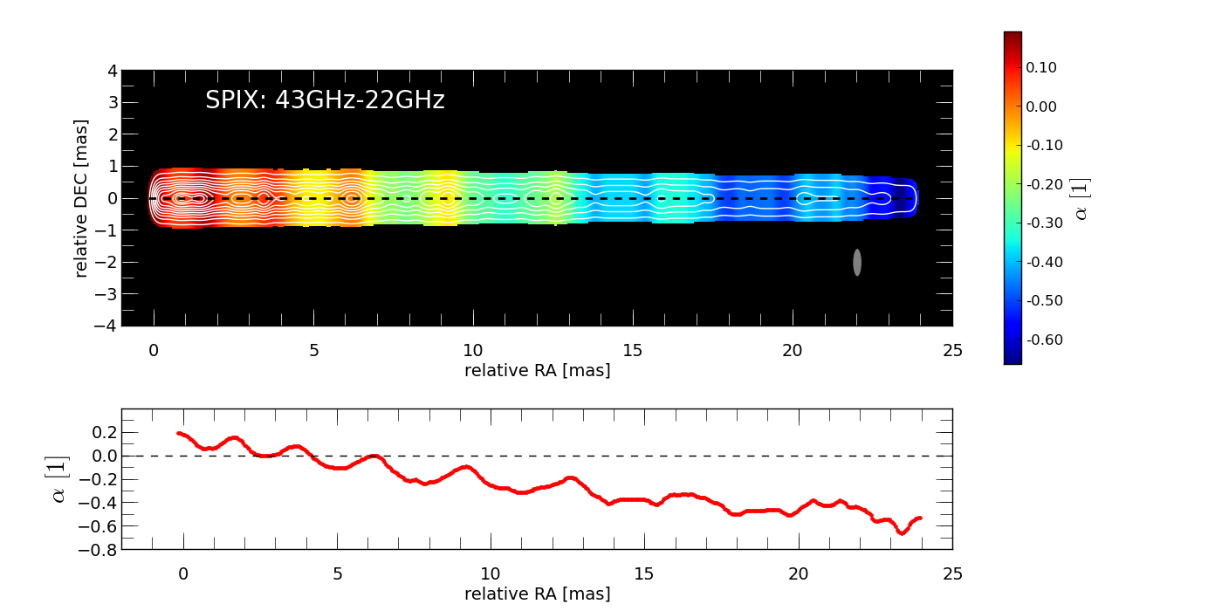
CTA 102 – numerical experiment:
emission and spectrum
The emission is computed at 90º viewing angle. The standing shocks also
show bumps in the spectral index.
Gómez et al. 1997, Mimica et al. 2009, Fromm, MP, et al., in preparation

Slide 14
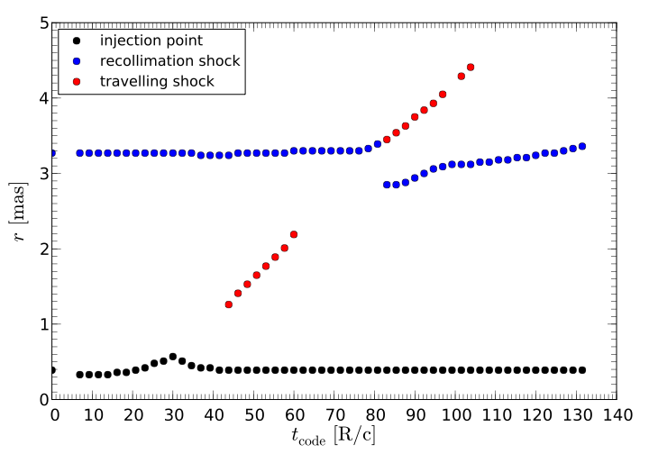
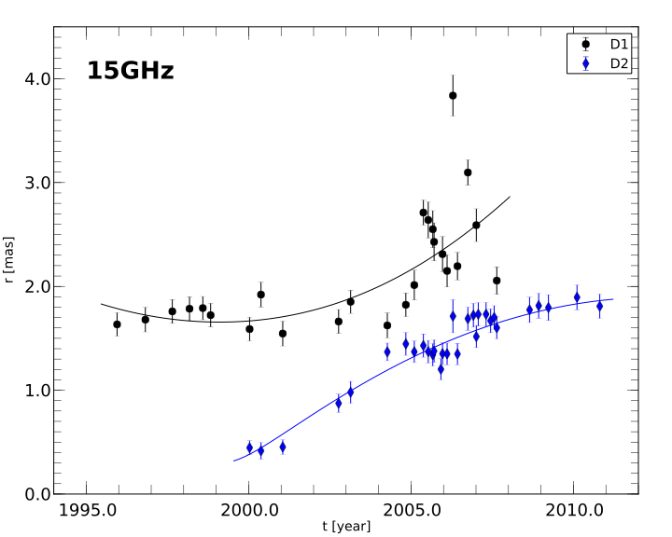
CTA 102 – numerical experiment:
kinematics
We can then revisit this identifi-cation of components at 2 mas, which is a region closer to the nucleus than the one shown for the spectral index.
Fitting Gaussian components to the simulated
jet, we are able to track the interaction between
the standing shock and the perturbation.

Slide 15
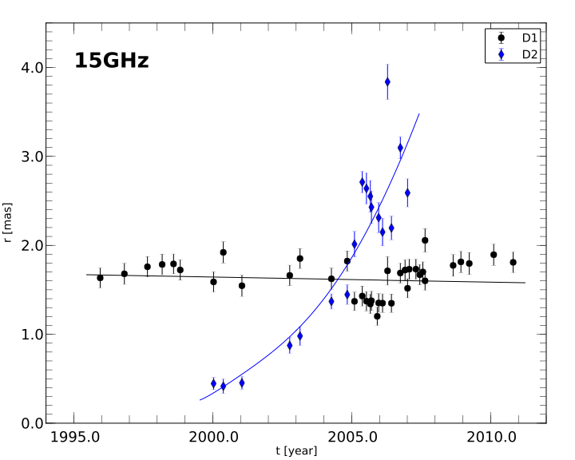
CTA 102 – numerical experiment:
kinematics
We can then revisit this identifi-cation of components at 2 mas, which is a region closer to the nucleus than the one shown for the spectral index: Possible shock-shock interaction at 2 mas…
Perturbation associated to a
previous flare (late nineties).
Fitting Gaussian components to the simulated
jet, we are able to track the interaction between
the standing shock and the perturbation.

Slide 16
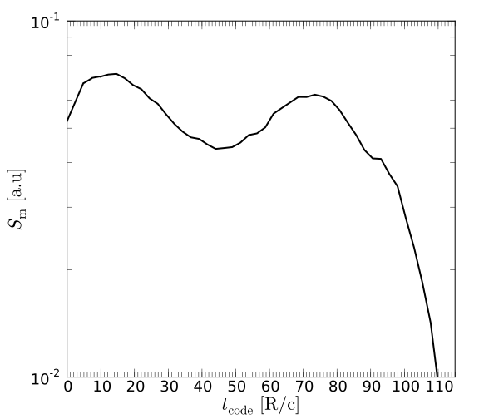
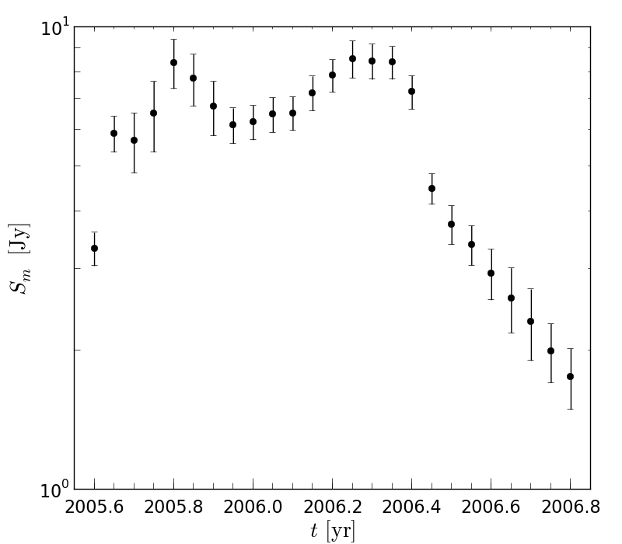
CTA 102 – numerical experiment:
spectral evolution
Peak flux of the flaring spectrum
from the simulation
first peak (injection)
Second peak:
crossing of the
recollimation shock.
Observed evolution of the flaring
spectrum in CTA102.

Slide 17
Conclusions
Light curve + VLBI kinematics + spectral analysis + numerical simulations.
Evidence, from spectral analysis, for standing shocks at the 3-10 mas region.
Evidence, from numerical simulations, compared with the observations, of:
Shock-shock interaction at ~ 2 mas.
Shock-shock interaction at ~ 0.1 mas.
NOTE: This is within the core region with our current resolution, but it is not the core itself.

Slide 18
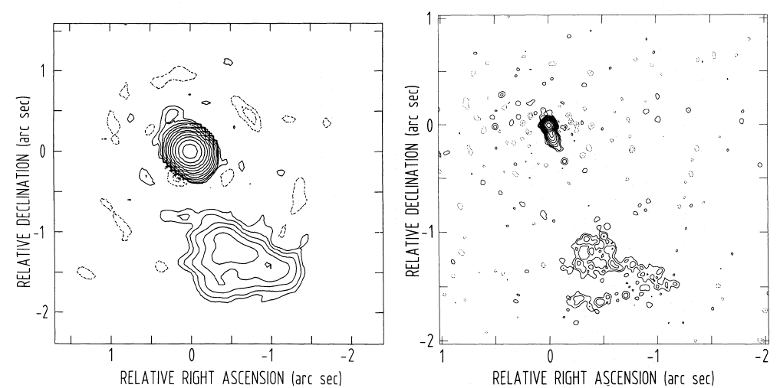
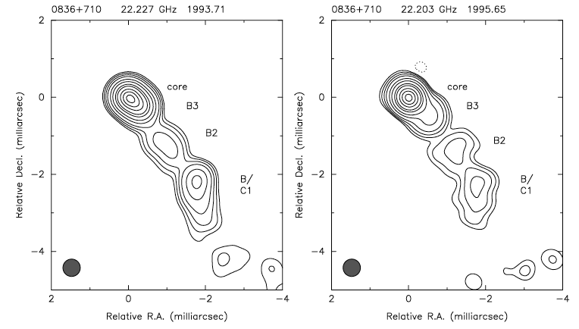
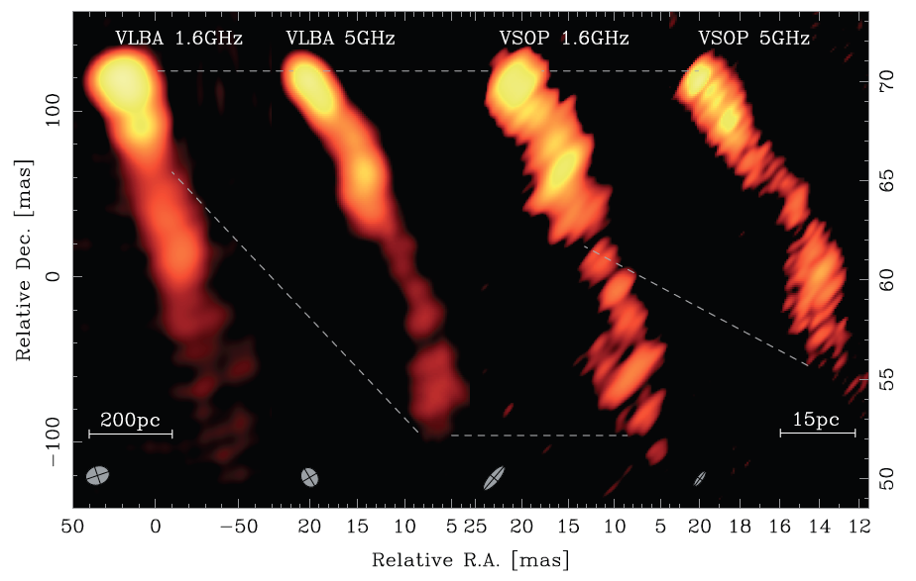
S5 0836+710
The large-scale structure of the jet is diffuse and irregular, with no trace of a hotspot.
Quasar, z=2.16. Classified as an FRII in terms
of luminosity (O’Dea et al. 1988).
MERLIN – 1.6 GHz
EVN-MERLIN – 1.6 GHz
G-VLBI – 22 GHz
Krichbaum et al. 1990,
Hummel et al. 1992
Otterbein et al. 1998
VLBA – VSOP
1.6 – 5 GHz
Lobanov et al. 2006
1 mas = 8.4 pc
Viewing angle = 3º

Slide 19
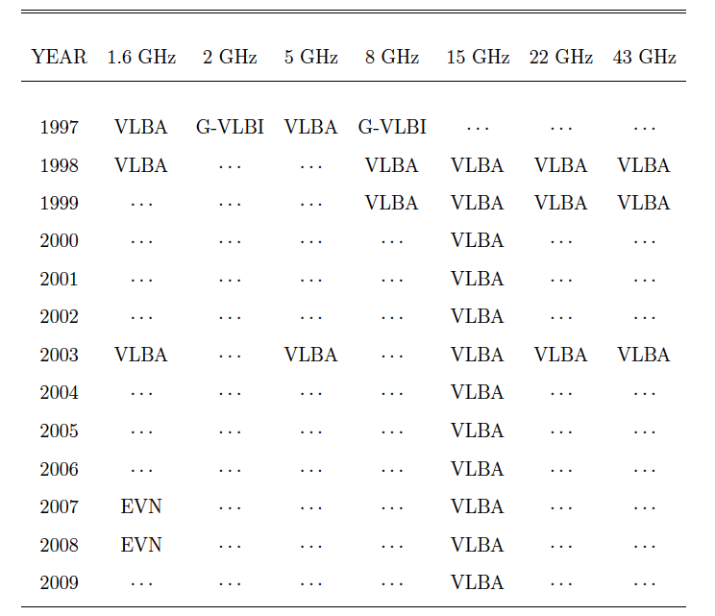
Observations of S5 0836+710
We have used different observations of the jet in the quasar 0836+710.
Perucho, Kovalev,
Lobanov, Hardee & Agudo
2012, ApJ, 749, 55
Lobanov et al. 2006
Pushkarev & Kovalev 2011
MOJAVE database
(Lister et al. 2009)
Perucho et al. 2012

Slide 20
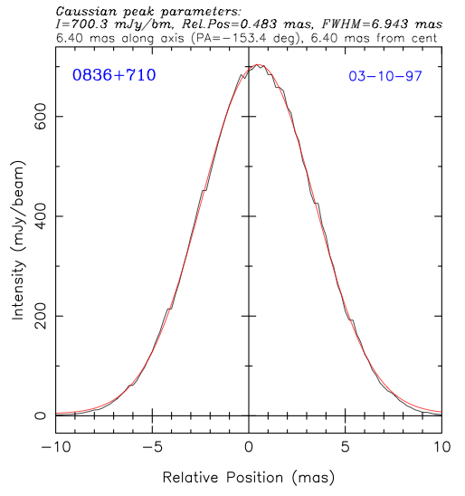
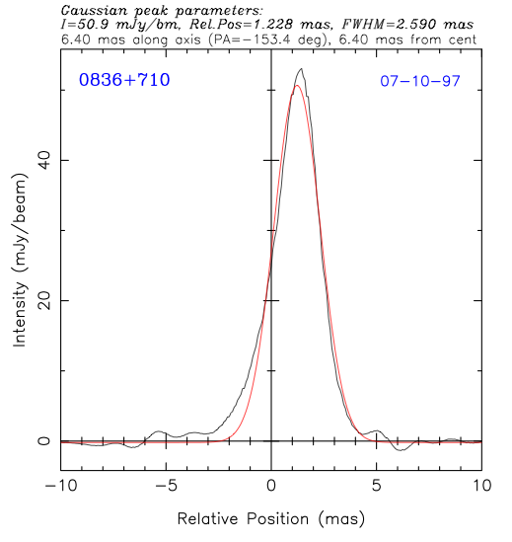
Ridge-lines
We define the ridge-line as the peak of the Gaussian fitted to the jet profile at
each radial distance from the core.
1.6 GHz
8 GHz

Slide 21
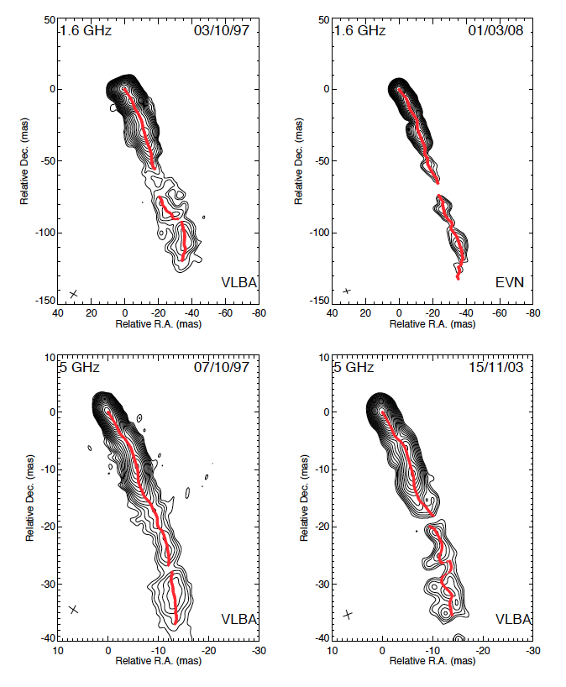
Ridge-lines
The ridge-line points indicate the
peak of a Gaussian fitted to the jet profile at each
radial distance from the core.

Slide 22
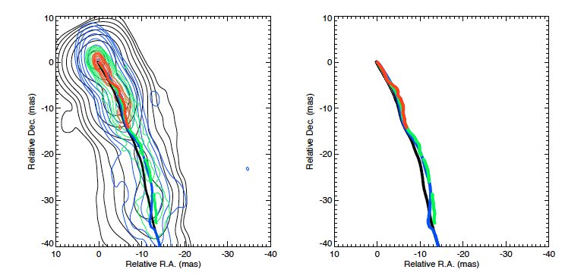
Ridge-lines at different frequencies
The ridge-lines obtained at different frequencies coincide within errors
1.6 (black), 2 (blue), 5 (green) and 8 (red) GHz (1997)

Slide 23
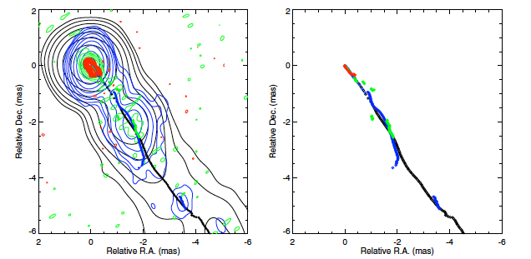
Ridge-lines at different frequencies
8 (black), 15 (blue), 22 (green) and 43 (red) GHz (1998)

Slide 24
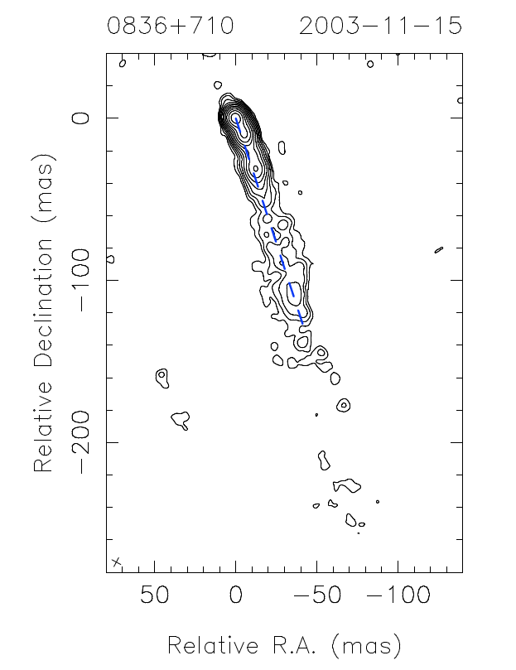
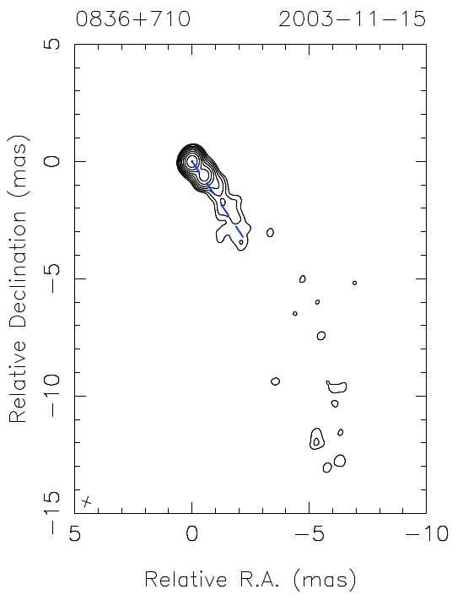
Defining an axis
We determined the position angle of the jet at each frequency by connecting the
core with the emission at the largest observed distances (it can also be done by
making the oscillations symmetric around this axis).

Slide 25
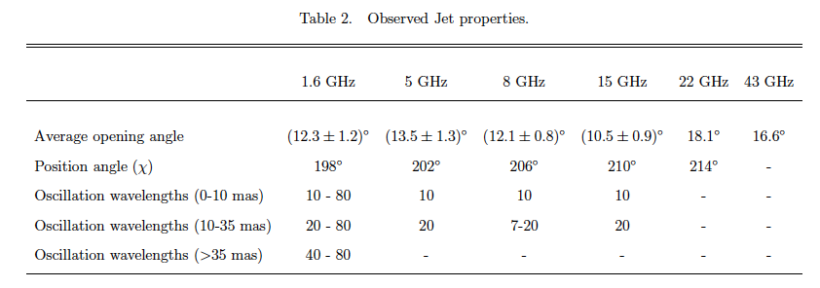
Observed opening angles and position angles
We use P.A.(1.6 GHz) to
rotate the ridge-lines and plot them along a horizontal axis.

Slide 26
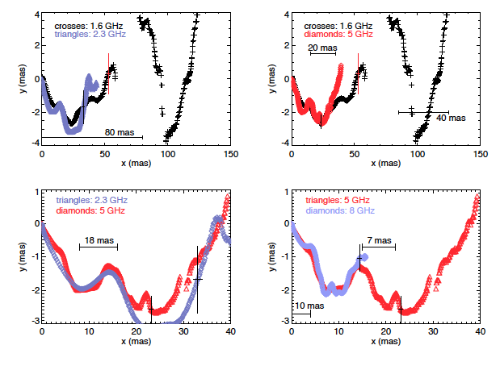
Rotated ridge-lines with the same P.A.
Rotating all ridge-lines with the same angle (1.6 GHz).

Slide 27
Observed opening angles and position angles
The jets observed at higher frequencies show the direction of propagation of the
ridge-line at lower frequencies. In other words, high–frequency jets develop on top
of the ridge-line of the jet at low frequency.
The different position angles give a natural explanation to parsec-to-kiloparsec
scale misalignment in helical jets.
The opening angles are obtained following the same methodology as given in
Pushkarev et al. (2009).
Mean jet opening angle:
At 3ºviewing angle:

Slide 28
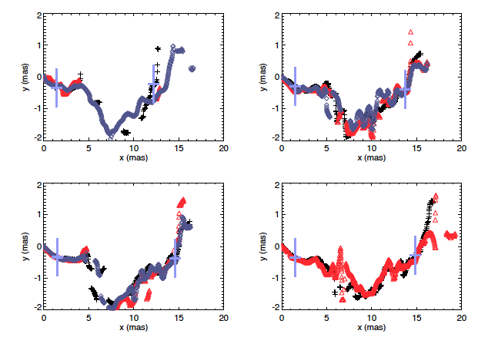
Rotated ridge-lines from the 15 GHz observations
15 GHz at different epochs (MOJAVE data 1998-2009).

Slide 29
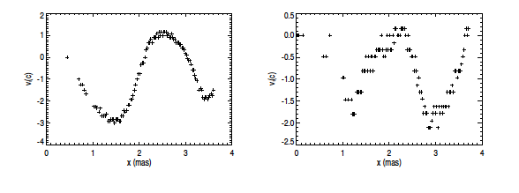
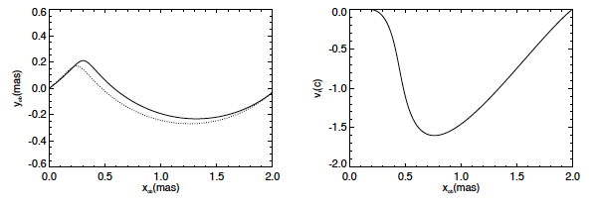
Vertical displacements of the 15 GHz ridge-lines
2002 - 2003
2008 - 2009
The errors in the measure of the ridge-line position are much larger than
the distance travelled by the light between epochs. In this jet, c = 0.012 mas/yr.
see also Agudo et al. 2007, 2012

Slide 30
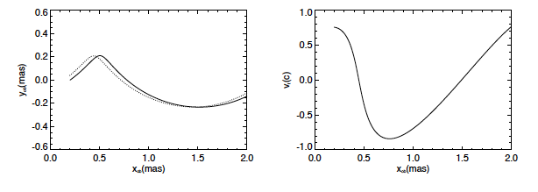
Vertical displacements of the 15 GHz ridge-lines
2002 - 2003
2008 - 2009
0.006 mas/yr
The errors in the measure of the ridge-line position are much larger than
the distance travelled by the light between epochs. In this jet, c = 0.012 mas/yr.
see also Agudo et al. 2007, 2012

Slide 31
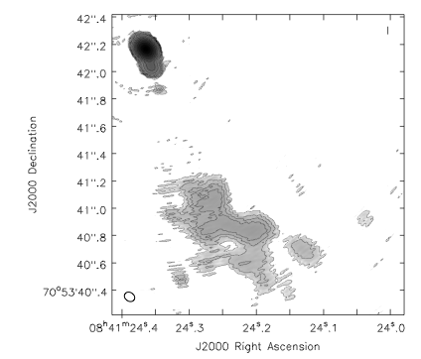
An FRII jet disrupted by a helical instability?
A recent observation of this source using EVN and MERLIN confirms this result.
Perucho, Martí-Vidal, Lobanov & Hardee (2012).
VLBI jet
This FRII-classified jet could be disrupted by the growth of an instability,
probably Kelvin-Helmholtz.
- The observed growth in amplitude is consistent with estimated growth-rates
of unstable modes (Perucho & Lobanov 2007, 2011, Perucho et al. 2012).

Slide 32
Conclusions
Ridge-lines correspond to physical structures.
Possible causes:
Longer wave: long-term precession at the formation region (10⁷ yr periodicity).
Shorter waves: shorter period asymmetries at the formation region or downstream.
When possible to measure, the transversal velocity shows a wave-structure and superluminal values.
We observe the motion of a wave pattern, and not the flow itself. The flow moves through the pattern, which most probably corresponds to pressure maxima across the jet cross-section.
Small scale transversal core motion plus errors associated to the determination of the ridge-line due to resolution, can explain the superluminal values.
The source will be observed with Radioastron + global VLBI next year (will allow comparison with VSOP observations).

