Slide 1

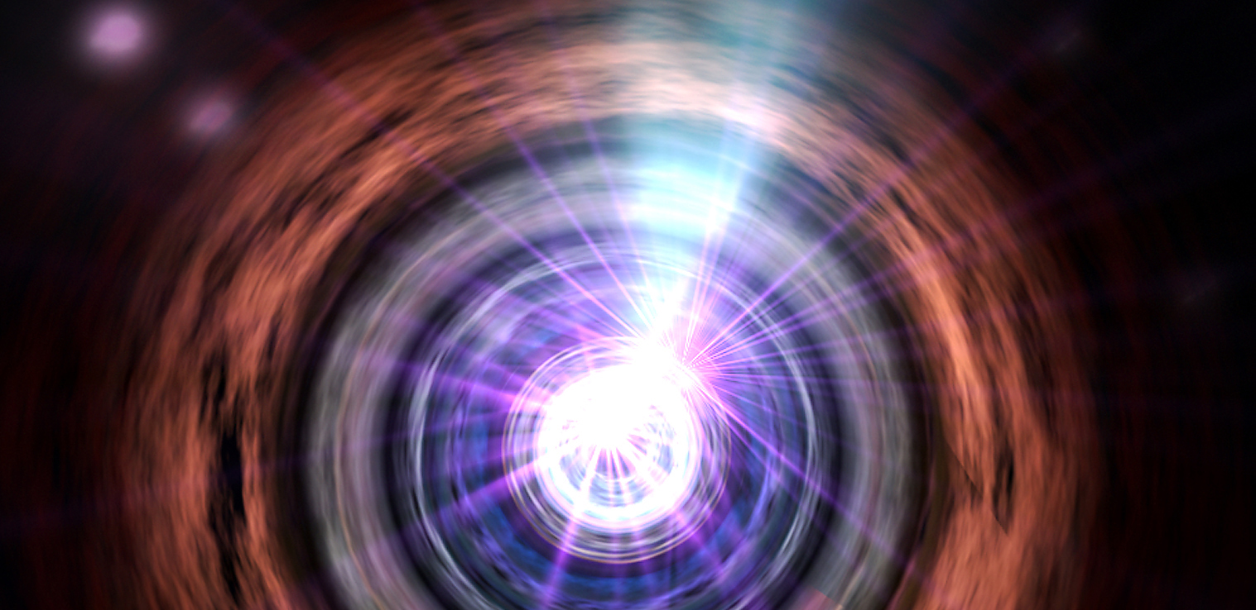
An Exceptional Radio Flare in Markarian 421
Joseph L. Richards, Talvikki Hovatta, Matthew L. Lister, Anthony C. S. Readhead,
Walter Max-Moerbeck, Tuomas Savolainen, Marcello Giroletti, Emmanouil Angelakis,
Lars Fuhrmann, Ioannis Myserlis, Vassilis Karamanavis, Hugh D. Aller, and Margo F. Aller

Slide 2
Acknowledgements
This work and the MOJAVE program were supported by NASA Fermi GI grant 11­Fermi11­0019.
The OVRO 40 m monitoring program is supported in part by NSF grants AST­ 0808050 and AST­1109911 and NASA grants NNX08AW31G and NNX11A043G.
UMRAO was supported in part by NSF grant AST­0607523, and NASA Fermi GI grants NNX09AU16G, NNX10AP16G, and NNX11AO13G.
The National Radio Astronomy Observatory is a facility of the National Science Foundation operated under cooperative agreement by Associated Universities, Inc.
Title page image credit: NASA/Goddard Space Flight Center Conceptual Image Lab

Slide 3
In September, 2012, Mrk 421 flared in radio like never before
34 years
1.4 years
2 months
UMRAO
OVRO + VLBA
Notes:
Replace RH with OVRO only.
Transition: start with UMRAO only (maybe + OVRO until x=100)

Slide 4
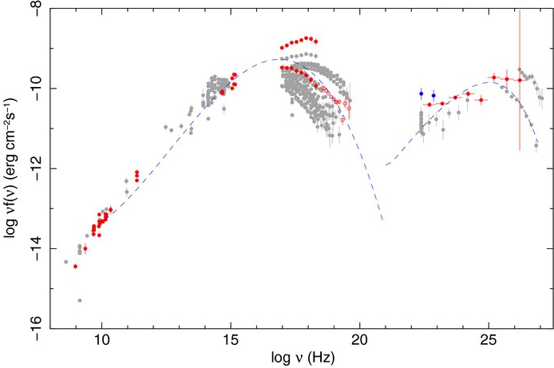
Background on Mrk 421
HSP BL Lac object
TeV γ-ray–loud
Subluminal* radio jet
Viewing angle ~2°–5°
(Lico et al. 2012, A&A, 545, A117)
Doppler factor: TeV => ~20, radio => ~3
z=0.031 (133 Mpc)
Abdo et al. 2010,
ApJ, 716, 30
* Except for recent tentative detection by
Niinuma et al. (2012, ApJ, 759, 84)

Slide 5
The radio flare was a wideband phenomenon
2.6–142 GHz radio
light curves
from F-GAMMA
OVRO
15 GHz
http://www.mpifr-bonn.mpg.de/div/vlbi/fgamma

Slide 6
The radio flare followed a period of intense gamma-ray emission
Fermi-LAT
public light
curve
OVRO
15 GHz
Notes:
Note similar duration of radio / GeV flares

Slide 7
Radio flare requires only a modest Doppler factor
Hovatta et al. 2009,
A&A, 494, 527

Slide 8
The radio / gamma-ray cross-correlation peaks are significant
OVRO
15 GHz
3σ
Preliminary
Preliminary
Fermi
γ ray
100 MeV–200 GeV
Max-Moerbeck et al. and the
Fermi-LAT collaboration, in prep.

Slide 9
VLBA Target of opportunity follow-up campaign
Five epochs in October/November 2012
U, K, and Q bands
  W band in first epoch
Full polarization
We aimed to pinpoint the radio flare location and detect any short-lived superluminal components

Slide 10
No major downstream changes associated with the flare
First ToO epoch
15 GHz
2012-10-12
Prev. MOJAVE epoch
15 GHz
2012-04-29
Notes:
Compare the MOJAVE model before the flare to the ToO model.

Slide 11
No major downstream changes associated with the flare
First ToO epoch
15 GHz
2012-10-12
Difference map
Notes:
Compare the MOJAVE model before the flare to the ToO model.

Slide 12
All components are stationary or subluminal
(0.3 ± 1.8)c
(3.8 ± 2.1)c
(1.9 ± 0.9)c
(1.2 ± 0.4)c
(0.2 ± 0.1)c
Notes:
discuss velocity of components. Probably overfitting with both cpts 1 and 2.

Slide 13
Parsec-scale structure is similar between radio bands
U band
K band
Q band

Slide 14
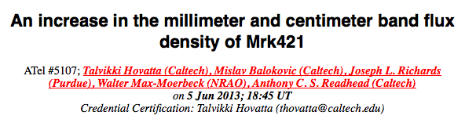
Activity continues in 2013
Fermi-LAT
public light
curve
!?!
OVRO
15 GHz
See Poster:
M. Balokovic
Notes:
Mention MWL activity, TeV flare, etc.
Show OVRO light curve with ATel flare?

Slide 15
Summary and conclusions
An exceptional radio flare occurred in Mrk 421 about two months after a sustained GeV flare.
Similar duration in radio / GeV
Cross-correlation analysis supports a physical connection
  GeV emission ~0.25 pc upstream of radio, ~2 pc from C.E.
Flux increase contained in unresolved sub-parsec core
  No superluminal component ejections
Radio Doppler factor still in conflict with TeV Doppler factor (~4 vs ~15)

Slide 17
Radio spectral evolution
F-GAMMA
OVRO 15 GHz
Notes:
MWL VLBA, F-GAMMA, ?

